Slide 1
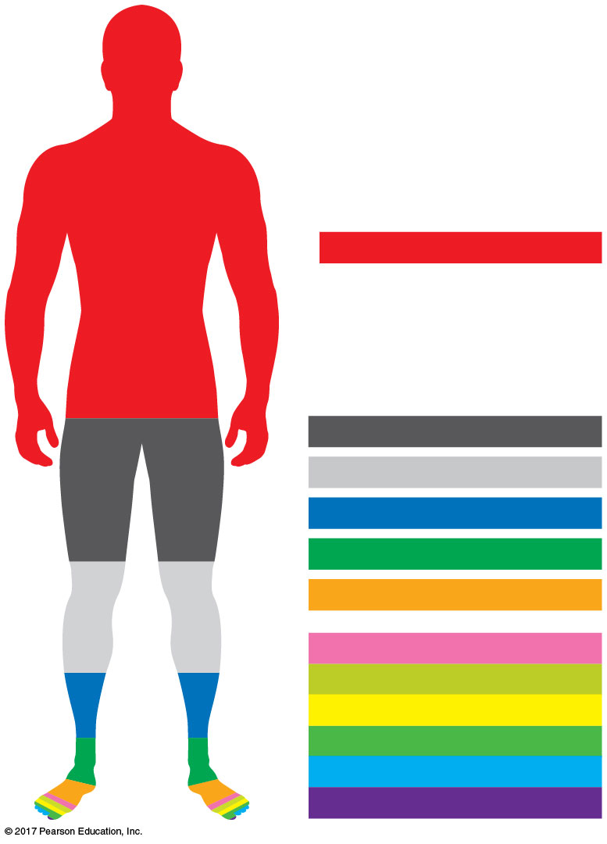
What are the main biological molecules organisms are made of?
elements
Oxygen (O): 65%
Carbon (C): 18.5%
Hydrogen (H): 9.5%
Nitrogen (N): 3.3%
Calcium (Ca): 1.5%
Phosphorus (P): 1.0%
Potassium (K): 0.4%
Sulfur (S): 0.3%
Sodium (Na): 0.2%
Chlorine (Cl): 0.2%
Magnesium (Mg): 0.1%
Trace elements: < 0.01%
Notes:
Pure elements rarely found.
Molecules they form and that are important for life

Slide 3
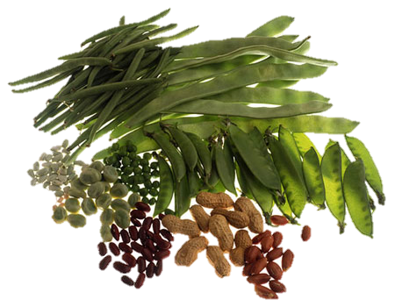
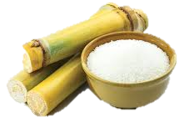
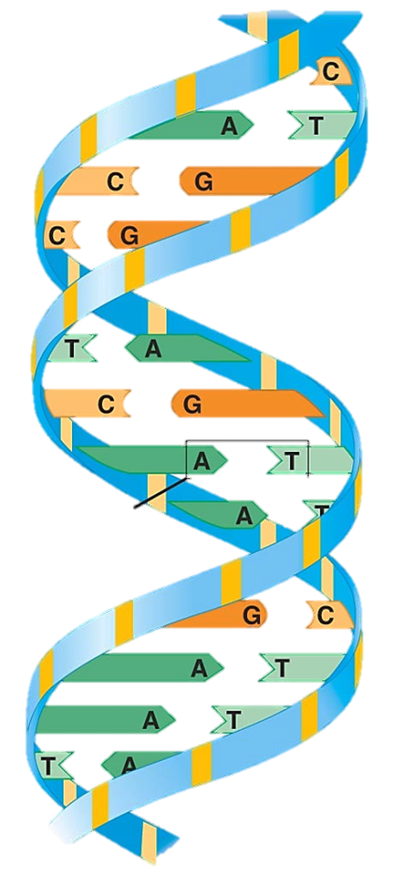
Chapter 3
The Molecules of Cells
Organisms are made up of four main classes of biological molecules
All are carbon-based molecules =
Organic molecules
Carbohydrates
Proteins
Lipids
Nucleic Acids

Slide 4
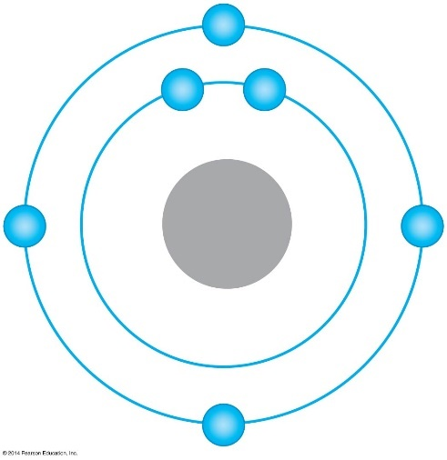
Life’s Molecular Diversity is Based on the Properties of Carbon
Organic molecules include carbon and hydrogen atoms.
How Many bonds is Carbon capable of making?

Slide 5
Organic molecules
Carbon’s ability to bond with four other atoms is the basis for building large and diverse organic molecules.
A series of covalently bonded carbons forms the carbon skeleton of the molecule.
Hydrocarbons

Slide 6
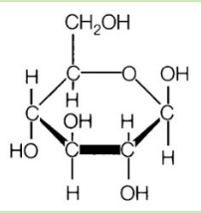
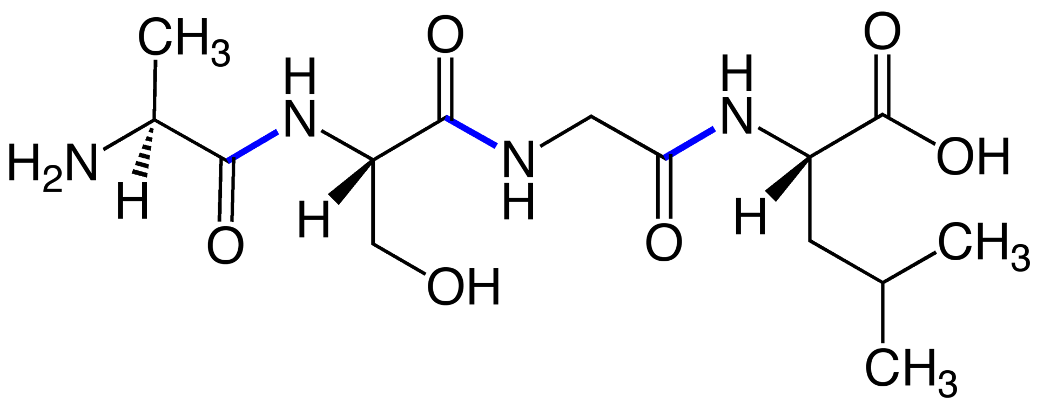
Molecules of life contain carbon skeleton, hydrogen atoms and additional groups

Slide 7
Choose all organic molecules from the following list:
CH₄
C₆H₁₂O₆
PO₄³⁻
C₈H₁₀N₄O₂
CN⁻
N₂H₄
Notes:
In order: methane, glucose/fructose, phosphate, caffeine, cyanide ion, hydrazine

Slide 8
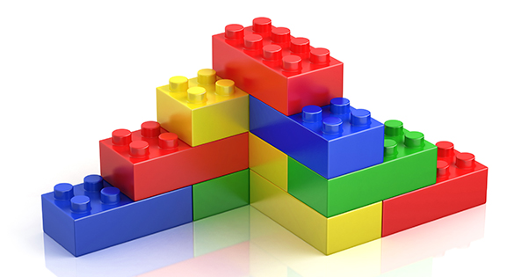
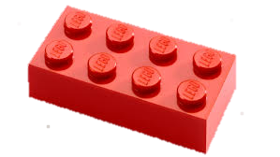
Major Biological Macromolecules
Carbon-based molecules
Generally, made of similar units bonded together.
Monomer Polymer

Slide 9
Cells often build up & break down polymers using water Dehydration Synthesis
de = removal, hydro = water
1
2
3
4
1
2
3
4
Notes:
M
This is short polymer. Attaching another mono occurs through the removal of water molec. Dehyd.

Slide 10
Cells often build up & break down polymers using water Dehydration Synthesis
de = removal, hydro = water
1
2
3
4
1
2
3
4

Slide 11
Hydrolysis
Cells often build up & break down polymers using water
lysis = breakdown

Slide 12
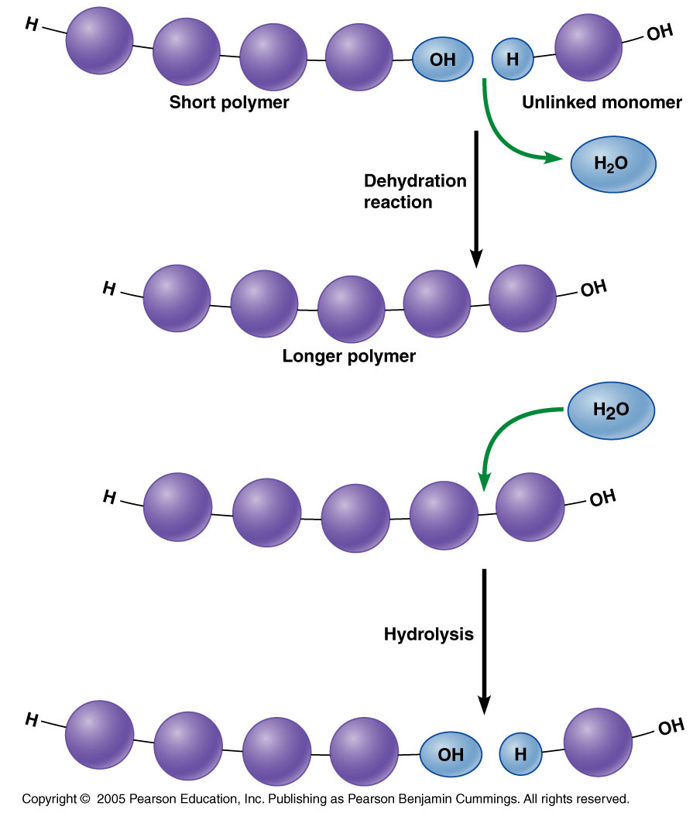
Cells often build up & break down polymers using water
dehydration
Anabolism
Catabolism
hydrolysis

Slide 13
Which of the following statements about dehydration reactions is false?
One monomer loses a hydrogen atom, and the other loses a hydroxyl group.
H2O is formed as the monomers are joined.
Covalent bonds are formed between the monomers.
Animal digestive systems utilize this process to break down food.

Slide 14
Which of the following statements about dehydration reactions is false?
One monomer loses a hydrogen atom, and the other loses a hydroxyl group.
H2O is formed as the monomers are joined.
Covalent bonds are formed between the monomers.
Animal digestive systems utilize this process to break down food.

Slide 15
Major Biological Molecules
Carbohydrates
Proteins
Lipids
Nucleic acids (DNA & RNA)
Structure and function

Slide 16
Carbohydrates
Structure
Monomer: Monosaccharide
Polymer: Polysaccharide
Function
Energy storage,
Plant cell structure
Notes:
P

Slide 17
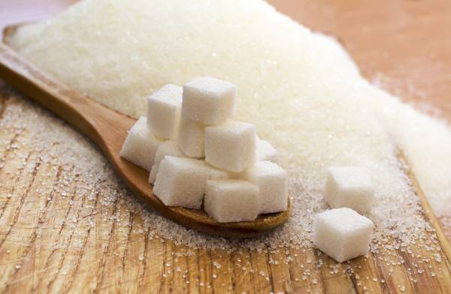
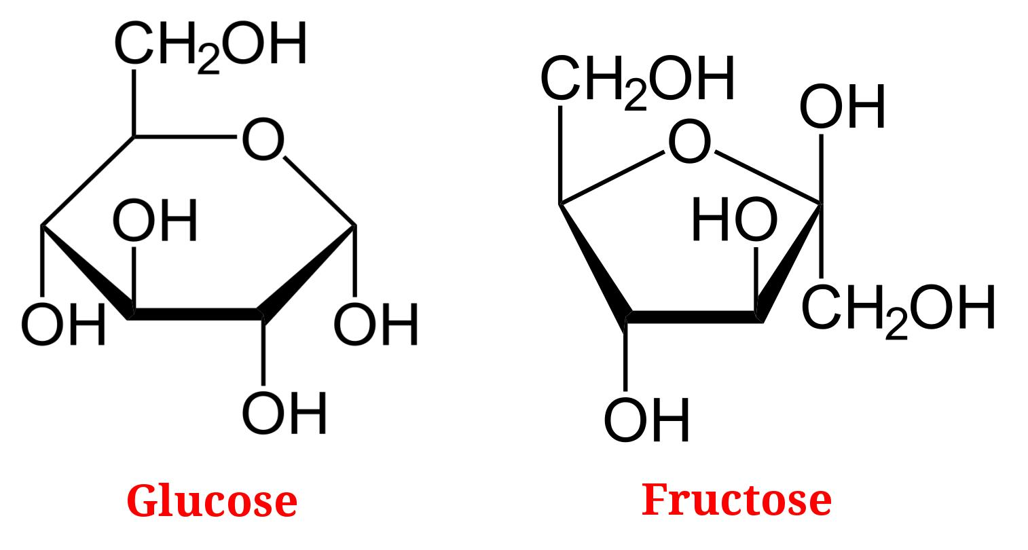
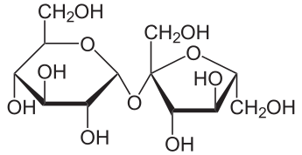
Carbohydrates
Sucrose
Disaccharide

Slide 18
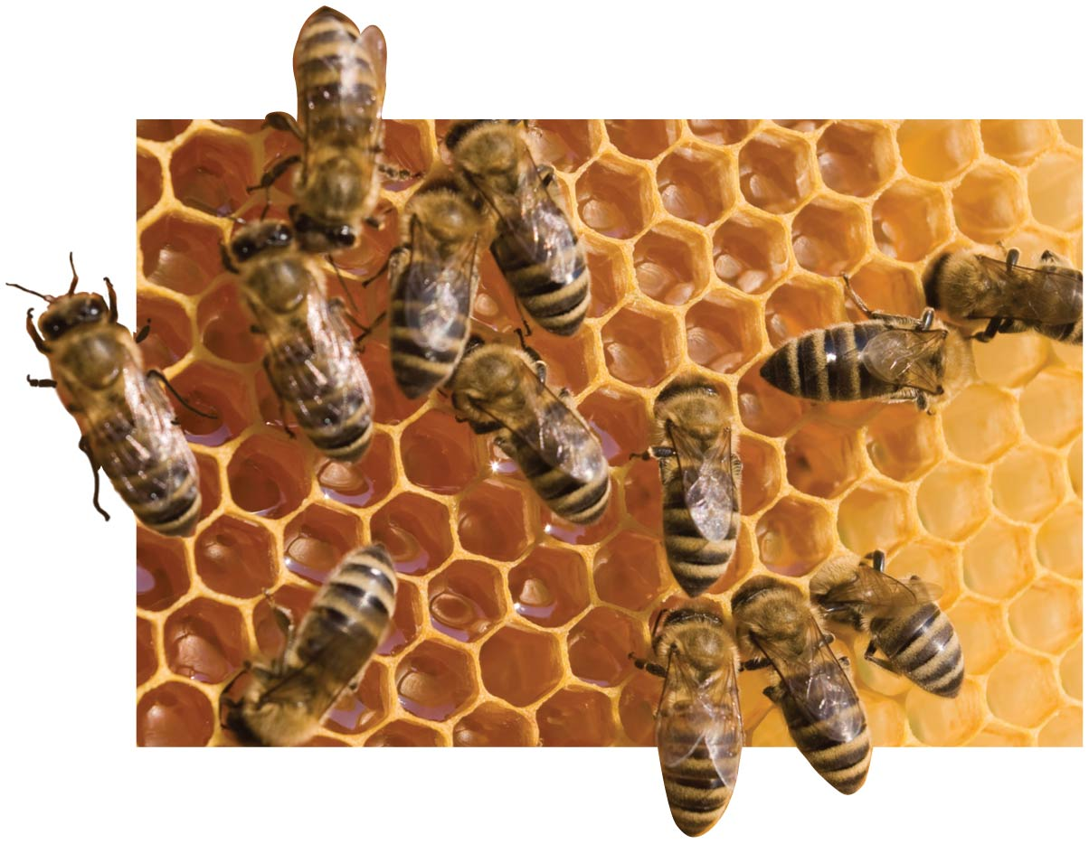
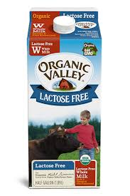
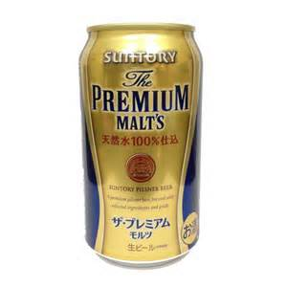
Carbohydrates: Monosaccharides and Disaccharides
Monosaccharaides
Honey: glucose and fructose
Blood sugar: glucose
Fruit sugar: fructose
Disaccharides
Barley Sugar: Maltose (glucose+glucose)
Table sugar: sucrose (glucose+fructose)
Milk Sugar: Lactose (glucose+galactose)

Slide 19
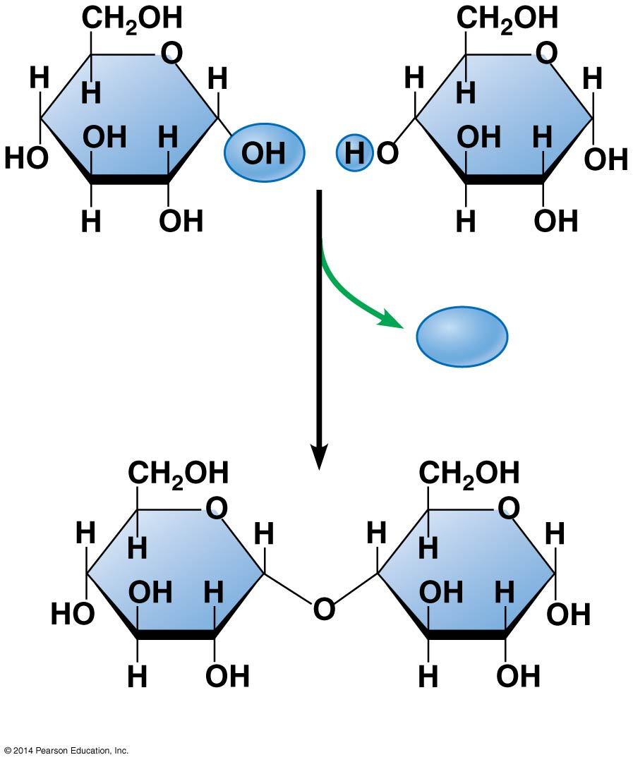
Glucose
Glucose
H₂O
Maltose
Notes:
Figure 3.5-2 Disaccharide formation by a dehydration reaction (step 2)

Slide 20
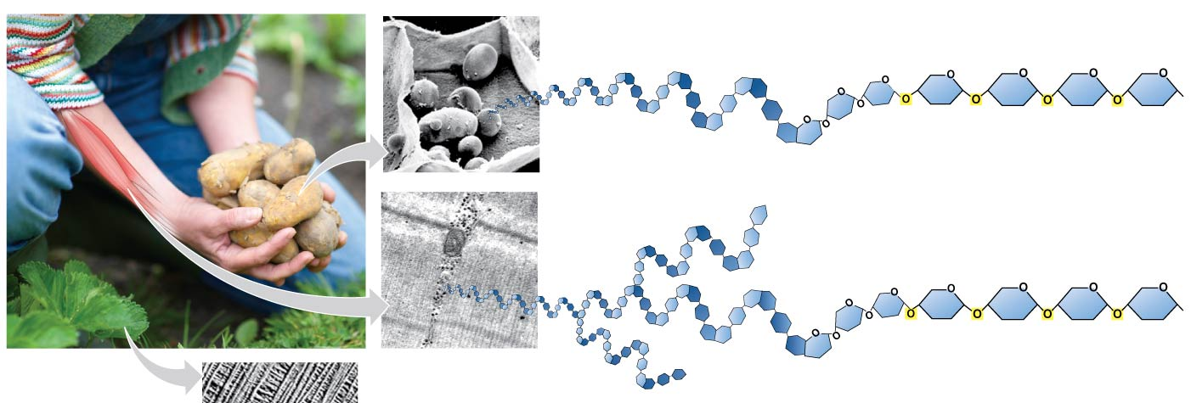
Carbohydrates: Polysaccharides
Starch and Glycogen
Large Polysaccharides of glucose monomers
Function: Longer term energy storage

Slide 21
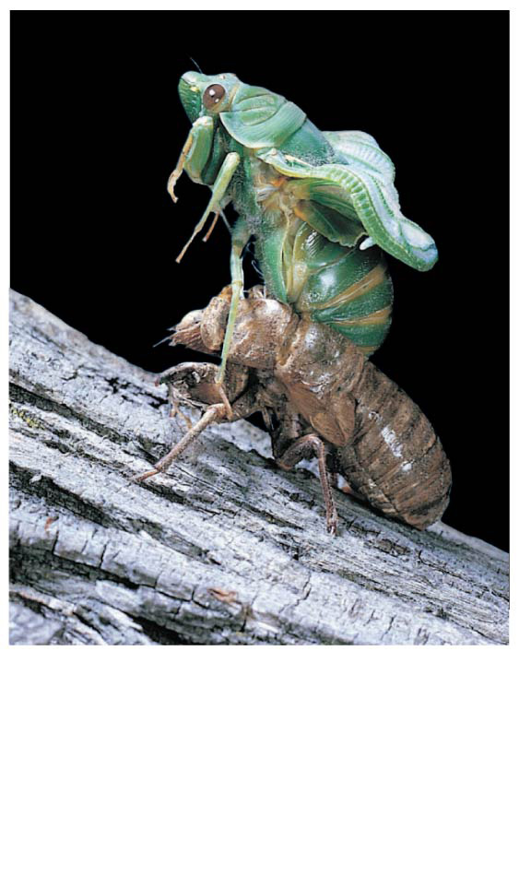
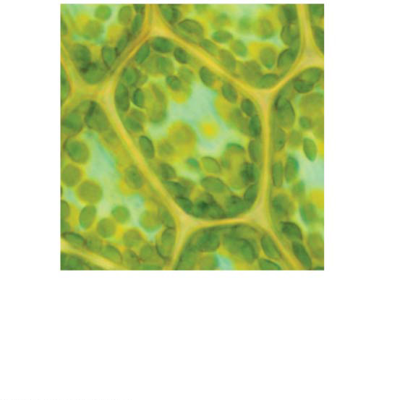
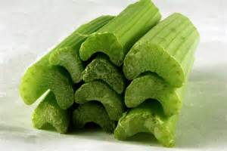
Carbohydrates :Polysaccharides
Cellulose and Chitin
Large Polysaccharides
Function: Structural
Cell
wall
Chitin, embedded in
proteins, forms the
exoskeleton of
arthropods.
Plant cell,
surrounded
by cell wall
10 µm

Slide 22
Major Biological Molecules
Carbohydrates
Proteins
Lipids
Nucleic acids (DNA & RNA)
Structure and function

Slide 23
Proteins
Structure
Monomer: Amino Acid
Polymer: peptide, polypeptide / protein
Function
Many!
monomers
polymers

Slide 24
Proteins have a wide range of functions and structures
Proteins are involved in nearly every dynamic function in organisms’ body and are very diverse.
Proteins function as:
Enzymes.
Transport proteins embedded in cell membranes.
Defensive proteins, such as antibodies.
Signal proteins such as hormones.
receptor proteins.
contractile proteins found within muscle cells.
structural proteins such as Keratin in hair and nails.
storage proteins.
Notes:
24
Student Misconceptions and Concerns
The functional significance of protein shape is an abstract molecular example of form and function relationships, which might be new to some students. The binding of an enzyme to its substrate is a type of molecular handshake, which permits specific interactions. To help students think about form and function relationships, share some concrete analogies in their lives—perhaps flathead and Phillips screwdrivers that match the proper type of screws or the fit of a hand into a glove. (3.12)
Teaching Tips
Most cooking results in changes in the texture and color of food. The brown color of a cooked steak is the product of the denaturation of proteins. Fixatives such as formalin also denature proteins and cause color changes. Students who have dissected vertebrates will realize that the brown color of the muscles makes it look as if the animal has been cooked. (3.12)
Active Lecture Tips
See the Activity “Reviewing Macromolecules” on the Instructor Exchange. Visit the Instructor Exchange in the MasteringBiology instructor resource area for a description of this activity. (3.12–3.14)

Slide 25
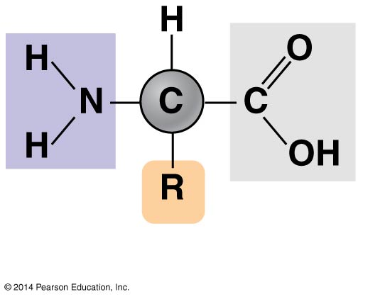
Proteins are composed of differing arrangements of amino acid monomers
There are 20 different amino acids. Each with unique properties
They differ only in the R group
Amino
group
Carboxyl
group

Slide 26
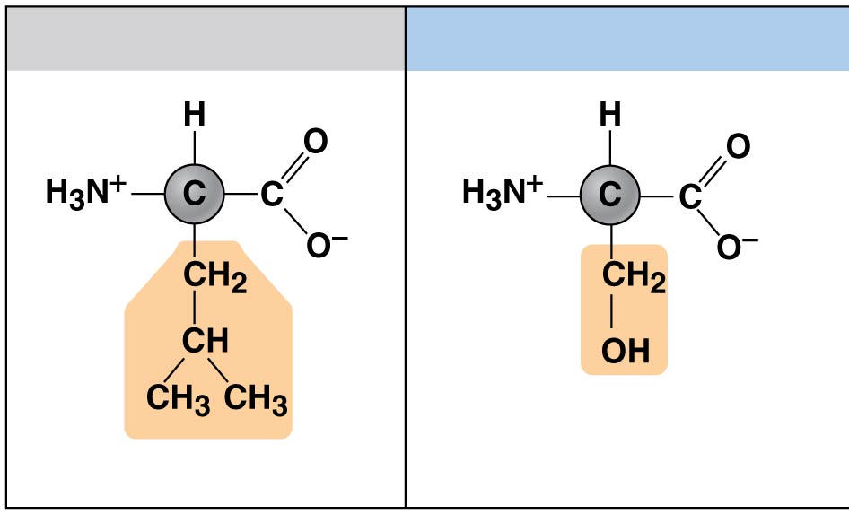
Examples of amino acids with hydrophobic and hydrophilic R groups
Nonpolar / hydrophobic
Polar / hydrophilic
Leucine (Leu)
Serine (Ser)
© 2018 Pearson Education, Inc.
Notes:
Figure 3.13b Examples of amino acids with hydrophobic and hydrophilic R groups

Slide 27
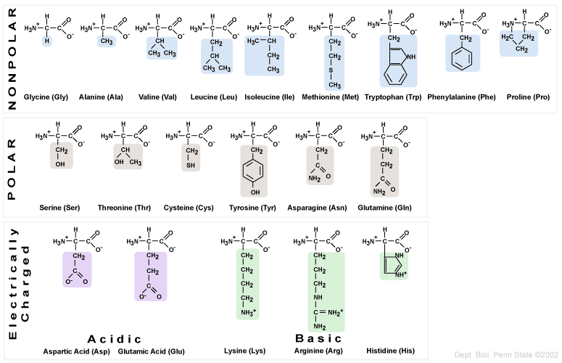
Amino acids
Hydrophilic / hydrophobic/
20 different amino acids.
Differ in the “R” group =
each has unique properties.

Slide 28
Proteins
Monomer: Amino Acid Polymer: Polypeptide
Peptide bond
(Covalent bond)
Carboxyl
group
Amino
group
Dehydration
reaction
H₂O
Amino acid
Amino acid
Peptide
Hydrolysis

Slide 29
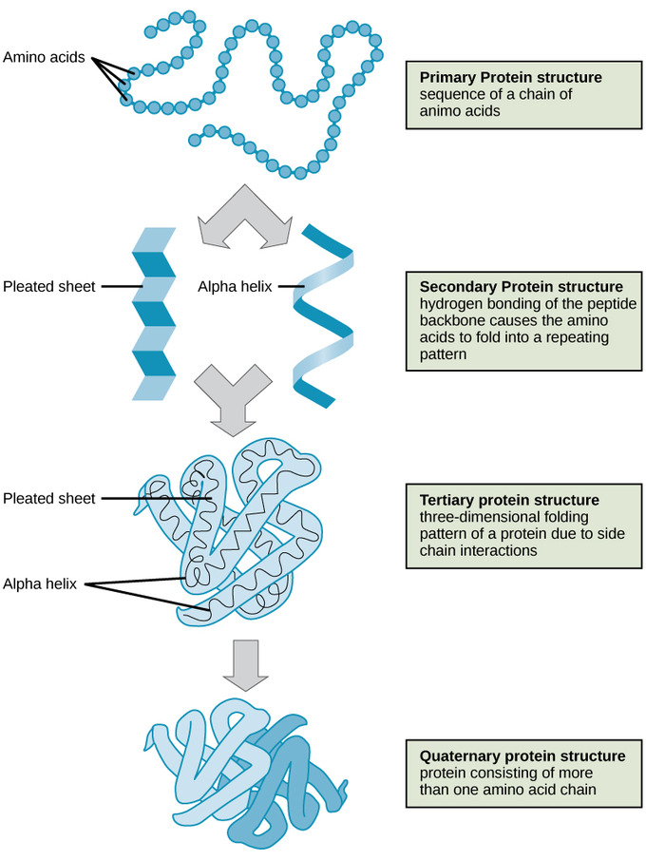
A protein can have four levels of structure

Slide 30
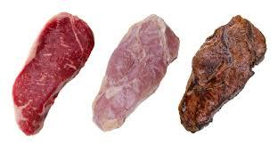
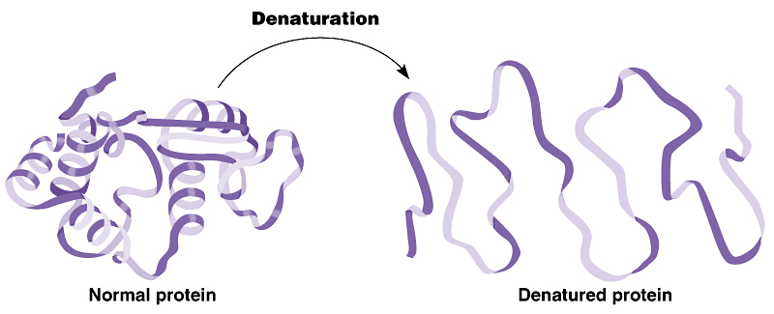
Protein Denaturation
Protein structure is altered due to exposure to certain chemicals or physical factors (e.g. heat, acid, salt), causing the protein to become biologically inactive.
Notes:
Boiling of egg. Makes protein soild, white and opaque. Huntingtons disease, Parkinsons disease, alzheimers disease.
http://highered.mheducation.com/sites/0072943696/student_view0/chapter2/animation__protein_denaturation.html

Slide 31
0
The key to a protein’s function is its shape. The shape can be altered (or denatured) under unfavorable conditions. By heating a protein such as that found in egg whites, the protein’s shape changes. What best describes why this happens?
Peptide bonds undergo a series of dehydration reactions.
Peptide bonds undergo a series of hydrolysis reactions.
Peptide bonds undergo a series of hydrolysis reactions.
Covalent bonds break down, altering the primary shape
Notes:
31

Slide 32
0
The key to a protein’s function is its shape. The shape can be altered (or denatured) under unfavorable conditions. By heating a protein such as that found in egg whites, the protein’s shape changes. What best describes why this happens?
Peptide bonds undergo a series of dehydration reactions.
Peptide bonds undergo a series of hydrolysis reactions.
Peptide bonds undergo a series of hydrolysis reactions.
Covalent bonds break down, altering the primary shape
Notes:
32

Slide 33
Major Biological Molecules
Carbohydrates
Proteins
Lipids
Nucleic acids (DNA & RNA)
Structure and function

Slide 34
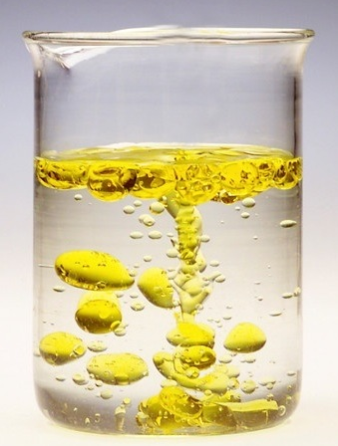
Lipids
Structure
Monomer: No true monomers
Polymer: No true polymers
Hydrophobic - not soluble in water because of large amounts of non-polar bonds.
May include different subunits
A very diverse group
Function
Fats & oils – long term energy storage Phospholipids - structure Steroids – structure & communication

Slide 35
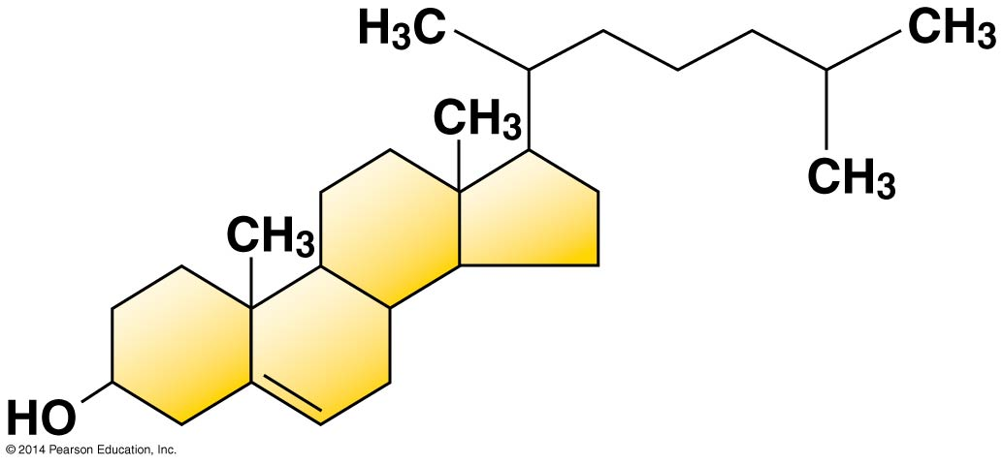
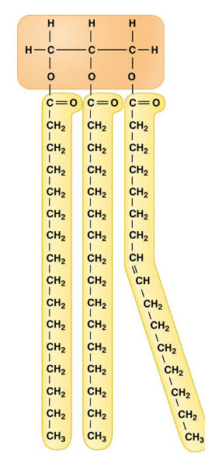
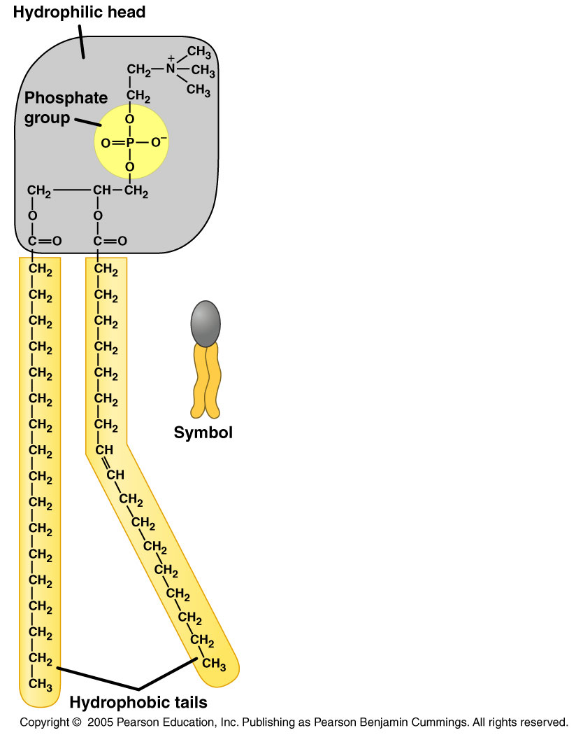
Lipids
Steroids
Fats and Oils
(also called Triglycerides)
Phospholipids

Slide 36
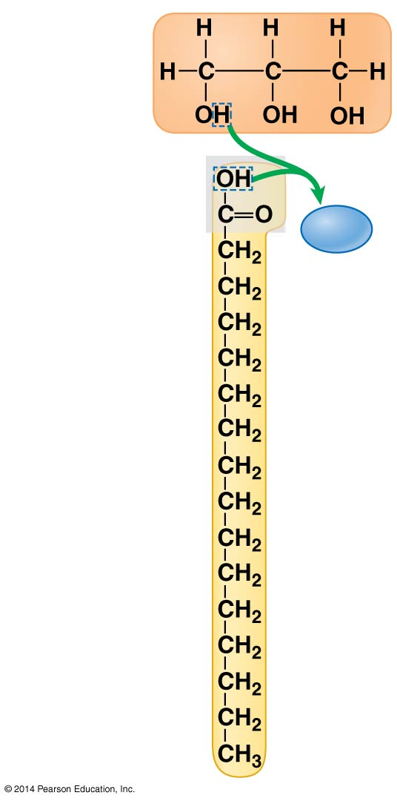
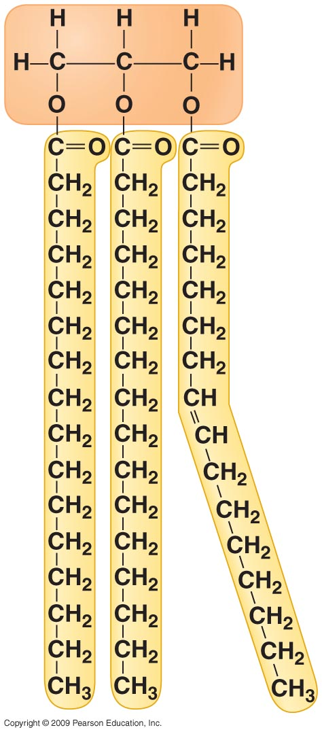
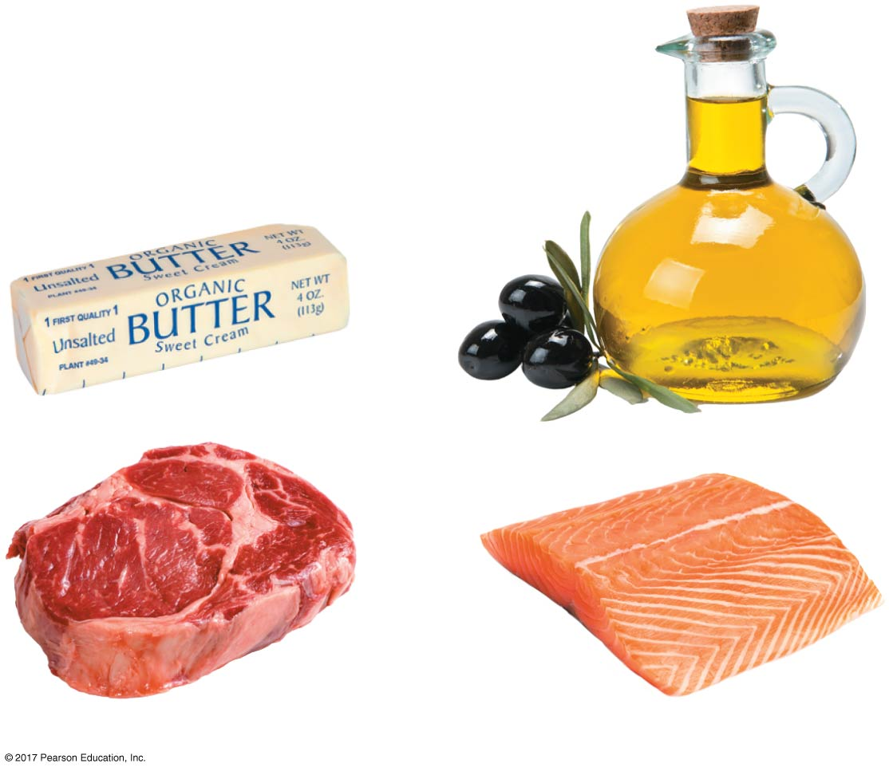
Lipids
Glycerol
Fats and oils
Glycerol and three fatty acids = Triglyceride
H₂O
Fatty acid

Slide 37
Lipids
Fats and oils
Saturated fats
Unsaturated fats
 | Physical State in room temperature | Double bonds in Fatty acids | Example
Fat | Solid | No double bonds (saturated) | Most animal fats
Fat/oil | Liquid | One or more (unsaturated) | Many fats of plants and fishes

Slide 38
Phospholipids
Lipids
major component of all cell membranes
Will be discussed in details in Chapter 5

Slide 39
Lipids
Steroids:
Lipids in which the carbon skeleton contains four fused rings.
Cholesterol:
the starting molecule for all steroids (e.g. sex hormones).
A common component in animal cell membranes.
Cholesterol

Slide 40
Which of the following statements regarding fats/triglyceride molecules is false?
Triglycerides consist of three fatty acids attached to a glycerol molecule.
Triglycerides play a role in energy storage.
Their fatty acids can be either saturated or unsaturated.
Triglycerides are hydrophilic.

Slide 41
Which of the following statements regarding fats/triglyceride molecules is false?
Triglycerides consist of three fatty acids attached to a glycerol molecule.
Triglycerides play a role in energy storage.
Their fatty acids can be either saturated or unsaturated.
Triglycerides are hydrophilic.

Slide 42
Major Biological Molecules
Carbohydrates
Proteins
Lipids
Nucleic acids (DNA & RNA)
Structure and function

Slide 43
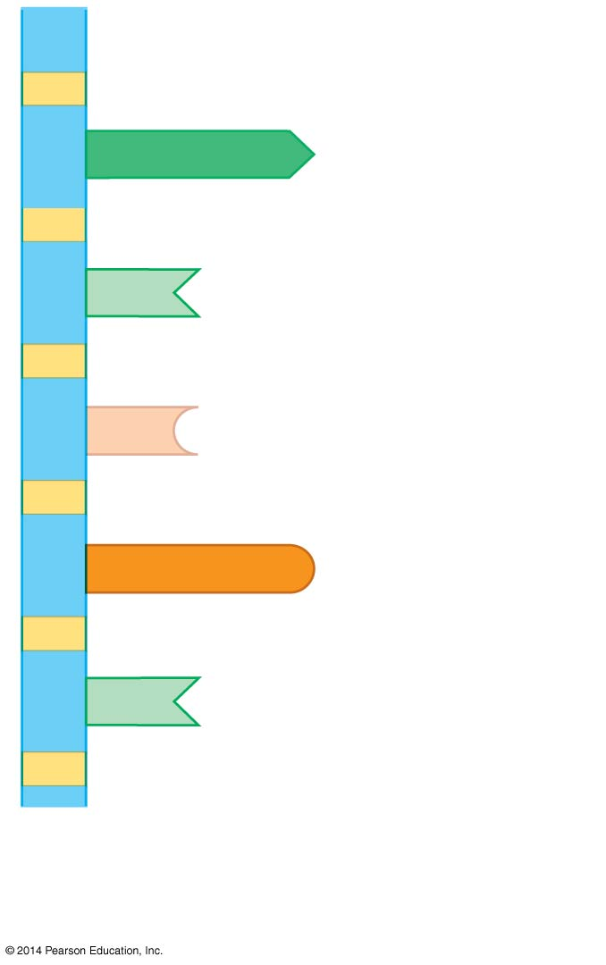
Nucleotides
Structure
Monomer: Nucleotide
Polymer: Nucleic Acid (RNA and DNA)
Function
Information storage molecules
Provide directions for building proteins
A
Nucleotide
T
C
G
T

Slide 44
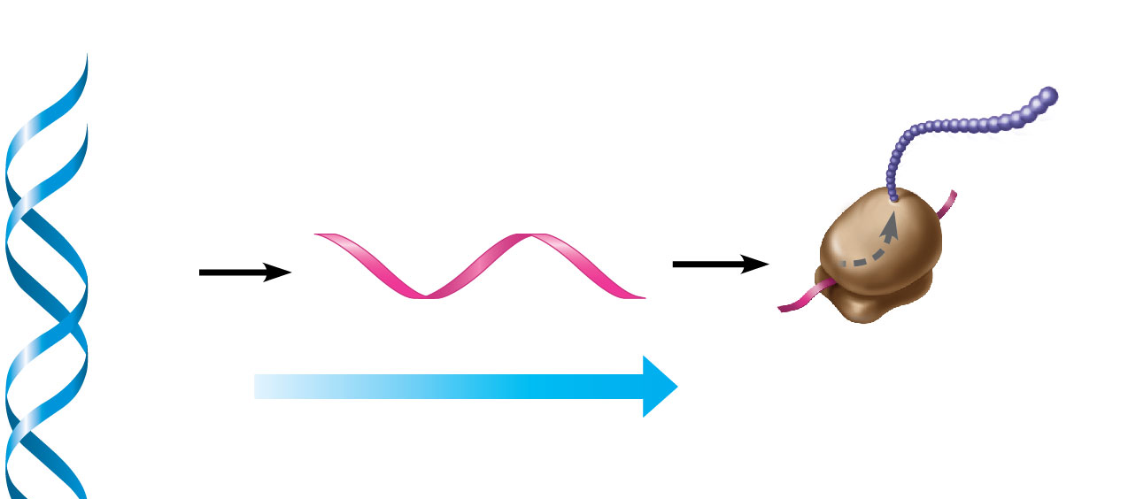
Genetic information & Expression:
From DNA to proteins
DNA
Protein X
RNA transcribed
from gene X
Gene X
RNA
Cellular
machinery
Information flow
Will be discussed in details in Chapter 10

Slide 45
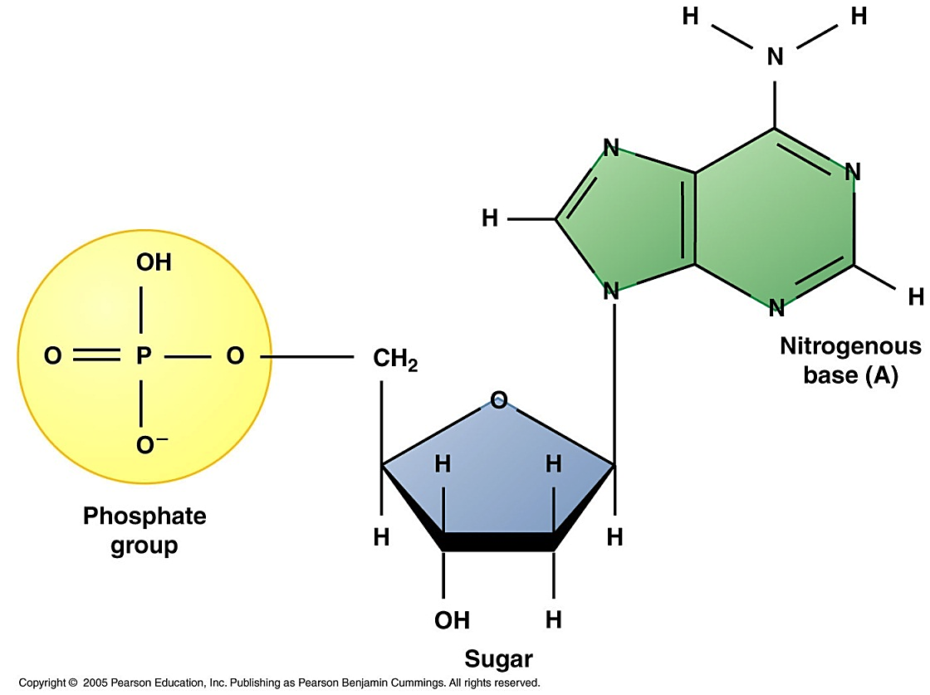
Nucleotides, monomers of Nucleic acids (Polynucleotide)
Nucleotides are composed of-
A five-carbon sugar ribose or deoxyribose
A phosphate group PO₄⁻
A nitrogenous base (1 of 5 types)

Slide 46
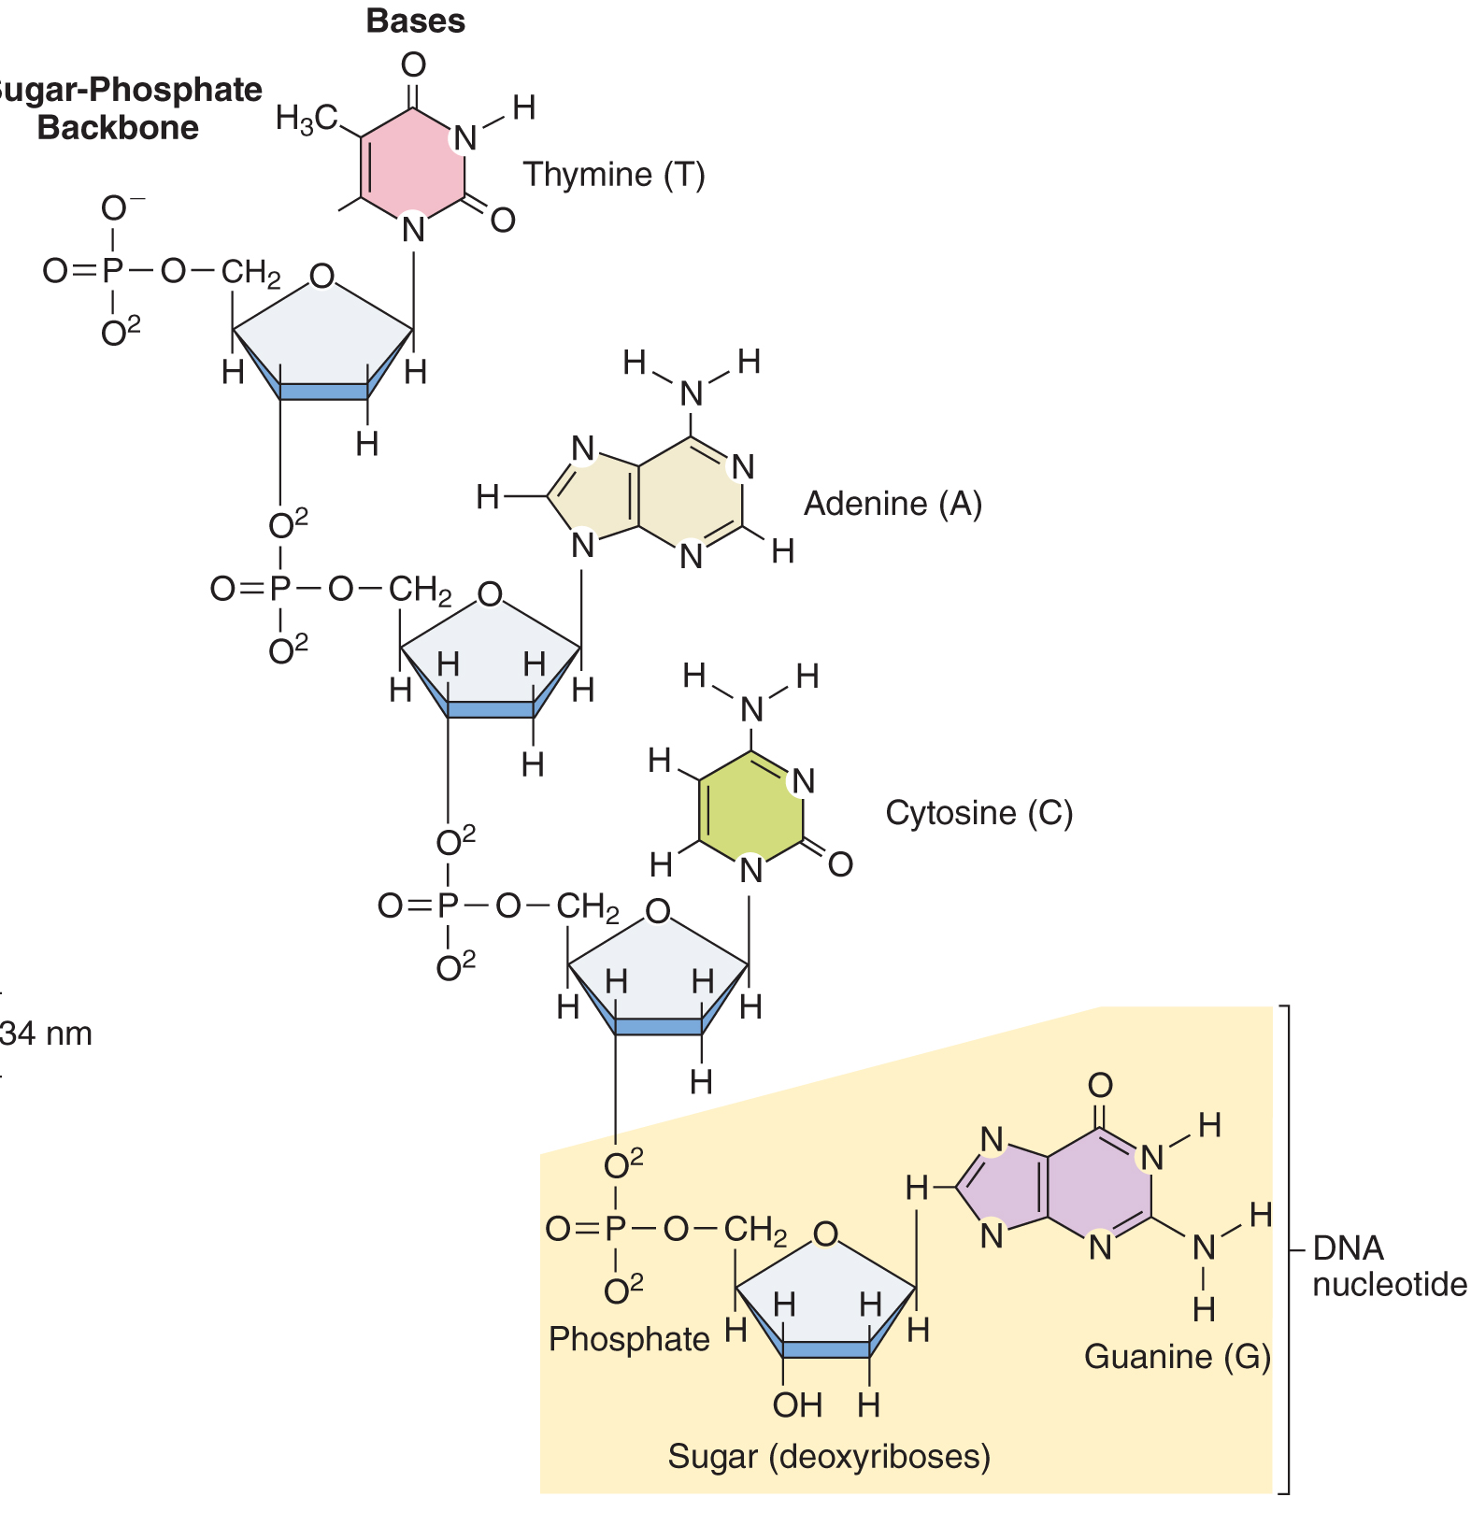
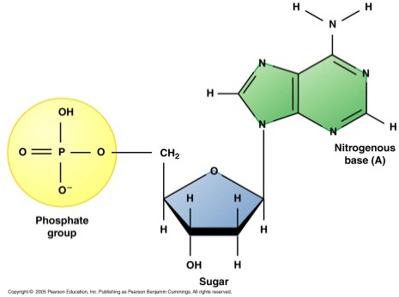
Nucleic acids are formed by dehydration synthesis of nucleotides
Monomer:
Nucleotide
Polymer:
Nucleic acid

Slide 47
How is RNA different from DNA?
RNA
DNA
Sugar:
Nitrogenous
bases:
Ribose Deoxyribose
A, U, C, G A, T, C, G

Slide 48
DNA

Slide 49
0
The formation of starch from simple sugars such as glucose involves a series of _______________ reactions.
hydrolysis
dehydration
hydrophobic
denaturation
Notes:
49

Slide 50
0
The formation of starch from simple sugars such as glucose involves a series of _______________ reactions.
hydrolysis
dehydration
hydrophobic
denaturation
Notes:
50

Slide 51
The relation between amino acids and proteins is similar to the relation between:
Triglycerides and fats
Disaccharides and polysaccharides
Nucleotides and nucleic acids
Cholesterol and steroids

Slide 52
The relation between amino acids and proteins is similar to the relation between:
Triglycerides and fats
Disaccharides and polysaccharides
Nucleotides and nucleic acids
Cholesterol and steroids

