Slide 1
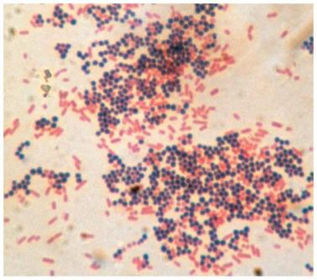
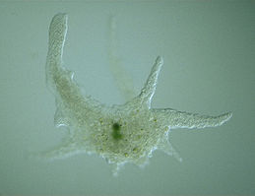
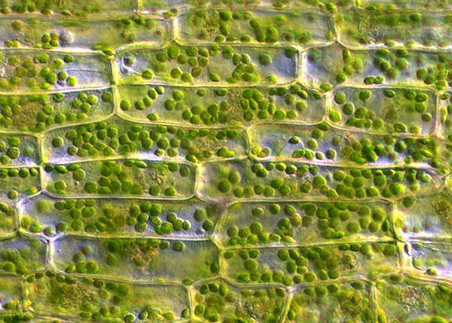
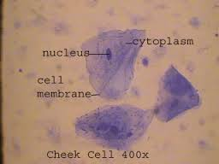
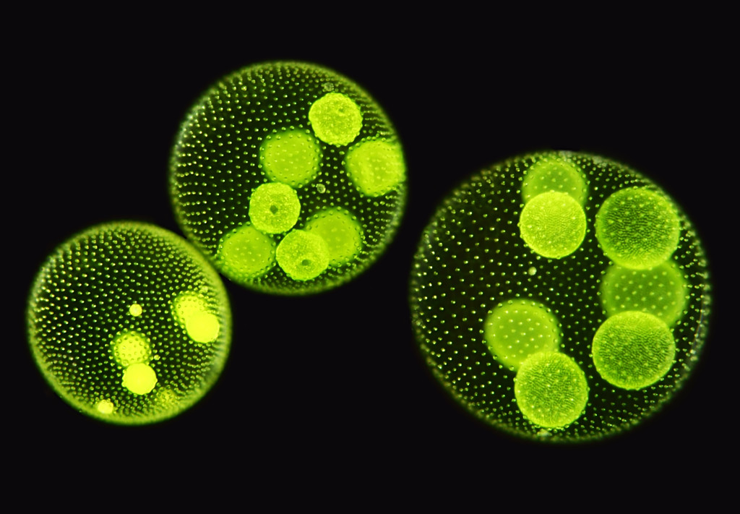
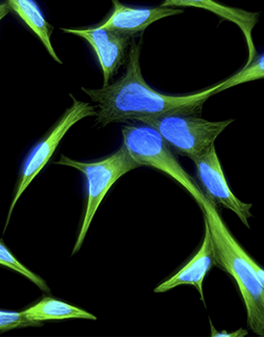
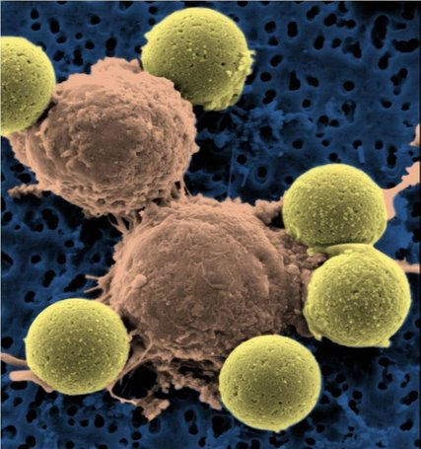
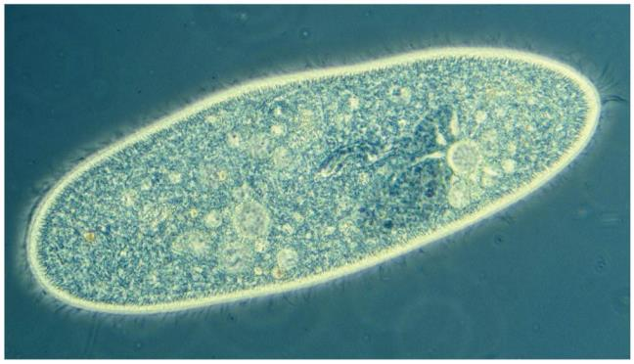
The Cell
Chapter 4
Notes:
Many of you might remember these specimen from your last lab. Whether it was bacterial specimen, onion or check cells all of them comprises of one or more cells. Despite of enormous diversity among living organisms . All organisms are made of cells. Cells are fundamental unit of life. Lets see how this idea of cell came into existence.

Slide 2
The Cell Theory
http://ed.ted.com/lessons/the-wacky-history-of-cell-theory
Notes:
Puja
It was all started with discovery of microscope. A scientist named Robert Hook in 16th century saw cork cells under the microscope and that reminded him the cells in a monastery and he coined the term Cells. At the same time other scientist Antoni wan layvanhook ta the same time developed his own microscope and watch enormous samples from pond water to plants and animals, sperm, blood cells, protozoa. First time saw microbes. Then in 18th century two scientists Schleiden and Schwan looked enormous samples of plants and animals and postualtes cell theory.

Slide 3
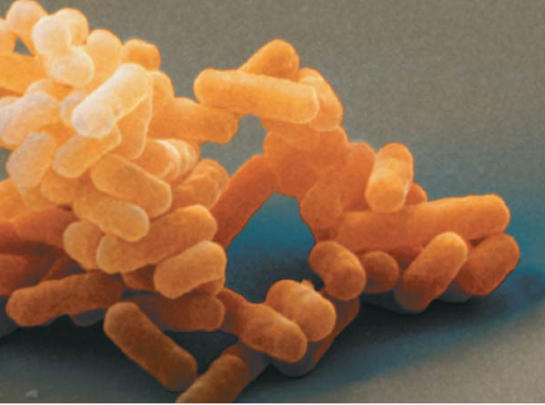
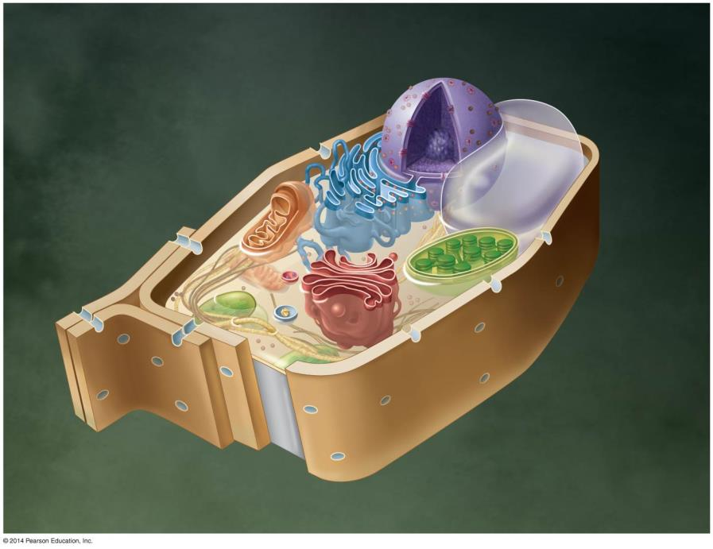
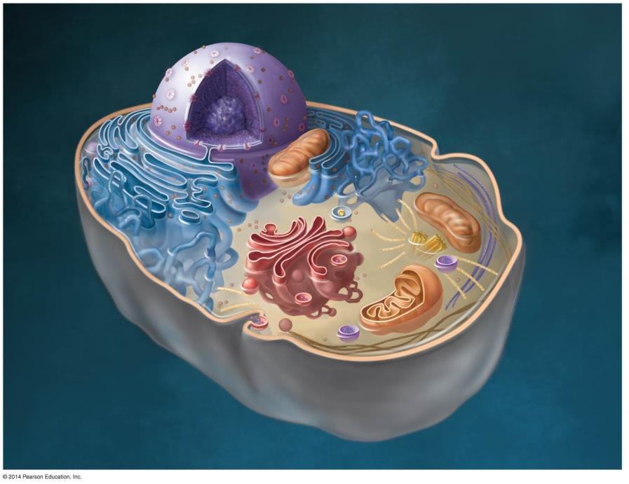
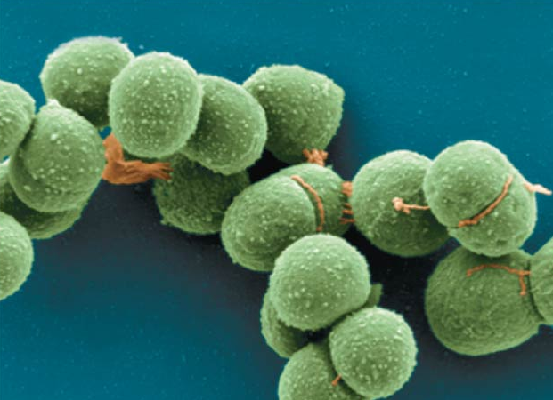
The Cell Theory
The cell is the basic unit of life.
All organisms are made of one or more cells.
Cells come from preexisting cells.

Slide 4
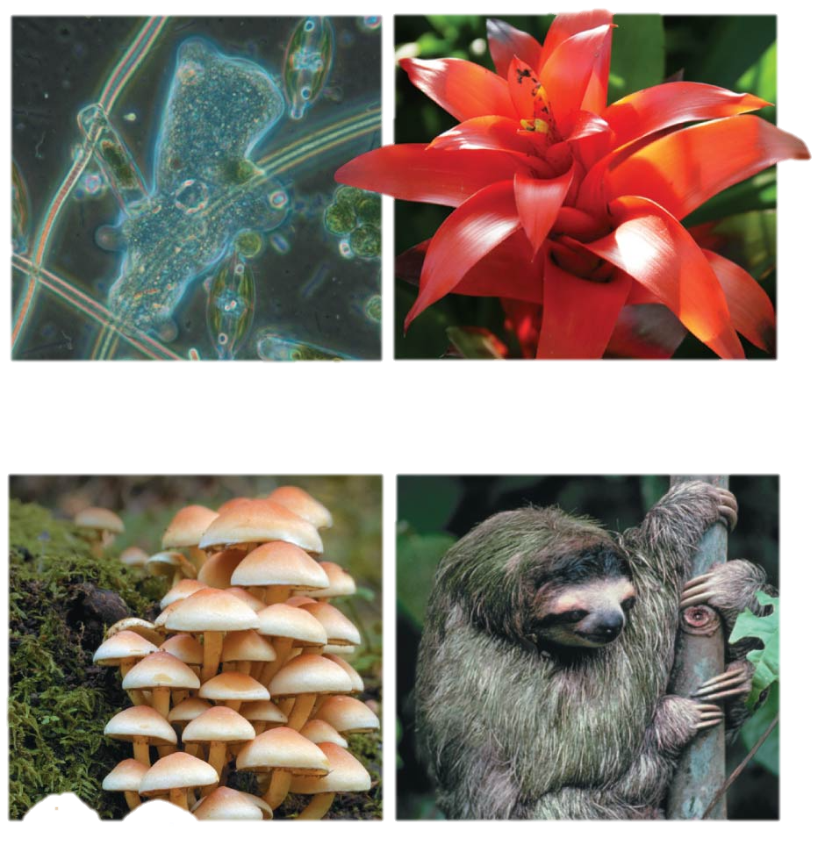
The diversity of life can be arranged into 3 domains
Prokaryotes
Eukaryotes
Domain Bacteria
Domain Archaea
Domain Eukarya
Protists (multiple kingdoms)
Kingdom Plantae
Kingdom Fungi
Kingdom Animalia
Notes:
Meirav
You have seen this slide. Now that we defined pro and euc cells, we will mainly focus on the two cell types of members of two eucaryotic kingdoms: animals and plants. You learned their organelles for homework.. We will focus today on the membrane. Q before.

Slide 5
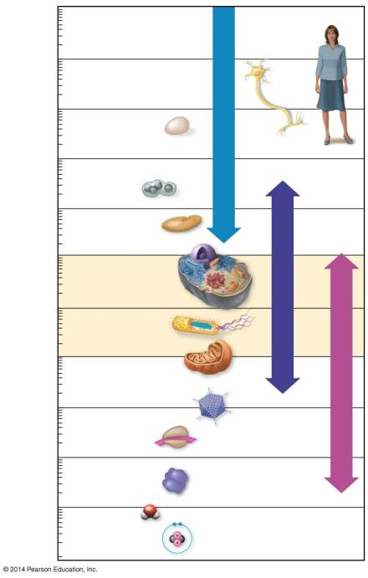
10 m
Cell Size
Human height
1 m
Length of some nerve and muscle cells
100 mm (10 cm)
Chicken egg
Unaided eye
10 mm (1 cm)
Frog egg
1 mm
Paramecium
Human egg
100 μm
Eukaryotic cells
Prokaryotic cells
Most plant and animal cells
Light microscope
10 μm
Nucleus
Most bacteria
1 μm
Mitochondrion
Electron microscope
100 nm
Smallest bacteria
Viruses
10 nm
Ribosome
Proteins
Lipids
1 nm
Small molecules
0.1 nm
Atoms
Notes:
Meirav
Cells are small. The range in micro light. And in electron
visible light passes through a specimen, then through glass lenses, and then into the viewer’s eye
Beam of

Slide 6
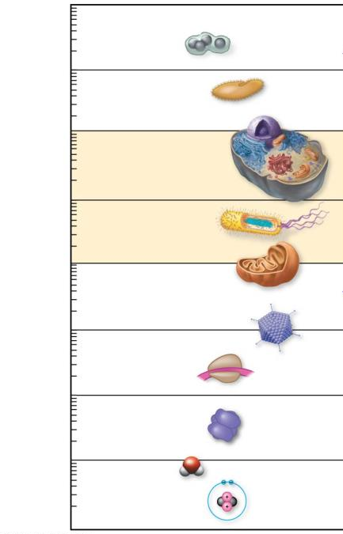
Cell Size
100 μm
Why aren’t they smaller?
Why aren’t they bigger?
Most plant and animal cells
10 μm
Nucleus
Most bacteria
1 μm
Mitochondrion
Cells are large enough to house DNA, proteins, and structures needed to survive and reproduce
Notes:
Meirav
Why are they in that range?
Why not smaller? Why for example eu are bigger than pro?

Slide 7
Cell Size
100 μm
Why aren’t they bigger?
Most plant and animal cells
10 μm
Nucleus
Most bacteria
Think while watching the demonstration
Mitochondrion
1 μm
Notes:
Meirav
Is there an advantage to be small?

Slide 8
Why did the acid spread quicker in the smallest cube?
https://www.youtube.com/watch?v=DM8mLV6-MUw
Starts at 1:04 minutes. Ends at 2:08.
Notes:
Meirav

Slide 9
Cell Size
100 μm
Why aren’t they bigger?
Most plant and animal cells
10 μm
Nucleus
Most bacteria
1 μm
Mitochondrion
The small size of cells allows for a surface-to-volume ratio that will allow adequate exchange with the environment
Notes:
Meirav
The acid migrates the same speed, however, the volume was small relatively to the surface. We say that the smaller one had a high ratio of surface to volume.
Cells exchange materials with their environment. For example O2 CO2. A relative higher ratio, would make this exchange more efficient.
Another example: if we wrap the boxes together or separately the volume remains the same. However, we need more paper if we wrap them individually.

Slide 10
Calculating Surface Area and Volume
Imagine a cube of 1 cm high x 1 cm wide x 1 cm deep
Surface area (SA) = area of one side x 6 sides
1 cm x 1 cm x 6 sides = 6 cm²
Volume (V) = height x width x depth
1 cm x 1 cm x 1 cm = 1 cm³
1cm
1cm
1cm
SA to V ratio = 6
Notes:
Meirav
Squered/qubic cm

Slide 11
Your Turn…
Now, calculate the surface area and volume for a cube 2 cm high x 2 cm wide x 2 cm deep.
SA = 2 cm x 2 cm x 6 sides = 24 cm²
V = 2 cm x 2 cm x 2 cm = 8 cm³
2 cm
SA to V ratio = 3
2 cm
2 cm
Notes:
Meirav

Slide 12
Now, Let’s Compare the Blocks
1 cm
SA to V ratio= 6
1 cm
1 cm
2 cm
SA to V ratio= 3
2 cm
2 cm
Notes:
Meirav

Slide 13
As a cell becomes larger it’s surface area/volume ratio becomes?
A. Larger
B. Smaller
C. Stays the Same
Notes:
C. Eukarya

Slide 14
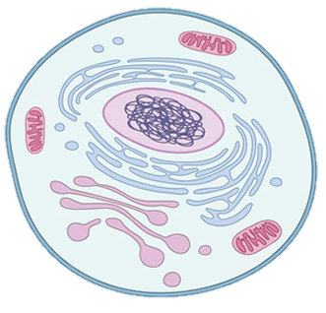
Eukaryotes and Prokaryotes
Prokaryotes
Domains: Bacteria &
Archaea
Smaller
No true organelles
Genetic material not bounded by a membrane
Many other differences
Eukaryotes
Domain: Eukarya
Larger size
Characterized by organelles: membranous bound compartments in cytoplasm, each devoted to a particular function.
Membrane around genetic material: nucleus
Notes:
Puja. Recall that in chapter-1 we had a glimpse of similarity and differences between Eukaryotic and Prokaryotic cells. Here, I would like to draw your attention on few more differences among these cell types. In eukaryotes the ribosomes that are involved in protein synthesis are 80S type and in prokaryotes it is 70S.
Eukaryotic cells DNA is linear where as in prokaryotes is circular. You might remember that you would need to use 100X magnification to see bacterial cells where it was comparitvely easy to see other eukaryotic cells.

Slide 15
Figure 4.4a
NUCLEUS
Nuclear envelope
Rough endoplasmic reticulum
Nucleolus
Chromatin
CYTOSKELETON
Microtubule
Microfilament
Intermediate filament
Ribosomes
Peroxisome
Smooth endoplasmic reticulum
Plasma membrane
Golgi apparatus
Centrosome with pair of centrioles
Lysosome
Mitochondrion
Notes:
Show bioflix animation

Slide 16
Figure 4.4b
NUCLEUS
Rough endoplasmic reticulum
Nuclear envelope
Smooth endoplasmic reticulum
Nucleolus
Chromatin
Mitochondrion
CYTOSKELETON
Microfilament
Microtubule
Central vacuole
Ribosomes
Chloroplast
Cell wall
Cell wall of adjacent cell
Plasmodesma
Golgi apparatus
Peroxisome
Plasma membrane
Notes:
Show bioflix animation

Slide 17
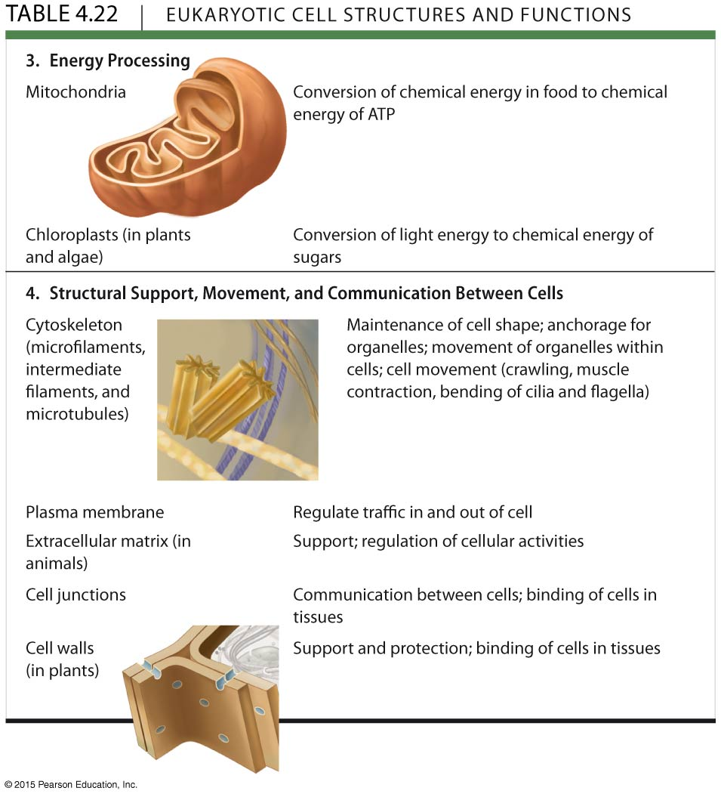
Table 4.22
Notes:
Show bioflix animation

Slide 18
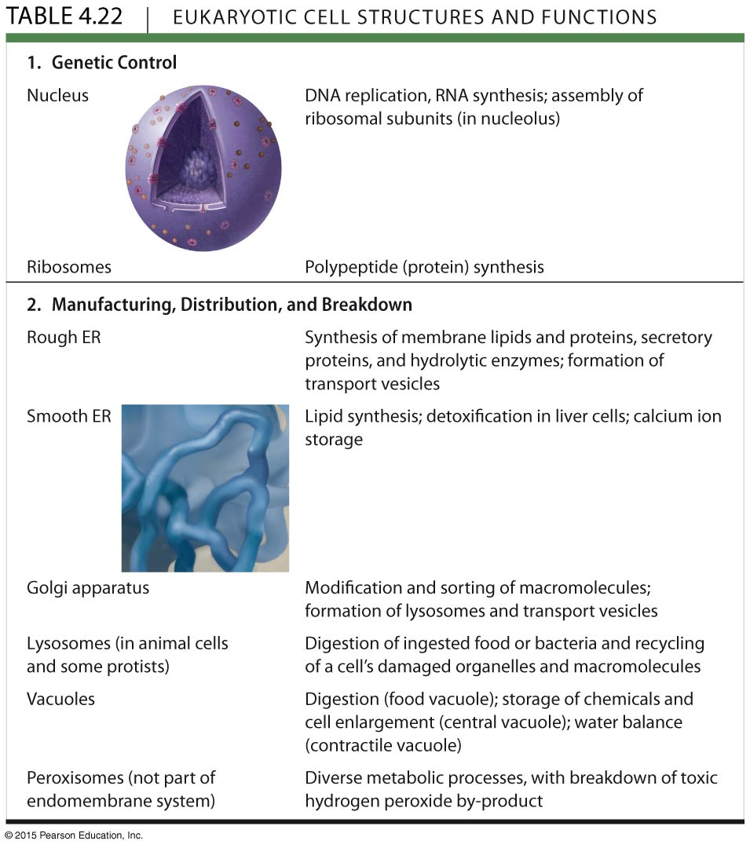
Table 4.22

Slide 19
Organelles are found in what domain(s) of life?
A. Archaea
B. Bacteria
C. Eukarya
D. All of the above
Notes:
C. Eukarya

Slide 20
Organelles are found in what domain(s) of life?
A. Archaea
B. Bacteria
C. Eukarya
D. All of the above
Notes:
C. Eukarya

Slide 21
The Cell Theory states:
A. All organisms are made of one or more cells.
B. The cell is the basic unit of all living things.
C. All cells come from existing cells.
D. All of the above are correct.
E. None of these is correct.
Notes:
Answer: D

Slide 22
The Cell Theory states:
A. All organisms are made of one or more cells.
B. The cell is the basic unit of all living things.
C. All cells come from existing cells.
D. All of the above are correct
E. None of these is correct
Notes:
Answer: D

