Slide 1
Chapter 8
Cellular Division and Chromosomes

Slide 2
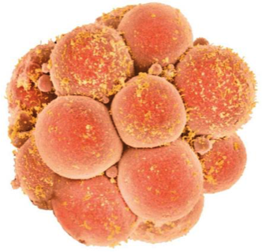
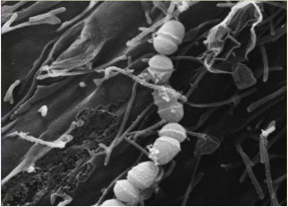
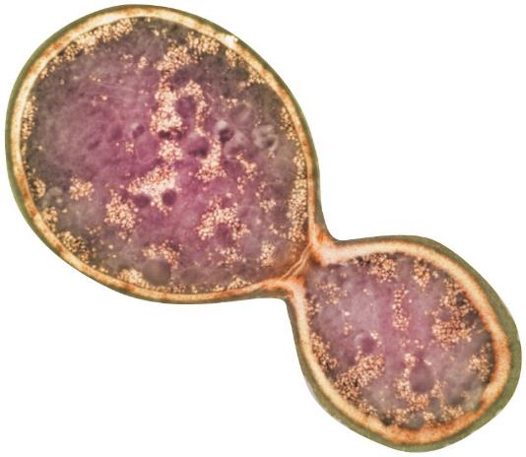
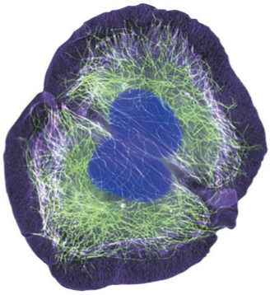
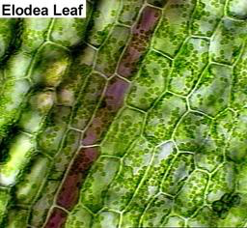
All living organisms are composed of cells.
Human embryo
Bacteria
Yeast
Human kidney
Elodea plant
Starfish
Notes:
The earth is full of countless living cells….your body is made up cells. An adult human being has approximately 100,000 billion cell to 1 trillion cells alone! They all originating from a single cell, or the fertilized egg cell. In adults there is also an enormous number of continuously dividing cells replacing those dying. They are you!! Cells come in all shapes and sizes and perform a number of different functions in living things. They work together to form tissues of living things. But cells do not live forever!....Eventually some die but fortunately cells have they ability to reproduce….first thru a process called Cell Division. It begins with a chemical signal to prepare for this cell division or reproduction.
Figure 8.1e and 8.1f – A Dividing cells in early human embryo and A human kidney cell dividing
Figure 8.1a A yeast cell producing a genetically identical daughter cell by asexual reproduction
Starfish cells

Slide 3
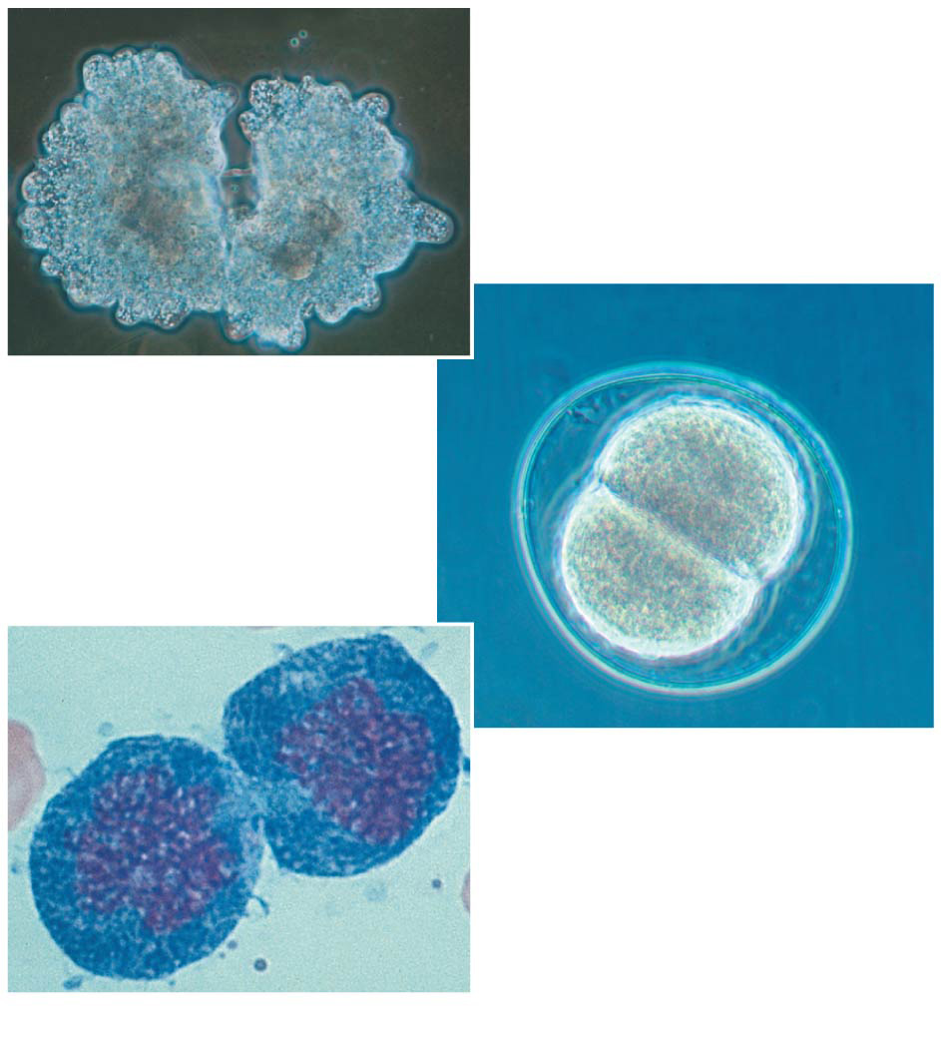
Cell Division
100 μm
A part of the cell cycle where a single parent cell replicates most or all of its cell parts to produce one or more daughter cells
50 μm
(a) Reproduction
(b) Growth and development
20 µm
(c) Tissue renewal
Notes:
Define cell divsions (in general) and list the three basic functions of cell division.

Slide 4
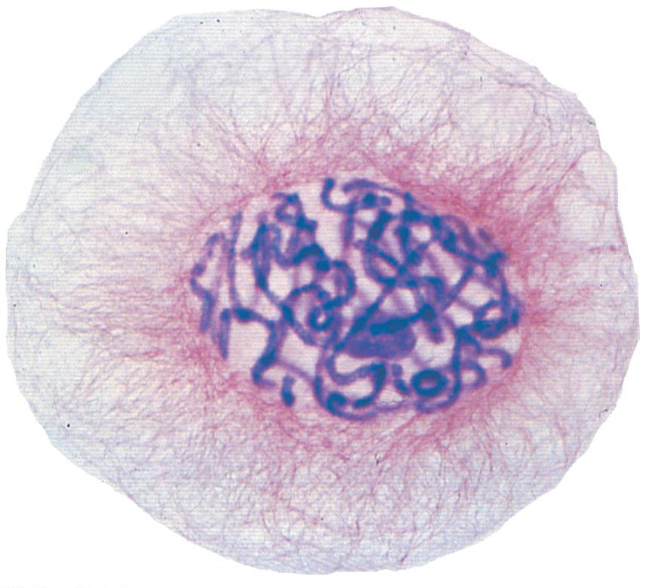
What parts of cells must be replicated in order for a cell to divide?
DNA
Organelles (if present)
Cytoplasm
All of the above
20 μm

Slide 5
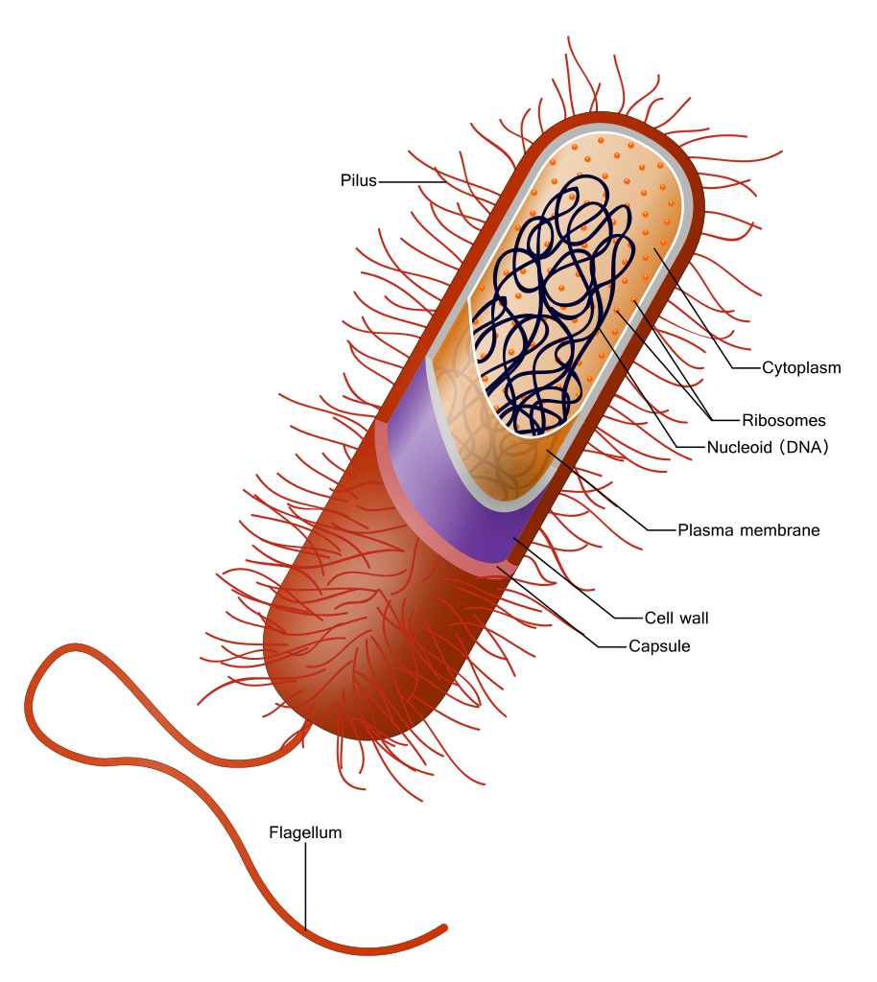
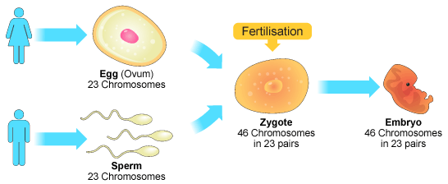
Different types of cells complete cell division differently
Prokaryotic
Eukaryotic
Somatic (body cells)
Gametes (sex cells)
Notes:
Just remind students of basic cell types. Introduce briefly the different between somatic cells and gametes in eukaryotes

Slide 6
Cell division: Prokaryotes vs Eukaryotes
Presence or absence of nucleus
Circular vs non circular chromosomes
Eukaryote
Prokaryote
DNA
Nucleus
No nucleus
Single loop of DNA
Has a nucleus with DNA in non-looped chromosomes
Single Circular chromosome
Multiple Linear chromosomes
Notes:
Cells can divide as single organisms or one cell of a multicellular organism can divide!

Slide 7
Prokaryotic cell division: Binary Fission
Function
asexual reproduction
1 parent cell produces 2 genetically identical daughter cells
Notes:
Binary fission is asexual reproduction of prokayotic cells- “dividing in half” . It is a means of reproduction in which a parent organism, often a single-cell, divides and this process produces two genetically identical daughter cells that are about equal size .
Prokaryotic organisms have only one circular strand of DNA that is their singular chromosome. *

Slide 8
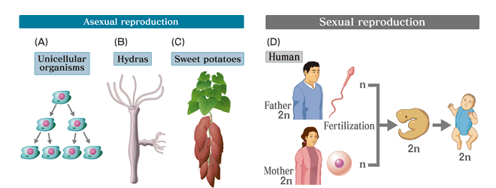
Eukaryotes: Asexual vs Sexual reproduction
One parent producing a genetically identical offspring
Two parents producing sex cells (gametes) that fuse to form a genetically unique offspring
Notes:
1. Asexual Reproduction – Reproduction involving only one parent and no egg or sperm. A clone is produced. This process is quick and easy, but produces little or no variation in offspring.
2. Sexual Reproduction – involves the union of a sperm and an egg, each containing one half of the genetic information, produces a zygote.
Usually involves genetic information from two parents, but always two gametes a sperm and an egg.
Some terms you will come across related to these types of cell division. The reason being that sometimes cellular division results in the reproduction of whole new organism
Life cycle – The development of a fertilized egg into a new adult organism is one phase of a multicellular organism’s life cycle. The sequence of events that occur between an adult of one generation to an adult of the next.

Slide 9
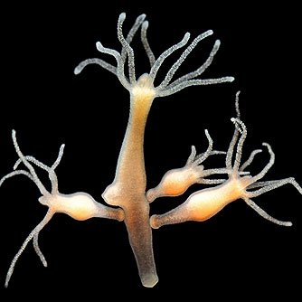
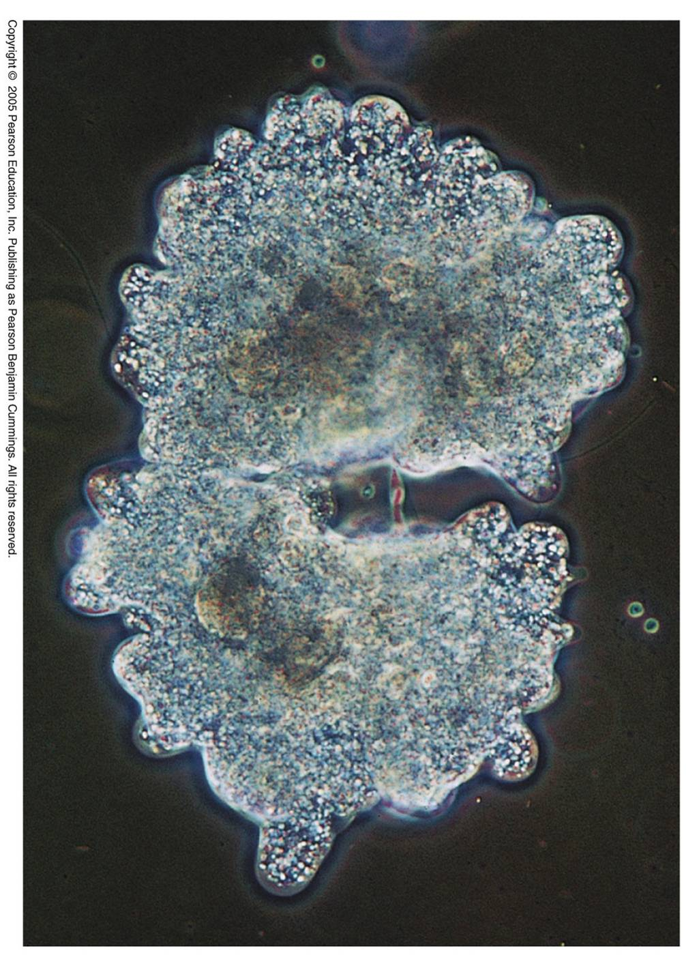
Eukaryotic Cell Division - Mitosis
Somatic cells only
Function
asexual reproduction
growth of multicellular organisms
repair damage
1 parent cell produces 2 genetically identical daughter cells
Hydra and amoeba

Slide 10
What is a Chromosome?
Pair up with a classmate and discuss what you know about chromosomes.
List the chromosome facts that the two of you come up with.
Write down a question that you and your partner have about chromosomes.

Slide 11
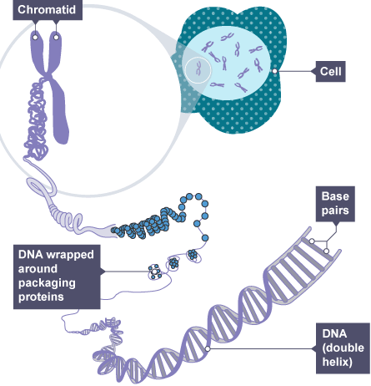
Eukaryotic chromosomes
Chromatin
DNA packaged around proteins
Uncondensed
good for normal cell function and replication
DNA loosely wrapped around proteins
Condensed
good only for cell division
DNA tightly packed around proteins
Notes:
Eukaryotic cellular division and their Chromosomes are more Complex. Chromosomes are duplicated long before the cell divides. The large complex chromosomes duplicate with each cell division. The term “Chromosome” literally means – Chroma (colored) soma (body). Chromatin – Is active threadlike strands that are composed of a complex of DNA & Proteins. It is the form taken by a chromosome when the cell is not dividing. DNA wraps around histone proteins forming nucleosomes; the "beads on a string" structure. The proteins help maintain the chromosomes structure and control DNA activity of genes. Most of the time, chromatin exists as a diffuse mass of long, thin fibers that if stretched out, would be too long to fit in the cells nucleus (exceeds your height!) and too thin to see under light microscope. As a cell prepares to divide, the chromatin coils up forming a tight dense form that are visible under light microscope. Ask students why is it maybe necessary to condense the chromosomes?…..
(Give analogy to students of belongs being spread out in your house , but as prepare to move you gather them up and pack them into small containers to make more easy to sort and transport…
In short, the primary functions of chromatin are:
1) to package DNA into a more compact, denser shape
2) to reinforce the DNA macromolecule to allow mitosis
3) to prevent DNA damage, and
4) to control gene expression and DNA replication. The primary protein components of chromatin are histones that compact the DNA. Chromatin is only found in eukaryotic cells (cells with defined nuclei).
Prokaryotic cells have a different organization of their DNA (the prokaryotic chromosome equivalent is called genophore and is localized within the nucleoid region).

Slide 12
Chromosomes – discrete DNA molecules that are not attached to other DNA molecules
Notes:
DRAW THIS ON BOARD
As a cell prepares to divide the chromatin condenses. The chromosomes of a eukaryotic cells are duplicated before they condense and the cell divides. The DNA molecule of each chromosome is replicated. Each chromosome consists of 2 copies called “sister chromatids, which are joined copies of the original chromosome shown on slide. The 2 sister chromosomes are attached together along their lengths by proteins and are cinched at an especially tight region called the centromere (narrow waist near center of each chromosome). These sister chromatids from a duplicated chromosome will separate from each other when the cell divides. Once separated from its sister, each chromatid is considered an individual chromosome, and is identical to the cell’s original chromosome.
Important vocab for this slide:
Chromatid
Chromosome
Sister chromatids
Duplicated chromosome
Centromere

Slide 13
A single chromosome can have two states: duplicated or unduplicated

Slide 14
Chromosomes contain genes
Genes
specific sequence of DNA usually encoding the amino acid sequence of a protein
Always found in the same location on a chromosome
Notes:
A somatic cell, or typical body cell, in a human has 46 chromosomes. These are 23 pairs of homologous chromosomes.
Student Misconceptions and Concerns
• Some students might conclude that sex chromosomes function only in determining the sex of an individual. As the authors note, sex chromosomes contain genes not involved in sex determination.
Teaching Tips
• Students might recall some basic genetics, remembering that for many traits a person receives a separate “signal” from mom and dad. These separate signals for the same trait are carried on the same portion of homologous chromosomes, such as the freckle trait noted in Module 8.11 of the textbook
Homologous chromosomes carry the same genes on the same locus, or place on the chromosome. One chromosome from each of these pairs is inherited from each parent.
22 pairs of our chromosomes are autosomes, the other pair is the sex chromosomes. Briefly explain diploid number 2N of humans and n number is haploid when forming the sex cells or gametes (egg, sperm)
A gene is a locus (or region) of DNA which is made up of nucleotides and is the molecular unit of heredity The transmission of genes to an organism's offspring is the basis of the inheritance of phenotypic traits. These genes make up different DNA sequences called genotypes. Genotypes along with environmental and developmental factors determine what the phenotypes will be
Provide an example of trait: Some genetic traits are instantly visible, such as eye colour or number of limbs, and some are not, such as blood type, risk for specific diseases.
Briefly explain what a Karyotype is- A photographic inventory of an individuals chromosome. Abnormalites can be detected by this method. Doctors can take a picture of the nucleus or a karyotype. The chromosomes are then arranged (usually in metaphase state) by size and shape and sorted in order on a computer. They are sorted into homologous pairs and then counted. The resulting display is the Karyotype with 22 pairs of autosomes and 2 sex chromosomes X and Y. Each of the chromosomes consists of 2 sister chromatids lying close together. Extra or missing chromosomes account for many genetic disorders.

Slide 15
Ploidy – the number of copies of each chromosome in a cell
Chromosomes that carry the same genes are called homologous chromosomes

Slide 16
Calculating total chromosome number
Total Number of chromosomes = n * x
n=ploidy (number of copies of each chromosome)
x=monoploid number (the number of unique chromosome types)

Slide 17
An adult (diploid) axolotl has 28 total chromosomes. How many chromosomes would you find in an axolotl blood cell?
28
14
56
16
Notes:
B

Slide 18
Homologous chromosome pairs
Figure 8.11
Notes:
Homologous chromosomes are matched in (2 chromosomes that make up a matched pair in a cell)
length,
centromere position, and
staining pattern.
A locus (plural, loci) is the position of a gene.
Different versions of a gene may be found at the same locus on the two chromosomes of a homologous pair.
Homologous Chromosomes: the 2 chromosomes of a homologous pair are indentical chromosomes that were inherited from 2 parents; may contain different versions of some gene
Homologous chromosomes have the same length, centromere position, and staining pattern and possess genes for the same characters at a corresponding loci (location on the chromosome). One homologous chromosome is inherited from the organism’s father, the other from the mother. Thus, homologous chromosomes carry the same genes on the same locus, or place on the chromosome. One chromosome from each of these pairs is inherited from each parent.

Slide 19
Match the structures using the vocabulary list. Some terms will be used more than once.
A.
C.
B.
Homologous chromosome
Centromere
Sister Chromatid
D.
E.
Figure 8.11
Notes:
Homologous chromosomes are matched in (2 chromosomes that make up a matched pair in a cell)
length,
centromere position, and
staining pattern.
A locus (plural, loci) is the position of a gene.
Different versions of a gene may be found at the same locus on the two chromosomes of a homologous pair.
Homologous Chromosomes: the 2 chromosomes of a homologous pair are indentical chromosomes that were inherited from 2 parents; may contain different versions of some gene
Homologous chromosomes have the same length, centromere position, and staining pattern and possess genes for the same characters at a corresponding loci (location on the chromosome). One homologous chromosome is inherited from the organism’s father, the other from the mother. Thus, homologous chromosomes carry the same genes on the same locus, or place on the chromosome. One chromosome from each of these pairs is inherited from each parent.

Slide 20
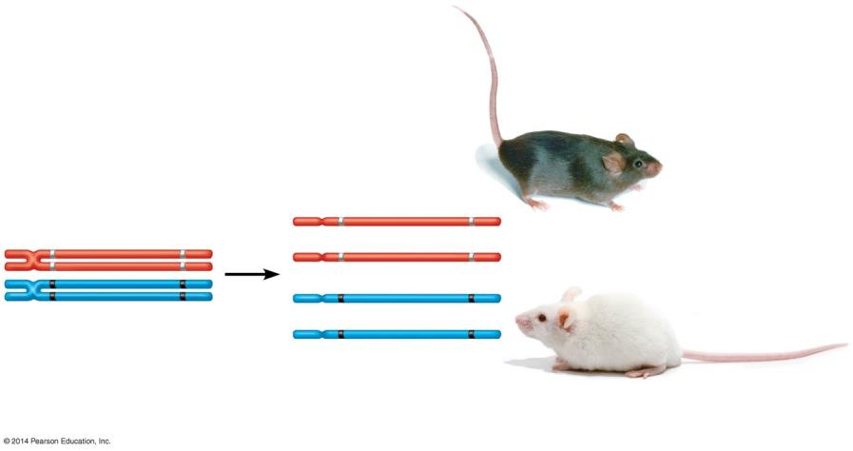
Homologous chromosomes may carry different versions of genes (alleles)
Coat-color genes
Eye-color genes
Brown C
Black E
C
E
Brown coat (C);
black eyes (E)
C
E
Meiosis
c
e
c
e
c
e
White
Pink
Tetrad in parent cell (homologous pair of duplicated chromosomes)
Chromosomes of
the four gametes
White coat (c);
pink eyes (e)
Notes:
Figure 8.16-0 Differing genetic information (coat color and eye color) on homologous chromosomes. Homologous chromosomes may carry different versions of genes (alleles). We get one allele each for our eye color for example from each parent.

Slide 21
Consider these two pieces of genetic material
They are…
homologous duplicated chromosomes.
sister chromatids.
one duplicated chromosome.
homologous unduplicated chromosomes.
Notes:
A, Homologous Chromosomes: the 2 chromosomes of a homologous pair are indentical chromosomes that were inherited from 2 parents; may contain different versions of some gene
Ex) 1 chromosome may contain a form of the gene for freckles while the homologous chromosome at the same location contains a form of the gene for the absense of freckles

Slide 22
Mitosis occurs during
Development of a zygote (after fertilization)
repair of tissues in a multicellular organism
Asexual reproduction of a unicellular organism
All of the above
Notes:
D.

Slide 23
Draw an example of each type of chromosome
 | Unduplicated | Duplicated
Haploid
Diploid

Slide 24
Karyotype
orderly display of homologous chromosomes
diploid (2N) cells have a pair of each chromosome
46, XX
Notes:
Doctors can take a picture of the nucleus or a karyotype. The chromosomes are then arranged (usually in metaphase state) by size and shape and sorted in order on a computer. They are sorted into homologous pairs and then counted. The resulting display is the Karyotype with 22 pairs of autosomes and 2 sex chromosomes X and Y. Each of the chromosomes consists of 2 sister chromatids lying close together. Extra or missing chromosomes account for many genetic disorders.
*Point out that a diploid cell contains two sets of chromosomes of which one is maternal, and the other is paternal. Diploid cells are produced by mitosis. During mitosis the parent nucleus divides into two daughter nuclei. Each daughter nucleus will contain the same number of chromosomes as the parent nucleus.
*A haploid cell contains only one set of chromosomes. Haploid cells are produced by meiosis. During meiosis, the chromosome number is halved from the diploid number to the haploid number. Similar to mitosis, in meiosis also, DNA replication takes place in the parent cell during the interphase. After this, two cycles of nuclear divisions and cell divisions take place. After the entire process, one diploid cell gives rise to four haploid cells. Haploid cells are very important for sexual reproduction. During fertilization, the two nuclei of the two gametes fuse with each other. Since each gamete has only one set of chromosomes, the end resulting zygote will have only two sets of chromosomes.

Slide 25
Cell Cycle Details
Interphase (90%)
G₁ phase
S phase (DNA replicates)
G₂ phase
Mitotic phase (10%)
mitosis
cytokinesis
Notes:
Cell cycle is a cells life cycle. It is an ordered sequence of events which include an interphase an a mitotic phase. That extends from the time a eukaryotic cell is first formed from a dividing parent cell until its own division into 2 cells. We have a cell division cycle because it enables a multicellular organism to grow to adult size, and it replaces worn-out or damaged cells, keeping the total number of cells in an adult organism relatively constant. Some cells in our body divide every second, some cells divide once a day, others less often. Highly specialized cells such as mature muscle cells and some nervous cells, don’t divide at all. Why some damage such as death of cardiac muscle during a heart attack and death of brain cells can never be reversed.
2 main stages in cell cycle : A growing stage (Interphase), during which the cell ~doubles everthing in its cytoplasm and replicates its chromosomal dna, metabolic activity is very high (ie intestinal cells). Interphase lasts for at least 90% of the total time required for the cell cycle and the actual cell division phase called the mitotic phase where the cell actually divides and accounts for only about 10% of the total time required in the cell cycle. The mitotic phase is divided into 2 overlapping phases, called mitosis (nucleus and its contents duplicated chromosomes divide and equally distributed to form 2 daughter nuclei, and cytokinesis, which begins usually before mitosis ends, the cytoplasm is divided and distributed to 2 new daughter cells. Cells then proceed thru G1 and repeat cycle. Explain G1 S and G2 what they are
P53- mutation that prevents cell cycle checkpoint

Slide 26
Mitosis yields two daughter cells that:
Are haploid
Have the same number of chromosomes as the parent cell
Have half as many chromosomes as the parent cell
Have double the number of chromosomes as the parent cell
Notes:
B

Slide 27
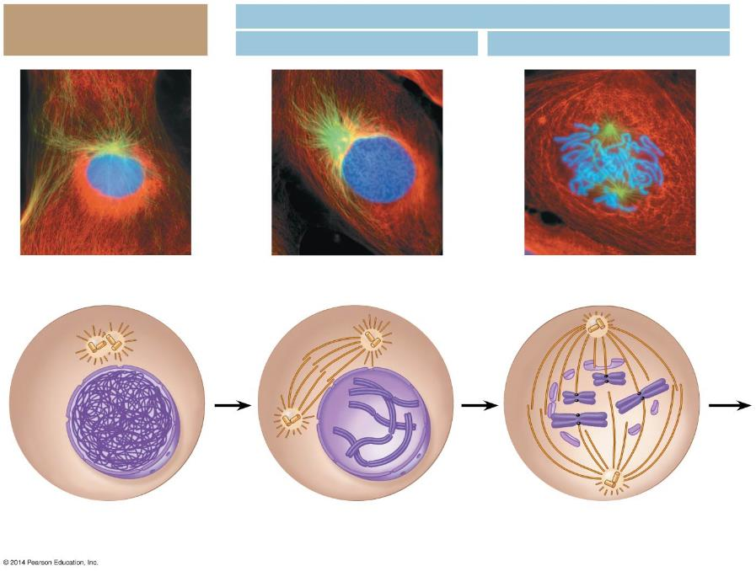
Mitosis
Interphase
Prophase
Prometaphase
Centrosomes
Early mitotic spindle
Fragments of the nuclear envelope
Chromatin
Centrosome
Kinetochore
Nuclear envelope
Centromere
Spindle microtubules
Plasma membrane
Chromosome, consisting of two sister chromatids
Notes:
Figure 8.5-2 The stages of cell division by mitosis: interphase through prometaphase
Interphase – period of cell growth, cell synthesizes new molecules & organelles, cell has doubled in its original contents, and cytoplasm, chromosomes in nucleus are duplicated and can’t be distinguished individually because they are still in the form of loosely packed chromatin
changes in nucleus and cytoplasm occur. Chromatin fibers become more tightly coiled and folded and can be seen with microscope, now chromosomes appears as 2 identical sister chromatids joined at centromere. And mitotic spindles appear to form as microtubles rapidly grow out from centrosomes that have moved to opposite sides.
Prometaphase – nuclear envelope breaks down and disappears and now centrosomes are at opposite poles, each sister chromatid has a protein structure called a kinetochore shown as black dot at a specific DNA region within the centromere. Some of spindle microtubules attach to kinetochore and forces a movement (motors) the movement of chromosomes toward center of cell.
Teaching Tips
• Students might keep better track of the sequence of events in a cell cycle by simply memorizing the letters IPPMAT, which are the first letters of interphase, prophase, prometaphase, metaphase, anaphase, and telophase.

Slide 28
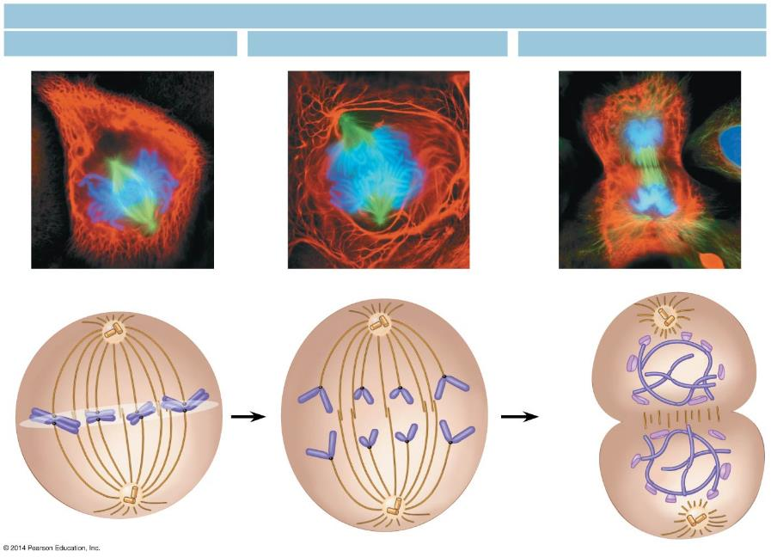
Mitosis
Metaphase
Anaphase
Telophase and Cytokinesis
Metaphase plate
Cleavage furrow
Nuclear envelope forming
Separated chromosomes
Mitotic spindle
Notes:
Metaphase mitotic spindle fully formed, with its poles at opposite ends of cell. Chromosomes now all align on the middle of the cell (or metaplate) all chromosomes lined up in the middle. Kinetochore are attached to two sister chromatids.
Anaphase, begins when 2 centromeres of each chromosome comes apart and separates the sister chromatids, Motor proteins of kinetochores, powered by ATP “walk” the newly separated daughter chromosome by the centromere first toward opposite poles. At the end of anaphase, the 2 ends of cell have equal amounts of chromosomes.
Telophase – cell elongation that started in anaphase continues, daughter nuclei appear at the poles of the cell and a nuclear envelopes forme around chromosomes. Teleophase is roughly the reverse of prophase. Chromatin fibers uncoil at the end of telophase, mitotic spindles disappear. Mitosis, equal division of nucleus.
Cytokinesis, the division of cytoplasm usually occurs simultaneously with telophase. 2 daughter cells completely separate soon after the end of mitosis. In animal cells, a cleavage furrow forms and the cell pinches into 2 new daughter cells.
Teaching Tips
• Students might keep better track of the sequence of events in a cell cycle by simply memorizing the letters IPPMAT, which are the first letters of interphase, prophase, prometaphase, metaphase, anaphase, and telophase.

Slide 29
https://ed.ted.com/on/n0MzxHbx#watch

Slide 30
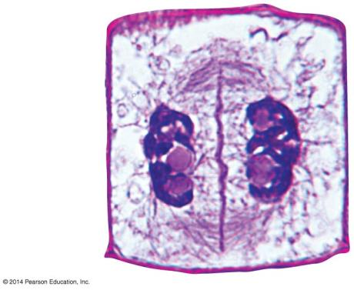
Cytokinesis: animal vs plant cell
animal cell plant cell
Cell wall of the parent cell
Daughter nucleus
Cell plate forming
cleavage furrow cell plate
Figure 8.6

Slide 31
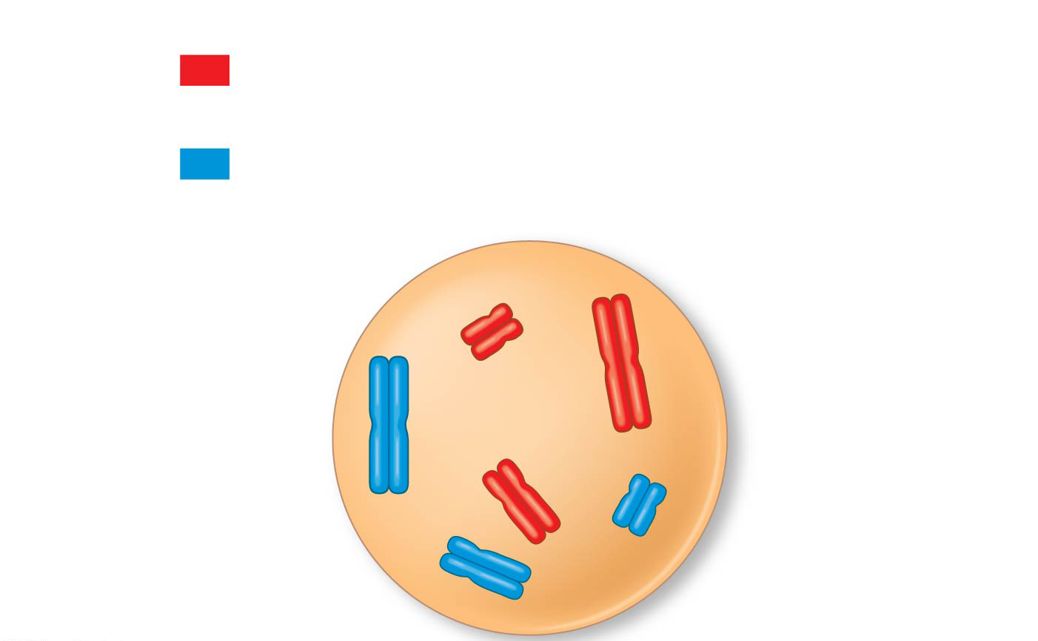
Identify the correct vocabulary term for the structure shown
Key
Maternal set of
chromosomes (n = 3)
2n = 6
Paternal set of
chromosomes (n = 3)
a
Sister chromatids
of one duplicated
chromosome
a)
b)
Centromere
a
c)
d)
Two nonsister
chromatids in
a homologous pair
Pair of homologous
chromosomes
(one from each set)
Notes:
Sister chromatids
Centromere
Homologous duplicated chromosome
Homologous chromosomes

