Slide 1
How do substances move in and out of cells?

Slide 2
One of the membrane functions:
Control what enters and leaves the cell=
regulate particle traffic across it
How do particles of any substance spread?
The tendency for particles to spread out evenly in an available space called Diffusion

Slide 3
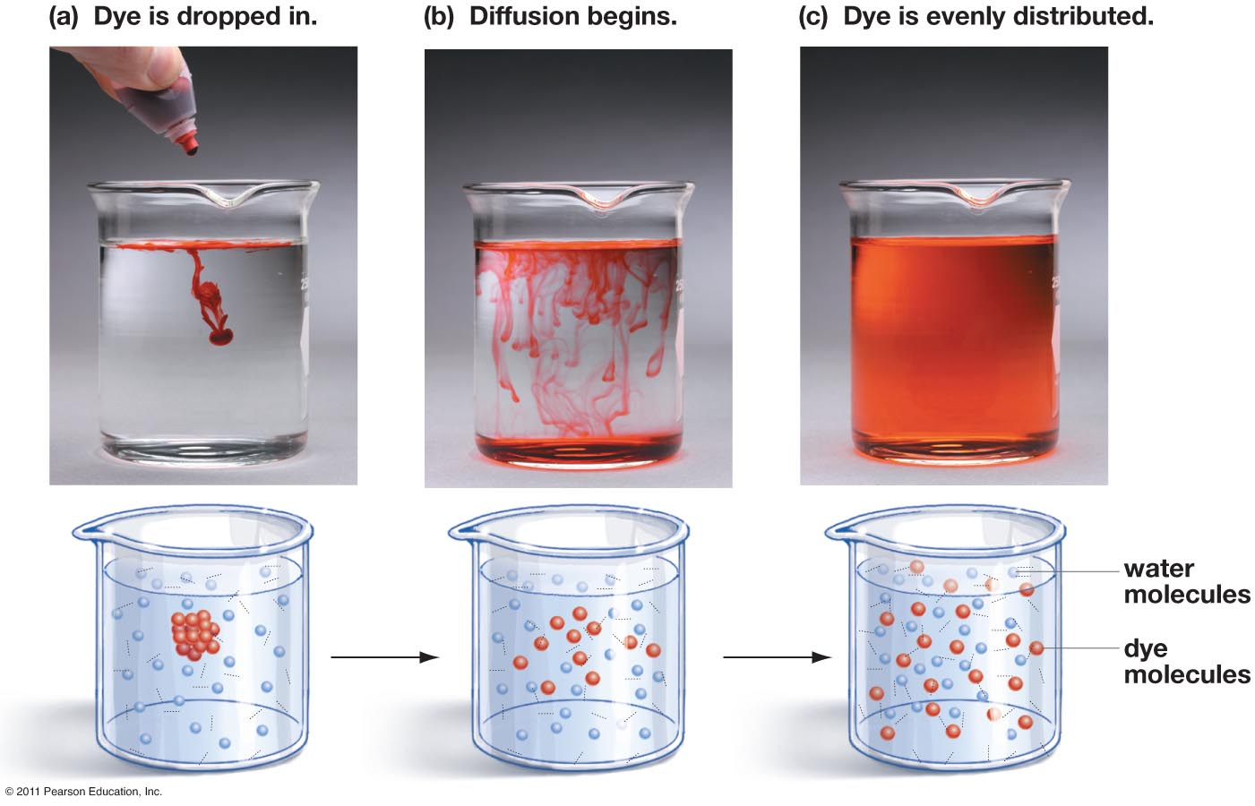
Diffusion

Slide 4
Diffusion

Slide 5
Diffusion
The net movement of particles Down the concentration gradient (= from an area of high concentration to an area of low concentration, until equilibrium is established.

Slide 6
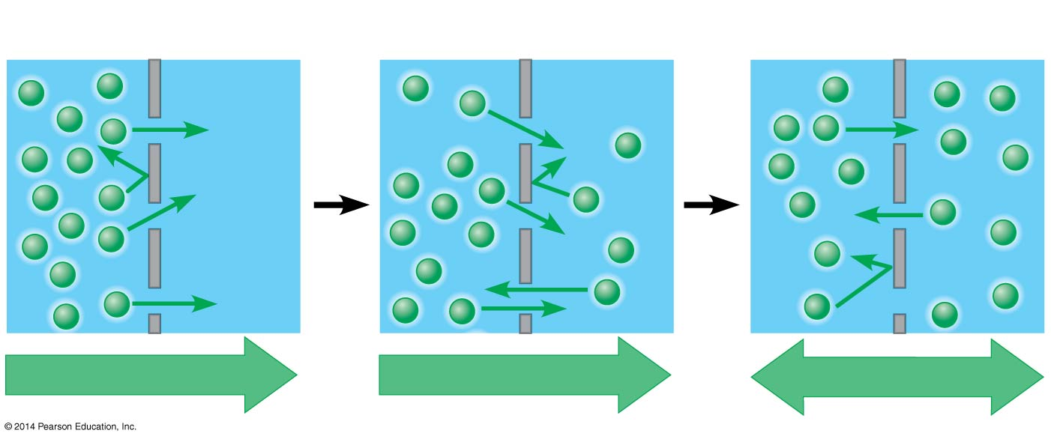
Diffusion across a membrane
Molecules of dye
Membrane
Pores
Net diffusion
Net diffusion
Equilibrium
Particles move down their concentration gradient.
High → Low
Notes:
the particles reach dynamic equilibrium, where there is no net change in concentration on either side of the membrane.

Slide 7
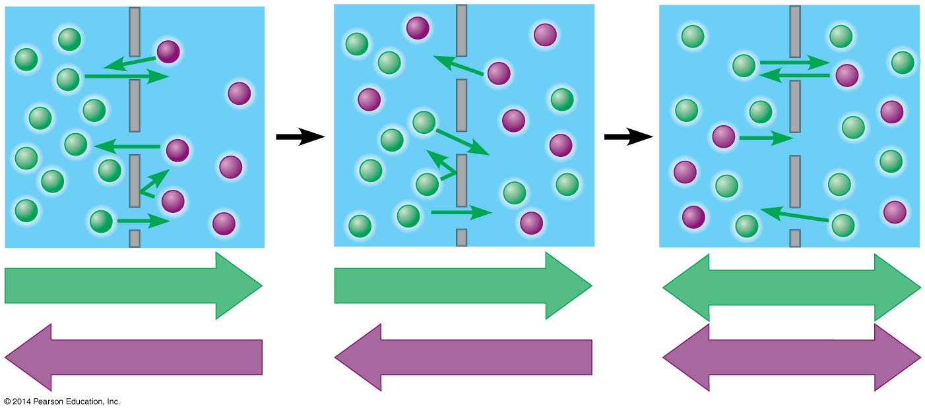
Diffusion across a membrane
Net diffusion
Net diffusion
Equilibrium
Net diffusion
Net diffusion
Equilibrium

Slide 8
Diffusion across a membrane

Slide 9
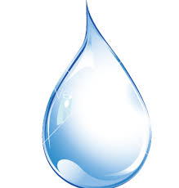
Osmosis: the diffusion of WATER from an area of high concentration to an area of low concentration, across a selectively permeable membrane, until equilibrium is established.
If a membrane, permeable to water but not to a solute, separates two solutions with different concentrations of solute, water will cross the membrane, moving down its own concentration gradient.

Slide 10
Tonicity
The ability of a surrounding solution to cause a cell to gain or lose water.
Hypotonic solution
(lower solute levels)
Isotonic solution
(equal solute levels)
Hypertonic solution
(higher solute levels)
H₂O
H₂O
H₂O
H₂O
Animal cell
Lysed
Normal
Shriveled

Slide 11
Water balance between cells and their surroundings is crucial to organisms
Isotonic solution:
The concentration of solute is the same on both sides of a membrane.
In isotonic solutions, animal cells are normal.
Hypotonic solution (Hypo=Below/Low)
the solute concentration is lower outside the cell,
Cells shrink in a hypertonic solution.
Hypertonic solution (Hyper= Above/High)
the solute concentration is higher outside the cell
Cells swell in a hypotonic solution.
Notes:
11

Slide 12
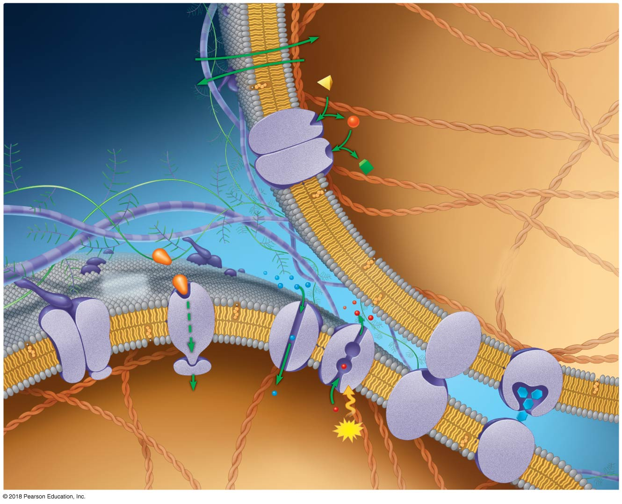
Membrane Structure and Function

Slide 13
Review Lab Exercise 3 for more information about Diffusion and Osmosis

Slide 14
Extracellular side
of membrane
Cytoplasmic side
of membrane
Phospholipid
Cholesterol
In Eukaryotes, cholesterol stabilizes the membrane
Proteins determine most of the membrane’s specific functions
© 2018 Pearson Education, Inc.
Notes:
Figure 5.1 Membranes are fluid mosaics of lipids and proteins with many functions

Slide 15
Extracellular side
of membrane
Cytoplasmic side
of membrane
Phospholipid
Cholesterol
Membrane
proteins
Receptor
protein
Attachment
protein
Junction
protein
Junction
protein
transport
protein
ATP
© 2018 Pearson Education, Inc.
Notes:
Figure 5.1 Membranes are fluid mosaics of lipids and proteins with many functions

Slide 16
Membrane Structure: the fluid mosaic model
Membranes are fluid mosaics of lipids and proteins with many functions.
© 2018 Pearson Education, Inc.
Notes:
Figure 5.1 Membranes are fluid mosaics of lipids and proteins with many functions

Slide 17
Aquaporins are transmembrane proteins that span the entire membrane. An aquaporin protein must be able to interact with polar regions that are both extracellular and intracellular as well as polar water molecules moving through its core. Additionally, it must be able to interact with the nonpolar phospholipid tails. How is it possible that this protein can meet all of these requirements?
The proteins have are able to constantly change shape and orientation to accommodate multiple types of interactions
The proteins are so large relative to the cell membrane that they are able to force their way through the entire span of the membrane despite the different regional polarities.
The protein has a very specific structure with amino acids arranged according to the properties of their R groups so that they can interact with surrounding molecules as needed.
PLICKER QUESTION

Slide 18
Phospholipids
Phospholipids are the main structural components of membranes
How is their structure related to their function?
Hydrophilic
Hydrophobic

Slide 19
Membranes: Phospholipid Bilayers
Phospholipids are the main structural components of membranes
Hydrophilic
Hydrophobic

Slide 20
Which answer correctly describes hydrophobic and hydrophilic regions of the lipid bilayer?
fatty acids tails are hydrophobic; phosphate heads are hydrophobic
fatty acids tails are hydrophobic; phosphate heads are hydrophilic
fatty acids tails are hydrophilic; phosphate heads are hydrophobic
fatty acids tails are hydrophilic; phosphate heads are hydrophilic

Slide 21
Which answer correctly describes hydrophobic and hydrophilic regions of the lipid bilayer?
fatty acids tails are hydrophobic; phosphate heads are hydrophobic
fatty acids tails are hydrophobic; phosphate heads are hydrophilic
fatty acids tails are hydrophilic; phosphate heads are hydrophobic
fatty acids tails are hydrophilic; phosphate heads are hydrophilic

Slide 22
Diffusion of particles across biological membranes

Slide 23
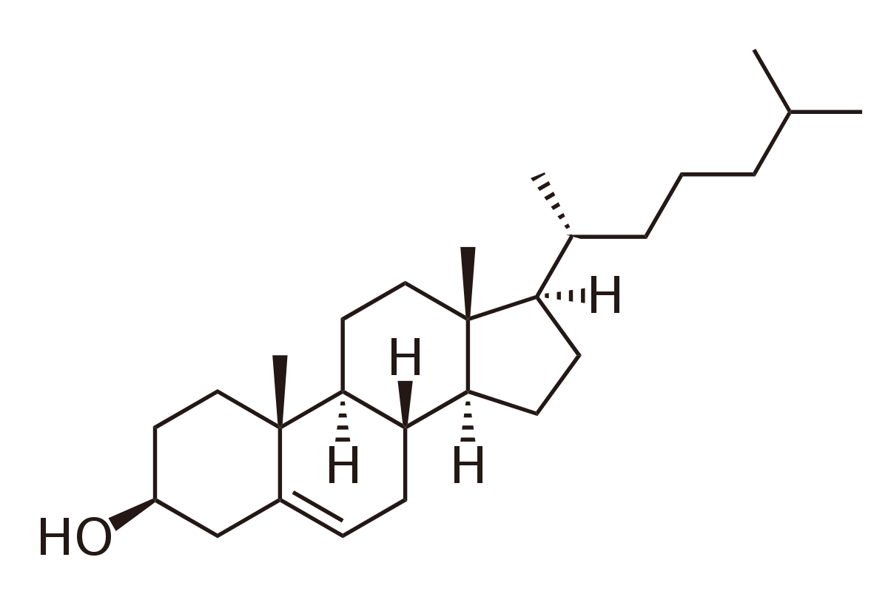
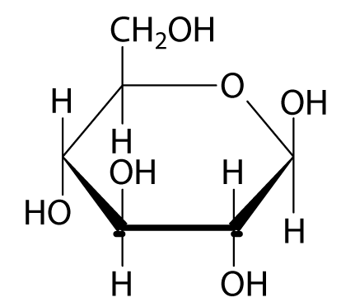
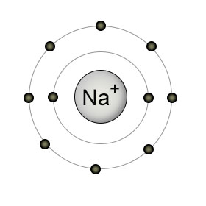
O₂
Oxygen
Cholesterol
Glucose
CO2
Carbon dioxide
H₂O
Water
Na+
Sodium ion
Which substances will most easily cross the membrane?

Slide 24
O₂
Oxygen
Cholesterol
Glucose
CO2
Carbon dioxide
H₂O
Water
Na+
Sodium ion

Slide 25
Selective Permeability
Small, non-polar substances can diffuse through the membrane,
big , polar; and charged substances cannot
Notes:
Frank Start

Slide 26
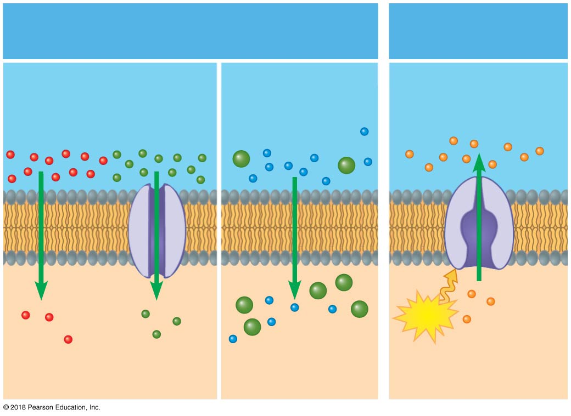
Transport across membranes
Passive transport
(requires no energy)
Diffusion
Facilitated
diffusion
Osmosis
Higher solute
concentration
Higher free water
concentration
Solute
Lower solute
concentration
Lower free water
concentration
© 2018 Pearson Education, Inc.
Notes:
Figure 5.UN01 Review the concepts, 5.8

Slide 27
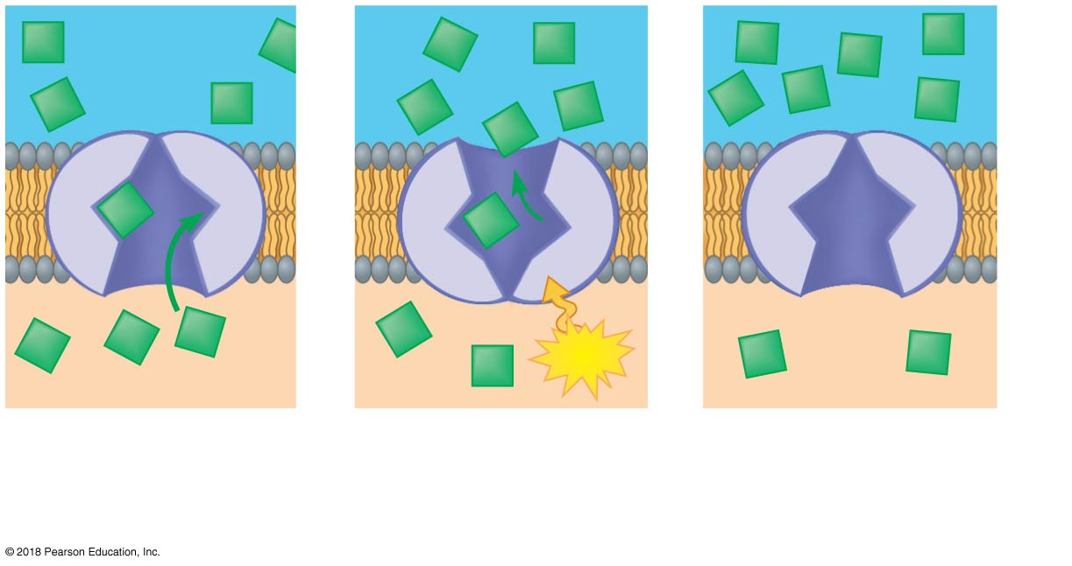
Active Transport
Transport
protein
ATP
Solute
1
Solute binds to
transport
protein.
2
ATP provides
energy for change
in protein shape.
3
Protein returns to
original shape; more
solute can bind.
© 2018 Pearson Education, Inc.
Notes:
sweep

Slide 28
Transport across membranes
Passive transport
(requires no energy)
Active transport
(requires energy)
Diffusion
Facilitated
diffusion
Osmosis
Higher solute
concentration
Higher solute
concentration
Higher free water
concentration
Solute
Water
ATP
Lower solute
concentration
Lower free water
concentration
Lower solute
concentration
© 2018 Pearson Education, Inc.
Notes:
Figure 5.UN01 Review the concepts, 5.8

Slide 29
Label the diagram: Red numbers refer to biological molecules and structures Black numbers refer to processes denoted by arrows
4
1
Phospholipid
6
5
Lipid bilayer
1
2
Inside the cell
Protein
3
7
Notes:
The cell can “select” when polar, charged, and larger molecules cross the membrane by providing protein gates.

Slide 30
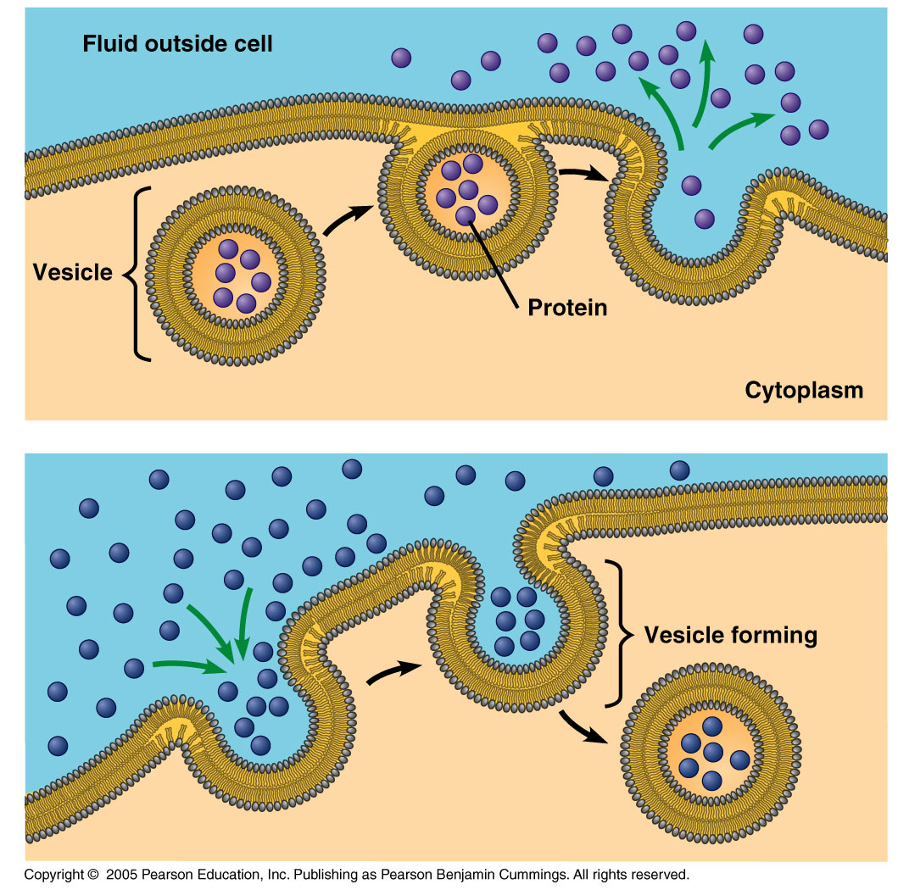
What about the transfer of VERY big substances?
Exocytosis
ATP
Endocytosis

Slide 31
Summary: Types of Cellular Transport
Passive Transport –
Cellular energy is not required
Molecules move down their concentration gradient
Diffusion
Facilitated Diffusion
Osmosis
Active Transport –
Cellular energy(ATP) is required.
Molecules move against the concentration gradient
Protein Pumps
Endocytosis
Exocytosis
Weeee!!!
high
low
This is gonna be hard work!!
high
ATP
low

Slide 32
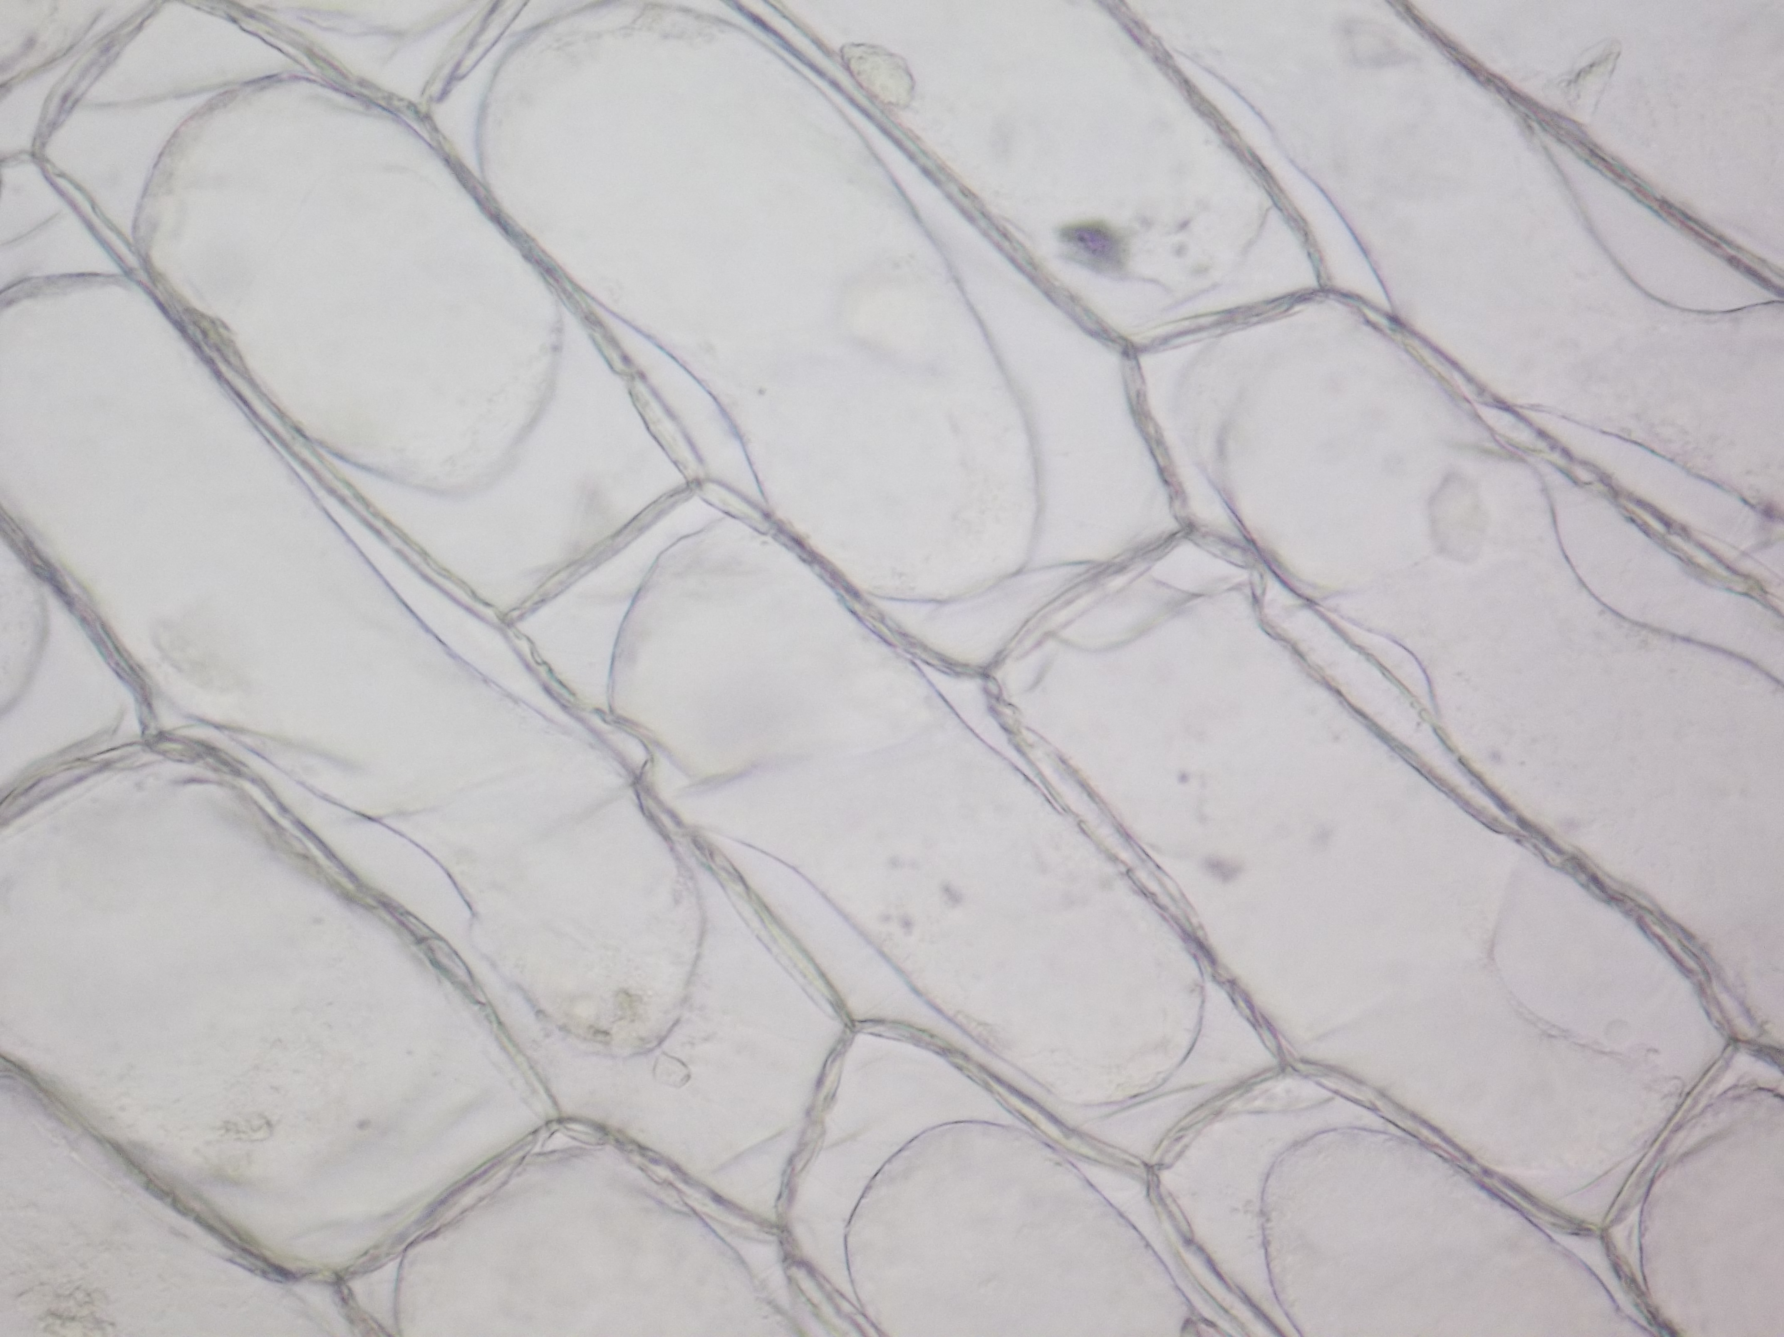
Cell membrane
Cell wall
Write a description of what is happening in the image. Use the technical terms that you know.

Slide 33
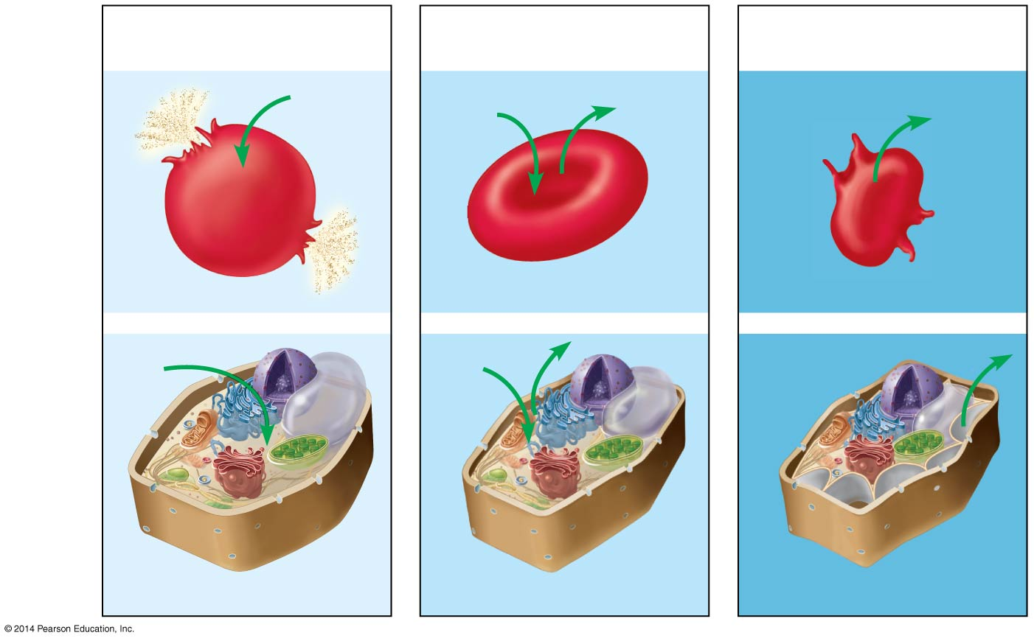
Figure 5.5
Hypotonic solution (lower solute levels)
Isotonic solution (equal solute levels)
Hypertonic solution (higher solute levels)
H₂O
H₂O
H₂O
H₂O
Animal cell
Lysed
Normal
Shriveled
Plasma membrane
H₂O
H₂O
H₂O
Plant cell
Turgid (normal)
Flaccid
Shriveled (plasmolyzed)

Slide 34
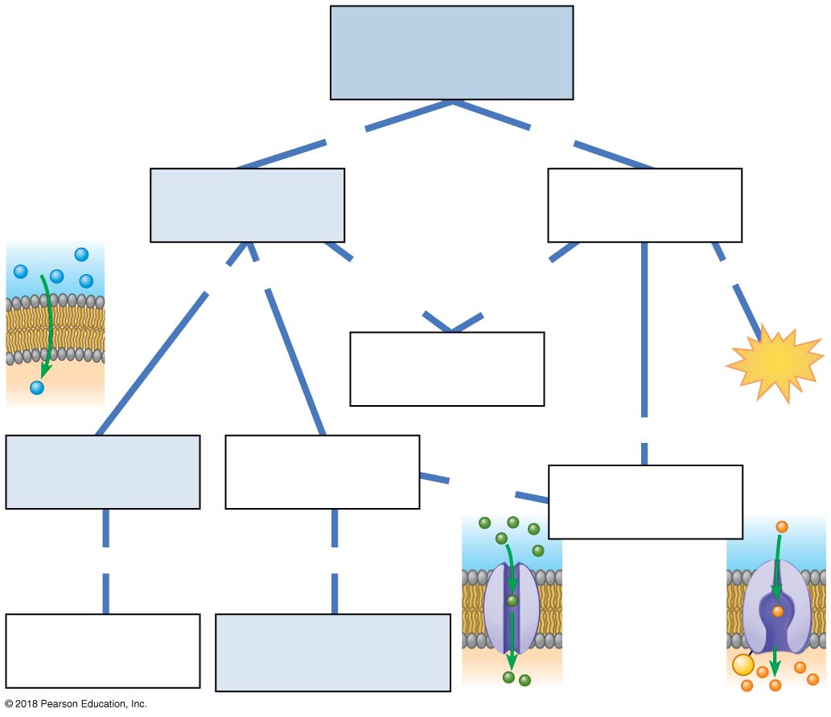
Molecules cross
cell membranes
by
by
passive
transport
(a)
may be
moving
down
moving
against
requires
(b)
ATP
uses
diffusion
(d)
uses
(e)
of
of
(c)
polar molecules
and ions
P
© 2018 Pearson Education, Inc.
Notes:
Figure 5.UN02 Connecting the concepts, question 1

