Slide 1
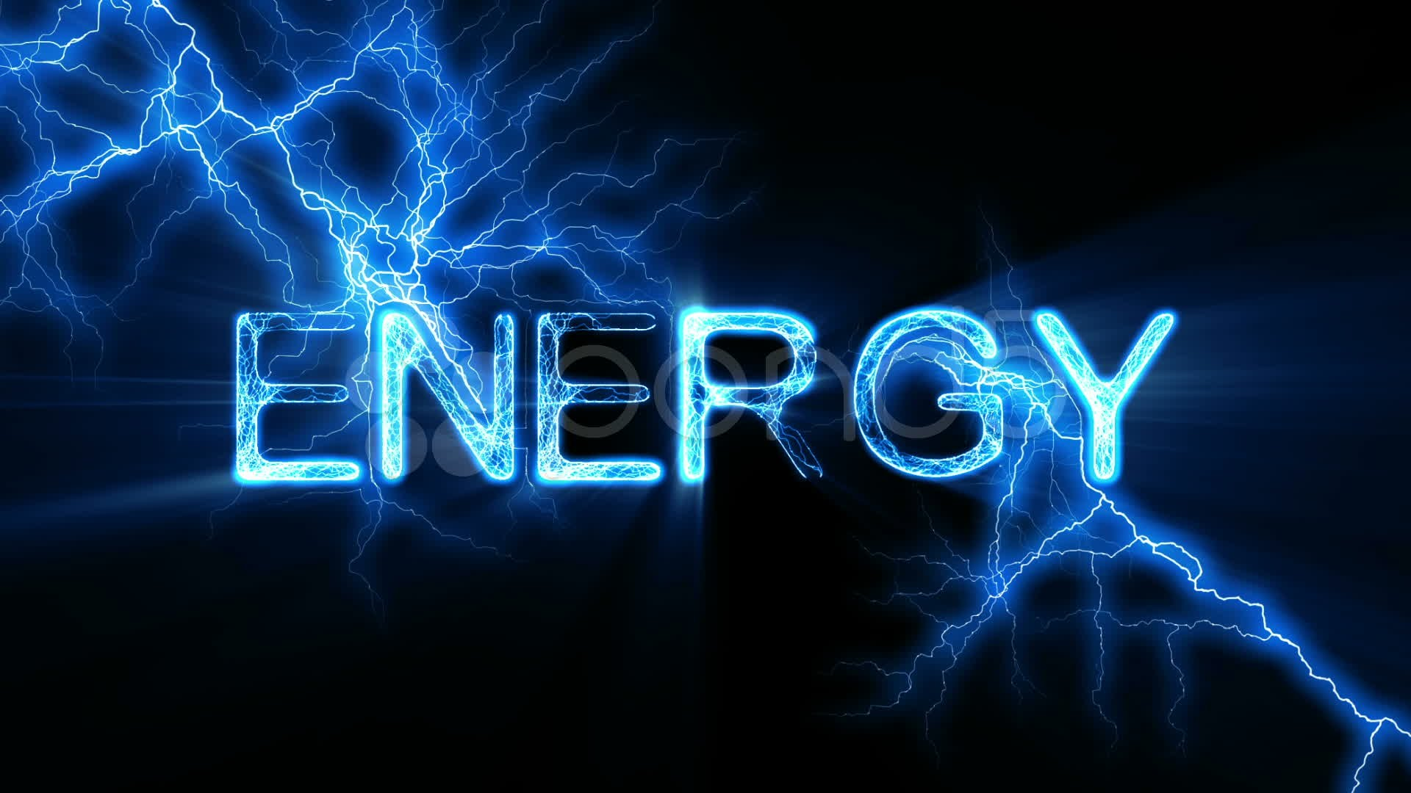
We are going to learn about the role of energy in biological systems. Let’s review our previous knowledge using the following questions:
What ideas come to mind when you think of energy?
How would you explain energy to someone else?
Where does energy come from?
Why do cells need energy ?
What are the sources of energy available for organisms?
What are the roles of energy in chemical reactions?

Slide 2
Energy and the Cell
Active transport
Energy

Slide 3
What is energy and what are some forms of energy?
http://ed.ted.com/lessons/all-of-the-energy-in-the-universe-is-george-zaidan-and-charles-morton

Slide 4
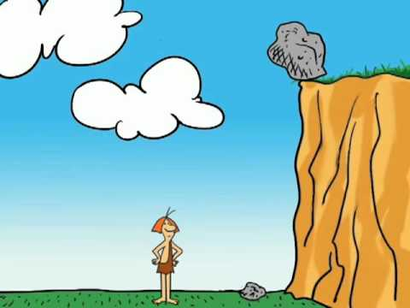
Energy is the capacity to cause change or to perform work
Kinetic energy is the energy of motion.
Potential energy is energy that matter
possesses as a result of its location or structure.

Slide 5
Chemical energy is a potential energy available for release in a chemical reaction
It is the most important type of energy for living organisms: can be transformed to power the work of the cell.
Notes:
5

Slide 6
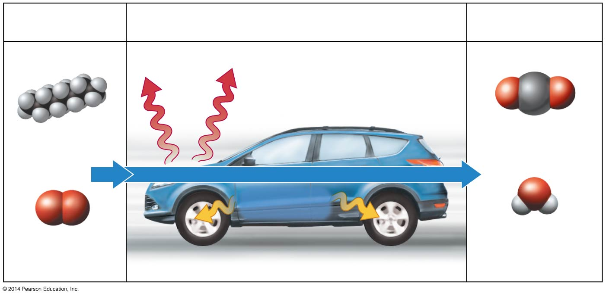
Forms of Energy
1
Fill in the blanks (1-3) with the terms listed below
Fuel
Energy conversion
Waste products
2
Gasoline
Carbon dioxide
+
+
Oxygen
Water
3
Kinetic Energy
Chemical Energy
Heat Energy
Potential Energy

Slide 7
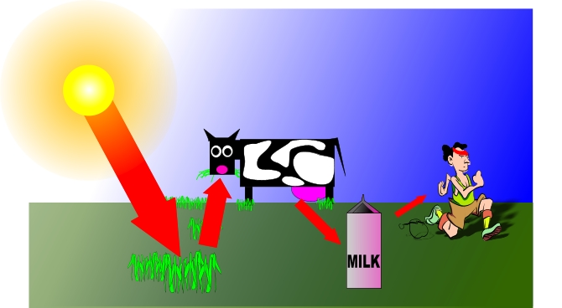
Laws of Thermodynamics (=the study of energy transformations)
Notes:
7

Slide 8
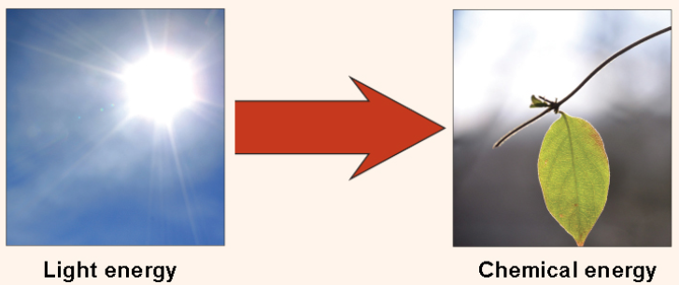
Laws of Thermodynamics (=the study of energy transformations)
First law of thermodynamics
Energy may be transferred from place to place or transformed into different forms, but it cannot be created or destroyed. Energy is conserved!!
Notes:
8
The first law of thermodynamics deals with the total amount of energy in the universe. It states that this total amount of energy is constant. In other words, there has always been, and always will be, exactly the same amount of energy in the universe. Energy exists in many different forms. According to the first law of thermodynamics, energy may be transferred from place to place or transformed into different forms, but it cannot be created or destroyed. The transfers and transformations of energy take place around us all the time. Light bulbs transform electrical energy into light energy. Gas stoves transform chemical energy from natural gas into heat energy. Plants perform one of the most biologically useful energy transformations on earth: that of converting the energy of sunlight into the chemical energy stored within organic molecules.

Slide 9
Laws of Thermodynamics (=the study of energy transformations)
Second law of thermodynamics
Energy transfers or transformations increase disorder, or entropy, with some energy being lost as heat.
Notes:
9
The first law of thermodynamics deals with the total amount of energy in the universe. It states that this total amount of energy is constant. In other words, there has always been, and always will be, exactly the same amount of energy in the universe. Energy exists in many different forms. According to the first law of thermodynamics, energy may be transferred from place to place or transformed into different forms, but it cannot be created or destroyed. The transfers and transformations of energy take place around us all the time. Light bulbs transform electrical energy into light energy. Gas stoves transform chemical energy from natural gas into heat energy. Plants perform one of the most biologically useful energy transformations on earth: that of converting the energy of sunlight into the chemical energy stored within organic molecules.

Slide 10
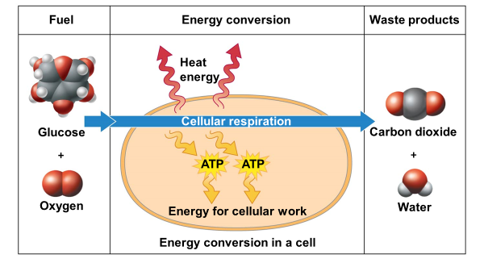
Cellular Respiration (=extracting energy from food)

Slide 11
Discuss with your neighbor and write down how the illustration below demonstrates the two laws of thermodynamics

Slide 12
Living systems
A) violate the first law of thermodynamics.
B) violate the second law of thermodynamics.
C) decrease their entropy while increasing the entropy of the universe.
D) are examples of a closed system.

Slide 13
Living systems…
A) violate the first law of thermodynamics.
B) violate the second law of thermodynamics.
C) decrease their entropy while increasing the entropy of the universe.
D) are examples of a closed system.

Slide 14
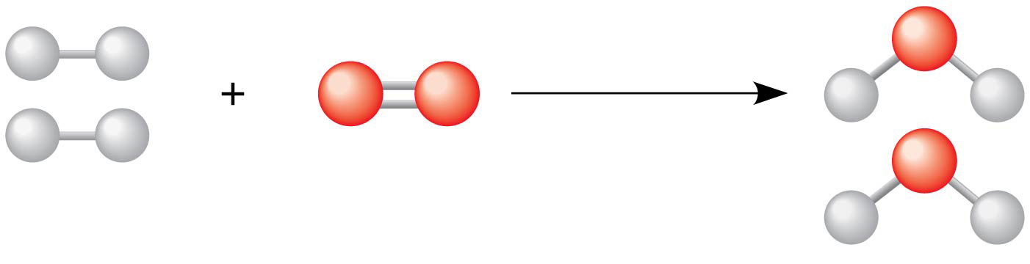
Chemical reactions make and break chemical bonds
Reaction
Reactants
Products
Chemical reactions either release or store energy

Slide 15
Chemical reactions either
energy
energy
Release energy
or
store energy
Notes:
15

Slide 16
Chemical reactions either
energy
Release energy
(exergonic reactions )
Notes:
16

Slide 17
Chemical reactions either
energy
store energy
Notes:
17

Slide 18
Chemical reactions either
Release energy
or
store energy
Begin with reactants that contain relatively little potential energy and yield products rich in potential energy.
(endergonic reactions)
(exergonic reactions )
Catabolic reactions
Anabolic reactions
Notes:
18
M

Slide 19
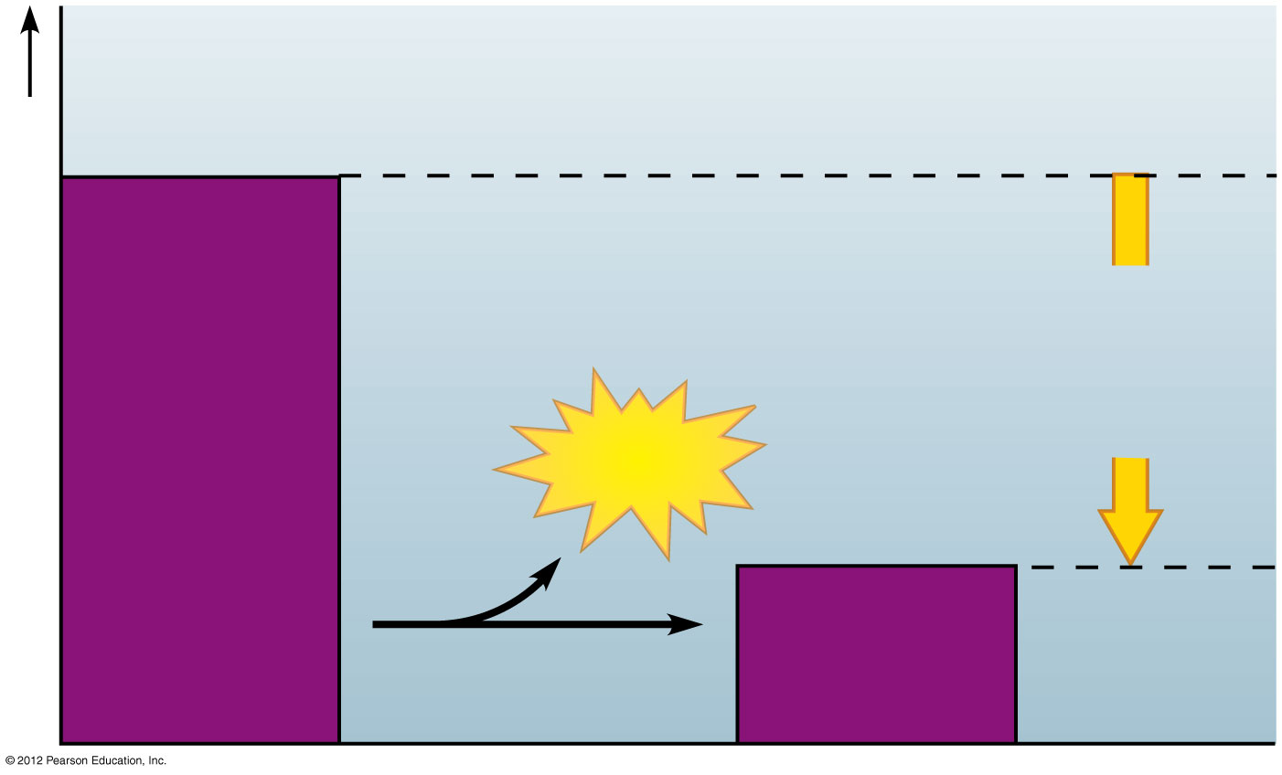
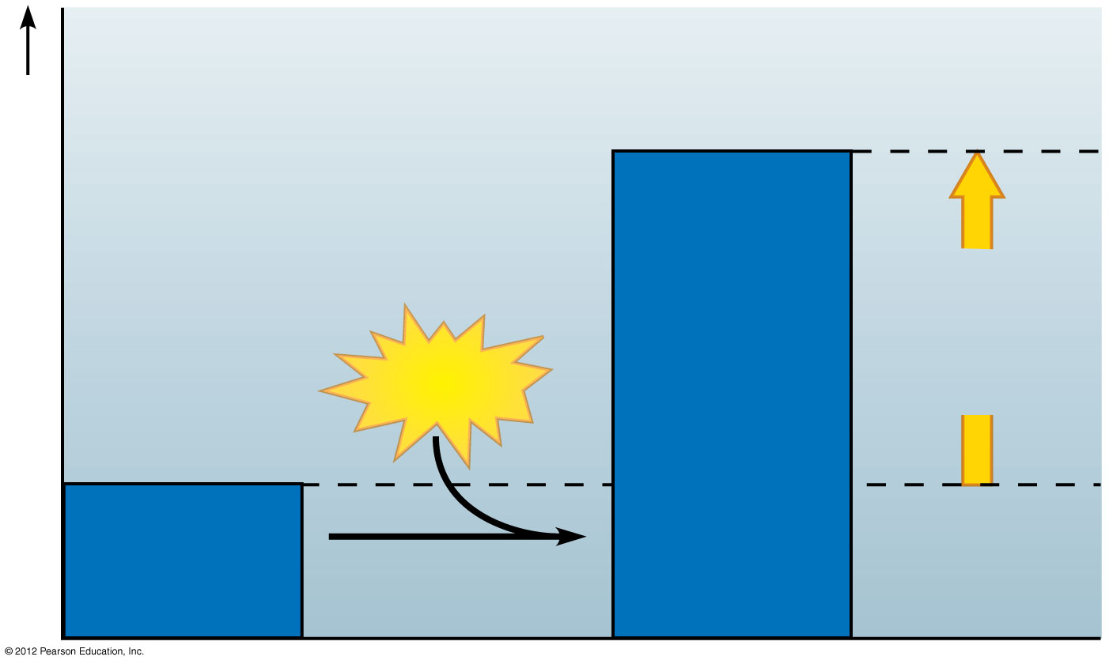
Exergonic reaction
Reactants
Amount of energy released
Potential energy of molecules
Energy
Products
Endergonic reaction
Products
Amount of energy required
Potential energy of molecules
Energy
Reactants
Notes:
19

Slide 20
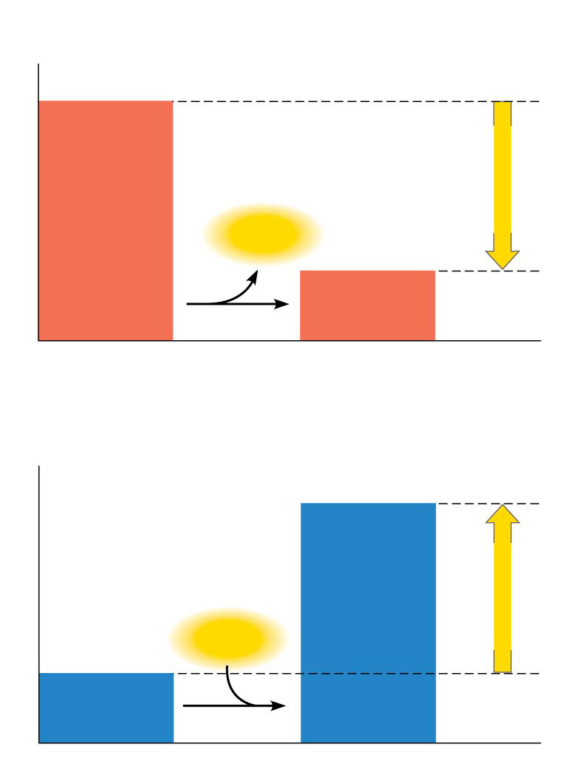
Energy Coupling
Energy
Energy
Energy
+ Energy

Slide 21
Cells couple endergonic and exergonic reactions
Cells use a special molecule that can:
Store Energy for short time
Deliver Energy
ATP
Energy from
cellular respiration
Energy for
cellular work
ADP
+
P

Slide 22
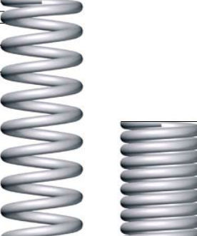
ATP, adenosine triphosphate, powers nearly all forms of cellular work
adenosine
a triphosphate tail of three phosphate groups
Phosphate group
- - -
P
P
P
Adenosine
Triphosphate
Notes:
22

Slide 23
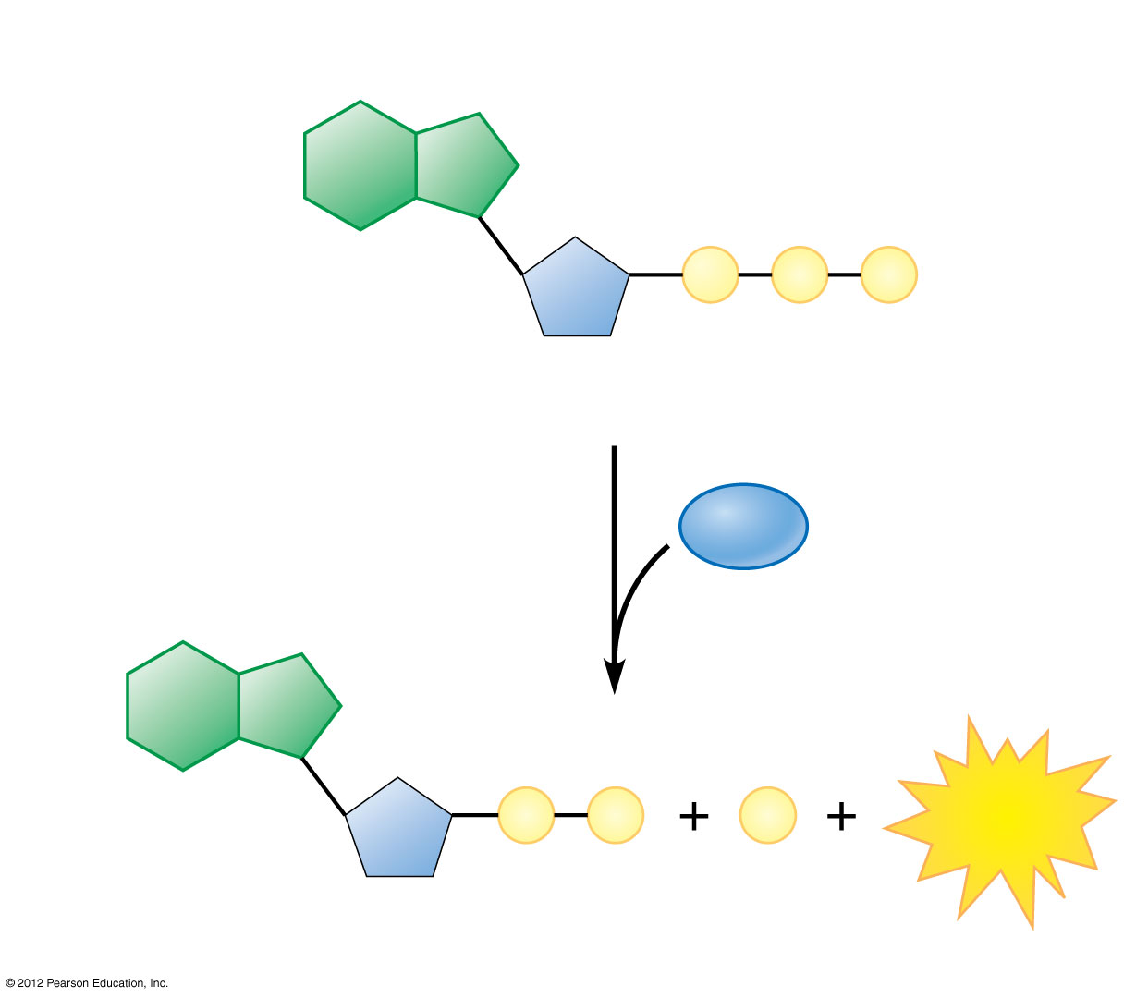
ATP:
Adenosine
Triphosphate
P
P
P
Hydrolysis
H₂O
P
P
P
Energy
ADP:
Adenosine
Diphosphate
Notes:
23

Slide 24
ATP:
Adenosine
Triphosphate
P
P
P
Hydrolysis
H₂O
reactant
P
P
P
P
Energy
ADP:
Adenosine
Diphosphate
Notes:
24

Slide 25
ATP:
Adenosine
Triphosphate
P
P
P
Phosphorylation: The transfer of phosphate group to another molecule
Hydrolysis
H₂O
reactant
P
P
P
P
Energy
ADP:
Adenosine
Diphosphate
Notes:
25
In what way does the second law of thermodynamics apply to this example? (There is some heat produced as a result of the inefficiencies of the chemical reaction)

Slide 26
Cells couple endergonic and exergonic reactions
Cells use a special molecule that can:
Store Energy for short time
Deliver Energy
ATP
Energy from
cellular respiration
Energy for
cellular work
ADP
+
P

Slide 27
Which of the following is not a characteristic of ATP?
It is formed by attaching a phosphate group to ADP with a high-energy bond.
It has more potential energy than ADP.
It is a good long-term energy storage molecule.
D. When a phosphate group is removed, ATP becomes ADP.
Notes:
Answer: C

Slide 28
Which of the following is not a characteristic of ATP?
It is formed by attaching a phosphate group to ADP with a high-energy bond.
It has more potential energy than ADP.
It is a good long-term energy storage molecule.
D. When a phosphate group is removed, ATP becomes ADP.
Notes:
Answer: C

Slide 29
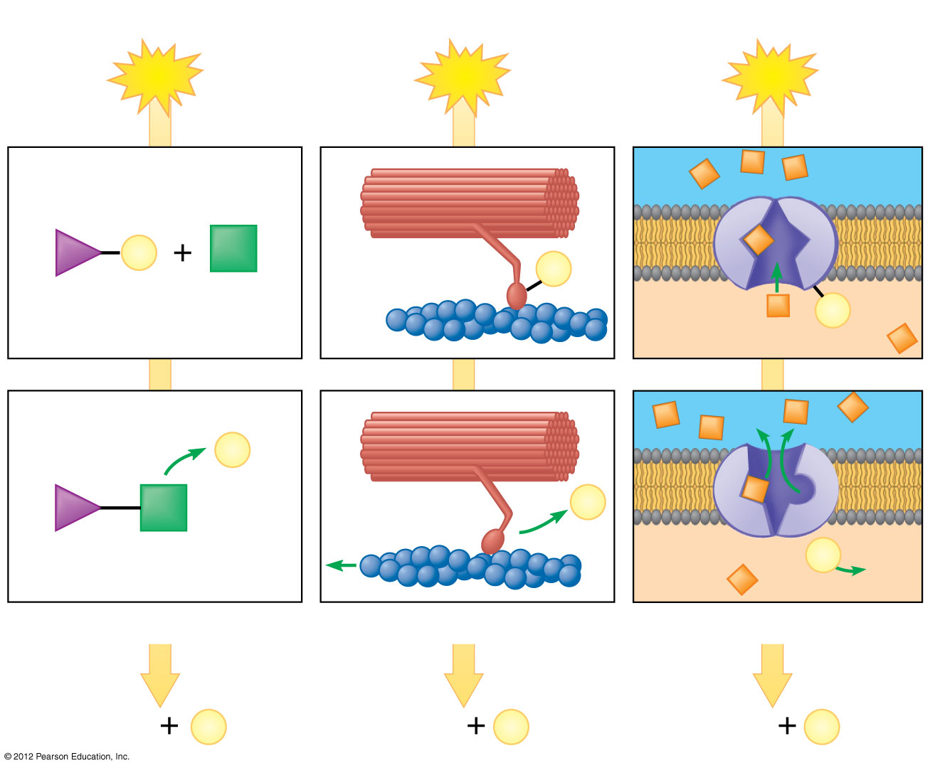
ATP drives cellular work by coupling exergonic and endergonic reactions
There are three main types of cellular work:
Chemical work
Mechanical work
Transport work
ATP
ATP
ATP
Solute
P
Motor protein
P
Reactants
P
Membrane protein
P
P
Product
P
Molecule formed
Protein filament moved
Solute transported
ADP
P
ADP
P
ADP
P
Notes:
29

Slide 30
ATP can be used as the cell's energy exchange mechanism because
endergonic reactions can be fueled by coupling them with the synthesis of ATP from ADP.
endergonic reactions can be fueled by coupling them with the hydrolysis of high-energy phosphate bonds in ATP.
C) ATP is a disposable form of chemical energy, used once and then discarded by the cell.
Answer in Socrative
Discuss your answer with your neighbors
Notes:
M

Slide 31
ATP can be used as the cell's energy exchange mechanism because
endergonic reactions can be fueled by coupling them with the synthesis of ATP from ADP.
endergonic reactions can be fueled by coupling them with the hydrolysis of high-energy phosphate bonds in ATP.
C) ATP is a disposable form of chemical energy, used once and then discarded by the cell.
Notes:
M

Slide 32
How Enzymes Function
Enzymes speed up metabolic reactions by lowering energy barriers
Enzymes are biological catalysts.
They speed up a chemical reaction without being consumed by the reaction.
Most of the enzymes are proteins.
Notes:
32

Slide 33
Hydrolysis of sucrose by the enzyme sucrase is an example of an enzyme-catalyzed reaction
ENZYME
Sucrase
Sucrose
(C₁₂H₂₂O₁₁)
Glucose
(C₆H₁₂O₆)
Fructose
(C₆H₁₂O₆)
REACTANT (SUBSTRATE)
PRODUCTS

Slide 34
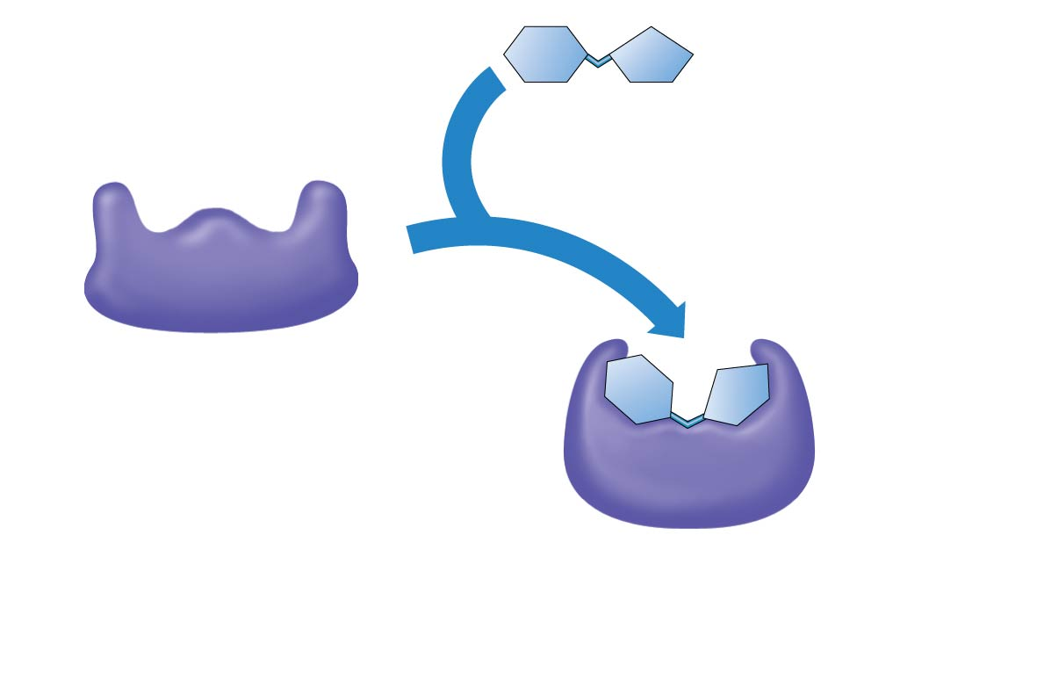
An enzyme’s substrate fits specifically in its active site
1
The enzyme is available
with an empty active site
Active site
Substrate
(sucrose)
2
The substrate
enters the active
site, which enfolds
the substrate with
an induced fit
Enzyme
(sucrase)
Notes:
Figure 5.14_2 The catalytic cycle of an enzyme (step 2)

Slide 35
The catalytic cycle of an enzyme
Active site:
A pocket on the enzyme surface that the substrate fits into
Substrate: a specific reactant that an enzyme acts on
Induced fit: The way the active site changes shape to "embrace" the substrate

Slide 36
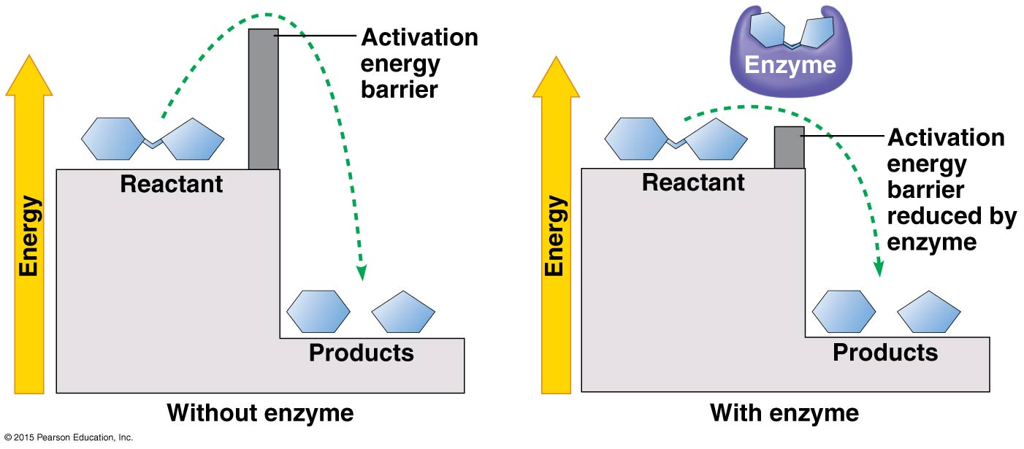
How do enzymes speed up reactions?
Enzymes decrease the activation energy needed to begin a reaction.

Slide 37
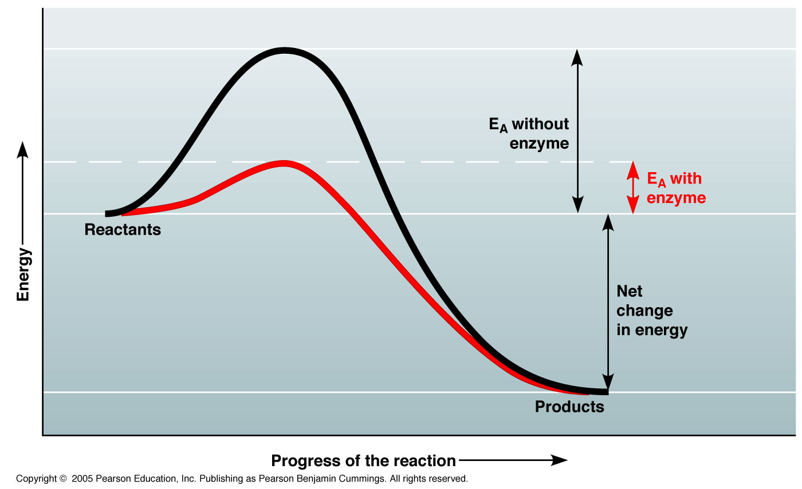
Enzymes decrease the activation energy (E_{A}) needed to begin a reaction

Slide 38
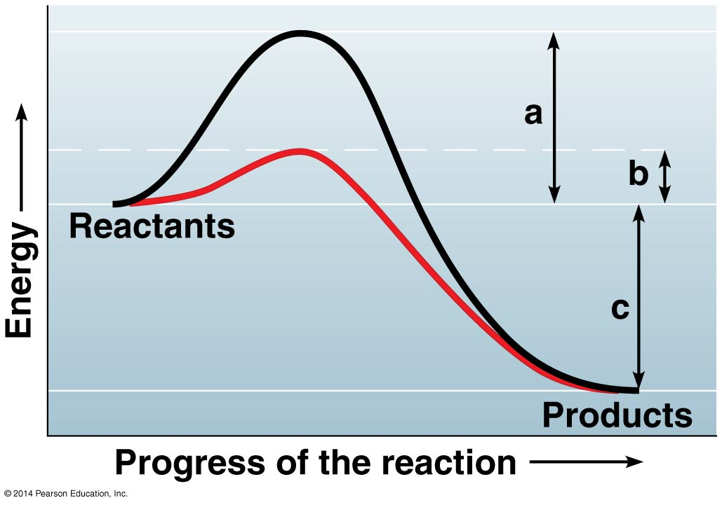
0
Is this reaction endergonic or exergonic?
Notes:
38
Answer: b

Slide 39
0
Which of the following represents the energy of activation that is modified by an enzyme?
(without modification)
a
b
c
Notes:
39
Answer: a

Slide 40
0
Which of the following represents the energy of activation that is modified by an enzyme?
(without modification)
a
b
c
Notes:
40
Answer: a

Slide 41
Enzymes catalyze the many reactions in a cell. There are hundreds of different enzymes in a cell—each with a unique three-dimensional shape. Why do cells have so many different enzymes?
Each enzyme molecule can only be used once.
The shape of an enzyme’s active site generally fits a specific substrate.
The substrate molecules react with enzymes to create new enzymes.
Enzymes are randomly produced. With thousands of different shapes—one is likely to work.
Notes:
41

Slide 42
Enzymes catalyze the many reactions in a cell. There are hundreds of different enzymes in a cell—each with a unique three-dimensional shape. Why do cells have so many different enzymes?
Each enzyme molecule can only be used once.
The shape of an enzyme’s active site generally fits a specific substrate.
The substrate molecules react with enzymes to create new enzymes.
Enzymes are randomly produced. With thousands of different shapes—one is likely to work.
Notes:
42

Slide 43
ATP drives cellular work by coupling exergonic and endergonic reactions
1 2
3 4
ATP synthesis
requires energy
ATP
ATP hydrolysis
releases energy
Energy from
cellular respiration
Energy for
cellular work
ADP
+
P
Determine what parts of the cycle refer to endergonic/exergonic reactions.
Notes:
Figure 5.12c The ATP cycle

Slide 44
ATP drives cellular work by coupling exergonic and endergonic reactions
Endergonic Exergonic
Endergonic Endergonic
ATP synthesis
requires energy
ATP
ATP hydrolysis
releases energy
Energy from
cellular respiration
Energy for
cellular work
ADP
+
P
Determine what parts of the cycle refer to endergonic/exergonic reactions.
Notes:
Figure 5.12c The ATP cycle

Slide 45
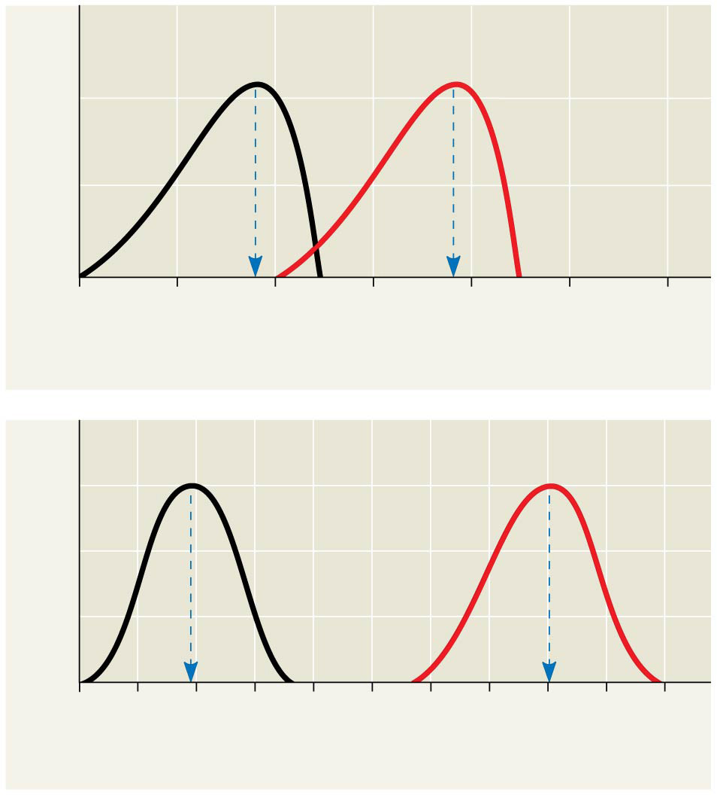
Optimal temperature for
typical human enzyme
(37°C)
Optimal temperature for
enzyme of thermophilic
(heat-tolerant)
bacteria (77°C)
Enzymes work best at their optimal conditions
Rate of reaction
0
20
40
60
80
100
120
Temperature (°C)
(a) Optimal temperature for two enzymes
Optimal pH for pepsin
(stomach
enzyme)
Optimal pH for trypsin
(intestinal
enzyme)
Rate of reaction
0
1
2
3
4
5
6
7
8
9
10
pH
(b) Optimal pH for two enzymes
Notes:
Environmental factors affecting enzyme activity

Slide 46
Q:
How does the second law of thermodynamics explain the diffusion of a solute ?
You can find the answer in the textbook

