Slide 1
Cellular Respiration and Fermentation
Organisms harvest energy from food molecules. In what form is that energy available to power cell work?
heat and light
glucose molecules
fat molecules
ATP molecules
Notes:
1

Slide 2
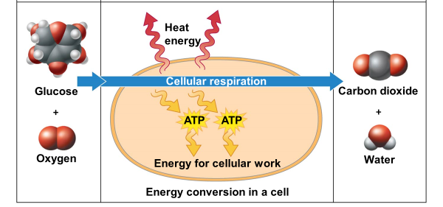
Cellular Respiration and Fermentation
Notes:
2

Slide 3
1. Is Cellular respiration an exergonic or endergonic reaction (Overall reaction)? 2. Which has more energy: the reactants or the products? 3. Is the reaction catabolic or anabolic?
Summary Reaction of Cellular Respiration
C₆H₁₂O₆
6
O₂
6
CO₂
6
H₂O
Energy
Glucose
Oxygen
Carbon dioxide
Water
The efficiency of respiration is = ~34%
The rest of the energy is released as heat.
Notes:
3

Slide 4
How do cells extract energy during cellular respiration?
C₆H₁₂O₆
6
O₂
6
CO₂
6
H₂O
energy
Glucose
Oxygen
Carbon dioxide
Water
Atoms, and electrons in chemical bonds are rearranged and energy is released
Electrons are transferred from glucose to oxygen
Notes:
4
M

Slide 5
Cellular Respiration is a reduction-oxidation(=redox) reaction
Loss of electrons
(becomes oxidized)
e-
e-
+ + + energy
C₆H₁₂O₆
6 O₂
C₆H₁₂O₆
Gain of electrons
(becomes reduced)
OIL RIG
Notes:
Figure 6.5a Movement of hydrogen atoms (with their electrons) in the redox reactions of cellular respiration

Slide 6
Redox Reaction

Slide 7
Which statement correctly describes redox reactions?
Reduction does not occur without oxidation.
A molecule is reduced if it gains electrons.
Oxidation may involve the loss of H⁺ ions in addition to the loss of electrons.
All of these describe redox reactions

Slide 8
Which statement correctly describes redox reactions?
Reduction does not occur without oxidation.
A molecule is reduced if it gains electrons.
Oxidation may involve the loss of H⁺ ions in addition to the loss of electrons.
All of these describe redox reactions

Slide 9
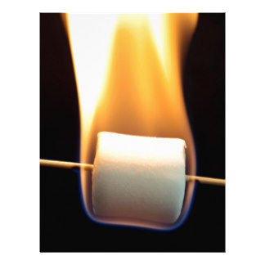
Burning of sugar is a redox reaction
Loss of hydrogen atoms
(becomes oxidized)
C₆H₁₂O₆
+
6 O₂
6 CO₂ + 6 H₂O + energy
(Glucose)
Gain of hydrogen atoms
(becomes reduced)
Notes:
Figure 6.5a Movement of hydrogen atoms (with their electrons) in the redox reactions of cellular respiration

Slide 10
Practice:
C₆H₁₂O₆ + 6 O₂ 6 CO₂ + 6 H₂O + ATP + Heat
Write down the summary reaction of cellular respiration.
Circle the reactant that is being oxidized.
Draw a line under the reactant that is being reduced.
Indicate the types of energy (potential/kinetic) released by the reaction.

Slide 11
2 C₃H₄O₃ 2 C₂H₆O + 2 CO₂
C₃H₄O₃ in this reaction is being:
a. Oxidized
b. Reduced
C₄H₆O₄ + FAD C₄H₄O₄ + FADH₂
FAD in this reaction is being:
a. Oxidized
b. Reduced
C₄H₆O₄ in this reaction is being:
a. Oxidized
b. Reduced

Slide 12
In cellular respiration energy is released in small amounts and harvested in a step-wise manner
Loss of hydrogen atoms
(becomes oxidized)
C₆H₁₂O₆
+
6 O₂
6 CO₂ + 6 H₂O + ATP + heat
(Glucose)
Gain of hydrogen atoms
(becomes reduced)
Notes:
Direct burning vs stepwise oxidation

Slide 13
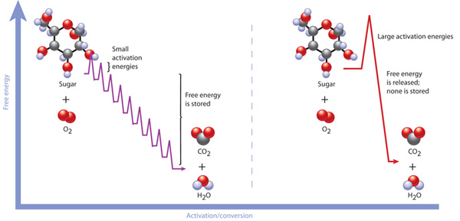
In cellular respiration energy is released in small amounts and harvested in a step-wise manner
© 2010 Nature Education
Cellular Respiration
Notes:
Which one represent direct /controlled and stepwise

Slide 14
Electrons removed from fuel molecules are transferred to Electron Carriers
Electron acceptors:
FAD and NAD⁺
Electron donors:
FADH₂ and NADH
NAD⁺
NADH
FAD
FADH₂
NADH: Nicotinamide adenine dinucleotide
FADH₂: Flavin adenine dinucleotide

Slide 15
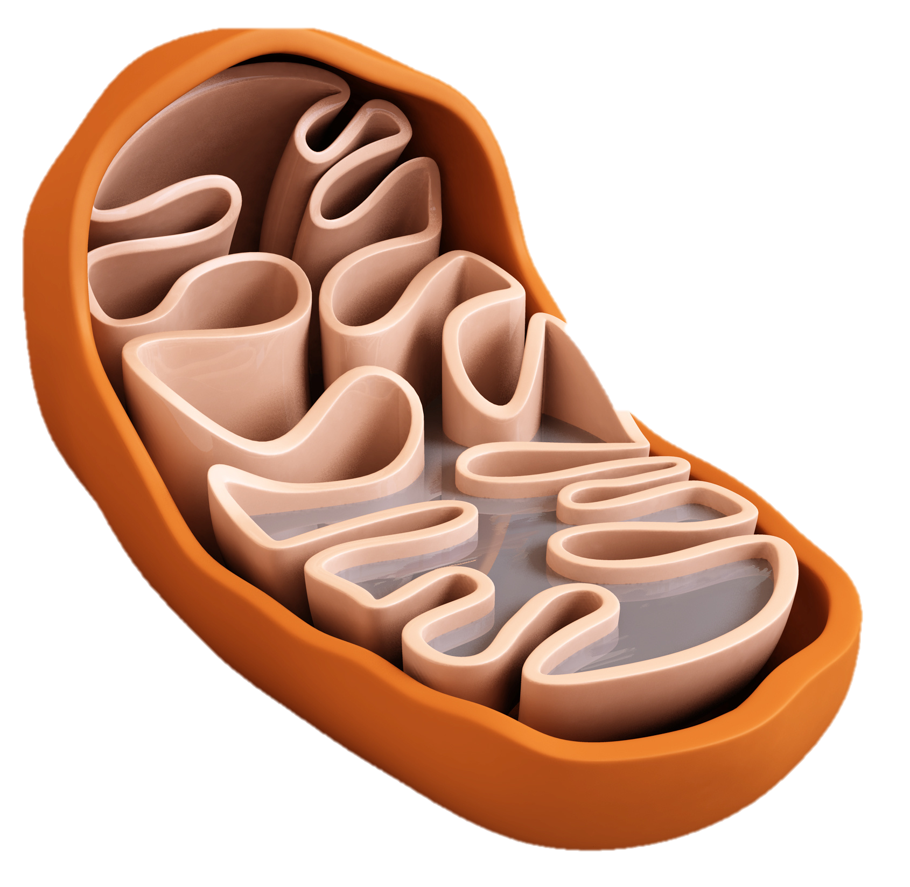
Cellular Respiration: three Stages
C₆H₁₂O₆
6
O₂
6
CO₂
6
H₂O
ATP
Glucose
Oxygen
Carbon dioxide
Water
In the cytosol:
Glycolysis
In the Mitochondrion:
Citric Acid Cycle
Electron transport system

Slide 16
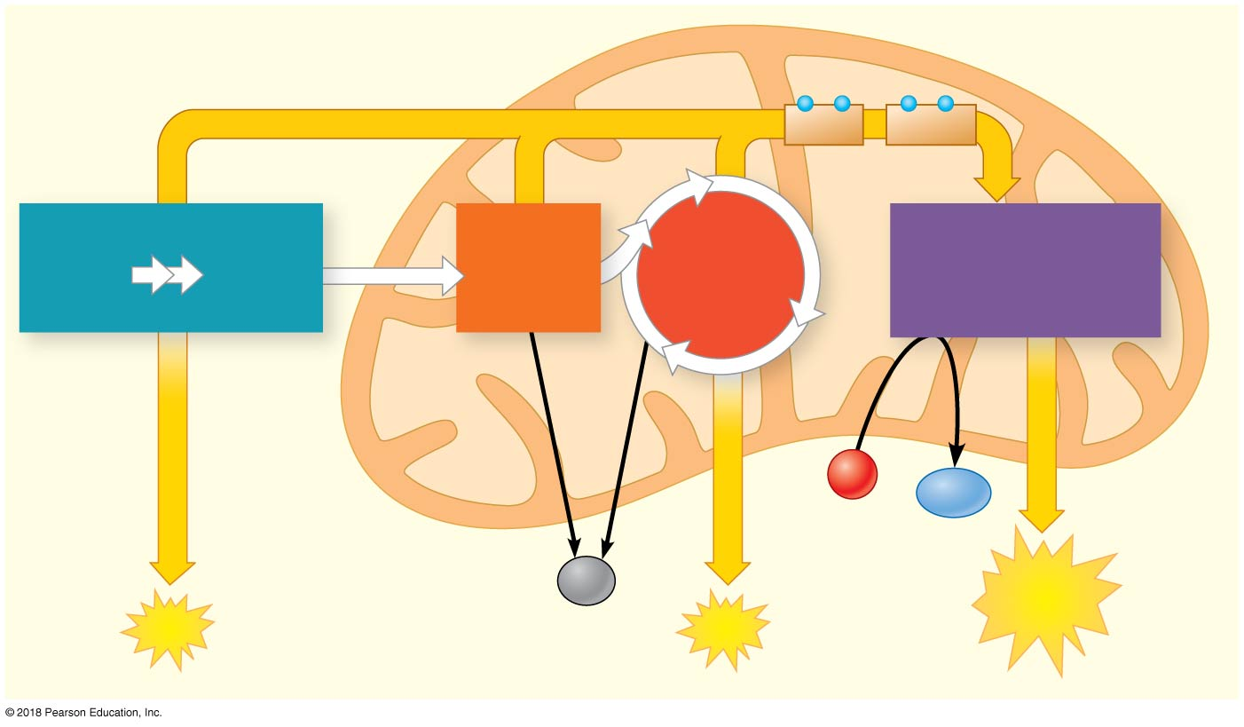
Cellular Respiration: three Stages
Glycolysis
Citric Acid Cycle
Electron transport and chemiosmosis
MITOCHONDRION
CYTOSOL
−
−
+
−
−
Electrons carried by
NADH
FADH₂
Stage 1
Stage 2
Stage 3
Glycolysis
Oxidative
Phosphorylation
(electron transport
and chemiosmosis)
Glucose
Pyruvate
Pyruvate
Oxidation
Citric Acid
Cycle
O₂
H₂O
CO₂
ATP
ATP
ATP

Slide 17
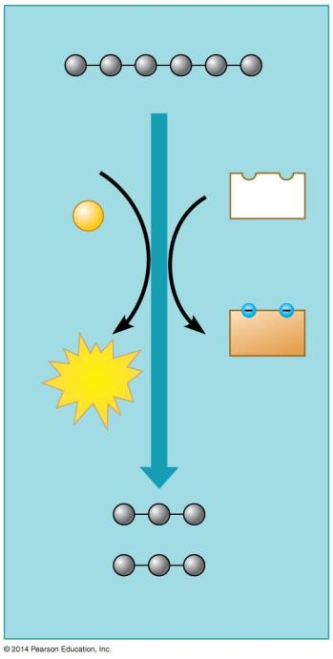
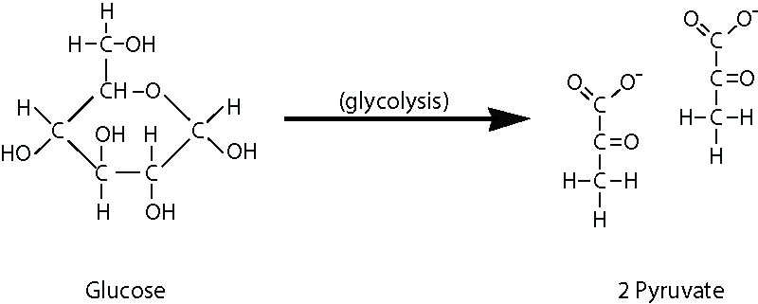
1) Glycolysis: harvest of chemical energy by oxidizing glucose to pyruvate
Glucose
2 ADP
2
NAD⁺
+2
P
2
NADH
2
ATP
+2 H⁺
2 Pyruvate
Notes:
M It costs 2 ATPs to generate 4 ATPs during glycolysis, leaving a net gain of two ATPs.

Slide 18
The first stage of Glycolysis is an energy investment stage
Notes:
M

Slide 19
The second stage of Glycolysis is an energy payoff stage
Figure 6.7
Notes:
M

Slide 20
Substrate Phosphorylation
Phosphate for ATP production comes from a phosphorylated substrate or compound.
Notes:
While matter is being rearranged, phosphate group are also being transffered from a substrate to ADP, producing ATP
: transfer of a phosphate group from a substrate to ADP, producing ATP
P) phosphoglycerate kinase and pyruvate kinase.,
PO4 group for the synthesis of

Slide 21
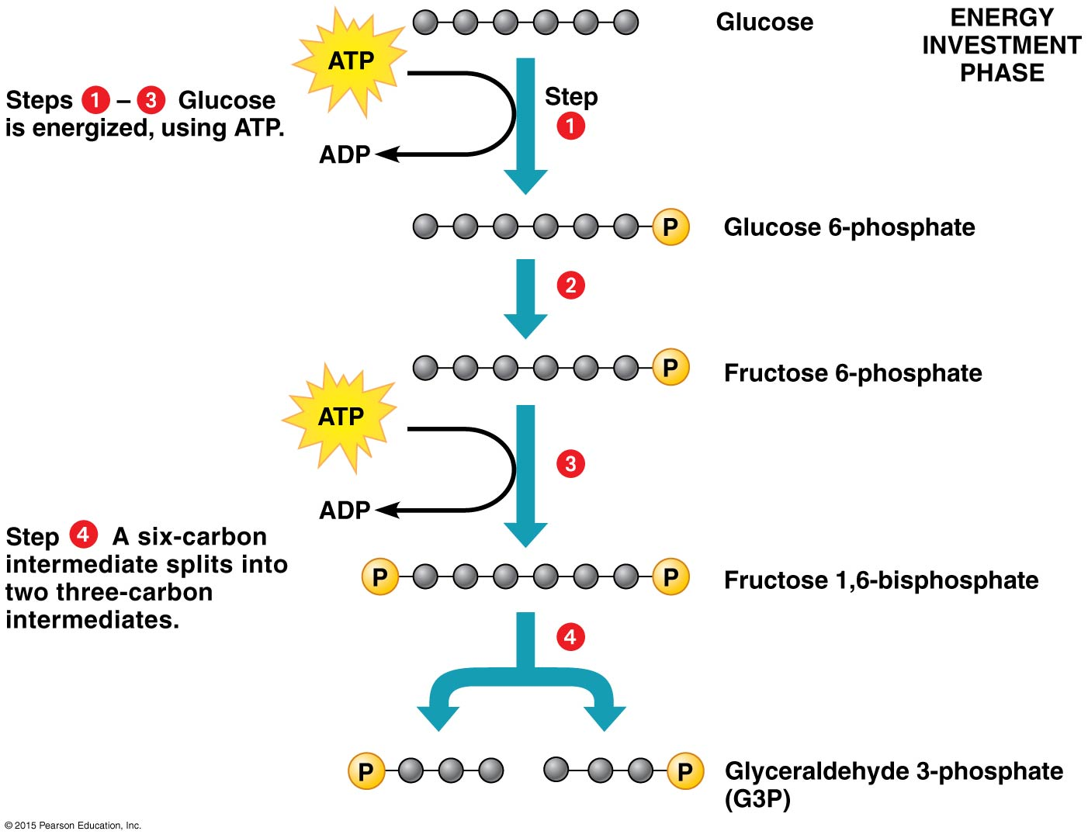
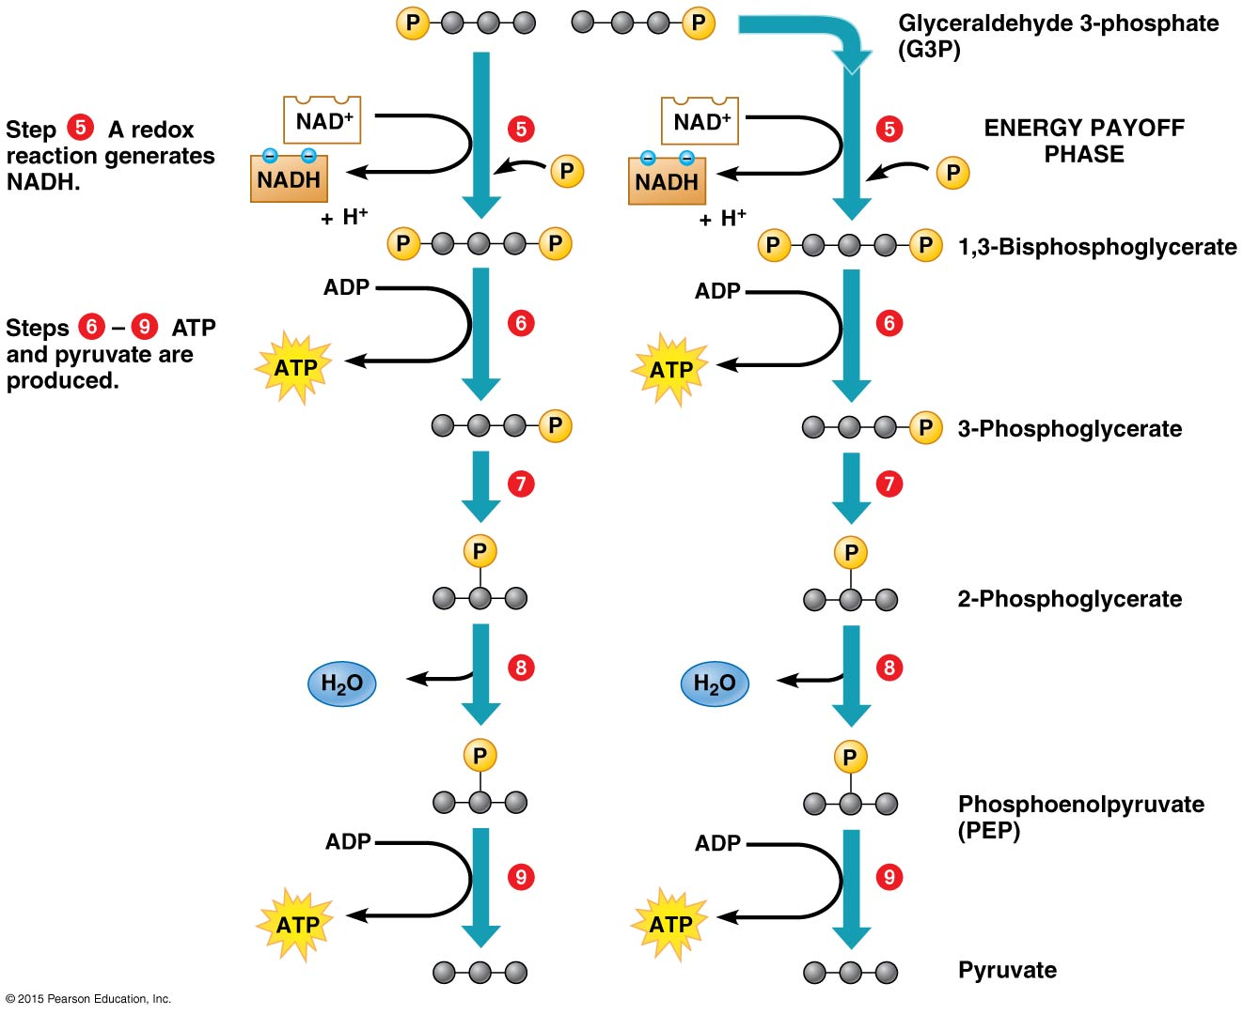
1) Glycolysis
Reactants | Products
Glucose (C₆)
2 NAD⁺
(2 ATP)
(4 ADP)
Net: 2 ADP
Notes:
c3h4o3

Slide 22
1) Glycolysis
Reactants | Products
Glucose (C₆) | 2 Pyruvates (2C₃)
2 NAD⁺ | 2 NADH+H⁺
(2 ATP) | (2 ADP)
(4 ADP) | (4 ATP)
Net: 2 ADP | Net: 2 ATP

Slide 23
1) Glycolysis: harvest of chemical energy by oxidizing glucose to pyruvate
Glucose
2 ADP
2
NAD⁺
+2
P
Reactants | Products
Glucose (C₆) | 2 Pyruvates (2C₃)
2 NAD⁺ | 2 NADH+H⁺
(2 ATP) | (2 ADP)
(4 ADP) | (4 ATP)
Net: 2 ADP | Net: 2 ATP
2
NADH
2
ATP
+2 H⁺
2 Pyruvate
Notes:
M It costs 2 ATPs to generate 4 ATPs during glycolysis, leaving a net gain of two ATPs.

Slide 24
Which does NOT describe glycolysis?
A. It is used to make ATP.
B. Two three-carbon compounds are produced from each glucose.
C. It requires O₂.
D. It is used by prokaryotic cells.

Slide 25
Which does NOT describe glycolysis?
A. It is used to make ATP.
B. Two three-carbon compounds are produced from each glucose.
C. It requires O₂.
D. It is used by prokaryotic cells.
Notes:
P/M

Slide 26
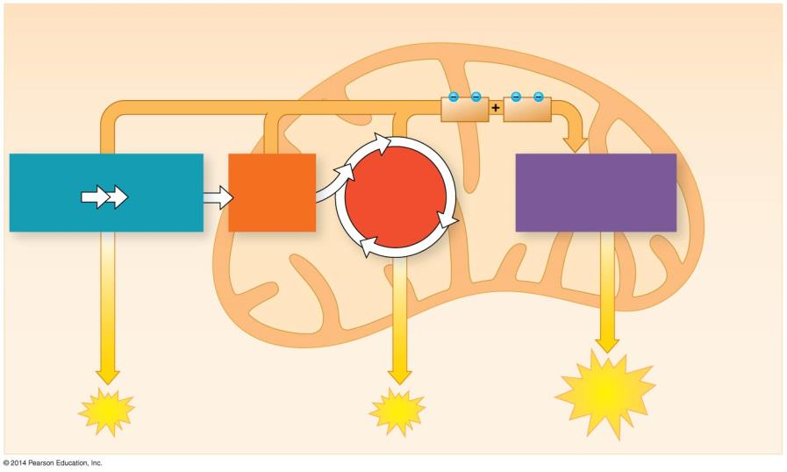
Cellular Respiration Transition step: Pyruvate grooming to Acetyl CoA
Which does NOT describe glycolysis?
A. It is used to make ATP.
B. Two three-carbon compounds are produced from each glucose.
C. It requires O₂.
D. It is used by prokaryotic cells.
Electrons carried by
NADH
FADH₂
Glycolysis
Oxidative Phosphorylation (Electron transport and chemiosmosis)
Glucose
Pyruvate
Pyruvate Oxidation
Citric Acid Cycle
CYTOSOL
MITOCHONDRION
O₂
H₂O
Substrate-level phosphorylation
Substrate-level phosphorylation
ATP
Oxidative phosphorylation
ATP
ATP

Slide 27
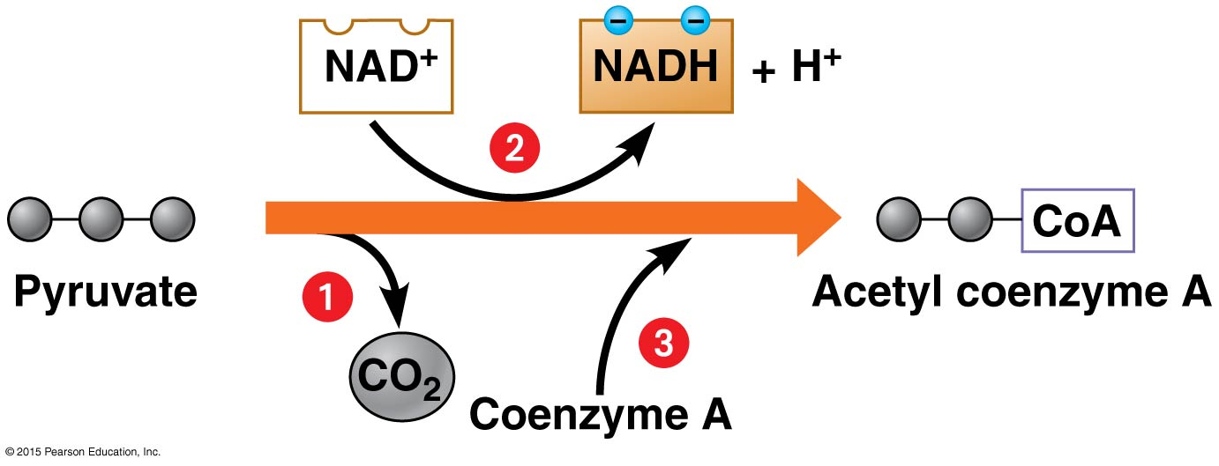
Transition step: Pyruvate grooming to Acetyl CoA
In mitochondria, before the citric acid cycle

Slide 28
Cellular Respiration: three Stages
Glycolysis
Citric Acid Cycle
Electron transport and chemiosmosis
Electrons carried by
NADH
FADH₂
Glycolysis
Oxidative Phosphorylation (Electron transport and chemiosmosis)
Glucose
Pyruvate
Pyruvate Oxidation
Citric Acid Cycle
CYTOSOL
MITOCHONDRION
O₂
H₂O
Substrate-level phosphorylation
Substrate-level phosphorylation
ATP
Oxidative phosphorylation
ATP
ATP

Slide 29
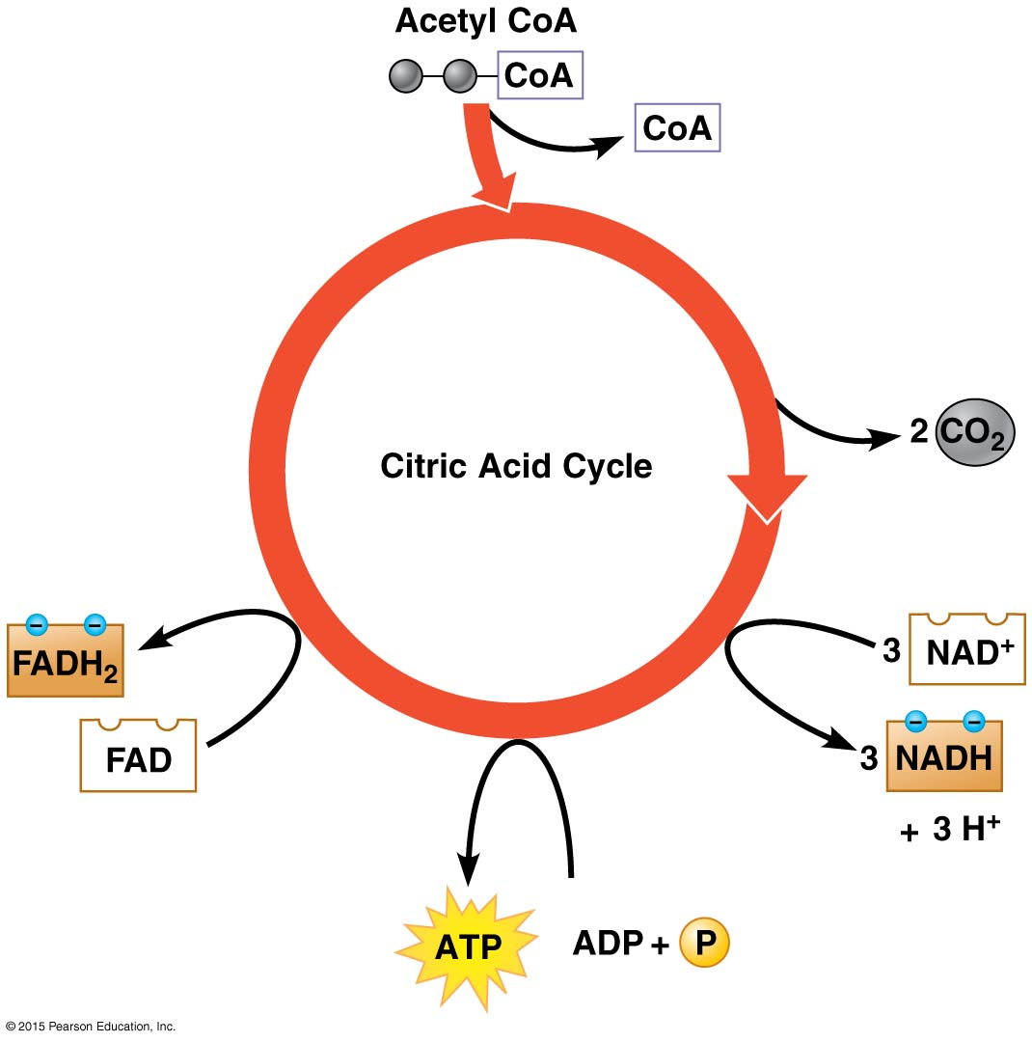
2) Citric Acid Cycle: The citric acid cycle completes the oxidation of organic molecules, generating many NADH and FADH₂ molecules
Acetyl-CoA is oxidized to 2CO₂
Products:
3NADH,
1 FADH₂,
2CO₂,
and 1 ATP per 1 Acetyl-CoA
Notes:
activity

Slide 30
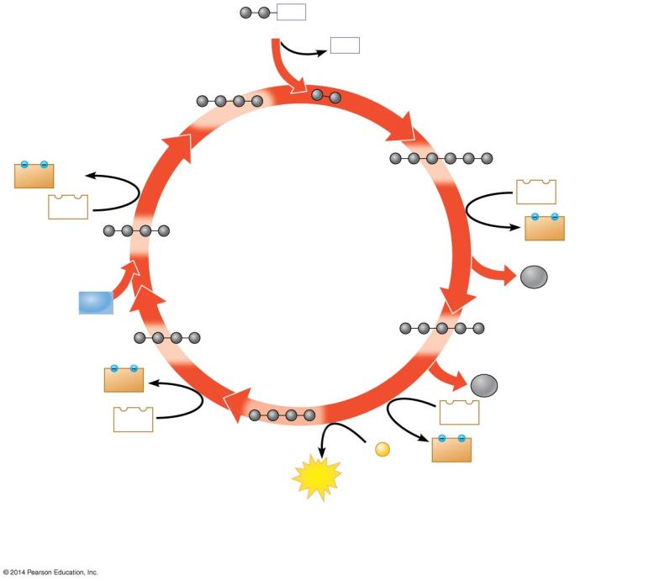
CoA
Acetyl CoA
2) Citric Acid Cycle
CoA
2 carbons enter cycle
Oxaloacetate
1
NADH
+ H⁺
Citrate
6
NAD⁺
NAD⁺
2
NADH
+ H⁺
Malate
Citric Acid Cycle
CO₂
H₂O
leaves cycle
5
Fumarate
Alpha-ketoglutarate
FADH₂
4
CO₂
leaves cycle
3
NAD⁺
FAD
Succinate
ADP +
P
NADH
+ H⁺
ATP
1
2
Step
Acetyl CoA stokes the furnace.
Steps –
NADH, ATP, and CO₂ are generated during redox reactions.
Steps –
Further redox reactions
generate FADH₂ and more NADH.
3
4
6
Notes:
Figure 6.9b-3 A closer look at the citric acid cycle (step 3)

Slide 31
Cellular Respiration: three Stages
Glycolysis
Citric Acid Cycle
Electron transport and chemiosmosis
Electrons carried by
NADH
FADH₂
Glycolysis
Oxidative Phosphorylation (Electron transport and chemiosmosis)
Glucose
Pyruvate
Pyruvate Oxidation
Citric Acid Cycle
CYTOSOL
MITOCHONDRION
O₂
H₂O
Substrate-level phosphorylation
Substrate-level phosphorylation
ATP
Oxidative phosphorylation
ATP
ATP

Slide 32
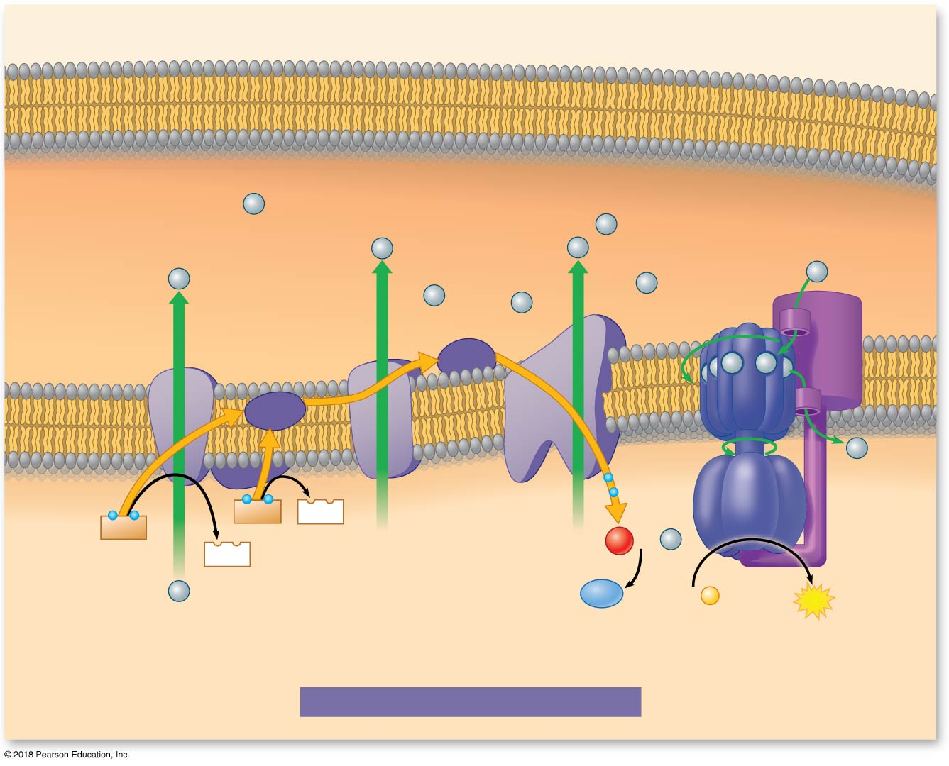
CYTOSOL
Outer mitochondrial membrane
INTERMEMBRANE
SPACE
H⁺
H⁺
H⁺
H⁺
ATP
synthase
H⁺
H⁺
H⁺
H⁺
H⁺
Rotor
Inner
mitochondrial
membrane
Cyt c
IV
H⁺
H⁺
I
III
Q
Internal
rod
H⁺
Electron
flow
II
–
–
–
–
–
–
FADH₂
FAD
NADH
1
O₂
+ 2
H⁺
NAD⁺
2
H⁺
H₂O
ADP + P
ATP
Electron Transport Chain
Chemiosmosis
MITOCHONDRIAL
MATRIX
OXIDATIVE PHOSPHORYLATION
Notes:
Figure 6.9_1 Most ATP production occurs by oxidative phosphorylation (part 1: enlarged)

Slide 33
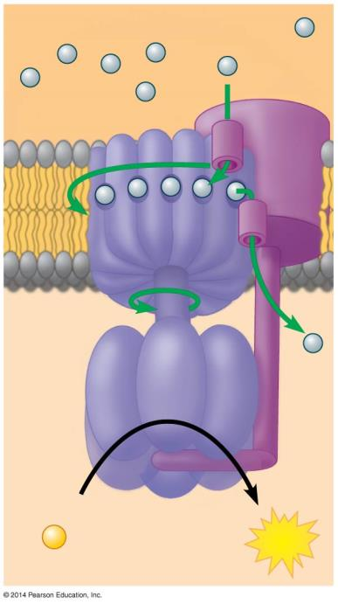
INTERMEMBRANE SPACE
Chemiosmosis:
H⁺
Rotor
H⁺ diffuses back across the inner membrane, through ATP synthase complexes, driving the synthesis of ATP.
Internal rod
Catalytic knob
ADP
+
ATP synthase –
a molecular rotary motor
P
ATP
MITOCHONDRIAL MATRIX

Slide 34
During cellular respiration, NADH
A) is chemically converted into ATP.
B) is reduced to form NAD+.
C) delivers its electron load to the first electron carrier molecule.
D) is the final electron acceptor.

Slide 35
During cellular respiration, NADH
A) is chemically converted into ATP.
B) is reduced to form NAD+.
C) delivers its electron load to the first electron carrier molecule.
D) is the final electron acceptor.

Slide 36
3) Electron Transport and Chemiosmosis
Go to the link listed below and watch the Video
Follow NADH and FADH₂
Follow the electrons
3. Follow the protons
http://web.biosci.utexas.edu/psaxena/MicrobiologyAnimations/Animations/ElectronTransport/PLAY_etc.html
Notes:
M

Slide 38
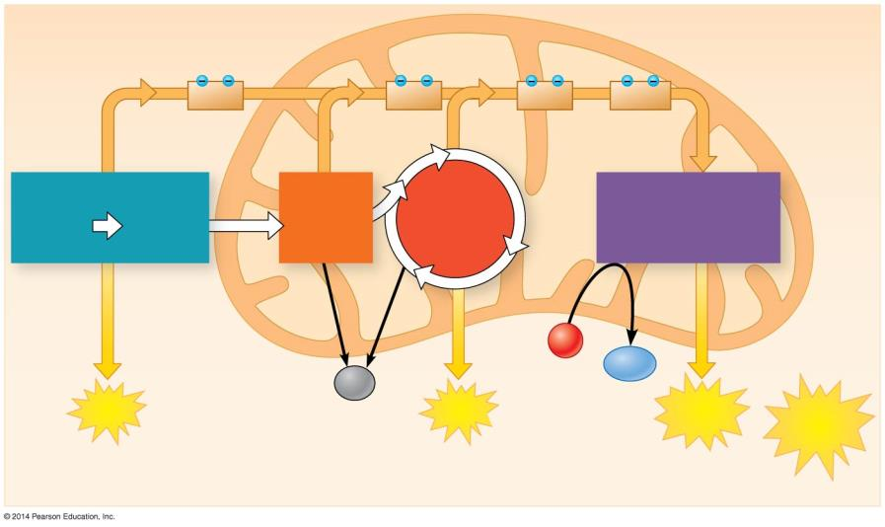
CYTOSOL
MITOCHONDRION
2
NADH
2
NADH
6
NADH
+ 2
FADH₂
Glycolysis
Pyruvate Oxidation 2 Acetyl CoA
Oxidative Phosphorylation (electron transport and chemiosmosis)
2 Pyruvate
Citric Acid Cycle
Glucose
O₂
Maximum per glucose:
H₂O
CO₂
+ 2
ATP
+ 2
ATP
+ about 28 ATP
About 32 ATP
by substrate-level phosphorylation
by substrate-level phosphorylation
by oxidative phosphorylation
Notes:
M

Slide 39
The largest net energy yield of ATP comes specifically from
Glycolysis: the breakdown of 6-carbon glucose into 2 molecules of 3-carbon pyruvate.
The citric acid Cycle: the movement of electrons to carrier complexes (NADH, FADH2).
The Electron Transport Chain: the transfer of electrons through transport proteins in the mitochondrial membrane.
Chemiosmosis: the spontaneous flow of protons into the mitochondrial matrix through protein complexes into the mitochondrial membrane.

Slide 40
The largest net energy yield of ATP comes specifically from
Glycolysis: the breakdown of 6-carbon glucose into 2 molecules of 3-carbon pyruvate.
The citric acid Cycle: the movement of electrons to carrier complexes (NADH, FADH2).
The Electron Transport Chain: the transfer of electrons through transport proteins in the mitochondrial membrane.
Chemiosmosis: the spontaneous flow of protons into the mitochondrial matrix through protein complexes into the mitochondrial membrane.

Slide 41
NADH pills can be purchased over the counter and are often taken by sufferers of chronic fatigue syndrome (CFS). What is the hypothesis about how these pills might benefit a CFS patient?
A) They would increase energy by creating more FADH2.
B) They would decrease the rate of glycolysis.
C) They would increase the number of electrons provided to the electron transport chain.
D) They would decrease the rate of alcoholic fermentation.

Slide 42
NADH pills can be purchased over the counter and are often taken by sufferers of chronic fatigue syndrome (CFS). What is the hypothesis about how these pills might benefit a CFS patient?
A) They would increase energy by creating more FADH2.
B) They would decrease the rate of glycolysis.
C) They would increase the number of electrons provided to the electron transport chain.
D) They would decrease the rate of alcoholic fermentation.

Slide 43
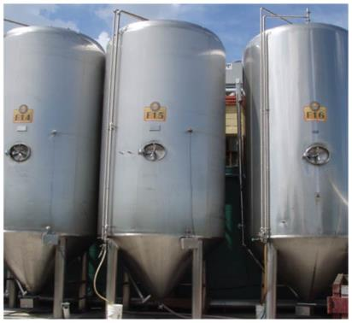
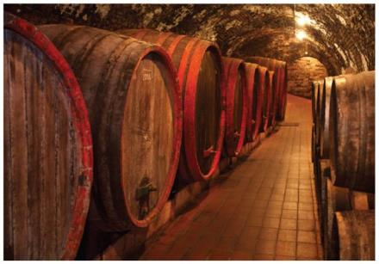
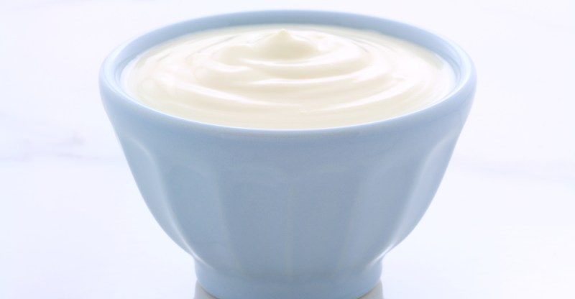
Fermentation: Anaerobic Harvesting of Energy

Slide 44
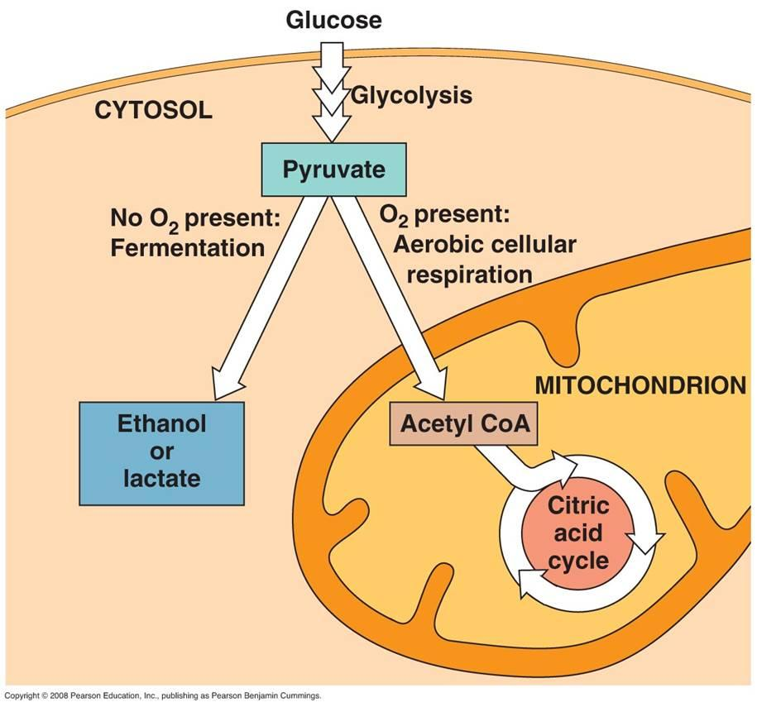
Energy harvesting
Anaerobic (no O₂):
_{-Fermentation}
Aerobic (in the presence of O₂)
_{-Cellular Respiration}
Notes:
The breakdown of organic molecules is exergonic
Fermentation is a partial degradation of sugars that occurs without O₂
Aerobic respiration consumes organic molecules and O₂ and yields ATP
Anaerobic respiration is similar to aerobic respiration but consumes compounds other than O₂

Slide 45
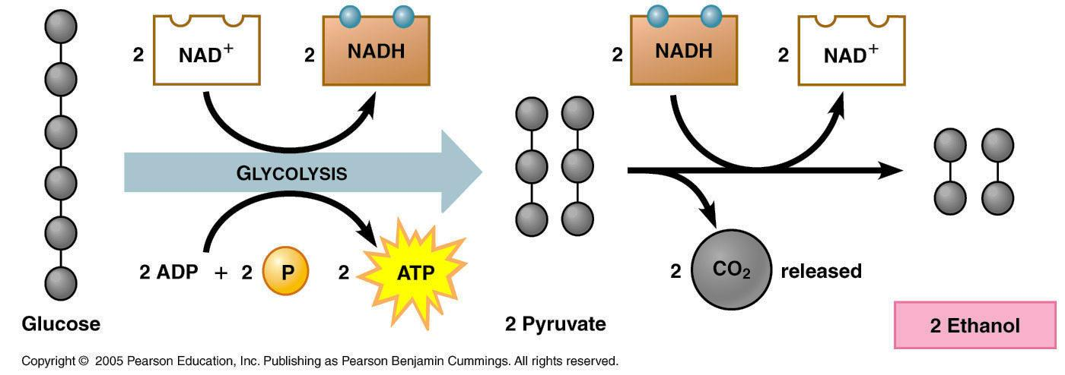
Alcoholic Fermentation
+2 CO₂
C₆H₁₂O₆
2
C₃H₄O₃
2
C₂H₆O
Notes:
M

Slide 46
Lactic acid fermentation
Alcohol fermentation
Glucose
Glucose
2 ADP
2 NAD⁺
2 ADP
Glycolysis
2 NAD⁺
+ 2
P
Glycolysis
+ 2 P
2
ATP
–
–
2
ATP
–
–
2
NADH
2
NADH
2 Pyruvate
2 Pyruvate
–
–
–
–
2 NADH
2 NADH
2 CO₂
2 NAD⁺
2 NAD⁺
2 Lactate
2 Ethanol

Slide 47
Fermentation enables cells to produce ATP without oxygen
Fermentation is a way of harvesting chemical energy that does not require oxygen.
Under anaerobic conditions, muscle cells, yeasts, and certain bacteria produce ATP by glycolysis.
NAD⁺ is recycled from NADH as pyruvate is reduced to
Lactic acid (in lactic acid fermentation) or
alcohol and CO₂ (in alcohol fermentation).
Notes:
47
Student Misconceptions and Concerns
Students may expect that fermentation will produce alcohol and maybe even carbon dioxide. Take the time to clarify the different possible products of fermentation and correct this general misconception. (6.12)
Teaching Tips
The text notes that some microbes are useful in the dairy industry because they produce lactic acid. However, the impact of acids on milk may not be obvious to many students. Consider a simple demonstration mixing about equal portions of milk (skim or 2%) with some acid (vinegar will work). Notice the accumulation of strands of milk curd (protein) on the side of the container and stirring device. (6.12)
Dry wines are produced when the yeast cells use up all or most of the sugar available. Sweet wines result when the alcohol accumulates enough to inhibit fermentation before the sugar is depleted. (6.12)
Exposing fermenting yeast to oxygen will slow or stop the process, because the yeast will switch back to aerobic respiration. When fermentation is rapid, the carbon dioxide produced drives away the oxygen immediately above the wine. However, as fermentation slows down, the wine must be sealed to prevent oxygen exposure and permit the fermentation process to finish. (6.12)

