Slide 1
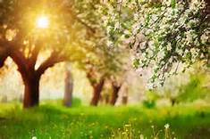
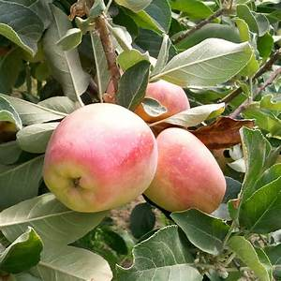
Photosynthesis:
Using Light to Make Food
Notes:
1

Slide 2
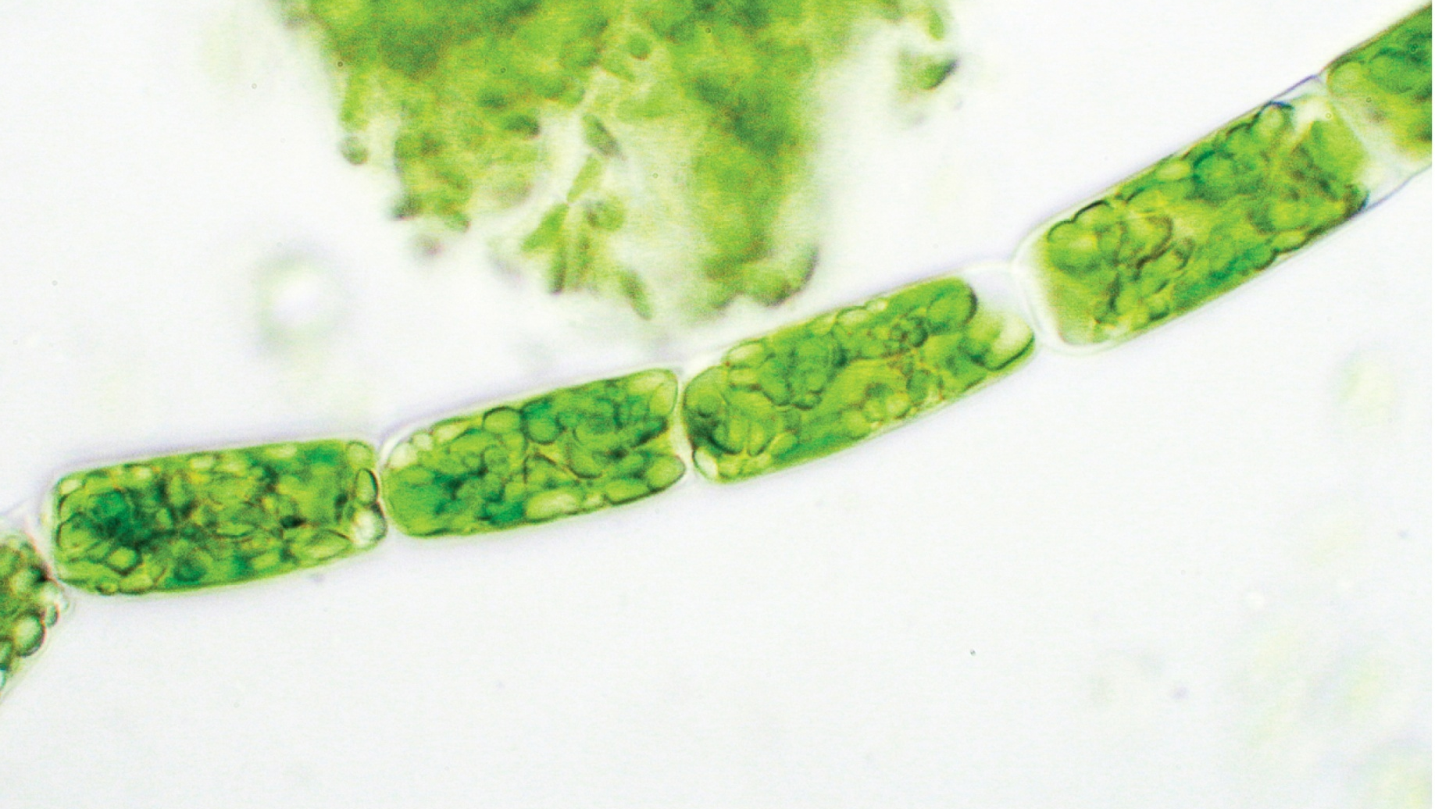
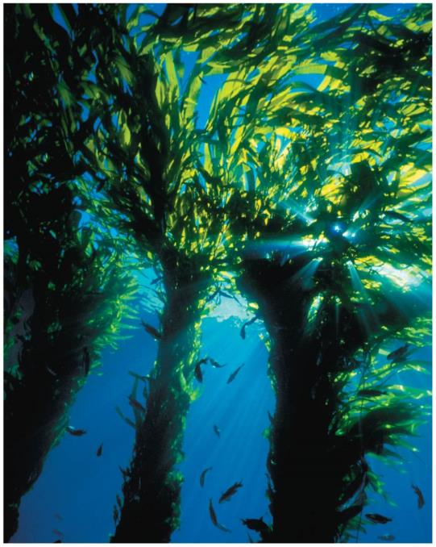
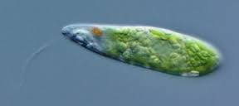
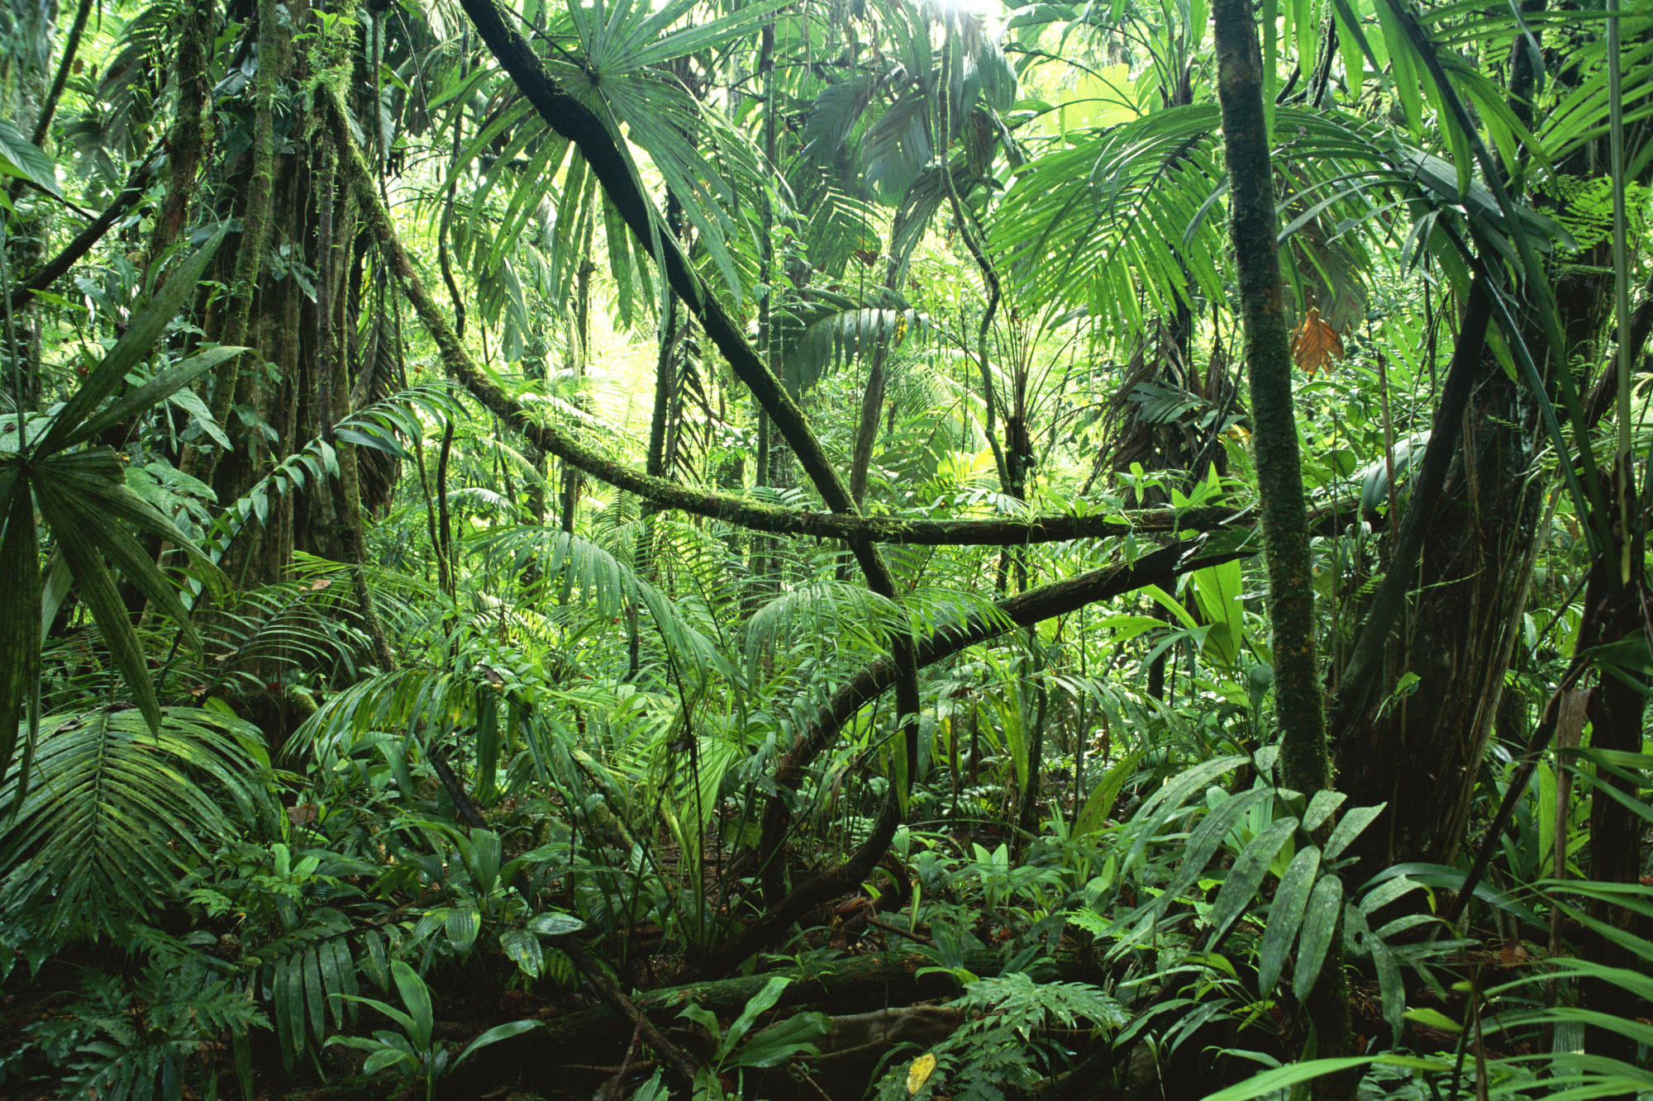
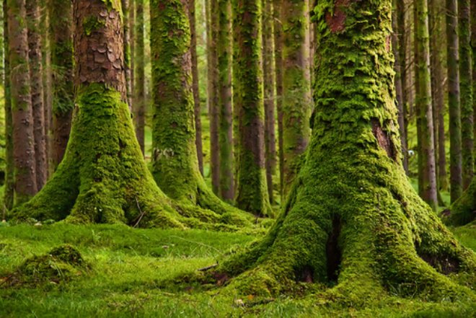
Autotrophs are the producers of the biosphere
Photoautotrophs
Cyanobacteria (Prokaryote)
Phytoplankton (Eukaryote)
Algae (Eukaryote)
Plants (Eukaryote)
Photo – light
Auto – self
Troph - food
Cyanobacteria
Phytoplankton
Algae

Slide 3
Autotrophs are the producers of the biosphere
Photosynthesis
Light
energy
+
6
CO₂
+
6
H₂O
C₆H₁₂O₆
+
6
O₂
Carbon dioxide
Water
Oxygen gas
Glucose
Photoautotrophs use the energy of light to produce organic molecules
Heterotrophs are consumers that feed on plants or animals or decompose organic material
Notes:
3

Slide 4
Photoautotrophs
make sugar by using organic raw materials.
produce organic molecules from inorganic molecules.
eat other organisms that use light energy to make food molecules.
include only the green plants.

Slide 5
Photoautotrophs
make sugar by using organic raw materials.
produce organic molecules from inorganic molecules.
eat other organisms that use light energy to make food molecules.
include only the green plants.

Slide 6
Photosynthesis is a redox reaction
OIL RIG
Cellular Respiration:
Becomes oxidized
EXERGONIC
CATABOLIC
Photosynthesis:
Becomes reduced
Becomes reduced
ENDERGONIC
ANABOLIC
Becomes oxidized
Notes:
6

Slide 7
Plant leaves and roots provide essential components of photosynthesis
light
CO2
Photosynthesis requires three components:
CO₂ – from air
H₂O – from soil
Light energy – from sun
water

Slide 8
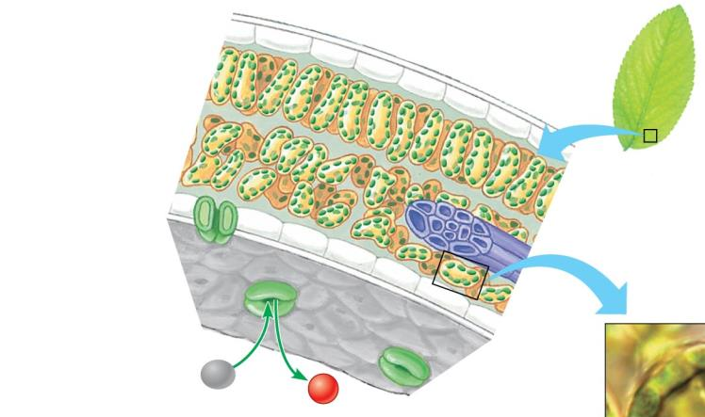
Chloroplasts are the site of photosynthesis
Leaf Cross Section
Leaf
CO₂
O₂
Stoma
Stomata – openings that allow CO₂ in

Slide 9
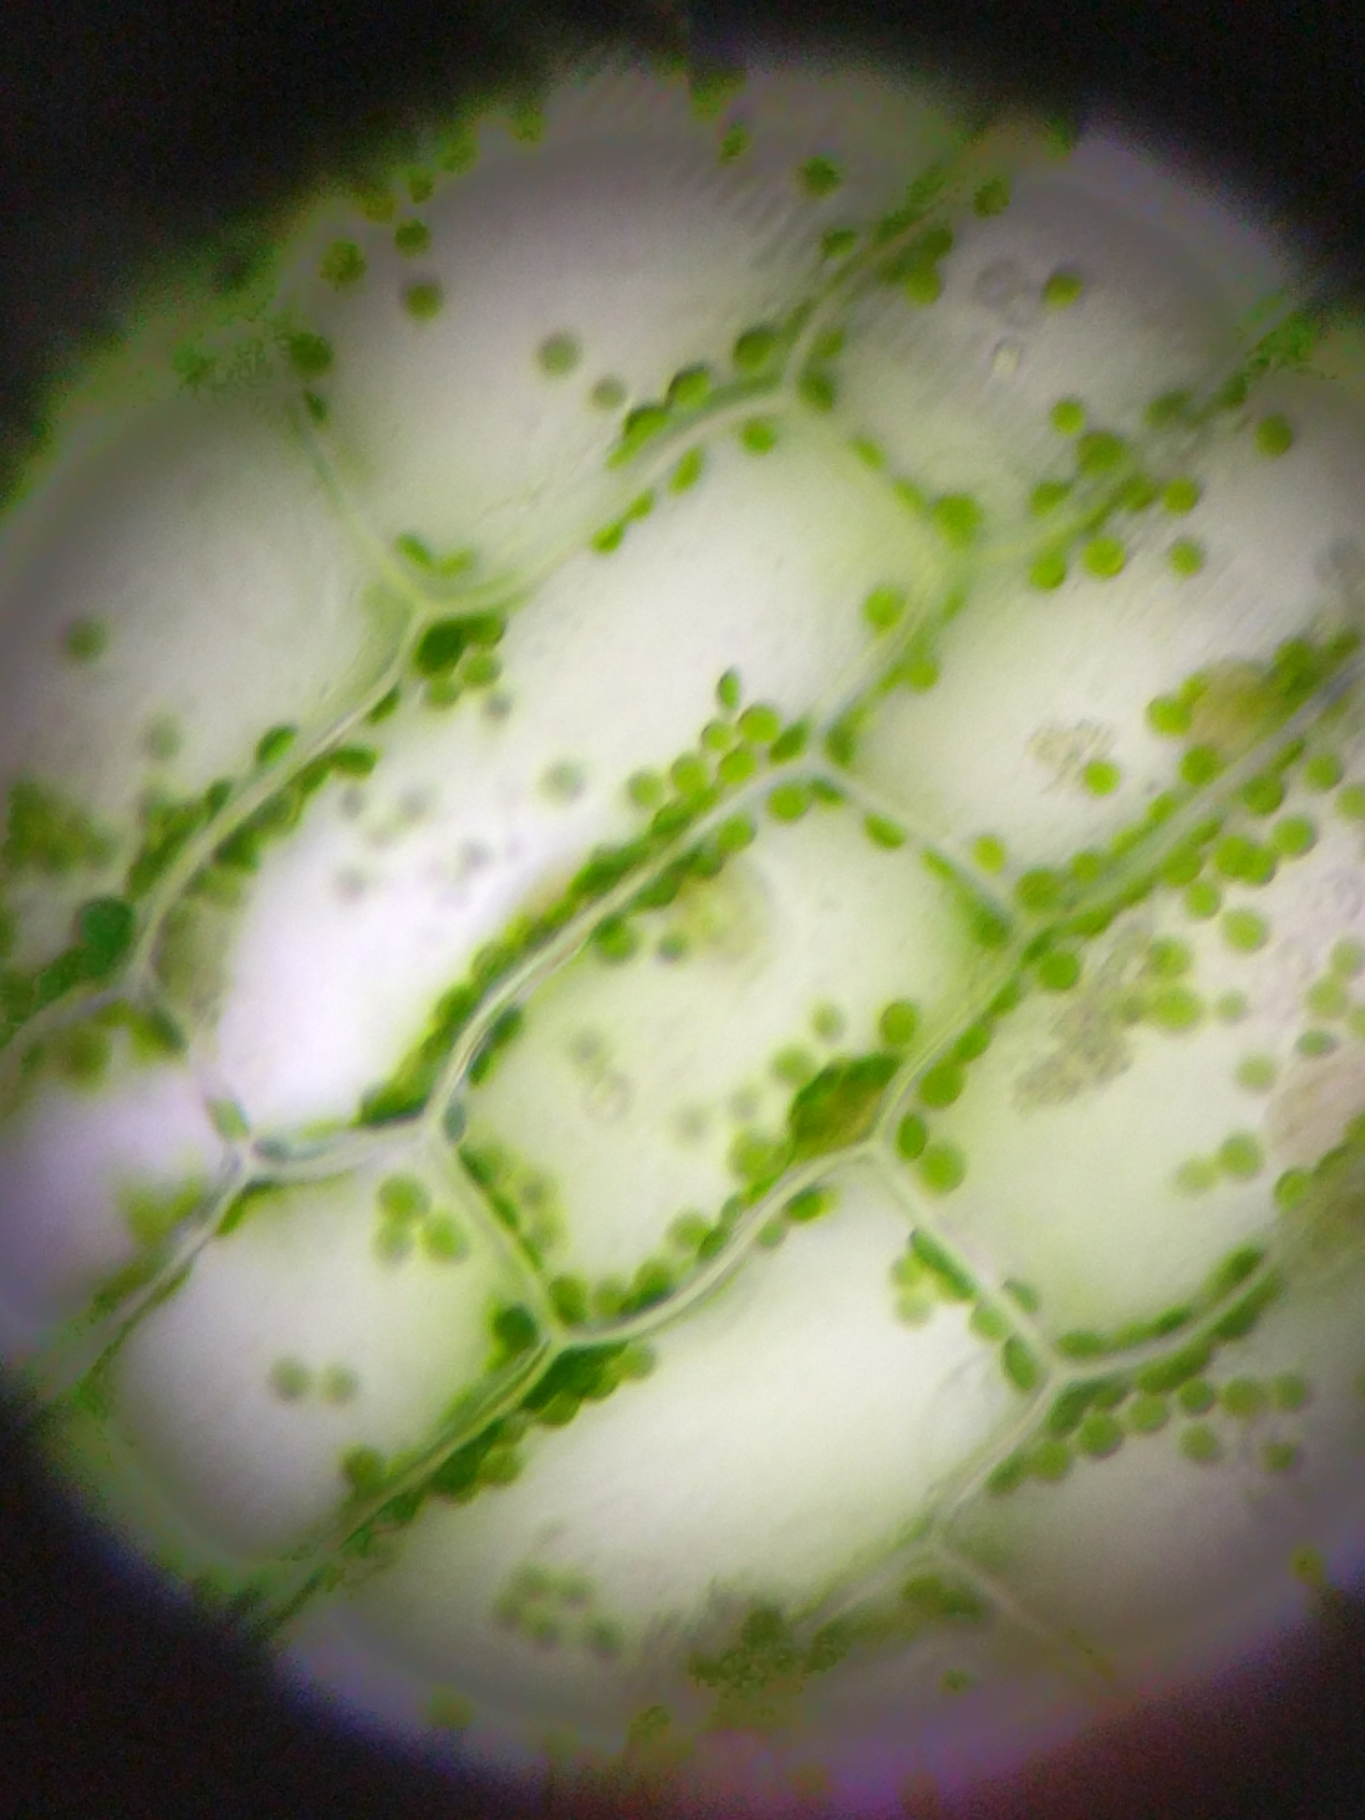
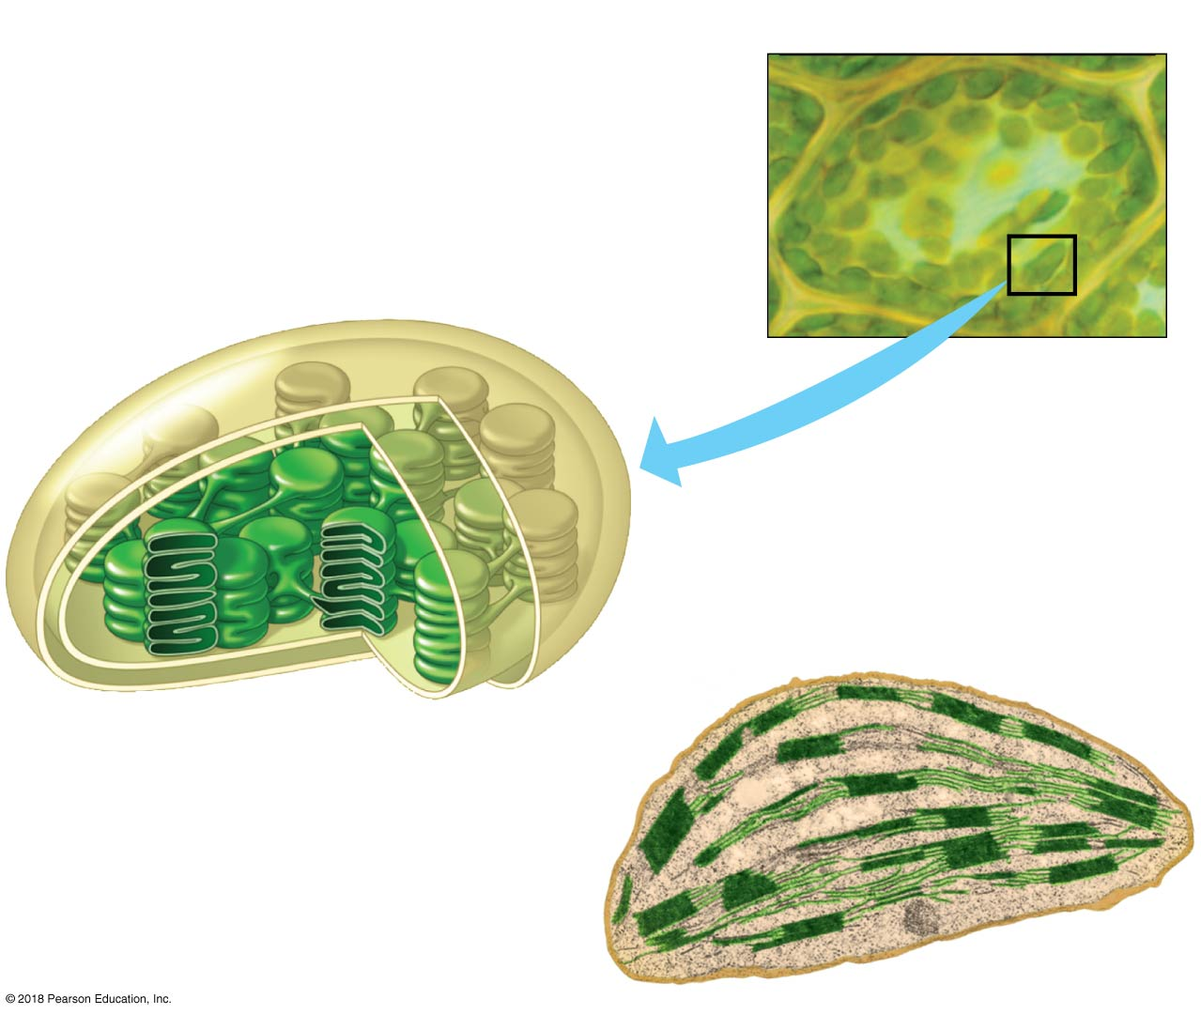
Chloroplasts are the site of photosynthesis
Chloroplast
Thylakoid
Photo courtesy of Aileen & Jovannie
Stroma

Slide 10
Chloroplast structure
Stroma – thick fluid inside chloroplasts
Thylakoid – membranous sacs
Chloroplast
Inner and outer
membranes
Thylakoid
Thylakoid space
Stroma
Notes:
10

Slide 11
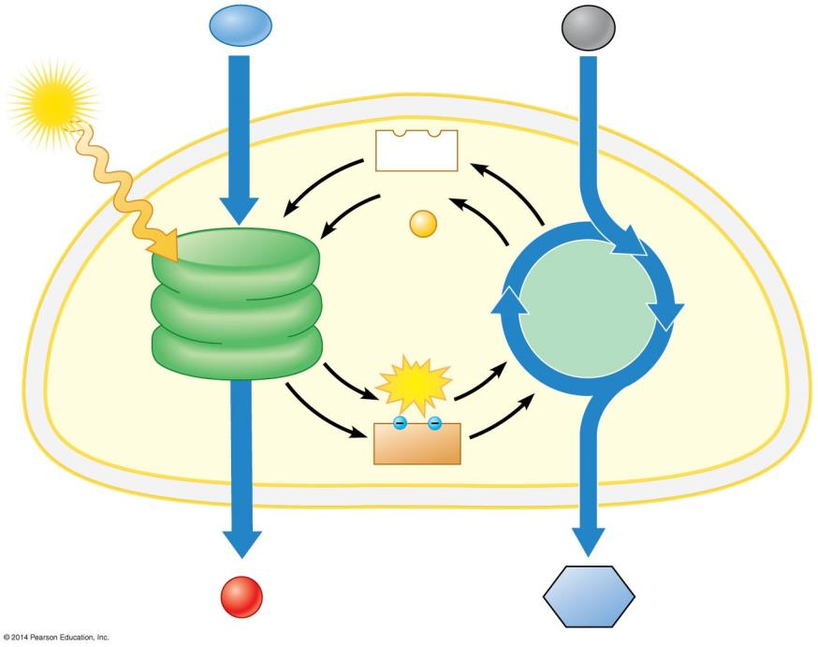
Two stages of photosynthesis
1) Light reactions
2)Light independent reaction: Calvin Cycle
H₂O
CO₂
Light
NADP ⁺
ADP
+
P
Light Reactions (in thylakoids)
Calvin Cycle (in stroma)
ATP
NADPH
Chloroplast
O₂
Sugar
Notes:
11

Slide 12
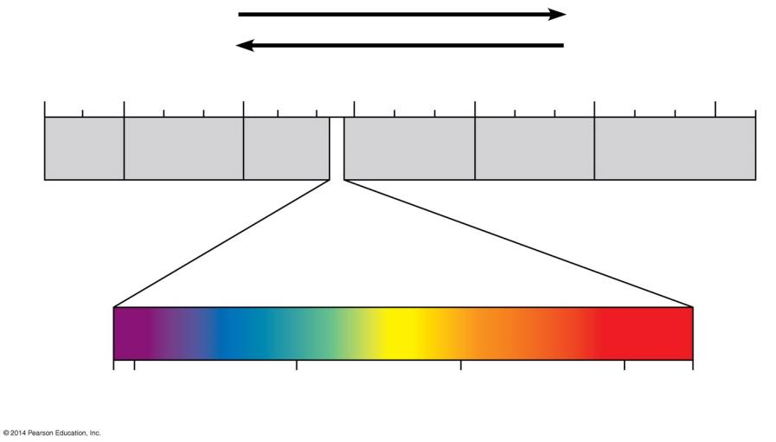
Figure 7.6a
The electromagnetic spectrum
Shorter wavelength
Longer wavelength
Higher energy
Lower energy
10⁻⁵ nm 10⁻³ nm 1 nm 10³ nm 10⁶ nm 1 m 10³ m
Gamma rays
X-rays
UV
Infrared
Micro- waves
Radio waves
Visible light
380 400 500 600 700 750
Wavelength (nm)
Notes:
The radiation from the sun traveles as waves. All these waves: the spectrum includes all the electromagnetic waves
Electro E travels as waves..the full range of electro wavelengths
Also as separate packets of E/ particles.
The shorter… thre greater E

Slide 13
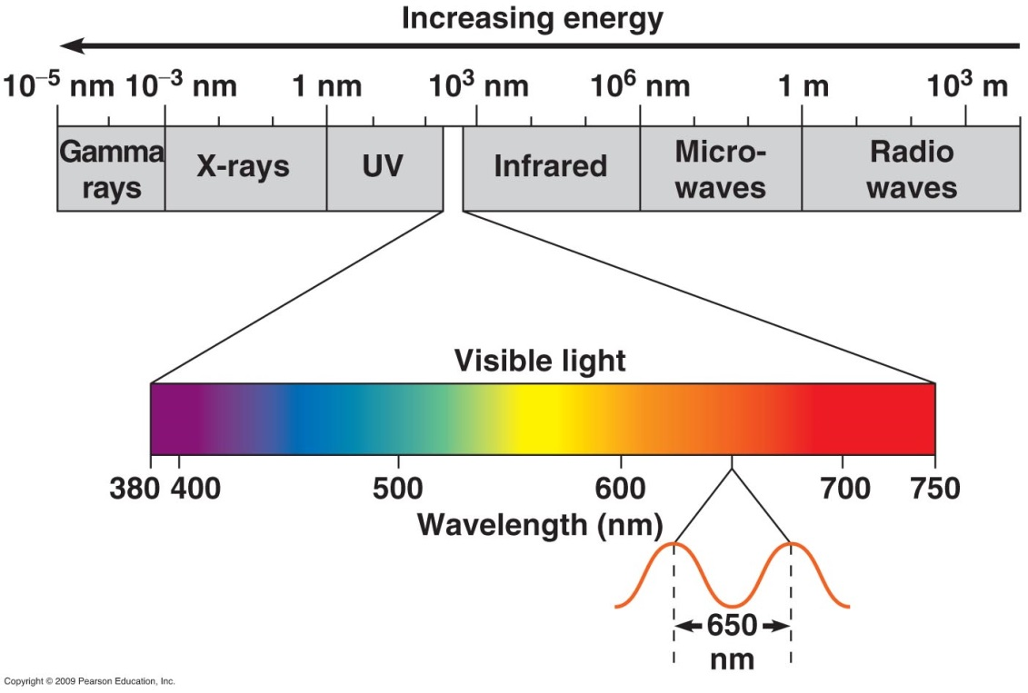
Photosynthesis is powered by light energy
Photon - has a fixed quantity of energy
Visible light (white) is a mixture of all colors
Visible light absorbed by plants’ pigments drives photosynthesis
Pigment - A light absorbing molecule
Notes:
13
separate packets of E/ particles.

Slide 14
High energy photons
Have long wavelengths
Have short wavelengths
Are more likely to produce red light than blue light
Cannot be absorbed

Slide 15
High energy photons
Have long wavelengths
Have short wavelengths
Are more likely to produce red light than blue light
Cannot be absorbed

Slide 16
The Leaf and Light
Pigments in the thylakoid membranes of plants absorb light
And capture the kinetic energy of photons.
Chlorophyll – A pigment important for photosynthesis.
Chlorophyll a absorbs mainly blue-violet and red light
(reflects green).
Chlorophyll b absorbs mainly blue and orange
(reflects yellow-green).

Slide 17
Which organisms perform photosynthesis?
Go to Socrative and select the most correct answer:
Only plants
Photoautotrophs
Plants and algae
Bacteria
Which organisms perform cellular respiration?
Animals
Animal and plants
Photoautotrophs
All organisms
Bacteria

Slide 18
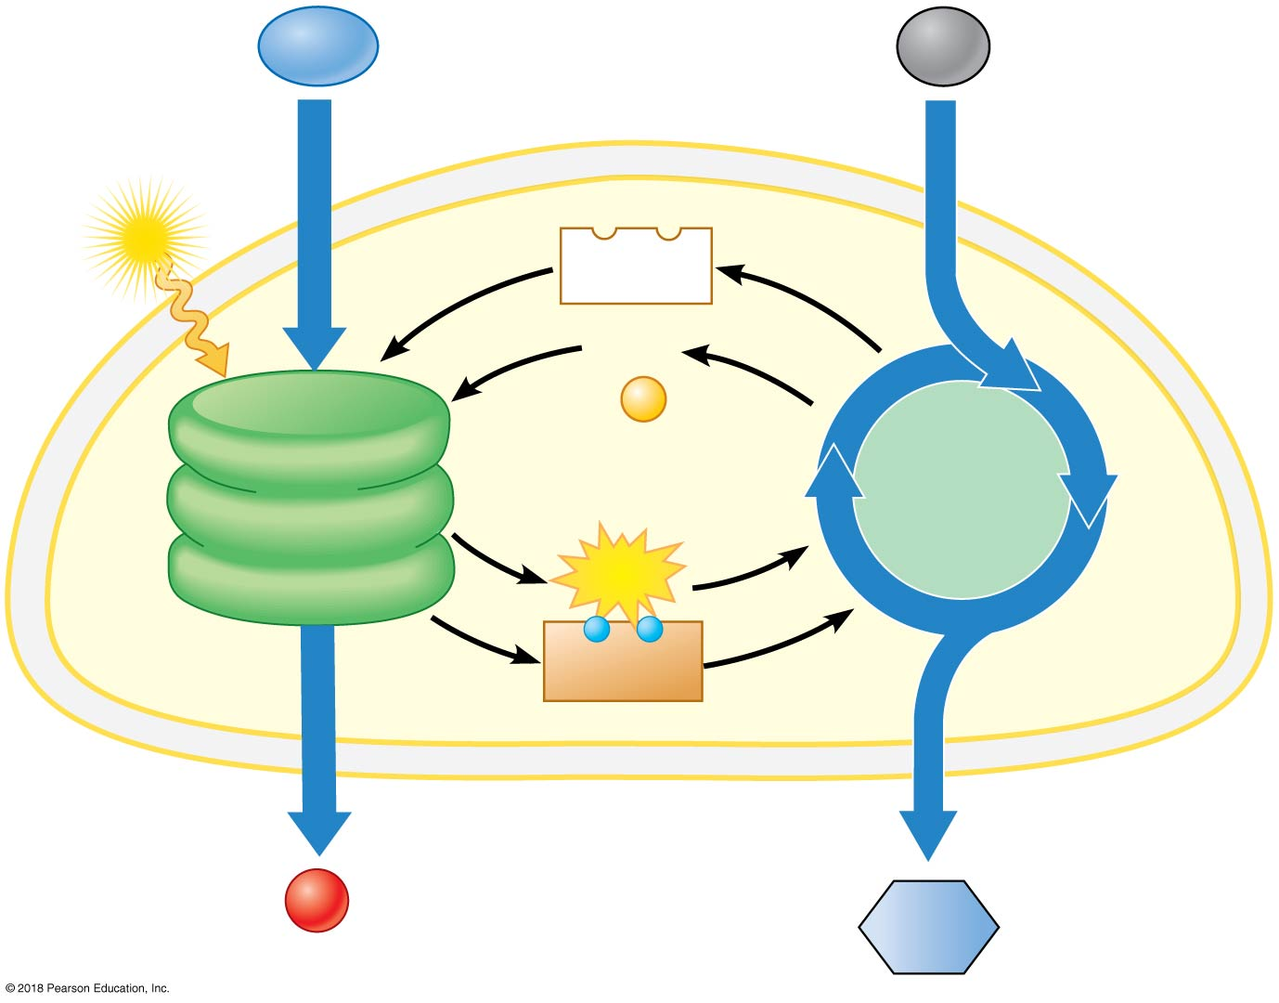
H₂O
CO₂
Light
NADP⁺
ADP
+
P
Calvin
Cycle
(in stroma)
Light
Reactions
(in thylakoids)
ATP
−
−
NADPH
Chloroplast
O₂
Sugar
Notes:
Figure 7.5b_3 An overview of the two stages of photosynthesis in a chloroplast (step 3)

Slide 19
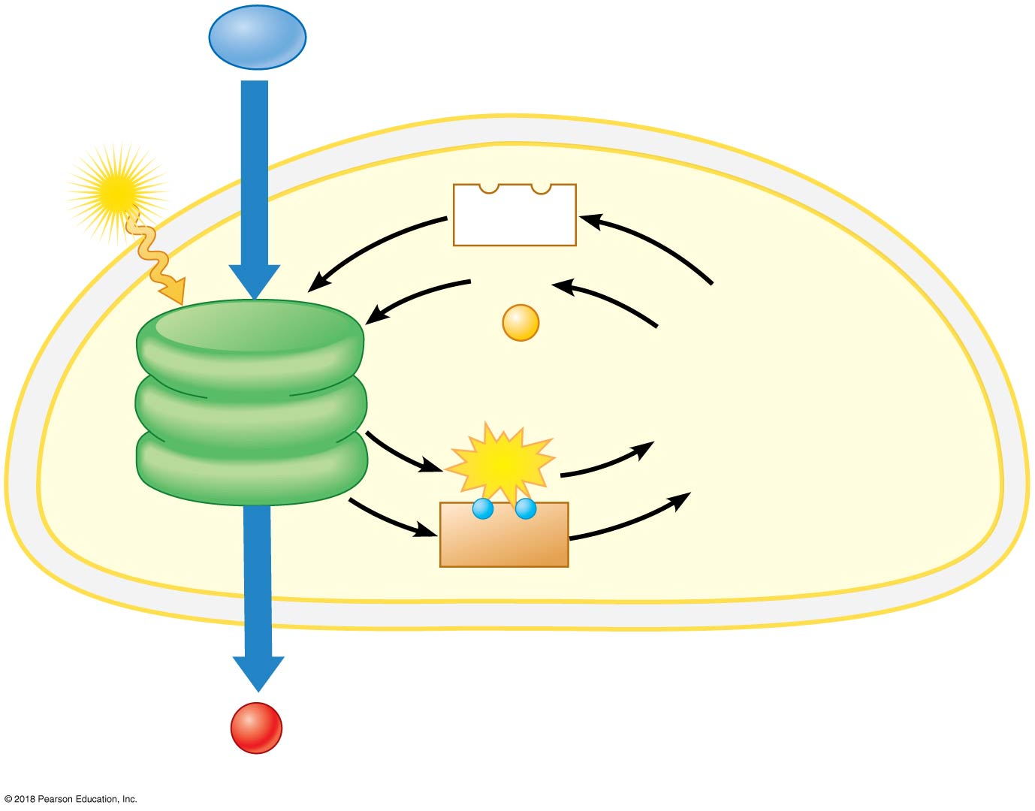
Light Reactions
H₂O
Light
NADP⁺
ADP
+
P
Light
Reactions
(in thylakoids)
ATP
−
−
NADPH
Chloroplast
O₂

Slide 20
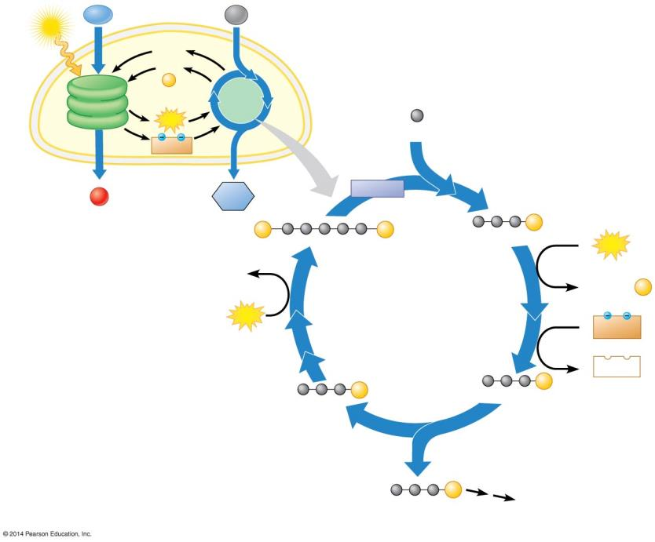
Light
H₂O
CO₂
NADP⁺
ADP
+
P
Light Reactions
Calvin Cycle
Input
ATP
3
Carbon fixation
CO₂
NADPH
Chloroplast
Rubisco
O₂
Sugar
3
P
P
6
P
RuBP
3-PGA
6
ATP
3 ADP
P
P
P
6 ADP + P
Regeneration of RuBP
CALVIN CYCLE
3
ATP
6
NADPH
6
NADP⁺
5
P
6
P
G3P
G3P
Release of one molecule of G3P
Reduction
1
P
G3P
Output
Glucose and other compounds

Slide 21
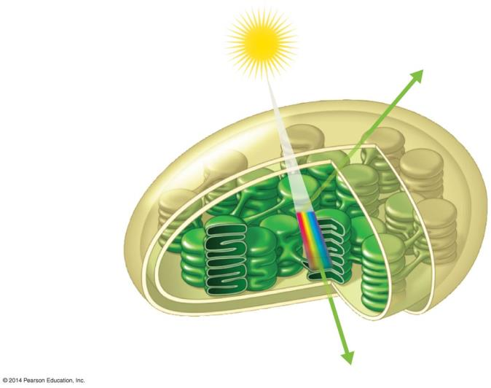
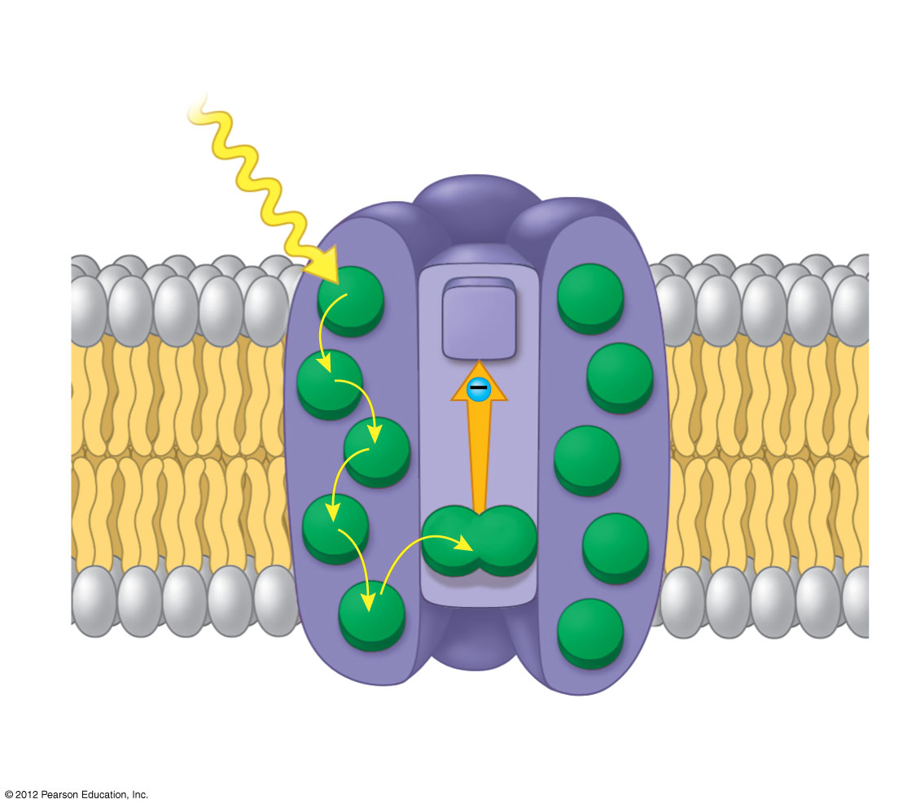
Photosystems capture solar energy
Photosystem
Light
Light-harvesting complexes
Reaction-center complex
Primary electron acceptor
Thylakoid membrane
Reaction center
An electron from chlorophyll a is energized
Primary electron acceptor gets reduced by accepting the energized electron
Pair of chlorophyll a molecules
Pigment molecules
Transfer of energy

Slide 22
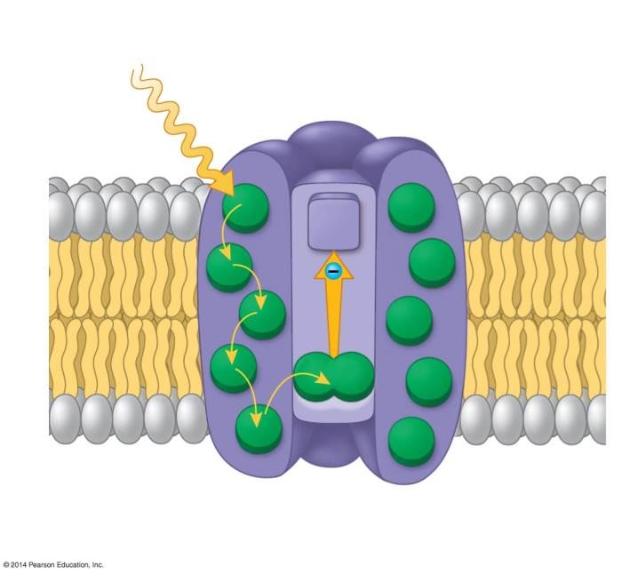
Photosystems capture solar energy
Photosystem
Light
Light-harvesting complexes
Reaction-center complex
Primary electron acceptor
STROMA
Thylakoid membrane
THYLAKOID SPACE
Pigment molecules
Transfer of energy
Pair of chlorophyll a molecules

Slide 23
Light reactions
Photosystem II and Photosystem I work together to form ATP and NADPH*
Photosystem II and I connected by electron transport chain
Light
Electron
transport chain
Light
Photosystem
II
H⁺
Photosystem
I
H⁺
–
–
–
H⁺
–
H⁺
H⁺
H⁺
H₂O
H⁺
*Nicotinamide adenine dinucleotide phosphate
1
O₂
+
2
H⁺
2
H⁺
Notes:
Figure 7.9_3 The light reactions take place within the thylakoid membranes (step 3)

Slide 24
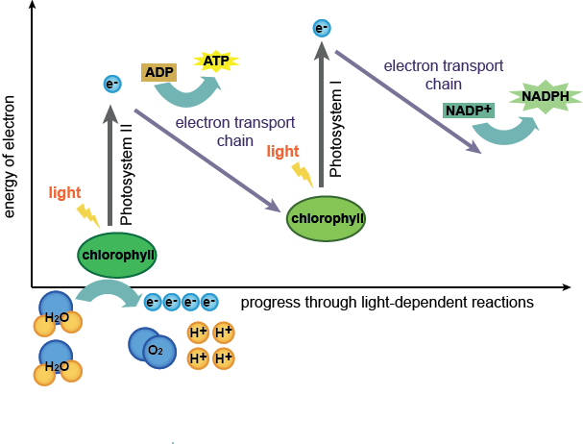

Slide 25
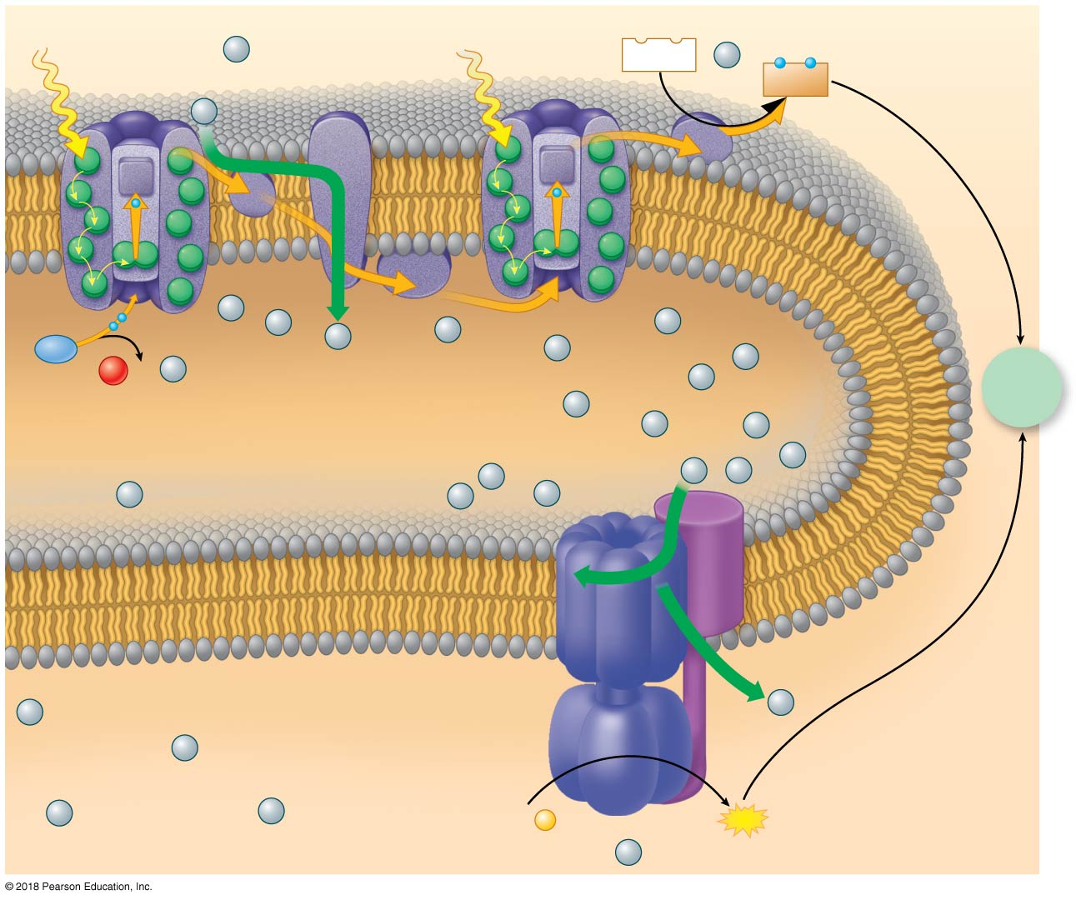
Light
H⁺
Electron
transport chain
Light
Photosystem
II
Photosystem
I
NADP⁺
+
H⁺
–
–
NADPH
H⁺
–
–
–
–
H⁺
H⁺
H⁺
H₂O
H⁺
H⁺
1
O₂
H⁺
H⁺
To
Calvin
Cycle
2
+
2
H⁺
H⁺
H⁺
H⁺
H⁺
H⁺
H⁺
H⁺
H⁺
H⁺
H⁺
H⁺
Thylakoid membrane
ATP synthase
H⁺
H⁺
H⁺
H⁺
H⁺
ADP
+
P
ATP
H⁺
Notes:
Figure 7.9_5 The light reactions take place within the thylakoid membranes (step 5)

Slide 26
The light reactions take place within the thylakoid membranes
In photophosphorylation, the electron transport chain pumps H⁺ into the thylakoid space.
The concentration gradient drives H⁺ back through ATP synthase, powering the synthesis of ATP.
Compare and contrast:
Oxidative phosphorylation and photophosphorylation
Notes:
Teaching Tips
Module 7.9 can be the basis for an excellent comparison between oxidative phosphorylation in mitochondria and photophosphorylation in chloroplasts. If your students have not already read or discussed chemiosmosis in mitochondria, consider assigning Modules 6.6 and 6.9 to show the similarities of these processes. (As noted in Module 7.2, the thylakoid space is analogous to the intermembrane space of mitochondria.) (7.9)
Active Lecture Tips
See the Activity “Demonstration of the Light Dependent Reactions of Photosynthesis Using Students as Molecules” on the Instructor Exchange. Visit the Instructor Exchange in the MasteringBiology instructor resource area for a description of this activity. (7.6–7.9)
See the Activity “Satellite TV and Photosystems” on the Instructor Exchange. Visit the Instructor Exchange in the MasteringBiology instructor resource area for a description of this activity. (7.6–7.9)

Slide 27
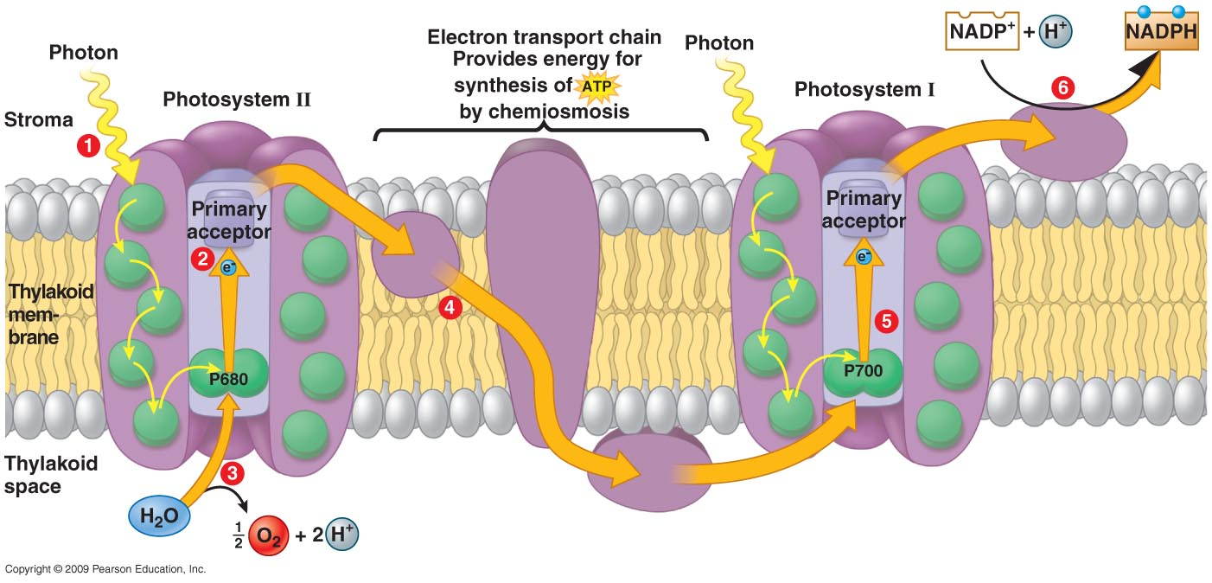
When a photon of the correct energy is absorbed by a photosystem, an electron is energized and transferred to a primary electron acceptor. This creates an electron “hole.” How is the missing electron replaced?
Electrons removed from glucose replace the missing electrons.
Electrons from hydrogen made available by splitting water replace the missing electrons.
The replacement electrons come from NADPH.
The electrons come from ATP.
Notes:
27
Answer: b

Slide 28
When a photon of the correct energy is absorbed by a photosystem, an electron is energized and transferred to a primary electron acceptor. This creates an electron “hole.” How is the missing electron replaced?
Electrons removed from glucose replace the missing electrons.
Electrons from hydrogen made available by splitting water replace the missing electrons.
The replacement electrons come from NADPH.
The electrons come from ATP.
Notes:
28
Answer: b

Slide 29
Chemiosmosis
Fill in the Table
Item | Mitochondrial ETC | Chloroplast ETC
Membrane Location
Function
Location of Proton gradient
Electron carriers
H₂O (product or reactant?)
Energy for ATP Synthesis

Slide 30
Chemiosmosis
Item | Mitochondrial ETC | Chloroplast ETC
Membrane Location | Inner mitochondrial membrane | Thylakoid membrane
Function | Shuttling electrons Provide energy for the proton pumps | Shuttling electrons Provide energy for the proton pumps
Location of Proton gradient | Intermembrane space | Thylakoid space
Electron carriers | NADH, FADH₂ | NADPH
H₂O (product or reactant?) | A product | A reactant
Energy for ATP Synthesis | Glucose oxidation | sunlight

Slide 31
Second stage of photosynthesis: Calvin Cycle
H₂O
CO₂
Light
NADP⁺
ADP
+
P
Calvin
Cycle
(in stroma)
Light
Reactions
(in thylakoids)
ATP
−
−
NADPH
Chloroplast
O₂
Sugar
Notes:
Figure 7.5b_3 An overview of the two stages of photosynthesis in a chloroplast (step 3)

Slide 32
Light
H₂O
CO₂
NADP⁺
ADP
+
P
Light Reactions
Calvin Cycle
Input
ATP
3
Carbon fixation
CO₂
NADPH
Chloroplast
Rubisco
O₂
Sugar
3
P
P
6
P
RuBP
3-PGA
6
ATP
3 ADP
P
P
P
6 ADP + P
Regeneration of RuBP
CALVIN CYCLE
3
ATP
6
NADPH
6
NADP⁺
5
P
6
P
G3P
G3P
Release of one molecule of G3P
Reduction
1
P
G3P
Output
Glucose and other compounds

Slide 33
Calvin Cycle: Summary
Reactants and Products
Reactants | Products
6CO₂+ 6H₂O | C₆H₁₂O₆+ 6O₂
12 NADPH | 12 NADP⁺
18 ATP | 18 ADP + 18 P_{i}
H₂O
CO₂
Light
NADP⁺
ADP
+
P
Calvin
Cycle
(in stroma)
Light
Reactions
(in thylakoids)
ATP
−
−
NADPH
Chloroplast
O₂
Sugar

Slide 34
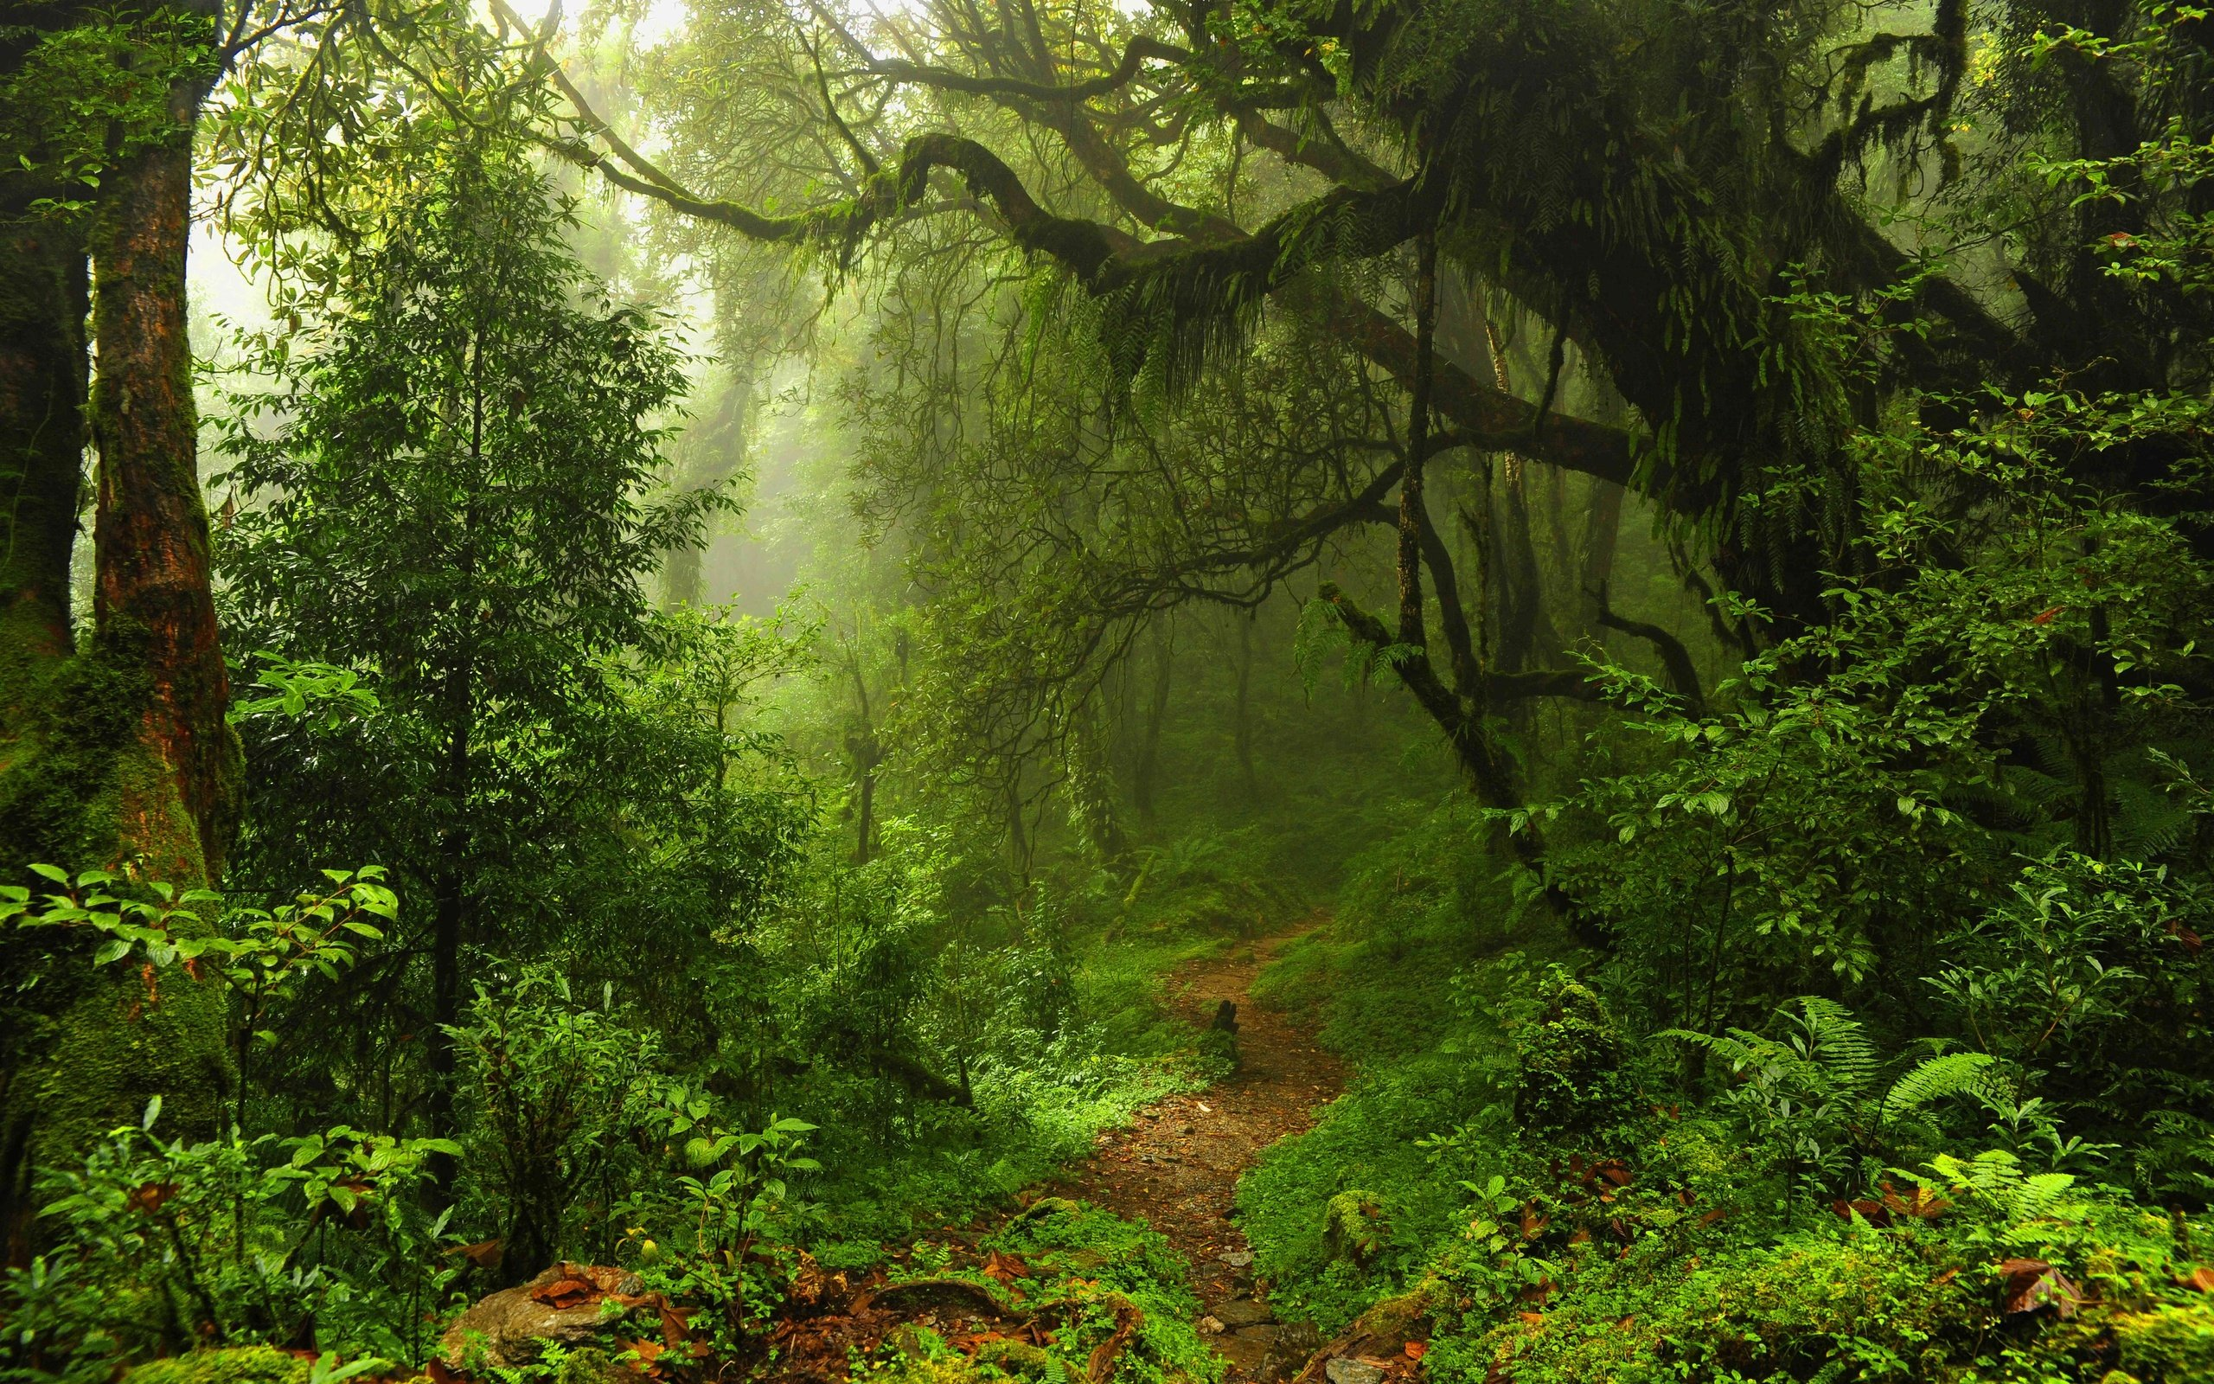
A (really great) summary of photosynthesis
http://www.mhhe.com/biosci/bio_animations/02_MH_Photosynthesis_Web/

Slide 35
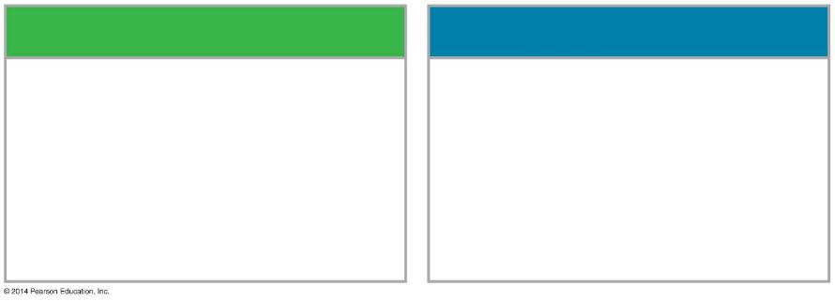
LIGHT REACTIONS
CALVIN CYCLE REACTIONS
Are carried out by molecules in the thylakoid membranes
Take place in the stroma
Use ATP and NADPH to convert CO₂ to the sugar G3P
Convert light energy to the chemical energy of ATP and NADPH
Return ADP, inorganic phosphate, and NADP⁺ to the light reactions
Split H₂O and release O₂ to the atmosphere

Slide 36
Which of the following are products of the light reactions of photosynthesis that are utilized in the Calvin cycle?
CO2 and glucose
H2O and O2
ADP, and NADP+
Electrons and H+
ATP and NADPH

Slide 37
Which of the following are products of the light reactions of photosynthesis that are utilized in the Calvin cycle?
CO2 and glucose
H2O and O2
ADP, and NADP+
Electrons and H+
ATP and NADPH

Slide 38
In photosynthesis, H₂O is used to produce O₂ in the _______, and CO₂ is used to produce the components of sugar in the _____________.
Chloroplasts; Mitochondria
Mitochondria; Chloroplasts
Thylakoids; Stroma
Stroma; Thylakoids
Notes:
C

Slide 39
In photosynthesis, H₂O is used to produce O₂ in the _______, and CO₂ is used to produce the components of sugar in the _____________.
Chloroplasts; Mitochondria
Mitochondria; Chloroplasts
Thylakoids; Stroma
Stroma; Thylakoids

