Slide 1
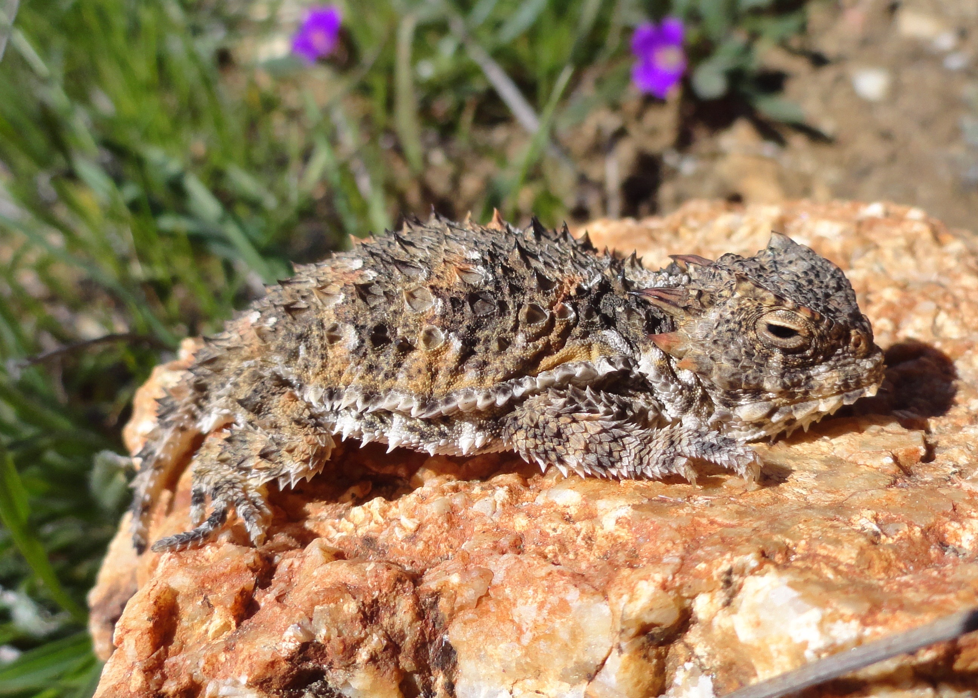
Welcome to Biology 120, Principles of Biology!

Slide 2
Professor Frank Santana
Lecture
Tuesday and Thursday 12:30 – 1:45 pm.
Room 36-345B
Lab
Thursday 2:00 - 5:00 pm. Room 30-128

Slide 3
Notes:
We are going to be studying a broad range of topics in this course. The goal of this course is to allow you to understand the general process of science as well as the specific study of biology.

Slide 4
Syllabus Review

Slide 5
Tips for Success in this course

Slide 7
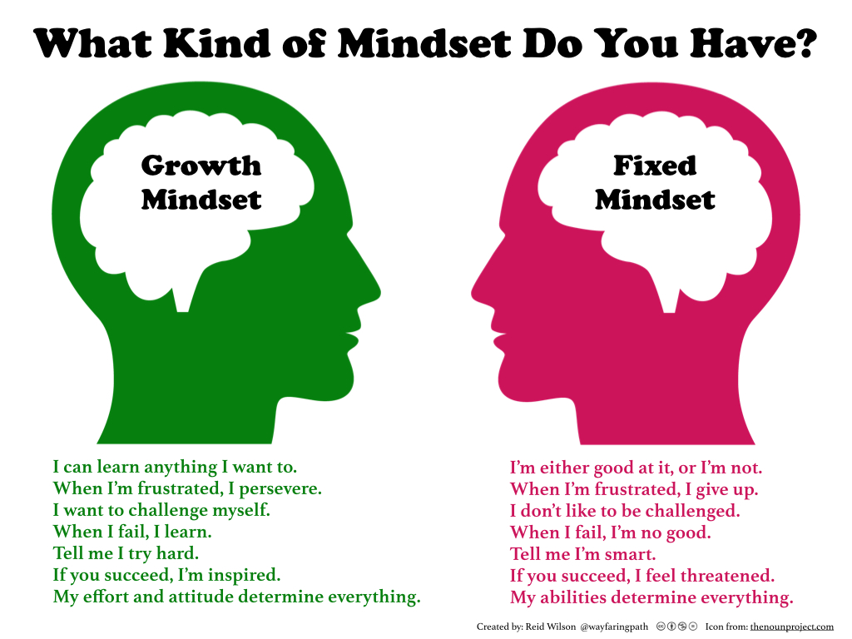

Slide 8
Culture of Respect and Collaboration
Notes:
Wait until you are called on before you speak. Show respect for your fellow students.

Slide 9
Form groups of 4 students.
Get each other’s contact information
Reach a consensus
What is one food that everyone in the group can agree that they LOVE.
What is one food that everyone in the group can agree that they DESPISE (very strongly dislike).

Slide 10
CHAPTER 1
What is Biology?

Slide 13
What is Science?
Notes:
What does science mean to you?
(Write down the main points that the students offer)
What is the Difference between science and Technology?
Technology is the application of Science for products and specific uses.

Slide 14
Scientific Method
Develop a Question from observations
Come up with a Hypothesis
Conduct an Experiment (Independent and Dependent Variables)
Analyze the Results
Arrive at a conclusion

Slide 15
Scientific Method Example
1. Question: Why aren’t captive frogs reproducing?

Slide 16
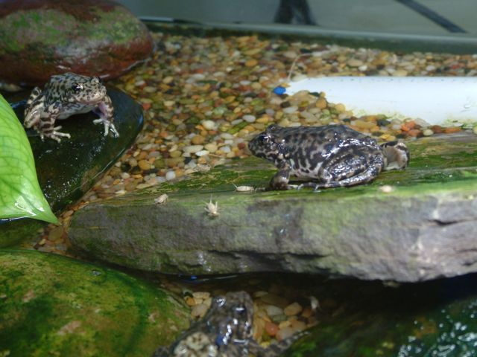
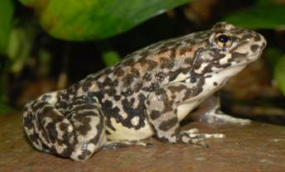
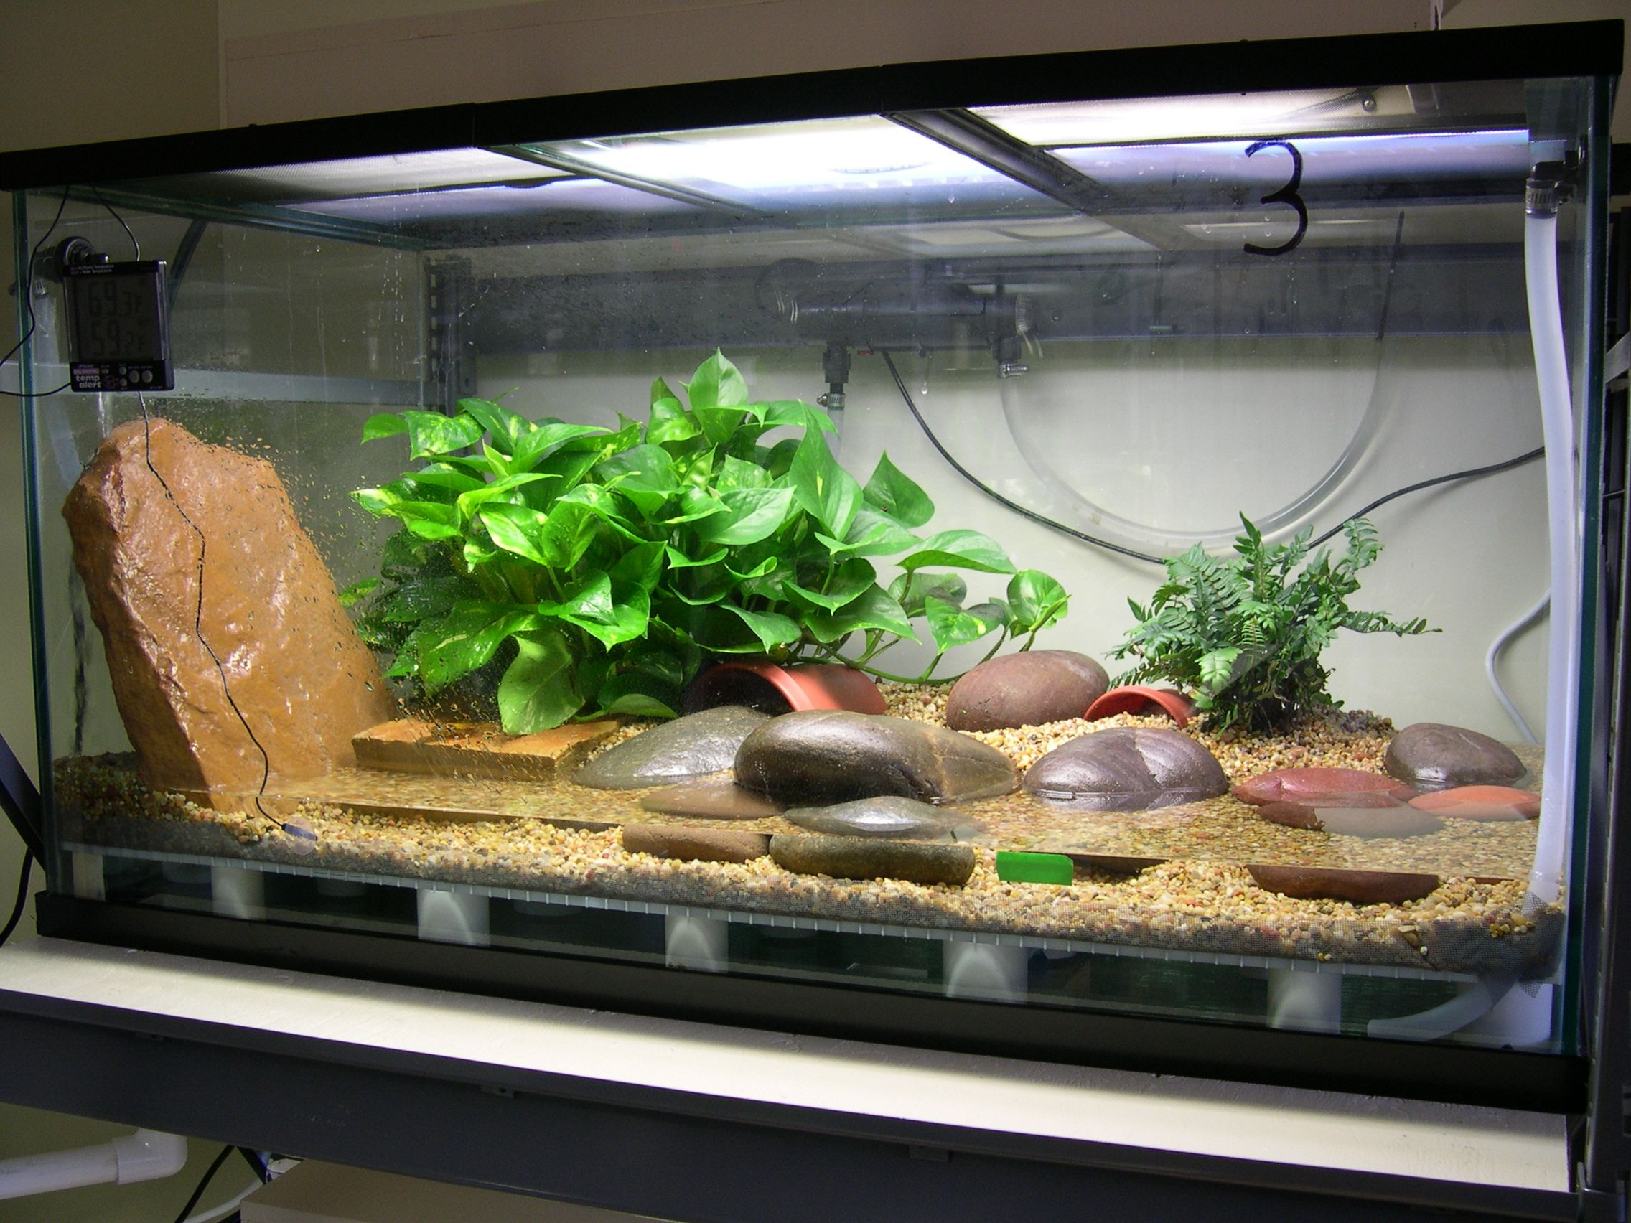
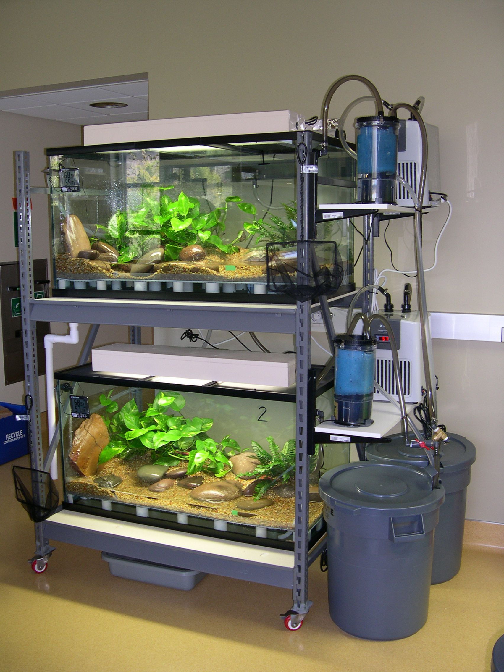
Scientific Method Example
2. Hypothesis: If captive frogs are placed in a hibernation state that mimics the one they experience in the wild then they will reproduce.

Slide 17
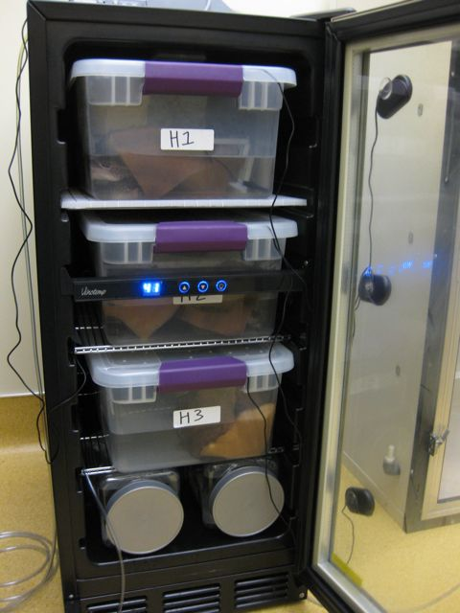
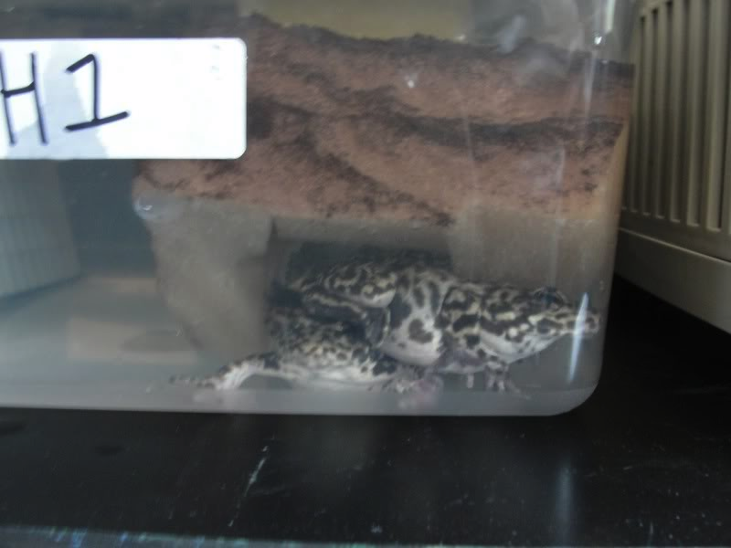
Scientific Method Example
Treatment
Control
16 Females & 8 Males Hibernated
Maintained at 13 Degrees Celsius
16 Females & 8 Males Not Hibernated
Maintained at 13 Degrees Celsius
3. Experiment: Hibernate half of the frogs and compare reproductive outcomes.

Slide 18
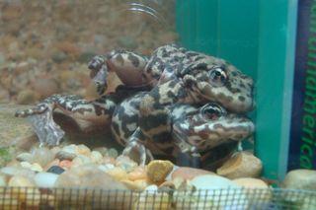
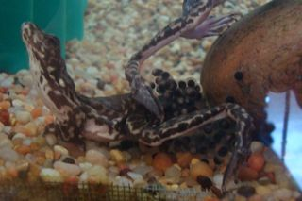
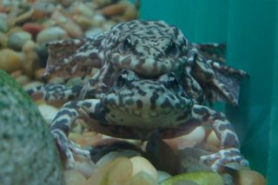
Scientific Method Example
4. Results: Only Hibernated frogs exhibited reproductive behaviors.

Slide 19
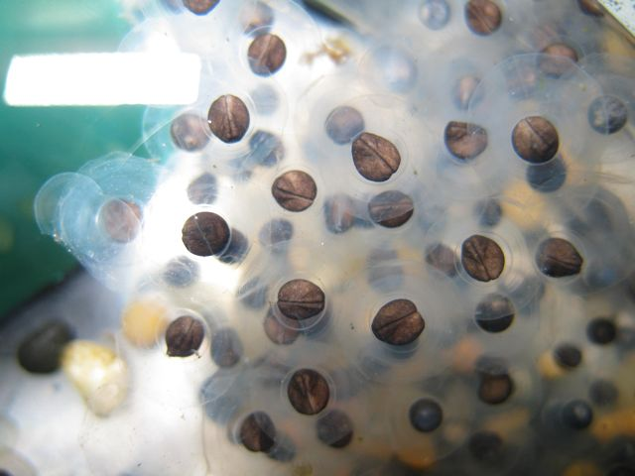
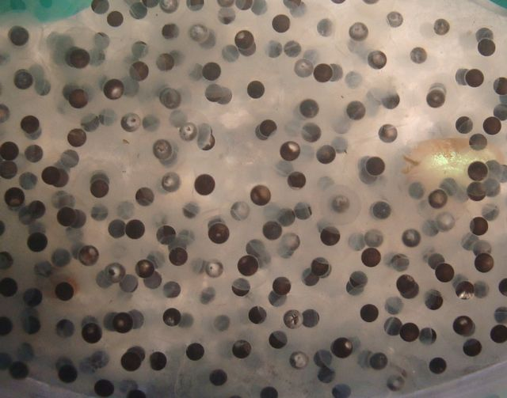
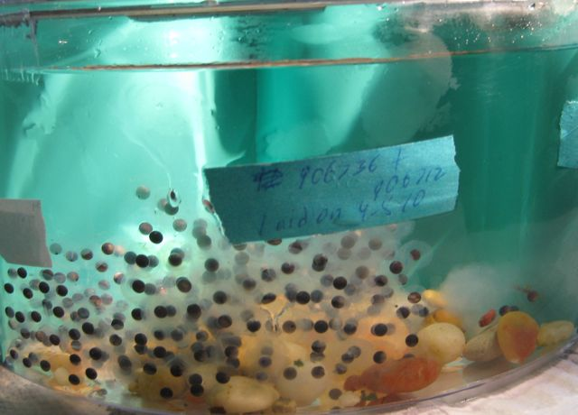
Scientific Method Example
5. Conclusion: Frogs require a cold temperature hibernation in order to reproduce. The results support the hypothesis.

Slide 20
Scientific Method Example
Assumptions
Unanswered Questions
Refined Hypothesis?
Do the results agree with the scientific consensus?

Slide 21
5 Unifying Themes in Biology 1. Evolution leads to diversity and relatedness

Slide 22
5 Unifying Themes in Biology 2. Life depends on the flow of information

Slide 23
5 Unifying Themes in Biology 3. Biological Structures are Driven by Function

Slide 24
5 Unifying Themes in Biology 4. Life Depends on the transfer and transformation of energy and matter.

Slide 25
5 Unifying Themes in Biology 5. Life Depends on interactions within and between systems.

Slide 26
Plicker Question:
Does the Scientific Method provide proof about a phenomenon?
Yes
No

