Slide 1
Chapter 2
Chemical Basis of Life
Notes:
Chemicals are the raw materials that make up
our bodies,
the bodies of other organisms, and
the physical environment.

Slide 2
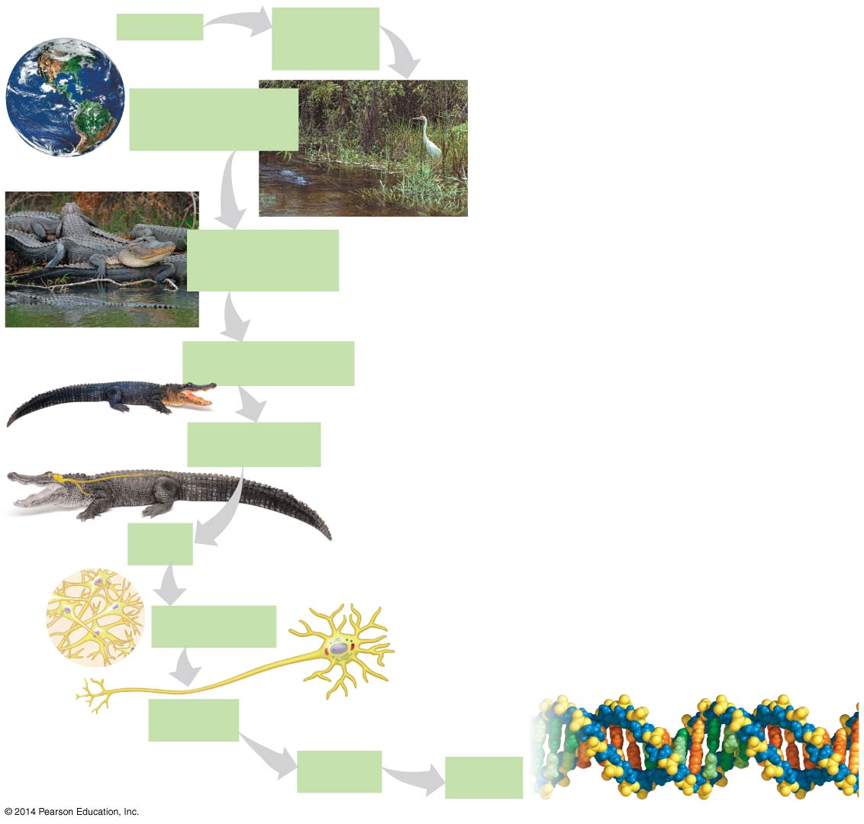
Figure 1.2-0
Biosphere
Ecosystem
Florida
Everglades
BIG
Florida
Community
All organisms in this
wetland ecosystem
Population
All alligators living
in the wetlands
Hierarchy of biological organization
Organism
an American alligator
Nerve
Spinal
cord
Organ system
Nervous system
Brain
Organ
Brain
Tissue
Nervous tissue
Atom
Cell
Nerve cell
Nucleus
SMALL
Organelle
Nucleus
Molecule
DNA
Notes:
Why study chemistry in a bio class?
living things made of cells
Cells made of molecules
Molecules made of 2 or more atoms held together by chemical bond
compounds -molecules made of 2 or more different atoms
organic compounds (biomolecules)
mostly atoms: O, C, H, N, P,S
Structure dets function of molecules

Slide 3
Figure 1.2-0
Biosphere
Ecosystem
Florida
Everglades
BIG
Florida
Community
All organisms in this
wetland ecosystem
Population
All alligators living
in the wetlands
Starting small: Why study chemistry in a biology class?
Organism
an American alligator
Nerve
Spinal
cord
Organ system
Nervous system
Brain
Organ
Brain
Tissue
Nervous tissue
Atom
Cell
Nerve cell
Nucleus
SMALL
Organelle
Nucleus
Molecule
DNA
Notes:
Get students to provide answers.

Slide 4
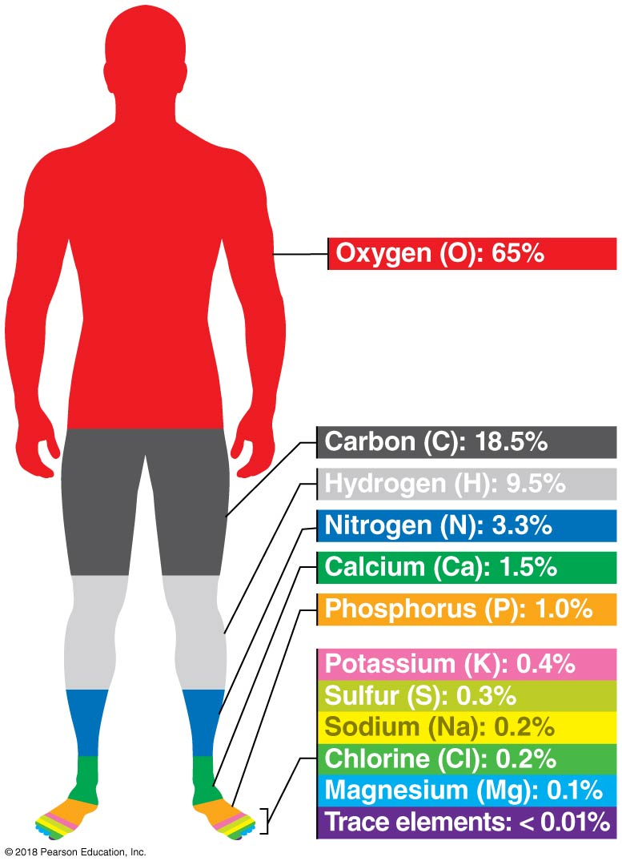
Living organisms are made of chemicals
Notes:
Six elements make up 99% of our body
O, C, H, N → make up biomolecules
Ca, P → bones and teeth

Slide 5

All life is tied to the chemical water
Notes:
Life’s chemistry is tied to water.
Life first evolved in water.
All living organisms require water.
Cells consist of about 70% water.

Slide 6
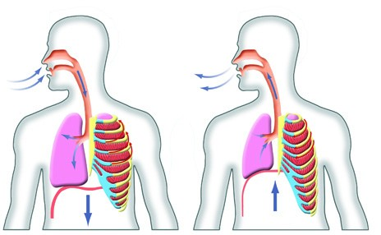
The non-living world is made of chemicals
Air Composition
N₂ ~ 78%
O₂ ~ 21%
CO₂ < 1%
Ar ~ 1%

Slide 7
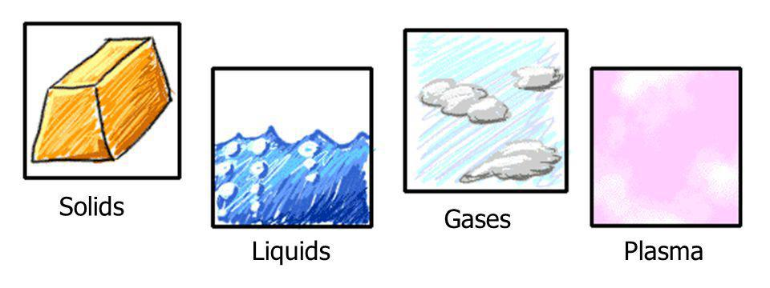
Living organisms and their environment are composed of matter
Occupies space
Has mass
Composed of chemical elements
Notes:
Table 2.1 Elements in the human body
Living organisms are composed of matter, which is anything that occupies space and has mass (weight).
Matter is composed of chemical elements.
An element is a substance that cannot be broken down to other substances by ordinary chemical means.
There are 92 elements in nature—only a few exist in a pure state.

Slide 8
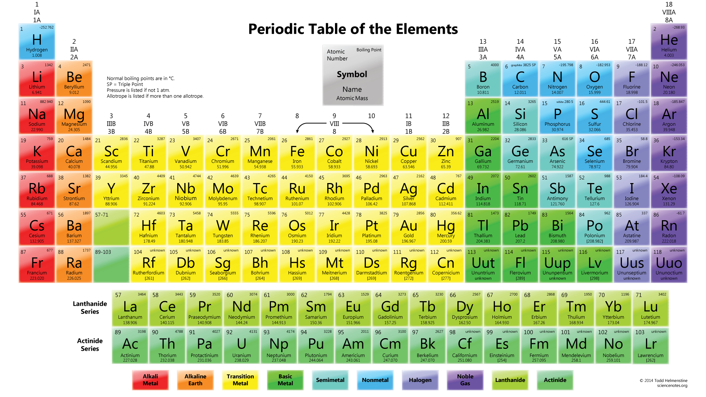
Elements – matter that can’t be broken down to another substance
Notes:
An element is a substance that cannot be broken down to other substances by ordinary chemical means.
There are 92 elements in nature—only a few exist in a pure state.

Slide 9
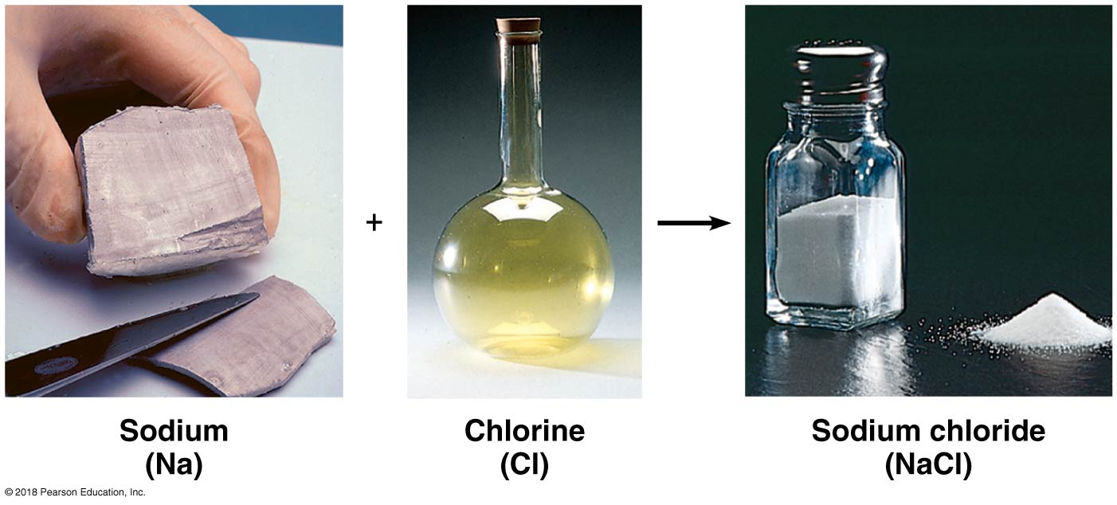
Very few elements exist in nature in pure form. Most interact with other elements to form compounds.
Notes:
A compound is a substance consisting of two or more different elements in a fixed ratio.
Compounds are more common than pure elements.
Sodium chloride, table salt, is a common compound of equal parts of sodium (Na) and chlorine (Cl).

Slide 10
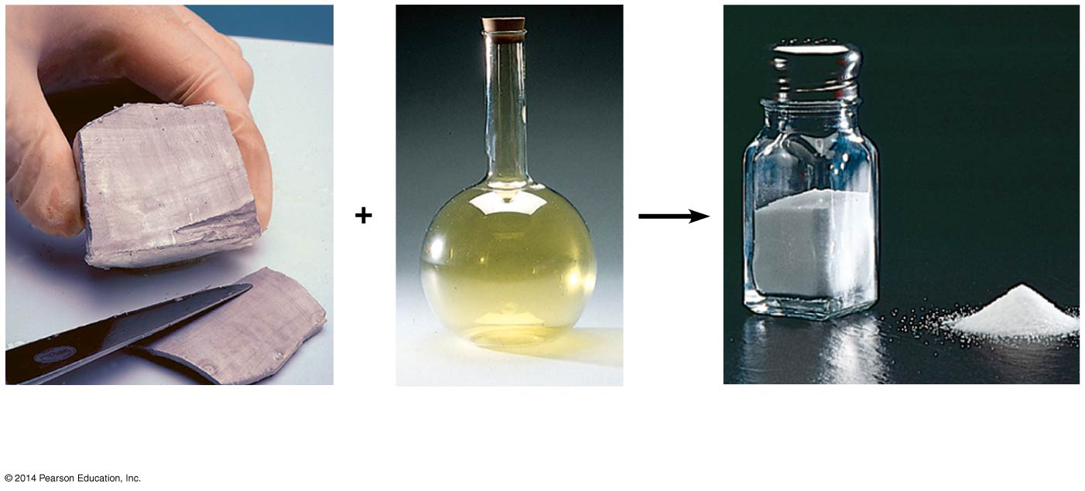
Compounds have emergent properties.
Sodium
(Na)
Chlorine
(Cl)
Sodium chloride
(NaCl)
What are the emergent properties of table salt?
Notes:
Sodium = metal
Chlorine = poisonous gas
Together, they make up edible crystals

Slide 11
Group Discussion
What is an Atom?
    Write down your understanding of an atom, draw diagrams, etc. (3 minutes)
    Discuss in groups of 10 students. Summarize on the white board. (10 minutes)

Slide 12
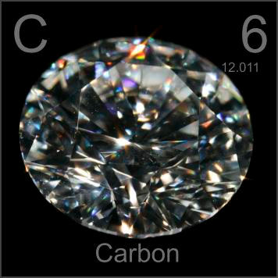
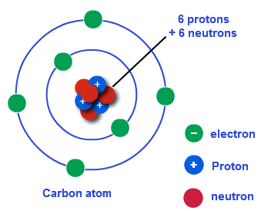
The smallest unit of an element is an atom
Pure Carbon
Single Carbon Atom
Notes:
An element is a substance that cannot be broken down to other substances by ordinary chemical means.
There are 92 elements in nature—only a few exist in a pure state.
Atom comes from the Greek indivisible. And is the smallest unit of matter that still retains the properties of an element.

Slide 13
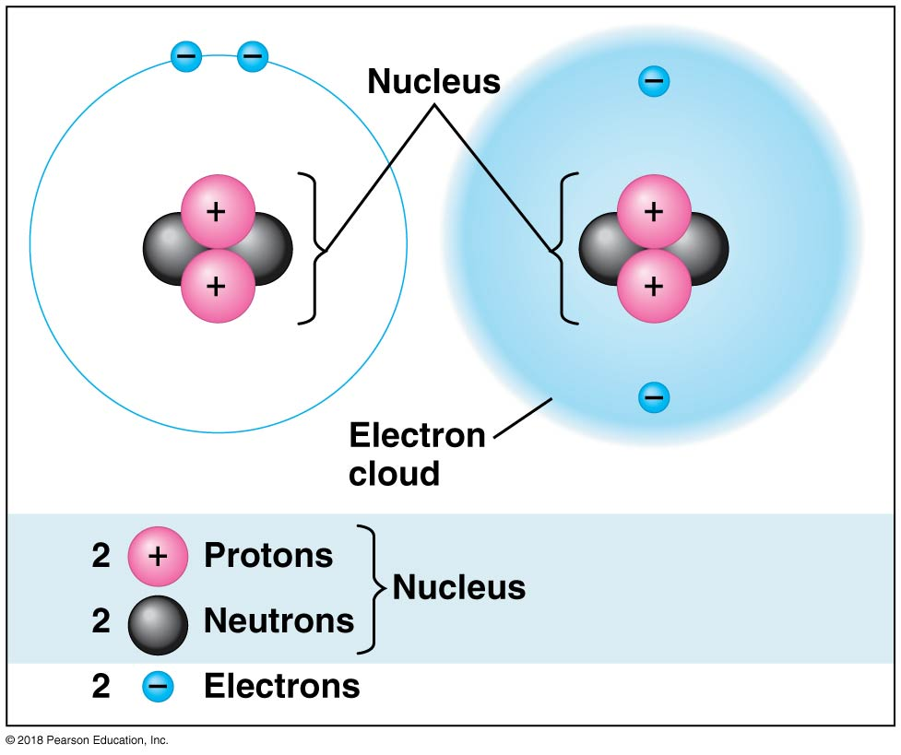
What Are Atoms?
Made up of 3 subatomic particles:
  Protons (electrical charge +1)
  Neutrons (no charge)
  Electrons (electrical charge -1)
Notes:
Atom comes from the Greek indivisible. And is the smallest unit of matter that still retains the properties of an element.
Each element consists of one kind of atom.
An atom is the smallest unit of matter that still retains the properties of an element.
Three subatomic particles are relevant to our discussion of elements.
Neutrons and protons are packed into an atom’s nucleus.
Electrons orbit the nucleus.
The unique number of protons is an element’s atomic number.
Made up of subatomic particles:
Protons (electrical charge +1)
Electrons (electrical charge -1)
Neutrons (no charge)
Atoms generally have the same number of protons as electrons so have an net electrical charge of zero. The protons and neutrons have more mass and cluster in the central part of the atom called the nucleus. They give the atom its atomic mass. The electrons have about 1/2000 the mass of a proton and move in a sphere around the nucleus as the electrons are held close to the protons by their electrical charges.

Slide 14
Protons
Have a positive electrical charge
Define the element
Notes:
Atom comes from the Greek indivisible. And is the smallest unit of matter that still retains the properties of an element.
Each element consists of one kind of atom.
An atom is the smallest unit of matter that still retains the properties of an element.
Three subatomic particles are relevant to our discussion of elements.
Neutrons and protons are packed into an atom’s nucleus.
Electrons orbit the nucleus.
The unique number of protons is an element’s atomic number.
Made up of subatomic particles:
Protons (electrical charge +1)
Electrons (electrical charge -1)
Neutrons (no charge)
Atoms generally have the same number of protons as electrons so have an net electrical charge of zero. The protons and neutrons have more mass and cluster in the central part of the atom called the nucleus. They give the atom its atomic mass. The electrons have about 1/2000 the mass of a proton and move in a sphere around the nucleus as the electrons are held close to the protons by their electrical charges.

Slide 15
Neutrons
Have a neutral electrical charge
Generally, the same number of protons as neutrons
Protons + neutrons give the atom its mass
Notes:
Atom comes from the Greek indivisible. And is the smallest unit of matter that still retains the properties of an element.
Each element consists of one kind of atom.
An atom is the smallest unit of matter that still retains the properties of an element.
Three subatomic particles are relevant to our discussion of elements.
Neutrons and protons are packed into an atom’s nucleus.
Electrons orbit the nucleus.
The unique number of protons is an element’s atomic number.
Made up of subatomic particles:
Protons (electrical charge +1)
Electrons (electrical charge -1)
Neutrons (no charge)
Atoms generally have the same number of protons as electrons so have an net electrical charge of zero. The protons and neutrons have more mass and cluster in the central part of the atom called the nucleus. They give the atom its atomic mass. The electrons have about 1/2000 the mass of a proton and move in a sphere around the nucleus as the electrons are held close to the protons by their electrical charges.

Slide 16
Electrons
Negative electrons attracted to the positive protons
Generally, same number of electrons as protons (balances the charge)
Electrons move around the nucleus
Electrons located in shells that hold a specific number of electrons
Notes:
Electrons are not unstructured around an atom’s nucleus. The arrangement of electrons around the nucleus impart unique chemical properties to different elements.
Electrons must be located within an electron shell. There are multiple electron shells each with a characteristic distance from the atom’s nucleus.

Slide 17
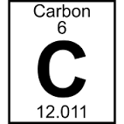
Atomic Notation
Atomic Number = # of protons
Atomic Mass = # of protons + # of neutrons
Chemical Name
Atomic Number
Chemical Symbol
Atomic Mass
Notes:
Atomic number is the number of protons of an atom.
Atomic mass is the mass of the atom which is roughly the number of protons and neutrons that make up the atom. They are usually written like this. Each element is identified by a letter code. With the atomic number as a superscript and the atomic mass as the number below the elements symbol.

Slide 18
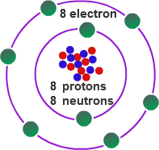
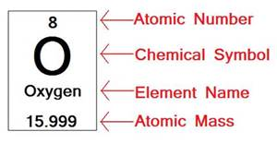
Atomic Notation
What are the atomic number and atomic mass of oxygen?
Notes:
Student work in small groups for 1-2 minutes to calculate the atomic mass and number of oxygen.

Slide 19
What makes a carbon atom different from an oxygen atom

Slide 20
Elements differ because they have a different number of protons.
Notes:
Elements differ because they have a different number of protons. Oxygen is oxygen specifically because it has 8 protons in the nucleus of the atom. This quality defines it at oxygen. Carbon is defined by having 6 protons in the nucleus of the atoms. If you add or sustract protons from a nucleus you turn the element into a differnent element.

Slide 21
Notes:
Point out the atomic number of major elements in living organism.
N, C, O.

Slide 22
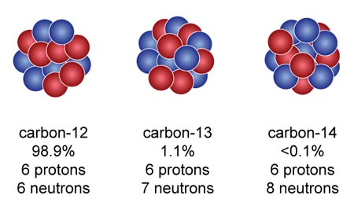
Isotopes of Atoms
Same number of protons
Different number of neutrons
Notes:
C12- 99%
C13 ~1% - stable, nucleus remains intact
C14 minute quantities- unstable, radioactive
Unstable nucleus - emits energy and particles when it decays
Decay transforms into a different element
Decay occurs at a fixed half life
Time for 50% of radioactive atoms to decay
C14 to N14, proton # changes

Slide 23
Solve for these carbon isotopes.
 | Carbon 12 | Carbon 13 | Carbon 14
atomic mass
# of protons
# of neutrons = atomic mass - # of protons
# of electrons = # of protons
Notes:
C12- 99%
C13 ~1% - stable, nucleus remains intact
C14 minute quantities- unstable, radioactive
Unstable nucleus - emits energy and particles when it decays
Decay transforms into a different element
Decay occurs at a fixed half life
Time for 50% of radioactive atoms to decay
C14 to N14, proton # changes

Slide 24
What about for an isotope of Oxygen and Nitrogen?
 | Oxygen Isotope | Nitrogen isotope
atomic mass
# of protons
# of neutrons = atomic mass - # of protons
# of electrons = # of protons
Notes:
C12- 99%
C13 ~1% - stable, nucleus remains intact
C14 minute quantities- unstable, radioactive
Unstable nucleus - emits energy and particles when it decays
Decay transforms into a different element
Decay occurs at a fixed half life
Time for 50% of radioactive atoms to decay
C14 to N14, proton # changes

Slide 25
Plicker Question:
Does an Isotope of Oxygen have more or less neutrons than the typical Oxygen atom?
More
Less

Slide 26
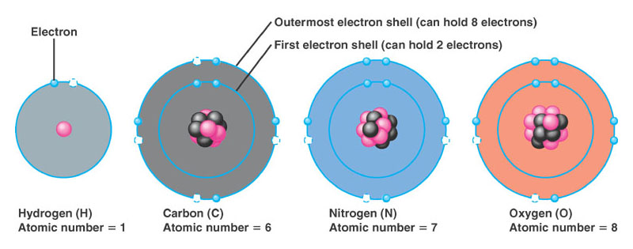
Atomic Charge
Ion - an atom that has charge because it has lost or gained electrons
Charge = # of protons - # of electrons
Notes:
Electrons are not unstructured around an atom’s nucleus. The arrangement of electrons around the nucleus impart unique chemical properties to different elements.
Electrons must be located within an electron shell. There are multiple electron shells each with a characteristic distance from the atom’s nucleus.

Slide 27
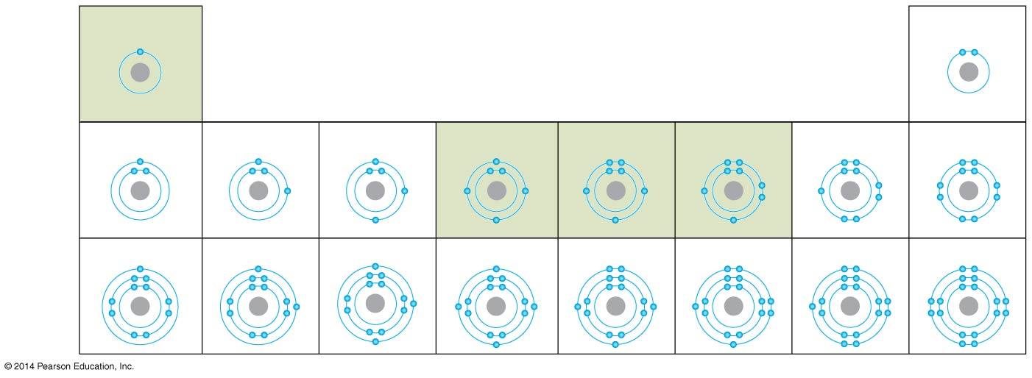
Electron shells
Hydrogen
Helium
First
shell
(2 e⁻)
Lithium
Beryllium
Boron
Carbon
Nitrogen
Oxygen
Fluorine
Neon
Second
shell
(8 e⁻)
Sodium
Magnesium
Aluminum
Silicon
Phosphorus
Sulfur
Chlorine
Argon
Third
shell
(8 e⁻)
Atoms are most stable when the outer most electron shells are filled
1st shell holds up to 2 electrons
2nd shell holds up to 8 electrons
3rd shell holds up to 8 electrons
Notes:
Figure 2.5b-0 The electron distribution diagrams of the first 18 elements in the periodic table
The number of electons in the outer shell determine the atom’s chemical properties. Atom’s with open spaces in there electron shells are attracted to other atoms to fill their shells. Atom’s with filled electron shells are very stable and do no readily interact with other atoms.

Slide 28
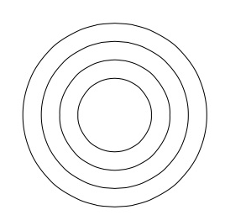
Atomic Structure
Please put the correct number of electrons in the correct shell and give the correct number of protons and neutrons in the nucleus. Fill in the chart for each element.
Atomic mass
# of protons
# of neutrons
# of electrons
Isotope? (yes/no)
Ion? (yes or no)
1
H
1)
1
3
Li⁺
2)
7
17
Cl⁻
3)
35
Notes:
# of neutrons = atomic mass – atomic #
# electrons = # protons - charge

Slide 29
Electron shells
Hydrogen
Helium
First
shell
(2 e⁻)
Lithium
Beryllium
Boron
Carbon
Nitrogen
Oxygen
Fluorine
Neon
Second
shell
(8 e⁻)
Sodium
Magnesium
Aluminum
Silicon
Phosphorus
Sulfur
Chlorine
Argon
Third
shell
(8 e⁻)
number of electrons in the outer shell determine the atom’s chemical properties
atoms with unfilled outer shells are chemically unstable
Notes:
Figure 2.5b-0 The electron distribution diagrams of the first 18 elements in the periodic table
The number of electons in the outer shell determine the atom’s chemical properties. Atom’s with open spaces in there electron shells are attracted to other atoms to fill their shells. Atom’s with filled electron shells are very stable and do no readily interact with other atoms.

Slide 30
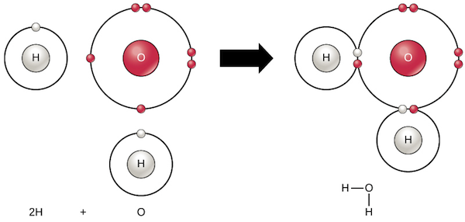
Chemical bonds form molecules
an attraction between two atoms so that the bonded atoms complete their outer electron shells
Notes:
An example of chemical bonding. The hydrogen and oxygen are held together by the bond and are not easily separated.

Slide 31
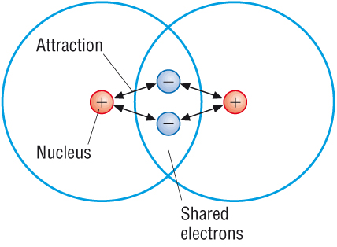
Covalent bond
Two atoms sharing electrons to fill their outer shell. Very strong bond.
Non-polar (equal sharing)
Polar (unequal sharing)
Notes:
In a covalent bond, two atoms, each with an unpaired electron in its outer shell, actually share a pair of electrons.
Two or more atoms held together by covalent bonds form a molecule.
A covalent bond connects two hydrogen atoms in a molecule of the gas H₂.
Extremely strong, hard to break once formed.

Slide 32
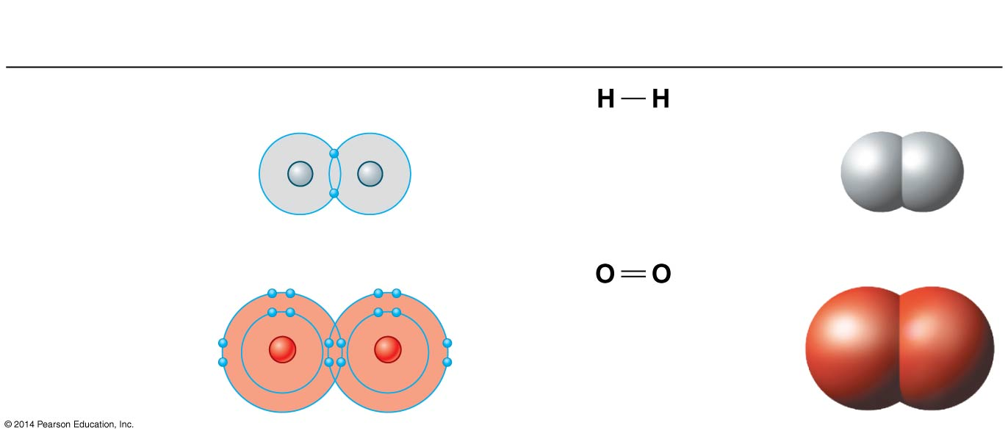
Non-polar Covalent Bonds
Molecular
Formula
Electron Distribution
Diagram
Structural
Formula
Space-Filling
Model
H₂
Hydrogen
Single bond
H
H
O₂
Oxygen
Double bond
O
O
Two atoms share electrons equally
Notes:
Note: point out different notations. How models show the relationships.
Atoms in a covalently bonded molecule continually compete for shared electrons.
The attraction (pull) for shared electrons is called electronegativity.
More electronegative atoms pull harder.
In molecules of only one element, the pull toward each atom is equal, because each atom has the same electronegativity.
The bonds formed are called nonpolar covalent bonds.

Slide 33
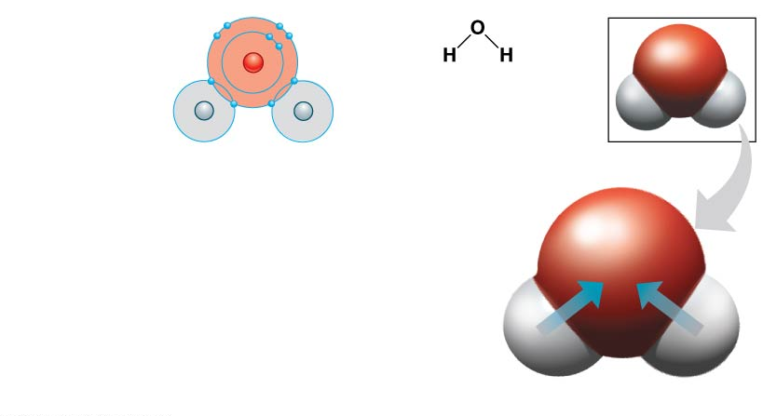
Polar Covalent Bonds
Molecular
Formula
Electron Distribution
Diagram
Structural
Formula
Space-Filling
Model
H₂O
Water
O
H
H
Polar covalent
bonds
(slightly −)
One atom of the pair pulls more strongly on the shared electron
O
(slightly +)
H
(slightly +)
H
Polar covalent bonds in a water molecule
Notes:
Note: point out different notations. How models show the relationships.
Atoms in a covalently bonded molecule continually compete for shared electrons.
The attraction (pull) for shared electrons is called electronegativity.
More electronegative atoms pull harder.
Water has atoms with different electronegativities.
Oxygen attracts the shared electrons more strongly than hydrogen.
So the shared electrons spend more time near oxygen.
The oxygen atom has a slightly negative charge and the hydrogen atoms have a slightly positive charge.
The result is a polar covalent bond.

Slide 34
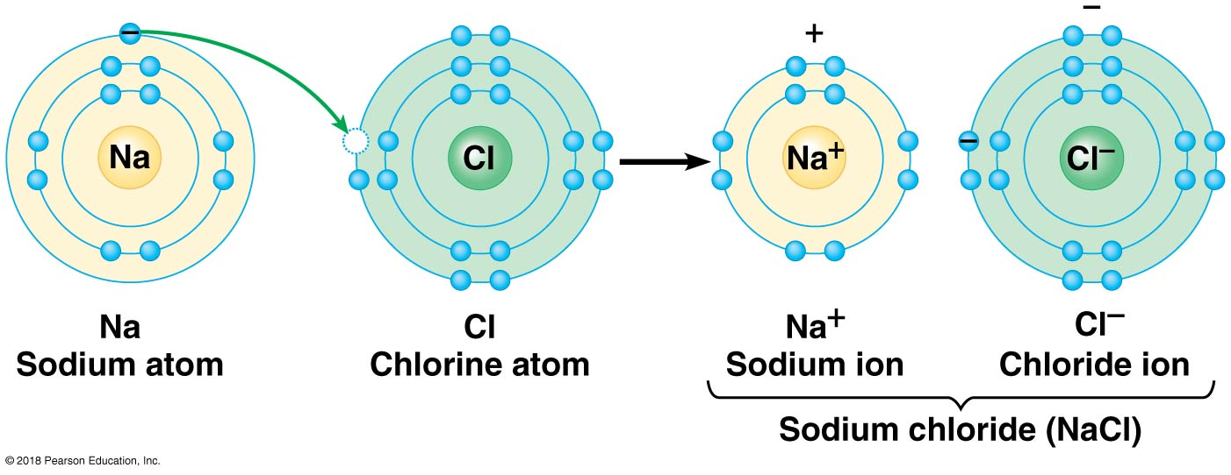
Ionic Bonds
cation
anion
Two ions with opposite charges attract each other. Weak, reversible bond.
Notes:
Charge = # of protons - # of electrons
An ion is an atom or molecule with an electrical charge resulting from gain or loss of one or more electrons.
When an electron is lost, a positive charge results.
When an electron is gained, a negative charge results.
Two ions with opposite charges attract each other.
When the attraction holds the ions together, it is called an ionic bond.
Salt is a synonym for an ionic compound.
Much weaker bonds. Fairly easy to break apart.

Slide 35
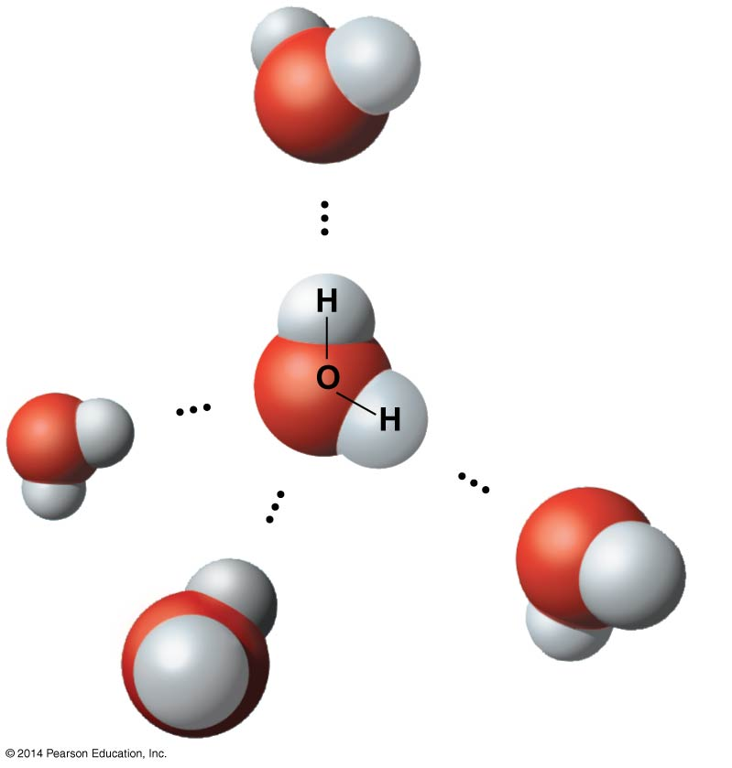
Hydrogen Bonds
Polar covalent bonds create partial positive charges on hydrogen atoms. They are attracted to a nearby atom that has a partial negative charge.
(−)
Hydrogen
bond
(+)
Polar covalent
bonds
(+)
(−)
(−)
(+)
(−)
(+)
Weak bonds
Reversible
Very important for cellular function
Notes:
In living organisms, most of the strong chemical bonds are covalent, linking atoms to form a cell’s molecules.
Crucial to the functioning of a cell are weaker bonds within and between molecules.
One of the most important types of weak bonds is the hydrogen bond, which is best illustrated with water molecules.
Very weak bonds. When a molecule with a polar covalent charge has a slightly positively charged hydrogen atoms with attracts other slightly negatively charged atoms.
This partial positive charge allows each hydrogen to be attracted to a nearby atom that has a partial negative charge.

Slide 36
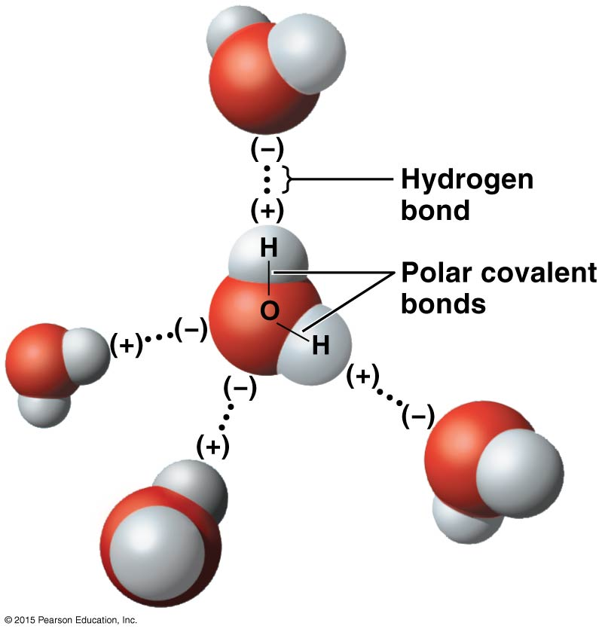
0
Water molecules form hydrogen bonds because
the water molecule
is polar.
the oxygen molecule is positively charged.
the water molecule forms a tetrahedron.
the hydrogen atoms are negatively charged.
Notes:
36
Answer: a

Slide 37
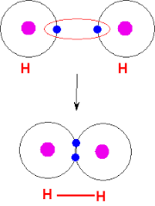
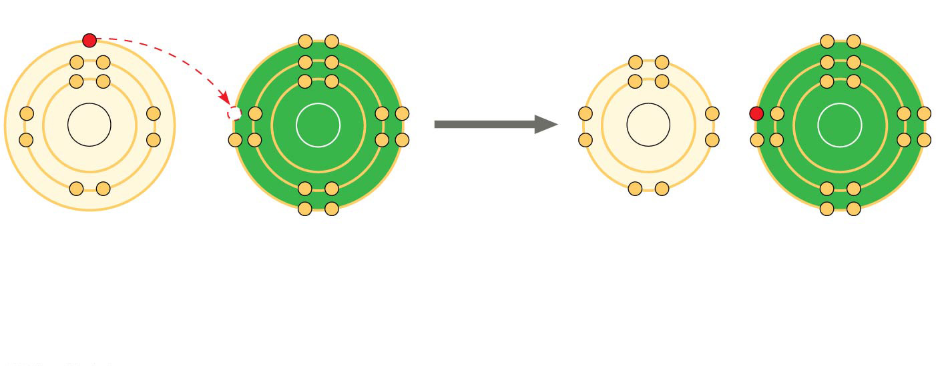
Strong Chemical Bonds
Weak Chemical Bonds
Require a lot of energy to break
Covalent bonds
Easily reversible
Ionic bonds
Hydrogen bonds
Notes:
Compare and contrast strong and weak bonds. Emphasize that both are essential for functioning in living organisms.
This slide could use some reorganization or clarifiication. I feel like its clunky.

Slide 38
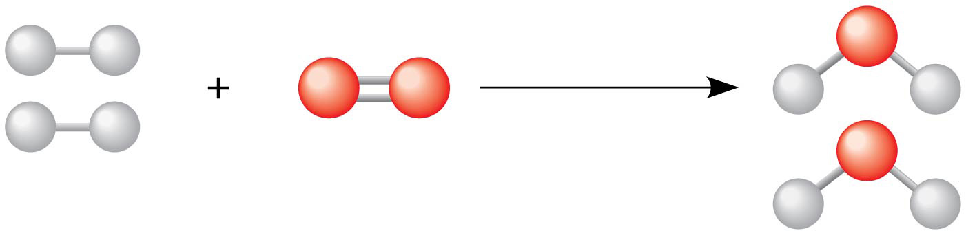
Chemical reactions make and break chemical bonds
The starting molecules of a chemical reaction are called reactants
The final molecules of a chemical reaction are called products
Reactants
Reaction
Products

Slide 39
Conservation of matter
Chemical reactions do not create or destroy matter.
Chemical reactions only rearrange matter.
Reactants
Reaction
Products
Notes:
Point out that there are 4 hydrogen atoms before the reaction and 4 after, 2 oxygen atoms before and 2 after.

Slide 40
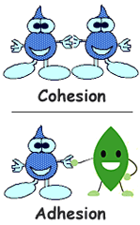
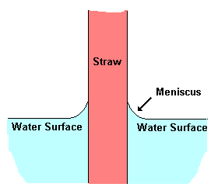
Water’s emergent properties
Water is Chemically “sticky”
Notes:
The tendency of molecules of the same kind to stick together is cohesion.
Cohesion is much stronger for water than for other liquids.
Most plants depend upon cohesion to help transport water and nutrients from their roots to their leaves.
The tendency of two different kinds of molecules
to stick together is adhesion.

Slide 41
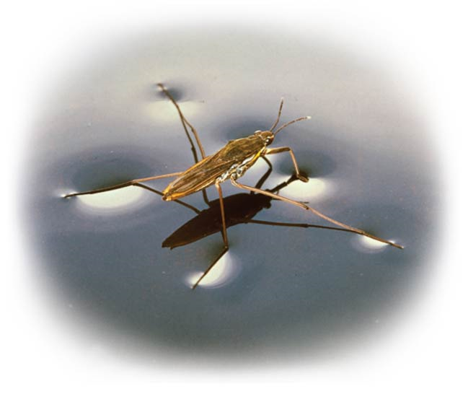
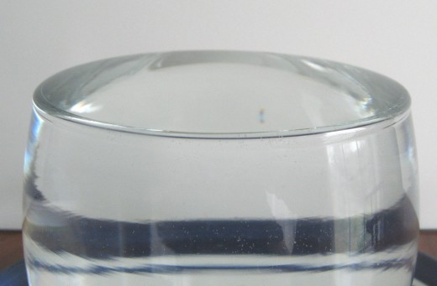
Water’s emergent properties
Cohesion contributes to surface tension
Notes:
Cohesion is related to surface tension—a measure of how difficult it is to break the surface of a liquid.
Hydrogen bonds give water high surface tension, making it behave as if it were coated with an invisible film.

Slide 42
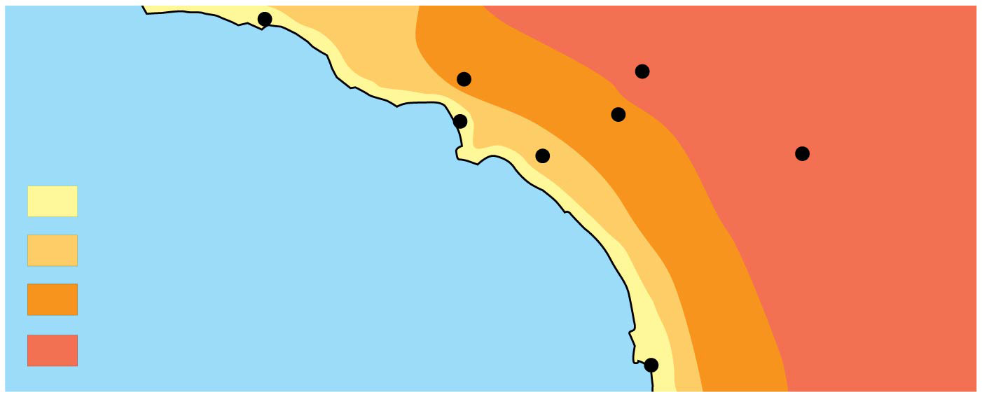

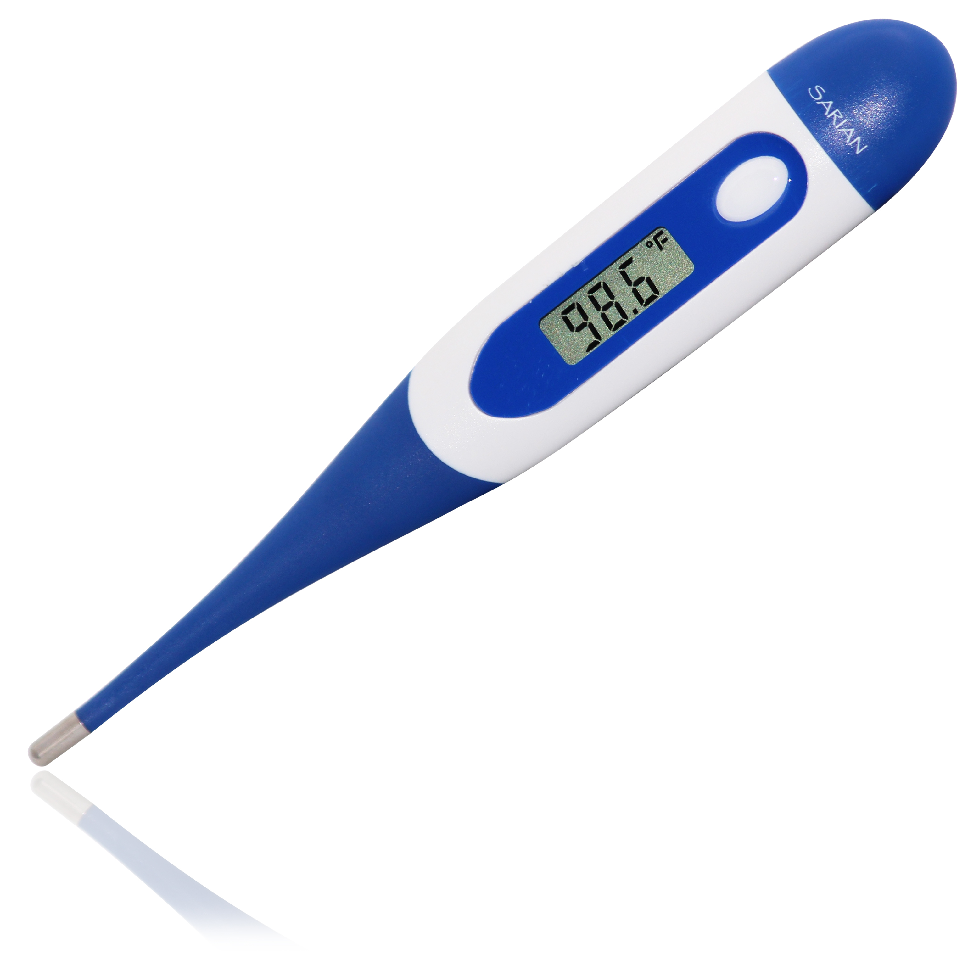
Water’s emergent properties
Burbank
90°
San Bernardino
100°
Santa Barbara 73°
Los Angeles
(Airport) 75°
Riverside 96°
Santa Ana
84°
70s (°F)
80s
90s
100s
Palm Springs
106°
Pacific Ocean 68°
San Diego 72°
40 miles
Regulates Temperature
Notes:
Water’s high specific heat can be traced to hydrogen bonding
Heat is absorbed when hydrogen bonds break
Heat is released when hydrogen bonds form
The high specific heat of water minimizes temperature fluctuations to within limits that permit life
Examples: costal regions moderated by ocean
Internal body temp
Lakes don’t freeze at 32F air temp

Slide 43

Water’s emergent properties
Regulates Temperature - Evaporative Cooling
Notes:
When a substance evaporates, the surface of the liquid that remains behind cools down; this is the process of evaporative cooling.
This cooling occurs because the molecules with the greatest energy leave the surface.
Ex: sweating to cool down

Slide 44
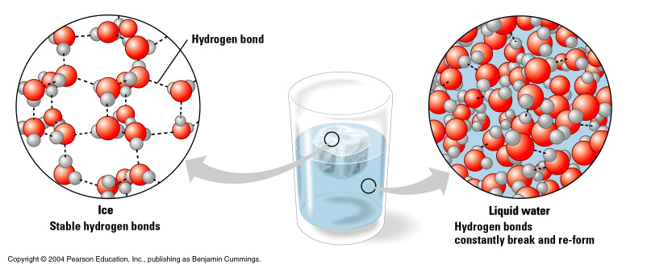
Water’s emergent properties
Solid water is less dense than liquid

Slide 45
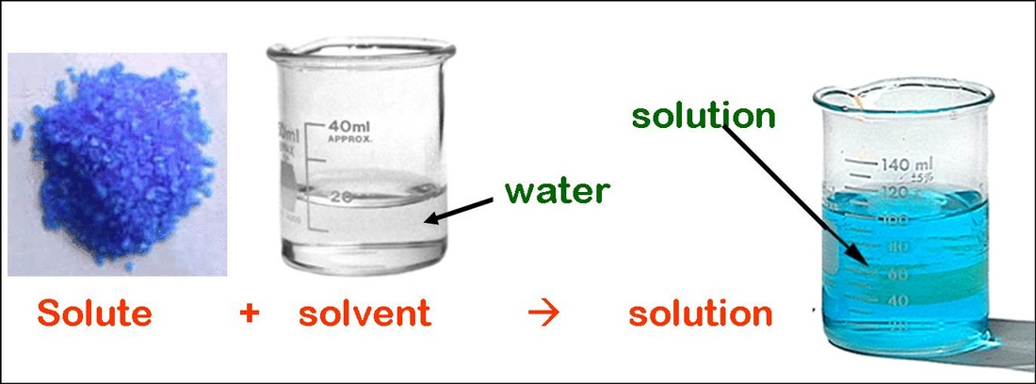
Water is the universal solvent
Notes:
A solution is a liquid consisting of a uniform mixture of two or more substances.
The dissolving agent is the solvent.
The substance that is dissolved is the solute.
An aqueous solution is one in which water is the solvent.

Slide 46
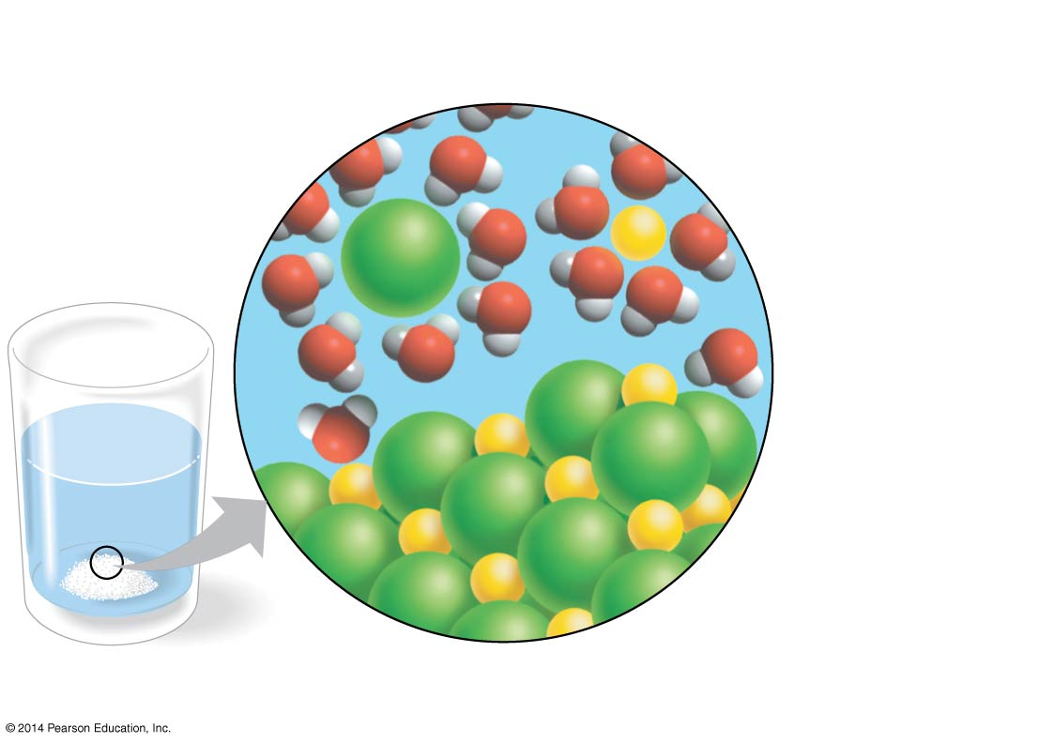
Why Water is a Great Solvent
Positive hydrogen ends of
water molecules attracted
to negative chloride ion
Negative oxygen ends of
water molecules attracted
to positive sodium ion
Na⁺
Cl⁻
−
+
−
+
Cl⁻
−
+
−
Na⁺
+
+
−
+
−
−
+
−
−
+
Salt crystal

Slide 47
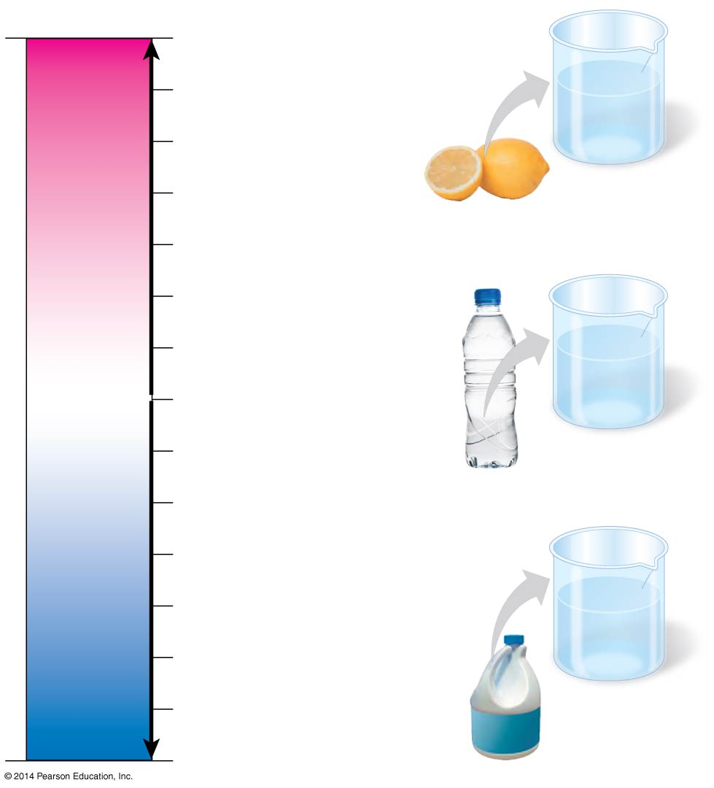
pH
pH scale
0
1
Battery acid
H⁺
H⁺
H⁺
OH⁻
H⁺
Lemon juice,
gastric juice
OH⁻
H⁺
2
H⁺
H⁺
H⁺
Measures the concentration of H⁺ ions in a solution
Log scale. Each step is 10X more concentrated than last.
3
Vinegar, cola
Acidic
solution
Increasingly ACIDIC
(Higher H⁺ concentration)
4
Tomato juice
5
Rainwater
6
Human urine
Saliva
OH⁻
H⁺
OH⁻
NEUTRAL
[H⁺] = [OH⁻]
H⁺
OH⁻
OH⁻
7
Pure water
Human blood, tears
H⁺
OH⁻
H⁺
H⁺
8
Seawater
Neutral
solution
9
10
Increasingly BASIC
(Higher OH⁻ concentration)
Milk of magnesia
11
OH⁻
OH⁻
Household ammonia
OH⁻
H⁺
OH⁻
12
OH⁻
OH⁻
H⁺
OH⁻
Household bleach
13
Basic
solution
Oven cleaner
14
Notes:
The pH scale describes how acidic or basic a solution is.
The pH scale ranges from 0 to 14, with 0 the most acidic and 14 the most basic.
Each pH unit represents a 10-fold change in the concentration of H⁺ in a solution.
pH is measure of [H⁺] in solution
neutral pH = ?
acidic pH = ?
basic (alkaline) pH =?
pH and [H⁺] are inversely related
buffers prevent big changes in pH

Slide 48
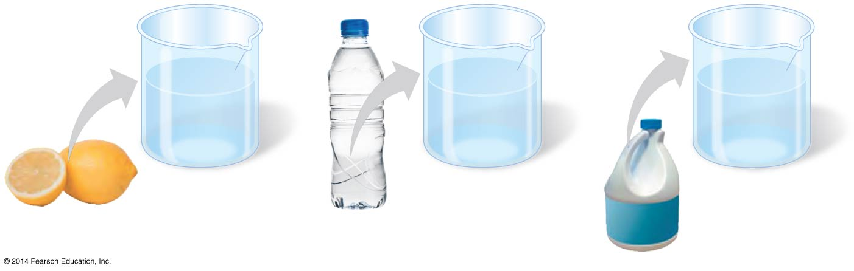
pH
H⁺
H⁺
OH⁻
H⁺
OH⁻
OH⁻
OH⁻
H⁺
OH⁻
H⁺
OH⁻
OH⁻
H⁺
OH⁻
H⁺
H⁺
OH⁻
OH⁻
OH⁻
OH⁻
H⁺
H⁺
H⁺
H⁺
H⁺
H⁺
OH⁻
H⁺
OH⁻
Acidic
solution
Neutral
solution
Basic
solution
pH=2 pH=7 pH=12.5
Notes:
The pH scale describes how acidic or basic a solution is.
The pH scale ranges from 0 to 14, with 0 the most acidic and 14 the most basic.
Each pH unit represents a 10-fold change in the concentration of H⁺ in a solution.
A substance that donates hydrogen ions to solutions is called an acid.
A base is a substance that reduces the hydrogen ion concentration of a solution.

Slide 49
How much more acidic?
pH scale
0
1
2
Lemon juice is pH 2
Water is pH 7
How much more acidic is lemon juice than water?
Count the steps on the scale = 5 steps
Lemon juice is 10⁵ more acidic than water or 100,000 times more acidic.
3
Increasingly ACIDIC
(Higher H⁺ concentration)
4
5
6
NEUTRAL
[H⁺] = [OH⁻]
7
8
9
10
Increasingly BASIC
(Higher OH⁻ concentration)
11
12
13
14

Slide 50
Your turn…
pH scale
0
1
2
Tomato juice is pH 4
Seawater is pH 8
How much more acidic is tomato juice than sea water?
3
Increasingly ACIDIC
(Higher H⁺ concentration)
4
5
6
NEUTRAL
[H⁺] = [OH⁻]
7
8
9
10
Increasingly BASIC
(Higher OH⁻ concentration)
11
12
13
14
Notes:
10⁴ = 10,000 times more acidic

Slide 51
Atomic Structure Homework Due Tuesday at 8am
Go to Blackboard
Download and print the “Atomic Structure” homework from the homework folder
Complete the homework and turn in a hard copy on Tuesday
Chapter 2 Dynamic Study Module Due Tuesday at 8am
Complete on Mastering Biology site.

