Slide 1
FAULTY LOGIC
Recognizing and Avoiding Faulty Logic

Slide 2
What is Faulty Logic?
Faulty logic is unsound reasoning
Logic can be flawed in a number of specific ways
Keep in mind that just because it is unsound doesn’t mean people don’t use it intentionally
Newspapers, commercials, print ads, informal conversations, political debates and speeches, magazines, books, and more…

Slide 3
Why Study Faulty Logic?
Understanding faulty logic can:
help you become a more astute consumer of media, products, and information
Argue your points more soundly
Argue against your opposition more easily

Slide 4
Types of Faulty Reasoning
Circular reasoning /Tautological Reasoning
Overgeneralization
Self-Contradictory
False Causality/Post hoc, ergo propter hoc
Oversimplification
Assumption
Ad Hominem
Either or Fallacy

Slide 5
Circular Reasoning
The writer (or speaker or ad) supports a claim with restatements of that same claim. The argument goes around and around with the reason making the same claim as the original argument.
A way of saying nothing
Ex) Rachel is a good student because she gets good grades.
Ex) Larry is handsome because he is very good looking.

Slide 6
Overgeneralization
The writer reaches a conclusion based on a generalization/
Look out for the words: all, every, always, and never.
Ex) All athletes earn enormous sums of money.
Ex) Because my niece likes to spend time with me, I know that children like me.

Slide 7
Self-Contradictory
The writer makes two plainly contradictory statements.
Often used as a type of misdirection
Ex) As Mayor, my top priority will be improving education, so my first act of office will be to cut funding for our public schools.

Slide 8
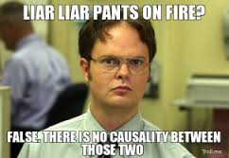
False Causality
Post hoc, ergo propter hoc: “After this, therefore because of this”
Two things can be connected, and the writer assumes that one event caused the other.
Ex) Our house was burglarized right after that new family moved in next door.
Ex) It has been proven that many heroin addicts smoked marijuana in their youth. Therefore, smoking marijuana leads to heroin addiction.

Slide 9
Oversimplification
This occurs when a single cause is assumed to have created a problem or an issue. In reality, the problem or issue may have been created by a number of causes.
Look for blatantly missing information.
Ex) The Civil War was caused by a national debate about slavery.

Slide 10
Assumption
This most often occurs when an author states a personal opinion as if it is a fact.
The statement may be true, but it isn’t based on evidence.
Ex) Yosemite Valley is the most beautiful place in America.
Ex) My brother is the worst person I know.

Slide 11
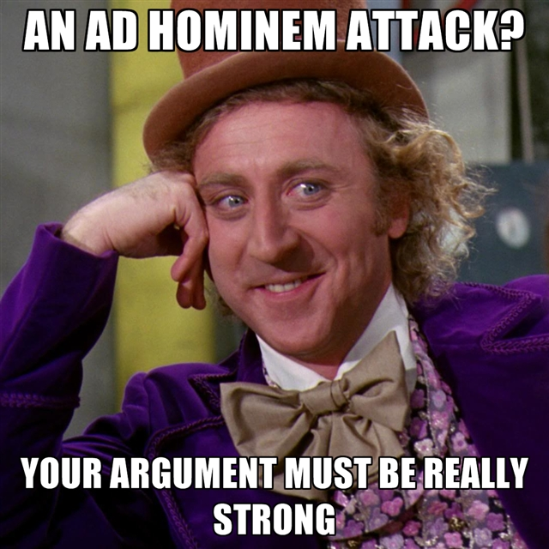
Ad Hominem
Ad Hominem: "Against the person."
Attacking a person’s character rather than addressing that person’s argument
Ex) Ms. Bauer is incorrect when she argues that we should build a new parking lot. She doesn’t even own a car.
Ex) How can you argue your case for vegetarianism when you are enjoying your steak?

Slide 12
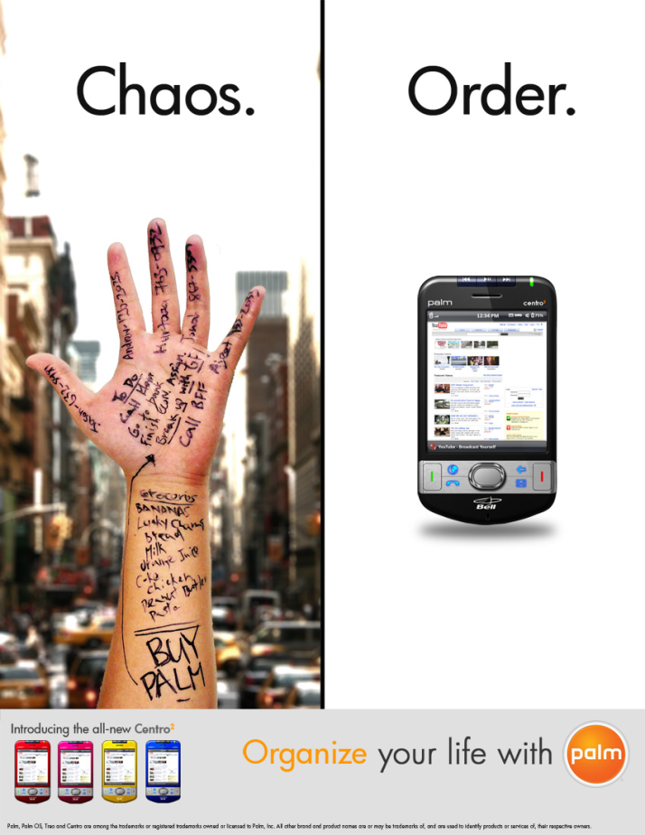
Either or Fallacy
The writer presents only two options and fails to acknowledge any middle ground or alternate options.
Ex) Either we continue to
build weapons or we will
fall prey to the demands
of other countries.

Slide 13
Review
Circular reasoning /Tautological Reasoning
Overgeneralization
Self-Contradictory
False Causality/Post hoc, ergo propter hoc
Oversimplification
Assumption
Ad Hominem
Either or Fallacy

