Slide 1
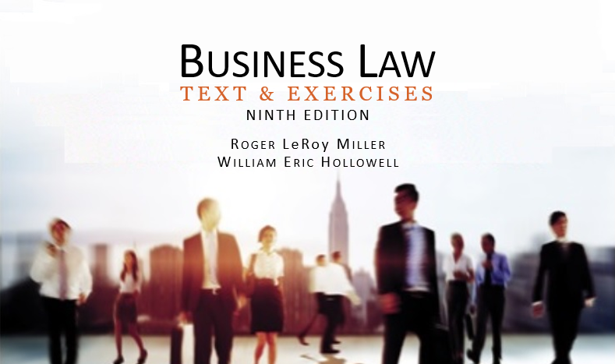
Business Law Text & Exercises Ninth Edition Roger LeRoy Miller William Eric Hollowell
Chapter 8 Introduction to Contracts

Slide 2
Learning Outcomes
LO1 List the four requirements of a contract.
LO2 Contrast express and limited contracts.
LO3 Distinguish valid, voidable, unenforceable, and void contracts.
LO4 Understand the plain meaning rule.

Slide 3
The Definition of a Contract (1)
An agreement that can be enforced in a court. It is formed by two or more parties who agree to perform, or refrain from performing, some act now or in the future.

Slide 4
The Definition of a Contract (2)
The Objective Theory of Contracts.
The view that the intent to contract should be determined by outward, objective facts.

Slide 5
The Basic Requirements of a Contract (1)
Agreement.
Consideration.
Capacity.
Legality.
LO1

Slide 6
The Basic Requirements of a Contract (2)
Defenses to Enforceability.
Voluntary consent.
Form.

Slide 7
Types of Contracts (1)
Bilateral versus Unilateral Contracts.
Offeror: A person who makes an offer. The offeror always promises to do something; also a promisor.
Offeree: A person to whom an offer is made.

Slide 8
Types of Contracts (2)
Express versus Implied Contracts.
Express: A contract that is stated in words, oral and/or written (as opposed to an implied contract).
Implied: A contract formed in whole or in part from the conduct of the parties (as opposed to an express contract).
LO2

Slide 9
Types of Contracts (3)
Quasi Contracts.
Contracts implied in law.
A fictional contract imposed by law to prevent unjust enrichment.

Slide 10
Types of Contracts (4)
Formal vs. Informal Contracts.
Formal: An agreement or contract that by law requires for its validity a specific form, such as execution under seal.
Informal: A contract that does not require a specified form or formality for its validity.

Slide 11
Types of Contracts (5)
Executed vs. Executory Contracts.
Executed: A contract that has been completely performed by both parties.
Executory: A contract that has not yet been fully performed.

Slide 12
Types of Contracts (6)
Valid, Voidable, Unenforceable, and Void Contracts.
Valid: A properly constituted contract having legal strength or force.
Voidable: A contract that may be legally annulled at the option of one of the parties.

Slide 13
Types of Contracts (7)
Valid, Voidable, Unenforceable, and Void Contracts.
Unenforceable: A valid contract having no legal effect or force in a court action.
Void: A contract having no legal force or binding effect.

Slide 14
Types of Contracts (8)
E-Contracts.
Contracts entered into online.
Require the same four requirements as valid paper contracts.

Slide 15
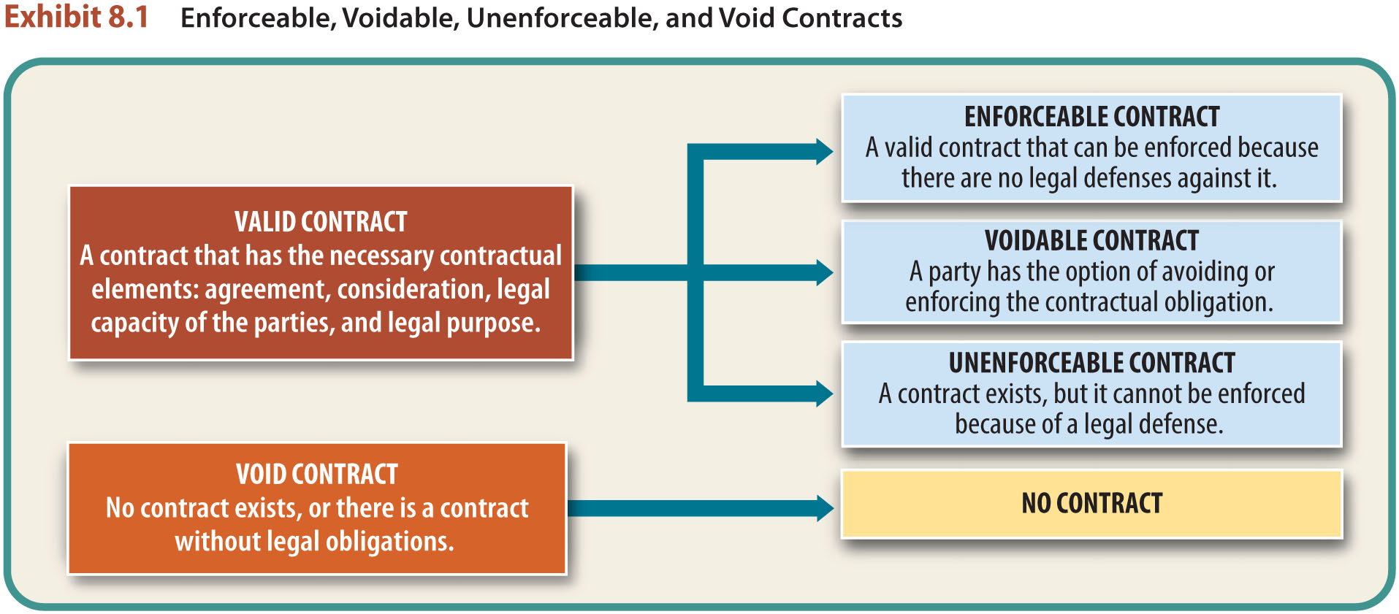
LO3 Enforceable, Voidable, Unenforceable, and Void Contracts
LO3

Slide 16
Interpretation of Contracts (1)
The Plain Meaning Rule.
If language of contract is clear, the court will enforce the contract according to obvious and ordinary meaning of terms.
LO4

Slide 17
Interpretation of Contracts (2)
Ambiguity and Outside Evidence.
If language is ambiguous, court will consider outside (extrinsic) evidence when:
Intent of parties is not clear.
Contract lacks a provision on a disputed issue.

Slide 18
Interpretation of Contracts (3)
Ambiguity and Outside Evidence.
If language is ambiguous, court will consider outside (extrinsic) evidence when:
Contract can be interpreted in more than one way.
Uncertainty about a provision.

Slide 19
Interpretation of Contracts (4)
Ambiguity and Outside Evidence.
To interpret contract, court will consider:
Oral testimony.
Other agreements or communications between the parties.
Court will interpret contract against party drafting it.

