Slide 1
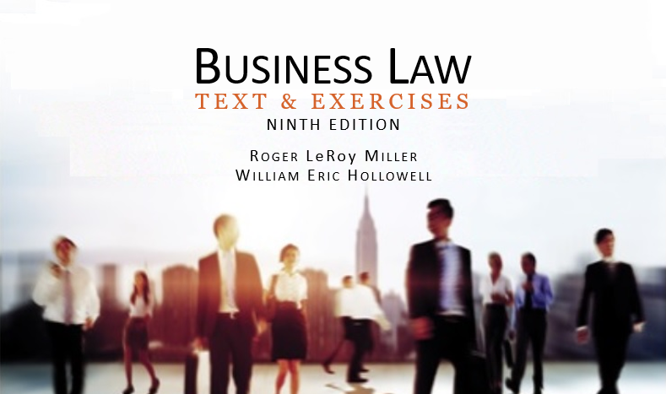
Business Law Text & Exercises Ninth Edition Roger LeRoy Miller William Eric Hollowell
Chapter 30 Management of a Corporation

Slide 2
Learning Outcomes
LO1 Discuss corporate directors’ management responsibilities.
LO2 State the primary function of corporate officers.
LO3 Define the business judgment rule.
LO4 Explain director and officer liabilities.

Slide 3
Corporate Management— Directors (1)
Every corporation is governed by a board of directors.
Directors have responsibility for all policymaking decisions necessary to the management of corporate affairs.

Slide 4
Corporate Management— Directors (2)
Election of Directors.
Number of directors set forth in articles of incorporation.
Initial board of directors appointed at the first organizational meeting.

Slide 5
Corporate Management— Directors (3)
Election of Directors.
In closely held companies, directors are generally the incorporators and/or the shareholders.
Term of office is generally for one year.

Slide 6
Corporate Management— Directors (4)
Removal of Directors.
Director can be removed for cause (for failing to perform a required duty).
Vacancies.
Vacancies can be filled based on state law or corporate bylaws.

Slide 7
Corporate Management— Directors (5)
Board of Directors’ Meetings.
Holding formal meetings with recorded minutes.
Generally, date and frequency of meetings is established in the bylaws.

Slide 8
Corporate Management— Directors (6)
Board of Directors’ Meetings.
Quorum varies by jurisdiction.
Voting.
One-vote-per-director.
Ordinary matters require majority vote.

Slide 9
Corporate Management— Directors (7)
Directors’ Responsibilities.
Directors have responsibility for all policy-making decisions, including:
Authorization for major corporate policy decisions.
Appointment, supervision, and removal of top corporate officers.
LO3

Slide 10
Corporate Management— Directors (8)
Directors’ Responsibilities.
Directors have responsibility for all policy-making decisions, including:
Major financial decisions, such as the declaration and payment of dividends to shareholders or the issuance of authorized shares (stocks) or bonds.
LO3

Slide 11
Corporate Management— Directors (9)
Directors’ Responsibilities.
The board can delegate some of its functions to an executive committee or to corporate officers.
But, the board is not relieved of its overall fiduciary responsibilities.
LO3

Slide 12
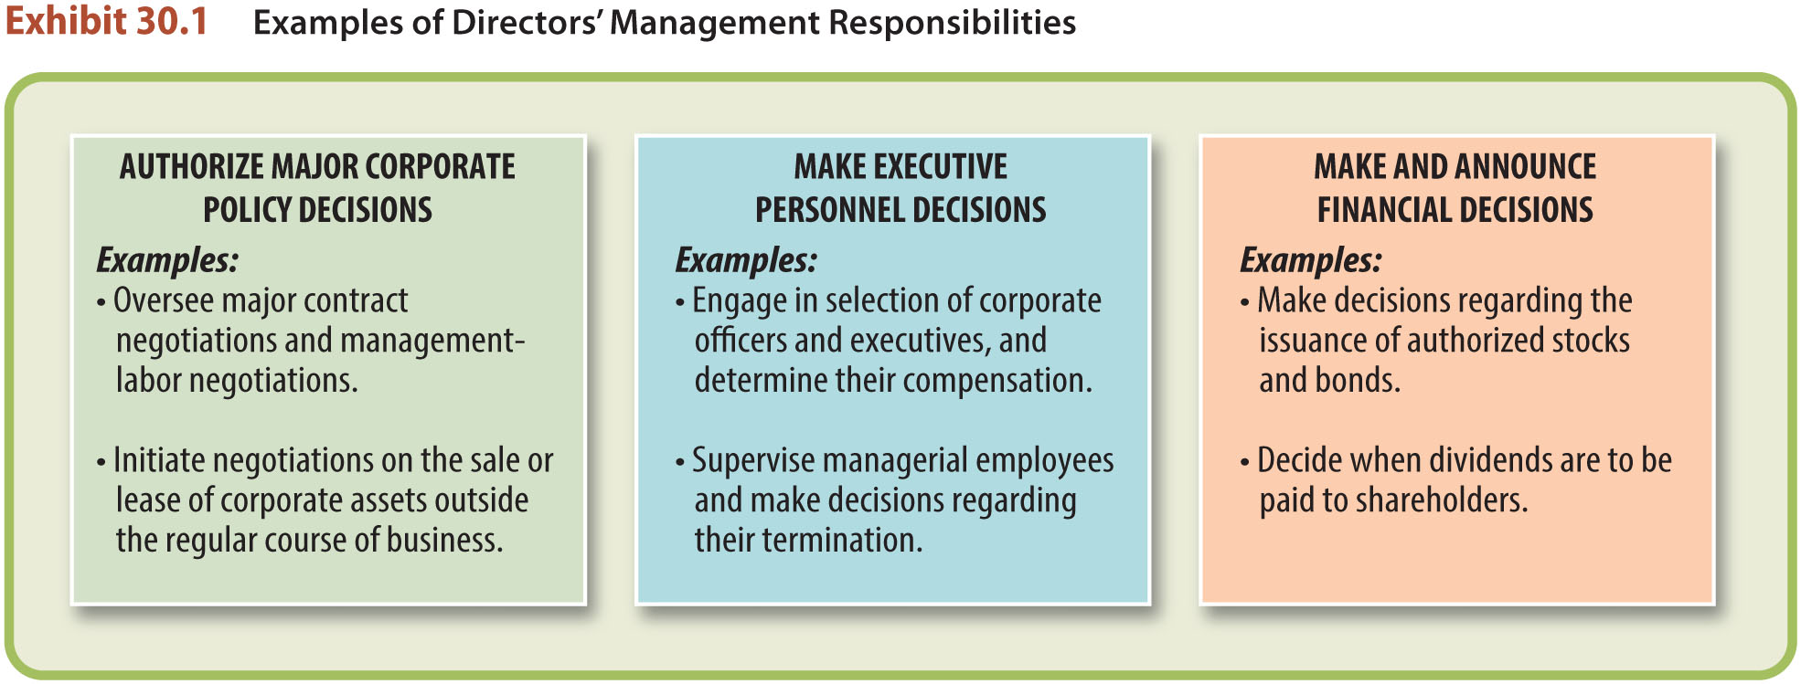
Corporate Management— Directors (10)

Slide 13
Corporate Management— Directors (11)
Directors’ Rights.
Right to Participation.
Right of Inspection.
Right to Indemnification.

Slide 14
Corporate Management— Officers (12)
The Role of Corporate Officers.
Primarily manage corporate policies and make daily business decisions.
Qualifications are within discretion of the board, and included in bylaws.
Can be removed by board.
Rights are defined by employment contracts.
LO2

Slide 15
Duties of Directors and Officers (1)
Duties of Directors and Officers.
Directors and officers are fiduciaries of the corporation, they owe ethical and legal duties to the corporation and shareholders:
Duty of Care.
Duty of Loyalty.

Slide 16
Duties of Directors and Officers (2)
Duty of Care.
Expected to act in good faith and the best interests of the corporation, make informed and reasonable decisions, rely on competent consultants and experts; and exercise reasonable supervision.

Slide 17
Duties of Directors and Officers (3)
Duty of Loyalty.
Subordination of personal interests to the welfare of the corporation.
No competition with corporation, no “corporate opportunity, no conflict of interests, no insider trading.

Slide 18
Duties of Directors and Officers (4)
The Business Judgment Rule.
Immunizes a director or officer from liability from consequences of a business decision that turned sour.
Court will not require directors or officers to manage “in hindsight.”
LO3

Slide 19
Duties of Directors and Officers (5)
The Business Judgment Rule.
As long as decision was reasonable, informed, made in good faith and in the best interests of the corporation, the business judgment rule will apply.
LO3

Slide 20
LO4 Liability of Directors and Officers (1)
LO4
Directors and officers may be held liable for:
Negligence in the performance of their duties.
Torts and crimes of employees under their supervision.

Slide 21
LO4 Liability of Directors and Officers (2)
LO4
Directors and officers may be held liable for:
Violations of a variety statutes.
Accuracy of financial statements and reports filed with SEC.

