Slide 1
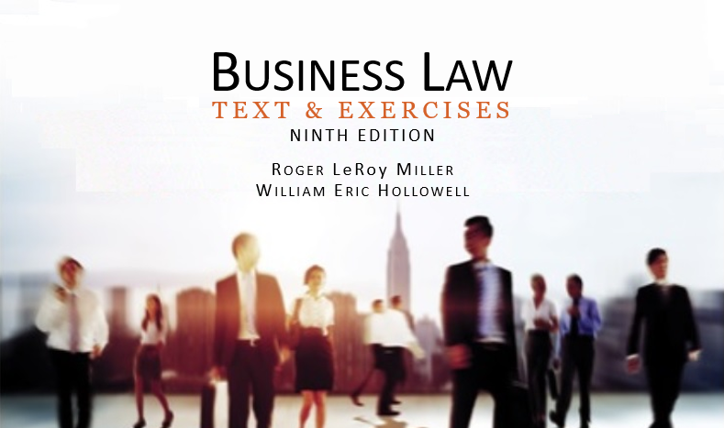
Business Law Text & Exercises Ninth Edition Roger LeRoy Miller William Eric Hollowell
Chapter 23 Negotiable Instruments: Transfer and Liability

Slide 2
Learning Outcomes
LO1 List the requirements for holder-in-due-course status.
LO2 Describe signature liability.
LO3 Identify transfer warranties.
LO4 Understand the defenses against the payment of negotiable instruments.

Slide 3
Introduction (1)
Ordinary Holder
Person who, by the terms of the instrument, is legally entitled to enforce payment of it.
An ordinary holder obtains only those rights that the predecessor-transferor had in the instrument.

Slide 4
Introduction (2)
Holder-in-Due-Course (HDC):
Holder who acquires a negotiable instrument for value; in good faith; and without notice of a defect (overdue, dishonored, or any other defense or claim).

Slide 5
LO1 Requirements for HDC Status (1)
LO1
An HDC must hold the instrument:
For value.
In good faith.
Without notice that it is defective.

Slide 6
Requirements for HDC Status (2)
Taking for Value. A holder takes an instrument for value if:
Performed the promise for which the instrument was issued or transferred.
Acquired a security interest or lien in the instrument.

Slide 7
Requirements for HDC Status (3)
Taking for Value. A holder takes an instrument for value if:
Taken an instrument in payment of, or security for, an antecedent debt.
Given a negotiable instrument as payment.
Given as payment a commitment that cannot be revoked.

Slide 8
Requirements for HDC Status (4)
Taking in Good Faith.
Good faith is honesty in fact and the observance of reasonable commercial standards of fair dealing.
The good faith requirement applies only to the holder.

Slide 9
Requirements for HDC Status (5)
Taking Without Notice.
A person will not be afforded HDC protection if he acquires an instrument knowing, or having reason to know, that it is defective in any one of the following ways:

Slide 10
Requirements for HDC Status (6)
Taking Without Notice.
It is overdue.
It has been dishonored.
There is an uncured default with respect to another instrument issued as part of the same series.

Slide 11
Requirements for HDC Status (7)
Taking Without Notice.
It contains an unauthorized signature or has been altered.
There is a defense against or claim to it.
It is so irregular or incomplete as to call into question its authenticity.

Slide 12
Requirements for HDC Status (8)
Taking Without Notice.
What Constitutes Notice?
Notice of a defective instrument is given when the holder has:
Actual knowledge of a defect.
Receipt of a notice about a defect.
Reason to know that a defect exists.

Slide 13
Requirements for HDC Status (9)
Taking Without Notice.
Overdue Instruments.
Definition varies depending upon whether it is a time instrument or a demand instrument.

Slide 14
LO2 Signature Liability (1)
LO2
A person is not liable on an instrument unless:
The person signed the instrument.
The person is represented by an agent or authorized representative who signed the instrument.

Slide 15
LO2 Signature Liability (2)
LO2
Primary Liability.
Primary liability is unconditional.
Acceptor: person (the drawee) who accepts a draft and who engages to be primarily responsible for its payment.

Slide 16
LO2 Signature Liability (3)
LO2
Secondary Liability.
Secondary parties promise to pay on that instrument only if the following events occur:
It is properly and timely presented.
It is dishonored.
If secondarily party is an unqualified indorser, timely notice of dishonor is given.

Slide 17
LO2 Signature Liability (4)
LO2
Proper and Timely Presentment.
By any commercially reasonable means, including oral, written, or electronic communication (but presentment is not effective until the demand for payment or acceptance is received).

Slide 18
LO2 Signature Liability (5)
LO2
Proper and Timely Presentment.
Through a clearinghouse procedure used by banks, such as for deposited checks.
At the place specified in the instrument for acceptance or payment.

Slide 19
LO2 Signature Liability (6)
LO2

Slide 20
LO2 Signature Liability (7)
LO2
Dishonor and Proper Notice.
Once an instrument is dishonored, reasonable notice must be given to hold secondary parties liable.
Oral notice, written notice, or electronic notice (notice by fax, modem, e-mail, and the like) and notice written or stamped on the instrument itself.

Slide 21
LO2 Signature Liability (8)
LO2
Unauthorized Signatures.
Unauthorized signatures are wholly inoperative and will not bind the person whose name is forged, with two exceptions:
(1) The person whose name is signed ratifies it, or (2) If the person’s negligence led to the unauthorized signature.

Slide 22
LO2 Signature Liability (9)
LO2
Unauthorized Indorsements.
Imposter.
One who, with the intent to deceive, pretends to be somebody else.
Imposter’s signature is effective against the drawer or maker.

Slide 23
LO2 Signature Liability (10)
LO2
Unauthorized Indorsements.
Fictitious Payee.
Payee on a negotiable instrument whom the maker or drawer does not intend to have an interest in the instrument.

Slide 24
LO2 Signature Liability (11)
LO2
Unauthorized Indorsements.
Fictitious Payee.
Indorsements by fictitious payees are not forgeries under negotiable instruments law.

Slide 25
LO3 Warranty Liability (1)
LO3
Transfer Warranties.
Guaranty made by any person who transfers a negotiable instrument for consideration to all subsequent transferees and holders who take the instrument in good faith.

Slide 26
LO3 Warranty Liability (2)
LO4
Transfer Warranties.
The transferor is entitled to enforce the instrument.
All signatures are authentic and authorized.
The instrument has not been materially altered.

Slide 27
LO3 Warranty Liability (3)
LO4
Transfer Warranties.
The instrument is not subject to a defense or claim of any party that can be asserted against the transferor.
The transferor has no knowledge of any insolvency proceedings against the maker, the acceptor, or the drawer of an unaccepted instrument.

Slide 28
LO3 Warranty Liability (4)
Presentment Warranties.
A warranty made by any person who presents an instrument for payment or acceptance.

Slide 29
LO3 Warranty Liability (5)
Presentment Warranties.
Types:
The person obtaining payment or acceptance is entitled to enforce the draft or is authorized to obtain payment or acceptance on behalf of a person who is entitled to enforce the draft.

Slide 30
LO3 Warranty Liability (6)
Presentment Warranties.
Types:
The draft has not been altered.
The person obtaining payment or acceptance has no knowledge that the signature of the drawer of the draft is unauthorized.

Slide 31
LO4 Defenses (1)
LO4
Universal Defenses.
Can be used to avoid payment to all holders of a negotiable instrument, including a holder in due course (HDC).
Also called a real defense.

Slide 32
LO4 Defenses (2)
LO4
Universal (Real) Defenses.
Forgery.
Fraud in the execution.
Material alteration.
Discharge in bankruptcy.
Illegality, mental incapacity, or extreme duress.

Slide 33
LO4 Defenses (3)
LO4
Personal Defenses.
Can be used to avoid payment to an ordinary holder of a negotiable instrument.
But cannot be used to avoid payment to a holder in due course (HDC).

Slide 34
LO4 Defenses (4)
LO4
Personal Defenses.
Breach of contract or breach of warranty.
Fraud in the inducement.
Lack or failure of consideration.
Illegality, mental incapacity, or ordinary duress.

Slide 35
LO4 Defenses (5)
LO4
Personal Defenses.
Payment, cancellation, or material alteration.
Writing the word “Paid” across the face of an instrument constitutes cancellation.
Destruction and mutilation.

Slide 36
Discharge (1)
Discharge from Liability can occur by:
Payment.
Cancellation, or
Surrender.
HDC can discharge any party by cancellation.

Slide 37
Discharge (2)
Discharge from Liability can occur by:
Destruction or mutilation of an instrument is considered cancellation, ONLY if it is done with the intention of eliminating original debt.

