Slide 1
Business Law Text & Exercises Ninth Edition Roger LeRoy Miller William Eric Hollowell
Chapter 41 Administrative Law

Slide 2
Learning Outcomes
LO1 Identify how administrative agencies are created.
LO2 Outline the basic functions of administrative agencies.
LO3 State the controls on agency powers.
LO4 Describe federal laws that make agencies accountable.

Slide 3
Introduction
Administrative law is the rules, orders, and decisions of federal, state, and local government agencies established to perform a specific function.
Agencies provide a comprehensive regulatory scheme.

Slide 4
Agency Creation (1)
Enabling legislation: specifies the name, purposes, functions, and powers of the agency being created.
Two basic types of agencies: executive and regulatory.
LO1

Slide 5
Agency Creation (2)
Executive Agencies.
Cabinet-level departments of the Executive Branch and their sub-departments.

Slide 6
Agency Creation (3)
Independent Regulatory Agencies.
Outside major executive departments such as the Federal Aviation Administration or the Federal Communications Commission.

Slide 7
The Administrative Process (1)
Basic functions of an administrative agency:
Making rules.
Investigating activities regulated by the agency.
Adjudicating disputes between the agency and those affected by the agency’s rules.
LO2

Slide 8
The Administrative Process (2)
Rulemaking: formulation of new regulations.
Notice and Comment Rulemaking:
Notice of the Proposed Rulemaking (NPRM).
Comment Period.
The Final Rule.

Slide 9
The Administrative Process (3)
Rulemaking: Notice.
Agency publishes notice of new rule in the Federal Register.
Notice states where and when proceedings will be held, agency authority, and subject matter.

Slide 10
The Administrative Process (4)
Rulemaking: Comment Period.
Rulemaking: Final Rule.
In the Federal Register and later complied into the Code of Federal Regulations. Final rules have binding effect unless overturned by a court.

Slide 11
The Administrative Process (5)
Investigation.
Purpose is to ensure that the rule issued is based on a consideration of relevant factors, rather than being arbitrary and capricious.

Slide 12
The Administrative Process (6)
Investigation. Federal agencies have powers to:
Do Inspections and Tests.
Issue Subpoenas. Subpoenas duces tecum requires production of documents; subpoenas ad testificandum requires testimony.

Slide 13
The Administrative Process (7)
Investigation. Federal agencies have powers to:
Issue Search Warrants: agencies can conduct warrantless searches in limited situations.

Slide 14
The Administrative Process (8)
Adjudication.
Negotiated Settlements.
Formal Complaints.
Hearing Procedures.
Agency Orders and Appeals.

Slide 15
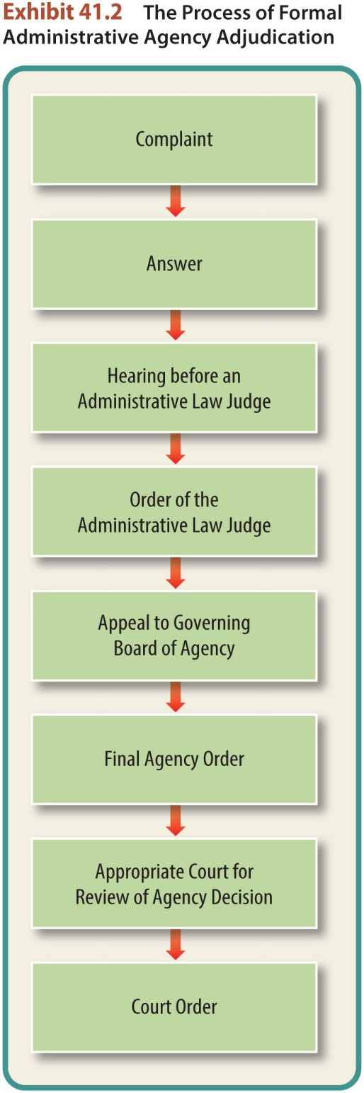
Hearing Procedures
Resembles a trial, except that in an administrative hearing, hearsay evidence can be admitted as evidence.

Slide 16
LO3 Controls on Agency Powers (1)
LO3
Executive Controls.
Appointing federal officers and President’s veto power.
Legislative Controls.
Judicial Controls.
Judicial Review.

Slide 17
LO3 Controls on Agency Powers (2)
LO3
Judicial Controls.
Judicial Review. Party seeking review must demonstrate standing to sue, with an actual controversy at issue, and have exhausted all possible administrative remedies.

Slide 18
LO3 Controls on Agency Powers (3)
LO3
Judicial Review.
Arbitrary and Capricious Test. Courts can set aside agency actions if the agency:
Failed to provide a rational explanation.
Changed its policy without justification. →

Slide 19
LO3 Controls on Agency Powers (4)
LO3
Judicial Review.
Arbitrary and Capricious Test. Courts can set aside agency actions if the agency:
Considered legally inappropriate favors.
Failed to consider a relevant factor.
Rendered a decision contrary to evidence.

Slide 20
LO4 Public Accountability (1)
LO4
A number of pieces of legislation make agencies more accountable through public scrutiny.
Freedom of Information Act.
Government in the Sunshine Act.
Regulatory Flexibility Act.
Small Business Regulatory Enforcement Fairness Act.

Slide 21
LO4 Public Accountability (2)
LO4
Freedom of Information Act.
This legislation requires the federal government to disclose certain “records” to “any person” on request, even if no reason is given for the request.
All federal government agencies are required to make their records available electronically.

Slide 22
LO4 Public Accountability (3)
LO4
Government-in-the-Sunshine Act.
Requires “every portion” of an agency’s meeting to be open to “public observation.”
Adequate notice of meetings must be given. Closed meetings are only authorized in limited circumstances.

Slide 23
LO4 Public Accountability (4)
LO4
Regulatory Flexibility Act.
Requires an analysis of the cost a regulation will impose on small business and must consider less burdensome alternatives.

Slide 24
LO4 Public Accountability (5)
LO4
Small Business Regulatory Enforcement Fairness Act.
This Act allows Congress to review new federal regulations for at least sixty-days before they can take effect.

