Slide 1
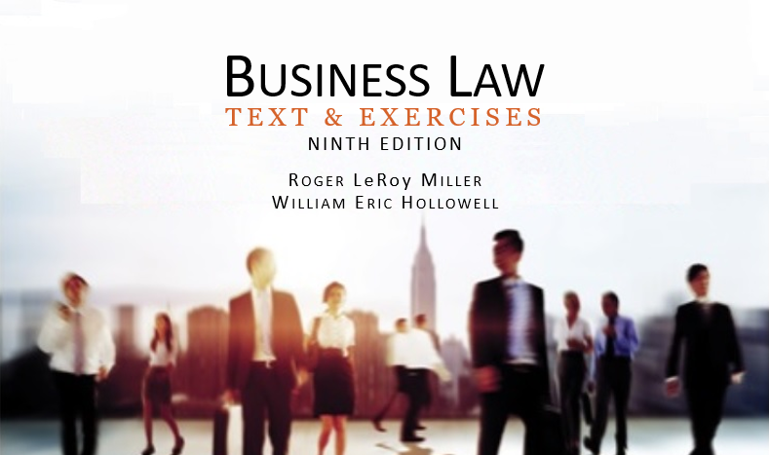
Business Law Text & Exercises Ninth Edition Roger LeRoy Miller William Eric Hollowell
Chapter 5 Business Torts

Slide 2
Learning Outcomes
LO1 Identify the types of intentional torts against persons.
LO2 Identify the types of intentional torts against property.
LO3 Name the four elements of negligence.
LO4 Define strict liability.

Slide 3
Introduction
A tort is wrongful conduct—a civil wrong not arising from a breach of contract.
Business torts occur only within the business context.

Slide 4
The Basis of Tort Law (1)
A single act can have both criminal and civil consequences.
Torts are ‘civil’ injuries for which the law provides damages to compensate the injured private party.

Slide 5
The Basis of Tort Law (2)
Criminal charges, on the other hand, are injuries to an entire community. In a criminal case, the state prosecutes the alleged wrong-doer.

Slide 6
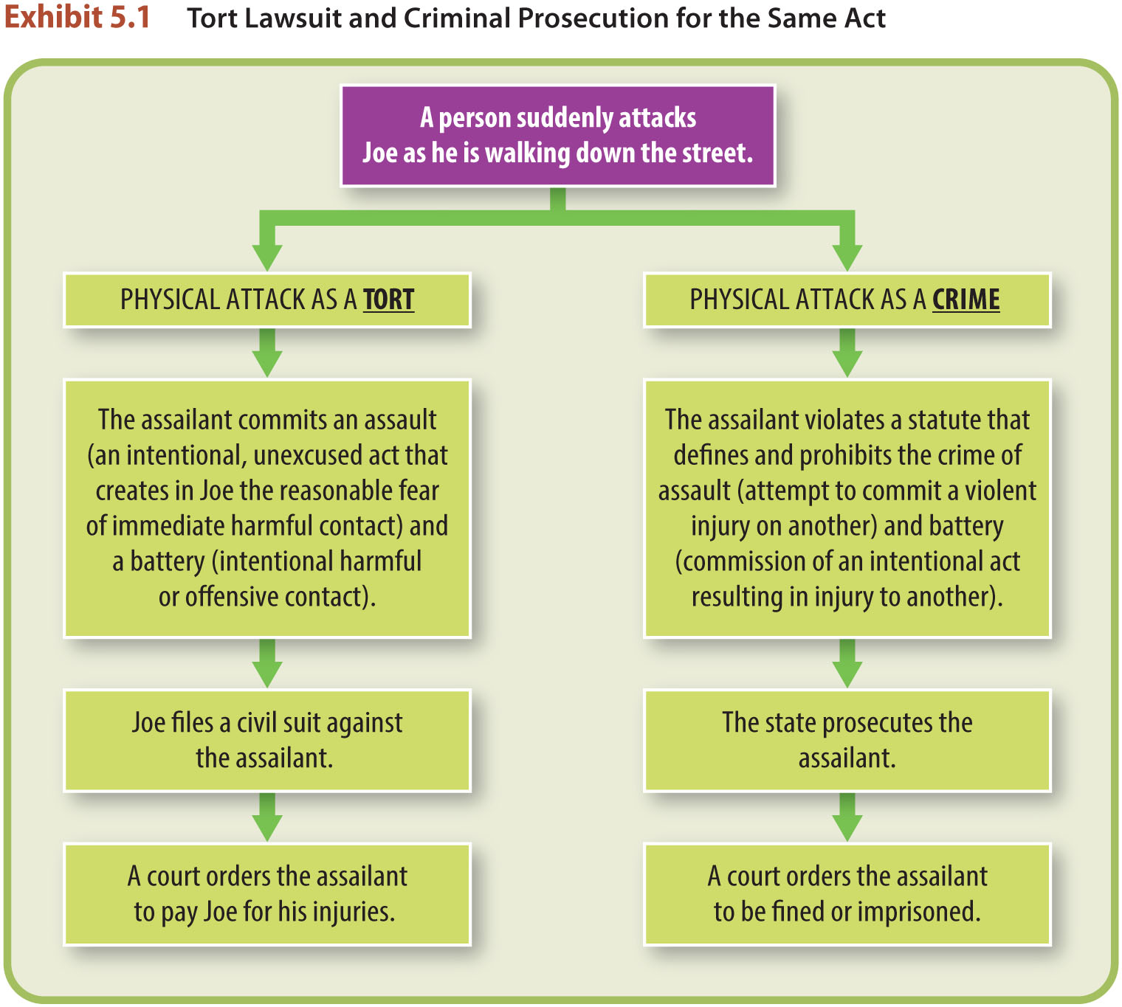
The Basis of Tort Law (3)

Slide 7
LO1 Intentional Torts against Persons (1)
Intentional tort requires INTENT.
Tortfeasor must intend the act (the tortfeasor intended the act, OR knew with substantial certainty the consequences of his act would interfere with the legal interests of another).

Slide 8
Intentional Torts against Persons (2)
LO1 Assault and Battery.
Assault: the reasonable apprehension or fear of immediate contact.
Battery: completion (contact) of the assault.

Slide 9
LO1 Intentional Torts against Persons (3)
LO1 Assault and Battery.
No motive is necessary, and plaintiff can be compensated for emotional harm.
Defenses: consent, self-defense and others, defense of property.

Slide 10
Intentional Torts against Persons (4)
LO1 False Imprisonment.
No motive is necessary, and plaintiff can be compensated for emotional harm.
Defenses: consent, self-defense and others, defense of property.

Slide 11
Intentional Torts against Persons (5)
LO1 Defamation.
Publication of a false statement (oral or written) that injures a person’s good reputation.

Slide 12
Intentional Torts against Persons (6)
LO1 Defamation.
Libel: written defamation.
Slander: oral defamation.

Slide 13
Intentional Torts against Persons (7)
LO1 Defamation.
Plaintiff must prove:
Defendant made a false statement of fact.
Statement about plaintiff and intended to harm.
Communicated to at least one other person.

Slide 14
Intentional Torts against Persons (8)
LO1 Defamation.
The Publication Requirement: a third party must actually (over)hear, see, or read the statement.
An individual who re-publishes the statement may be liable.

Slide 15
Intentional Torts against Persons (9)
LO1 Defamation: Defenses.
Truth is normally an absolute defense.
Statement was Privileged:
Absolute: judicial and legislative proceedings.
Qualified: good faith, limited.

Slide 16
Intentional Torts against Persons (10)
LO1 Defamation: Defenses.
Public figures: plaintiff must show statement made with “actual malice” or with reckless disregard for the truth.

Slide 17
Intentional Torts against Persons (11)
LO1 Fraud.
Intentional deception of another that causes belief in a condition that is different from the condition that already exists.

Slide 18
Intentional Torts against Persons (12)
LO1 Fraud.
Knowing misrepresentation of fact.
Intent to induce innocent party to rely.
Justifiable reliance by innocent party.
Causation and damages.

Slide 19
Intentional Torts against Persons (13)
LO1 Fraud.
Contrast fraud with “puffery” or statements of opinion.

Slide 20
Intentional Torts against Persons (14)
LO1 Wrongful Interference.
With a Contractual Relationship.
Valid, enforceable contract exists between two parties.
Third party knows about contract.
Third party intentionally causes either party to breach the original contract.

Slide 21
Intentional Torts against Persons (15)
LO1 Wrongful Interference.
With a Business Relationship.
Distinguish competition vs. predatory behavior, which is unlawfully driving competitors out of market.
To prevail, plaintiff must show defendant targeted only plaintiff’s customers and product.

Slide 22
LO2 Intentional Torts against Property (1)
LO2
Trespass to Land.
A person, without permission, enters onto (above or below) someone else’s land; or remains on the land or permits anything to remain on the land.
Actual damages or harm to the property is not required to prove trespass.

Slide 23
LO2 Intentional Torts against Property (2)
LO2
Trespass to Personal Property.
Wrongfully taking or harm or interference with exclusive right of use of personal property (chattel) of another.

Slide 24
LO2 Intentional Torts against Property (3)
LO2
Conversion.
Wrongfully taking or retaining possession of chattel and placing in service of another.
Good intentions are not a defense.

Slide 25
LO2 Intentional Torts against Property (4)
LO2
Disparagement of Property.
Occurs when economically injurious falsehoods are made about another’s property or product.

Slide 26
LO2 Intentional Torts against Property (5)
LO2
Disparagement of Property.
Slander of Quality (Trade Libel): false statement about another’s product that caused a third party to refrain from dealing with plaintiff, causing financial loss.

Slide 27
LO2 Intentional Torts against Property (6)
LO2
Disparagement of Property.
Slander of Title: false statement about legal ownership of another’s product resulting in financial loss.

Slide 28
Negligence (1)
Negligence occurs when plaintiff is legally injured due to defendant’s failure to live up to a reasonable standard of care causing foreseeable risk of injury.

Slide 29
Negligence (2)
LO3 Four elements of negligence.
Duty—Did the defendant owe a duty of care to the plaintiff?
Breach—Did the defendant breach that duty?
Harm—Did the plaintiff suffer an injury as a result of the defendant’s breach of the duty care?
Cause—Did the defendant’s breach cause the plaintiff’s injury?

Slide 30
Negligence (3)
The Duty of Care and Its Breach.
Based on reasonable person standard.
How would a reasonable person have acted under the circumstances?

Slide 31
Negligence (4)
The Duty of Care and Its Breach.
Duty of landowners: exercise reasonable care to ensure tenants and guests are not harmed in common areas.
Retailers: protect business invitees.

Slide 32
Negligence (5)
The Duty of Care and Its Breach.
Duty of professionals to clients (accountants, physicians, etc.).
Duty to use standard minimum level of special knowledge and ability, consistent with the profession.

Slide 33
Negligence (6)
The Injury Requirement
Plaintiff must suffer harm or injury as the result of an action.

Slide 34
Causation
Causation
If a person fails in a duty of care and someone suffers injury, the wrongful activity must have caused the harm for a tort to have been committed.

Slide 35
Defenses to Negligence (1)
Assumption of Risk.
Plaintiff voluntarily enters risky situation, not allowed to recover.
Knowledge of the risk.
Voluntary assumption of the risk.

Slide 36
Defenses to Negligence (2)
Comparative Negligence.
Liability for injuries based on
proportionate negligence.
As long as plaintiff is less than 50% at fault he/she can recover a pro-rata share of the verdict.

Slide 37
LO4 Strict Liability
LO4
No fault, intent or breach of duty.
Usually involves ‘abnormally dangerous’ activities and risk cannot be prevented.
Product Liability—manufacturers and sellers of harmful or defective products.

