Slide 1
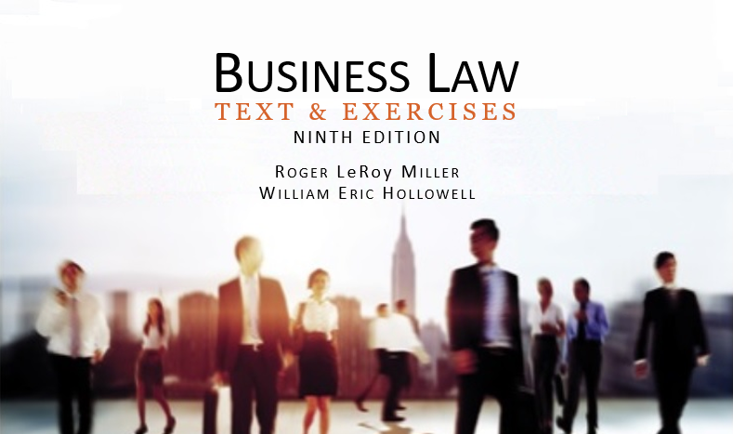
Business Law Text & Exercises Ninth Edition Roger LeRoy Miller William Eric Hollowell
Chapter 43 International and Space Law

Slide 2
Learning Outcomes (1)
LO1 Identify the important international principles and doctrines.
LO2 Discuss how business is done internationally.
LO3 Explain common provisions in international contracts.
LO4 Outline international business regulations.

Slide 3
Learning Outcomes
LO5 List international space law treaties.

Slide 4
LO1 International Principles and Doctrines (1)
LO1
The most important principles and doctrines applied in the interest of maintaining harmonious relations among nations:
The Principle of Comity.
The Act of State Doctrine.
The Doctrine of Sovereign Immunity.

Slide 5
LO1 International Principles and Doctrines (2)
LO1
The Principle of Comity.
One nation will defer and give effect to the laws and judicial decrees of another country, as long as those laws and judicial decrees are consistent with the law and public policy of the accommodating nation.

Slide 6
LO1 International Principles and Doctrines (3)
LO1
The Act of State Doctrine.
The judicial branch of one country will not examine the validity of public acts by a recognized foreign government within its own territory.
Doctrine is often invoked to protect: expropriation and confiscation.

Slide 7
LO1 International Principles and Doctrines (4)
LO1
Doctrine of Sovereign Immunity.
Exempts foreign nations from jurisdiction in U.S. courts.
The Foreign Sovereign Immunities Act expanded the jurisdiction of U.S. courts for creditors of foreign governments.

Slide 8
LO2 Doing Business Internationally (1)
LO2
Exporting.
Direct versus Indirect.
Agency Relationships versus Distributorships.
Distribution agreement: a contract between a seller and distributor setting out the terms and conditions.

Slide 9
LO2 Doing Business Internationally (2)
LO2
Manufacturing Abroad, through:
Licensing.
Franchising.
Subsidiaries.

Slide 10
International Contract Provisions
LO3
Choice of Language Clause.
Forum-Selection Clause.
Choice-of-Law Clause.
Force Majeure (impossibility or “act of God”).
Arbitration Clause.

Slide 11
LO4 Regulation of International Business Activities (1)
LO4
Nations impose laws and controls to restrict or facilitate international business.
Investment Protection.
Export Controls.
Import Controls.

Slide 12
LO4 Regulation of International Business Activities (2)
LO4
Import Controls.
Prohibitions.
Quotas and Tariffs.
Antidumping Duties: dumping is the sale of foreign goods below market prices.
Minimizing Trade Barriers.

Slide 13
LO4 Regulation of International Business Activities (3)
LO4
Import Controls.
Minimizing Trade Barriers. Most nations are members of the World Trade Organization and required to grant “normal trade relations” status to other members.

Slide 14
LO4 Regulation of International Business Activities (4)
LO4
Minimizing Trade Barriers.
European Union.
North American Free Trade Agreement.
Republic Korea–United States Free Trade Agreement.

Slide 15
Space Law (1)
International Space Law.
Exploration and Exploitation.
Outer Space Treaty.
Astronauts and Space Objects.
The Rescue Agreement.
The Liability Convention.
The Registration Convention.
Space Debris.
LO5

Slide 16
Space Law (2)
U.S. Space Law.
Commercial Spaceflight.
Exports of Space Technology.
Property Rights to Space Resources.

