Slide 1
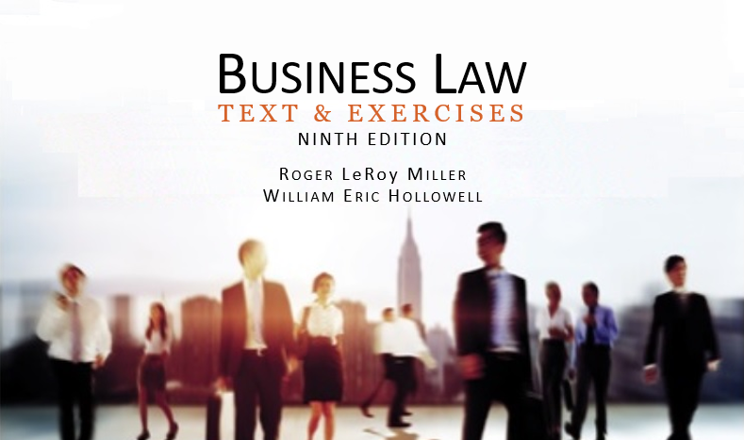
Business Law Text & Exercises Ninth Edition Roger LeRoy Miller William Eric Hollowell
Chapter 13 Voluntary Consent

Slide 2
Learning Outcomes
LO1 State the difference between mistakes of fact and of value.
LO2 List the elements of fraud.
LO3 Contrast misrepresentations of a material fact and of law.
LO4 Recognize the difference between undue influence and duress.

Slide 3
Introduction
An enforceable contract must have been entered into with voluntary consent, i.e., a knowledge of, and genuine assent to, the terms of a contract.

Slide 4
LO1 Mistakes (1)
LO1
The concept of mistake in contract law has to do with mistaken assumptions relating to contract formation.
Mistakes of Fact.
Mistakes of Value.

Slide 5
LO1 Mistakes (2)
LO1
Mistakes of Fact.
Unilateral Mistake.
Involves a material fact.
Generally does not give the mistaken party right to cancel contract, unless (exceptions):

Slide 6
LO1 Mistakes (3)
LO1
Mistakes of Fact.
Unilateral Mistake (Exceptions):
The other party to the contract knew or should have known that a mistake was made.
The error was due to some substantial mathematical mistake, and without gross negligence.

Slide 7
LO1 Mistakes (4)
LO1
Mistakes of Fact.
Bilateral (Mutual) Mistakes: when both parties are mistaken about the same material fact, contract can be rescinded by either party.

Slide 8
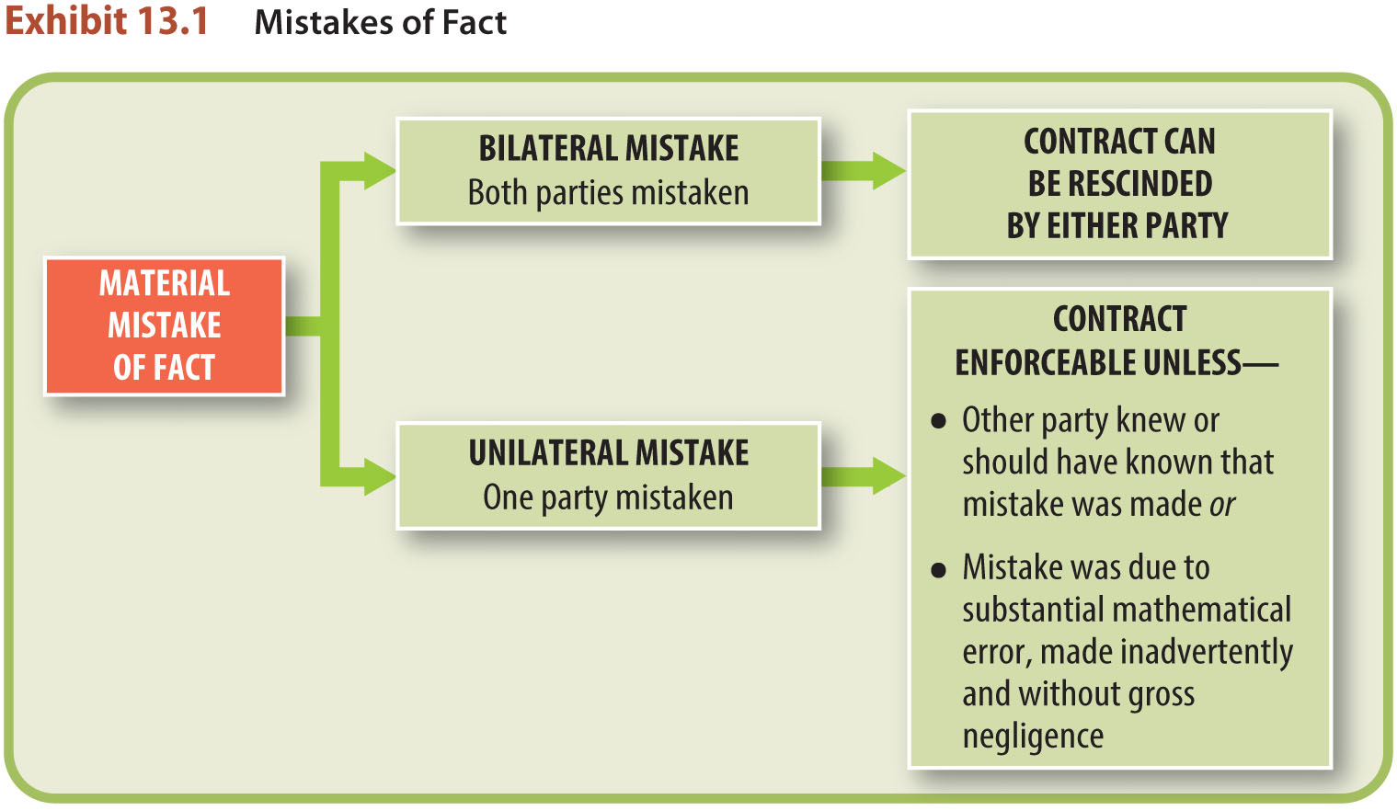
LO1 Mistakes (5)
LO1

Slide 9
LO1 Mistakes (6)
LO1
Mistakes of Value.
Contract is generally enforceable if the mistake (unilateral or bilateral) is about the actual value or quality of the object of the contract.

Slide 10
Fraudulent Misrepresentation (1)
Three elements of fraud:
A misrepresentation of a material fact must occur.
There must be an intent to deceive.
The innocent party must justifiably rely on the misrepresentation.
LO2

Slide 11
Fraudulent Misrepresentation (2)
Misrepresentation Has Occurred.
Misrepresentation of a material fact must have occurred (facts, not opinions).
Misrepresentation by Words.
Misrepresentation by Conduct.

Slide 12
Fraudulent Misrepresentation (3)
Misrepresentation by Words.
A misrepresentation of a material fact can be expressly made through a person’s words or writings.
A statement of opinion cannot be used in a claim of fraud.

Slide 13
Fraudulent Misrepresentation (4)
Misrepresentation by Conduct.
A misrepresentation can occur by conduct.
Misrepresentation can also involve denial.

Slide 14
Fraudulent Misrepresentation (5)
Misrepresentation of Law.
Does not ordinarily entitle a party to be relieved of a contract.
Misrepresentation by Silence.
Known serious potential problems that the buyer cannot reasonably be expected to discover, should be disclosed.
LO3

Slide 15
Fraudulent Misrepresentation (6)
Intent to Deceive.
Scienter: knowledge by the misrepresenting party that material facts have been falsely represented or omitted with an intent to deceive.

Slide 16
Fraudulent Misrepresentation (7)
Reliance on Misrepresentation.
The deceived party must have a justifiable reason for relying on the misrepresentation, and
The misrepresentation must be an important factor (but not necessarily the sole factor) in inducing the party to enter into the contract.

Slide 17
Fraudulent Misrepresentation (8)
Injury to the Innocent Party.
For a person to recover damages caused by fraud, proof of an injury is required.
Most courts do not require a showing of injury when the action is to rescind the contract.

Slide 18
LO4 Undue Influence and Duress (1)
LO4
Contract lacks voluntary consent if undue influence or duress is present.
Voidable.

Slide 19
LO4 Undue Influence and Duress (2)
LO4
Undue Influence.
Persuasion that is less than actual force but more than advice and that induces a person to act according to the will or purposes of the dominating party.

Slide 20
LO4 Undue Influence and Duress (3)
LO4
Duress.
Unlawful pressure brought to bear on a person, overcoming that person’s free will and causing him or her to do (or refrain from doing) what he or she otherwise would not (or would) have done.

