Slide 1
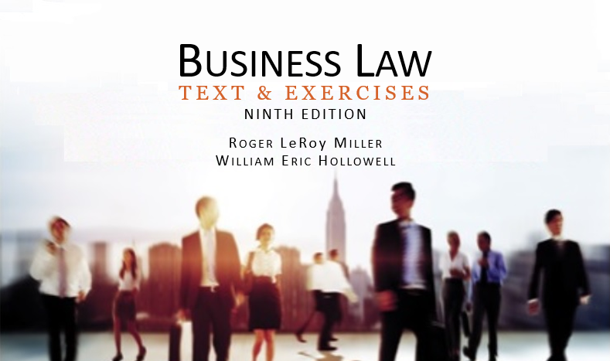
Business Law Text & Exercises Ninth Edition Roger LeRoy Miller William Eric Hollowell
Chapter 29 Formation and Ownership of a Corporation

Slide 2
Learning Outcomes (1)
LO1 Summarize incorporation procedures.
LO2 Describe basic corporate powers.
LO3 Explain the methods of corporate financing.

Slide 3
Learning Outcomes (2)
LO4 Define insider trading.
LO5 Explain how a shareholder’s derivative suit can help a corporation.

Slide 4
LO1 Incorporation Procedures (1)
LO1
Step 1: Select a State of Incorporation.
Most businesses incorporate in the state in which the corporation’s business will be primarily conducted.
Step 2: Secure the Corporate Name.

Slide 5
LO1 Incorporation Procedures (2)
LO1
Step 2: Secure the Corporate Name.
Cannot be the same as, or deceptively similar to, an existing corporation in the same state.
Must include Corporation (Corp.), Incorporated (Inc.), Company (Co.), or Limited (Ltd.).

Slide 6
LO1 Incorporation Procedures (3)
LO1
Step 3: Prepare the Articles of Incorporation.
Must include the corporation’s name, the number of shares it is authorized to issue, its registered agent, and the names of its incorporators.
Step 4: File the Articles of Incorporation.

Slide 7
Defects in Corporate Formation (1)
De Facto.
Can only be challenged by the state.
Corporation by Estoppel.
If business holds itself out as a corporation, then neither party can raise the issue of corporate status.

Slide 8
Defects in Corporate Formation (2)
Piercing the Corporate Veil.
Shareholders can be held personally liable if:
Party is tricked or misled into dealing with corporation instead of an individual.
Company is thinly capitalized, setup to lose money.

Slide 9
Defects in Corporate Formation (3)
Piercing the Corporate Veil.
Shareholders can be held personally liable if:
Corporate formalities are not followed.
Personal and corporate funds are commingled so the corporation has no separate financial identity.

Slide 10
Corporate Classifications (1)
Domestic, Foreign, and Alien Corporations.
Domestic: corporation that does business in and is organized under the laws of that state.

Slide 11
Corporate Classifications (2)
Domestic, Foreign, and Alien Corporations.
Foreign: corporation that does business in one state but is incorporated in another.

Slide 12
Corporate Classifications (3)
Domestic, Foreign, and Alien Corporations.
Alien: corporation doing business in the United States but formed in another country.

Slide 13
Corporate Classifications (4)
Public Corporation.
Formed by the government to meet some political or governmental purpose.
Private Corporation.
Created either wholly or in part for private benefit.

Slide 14
Corporate Classifications (5)
Nonprofit Corporations.
Formed without a profit-making purpose. Examples include private hospitals, charities, and religious organizations.

Slide 15
Corporate Classifications (6)
Close Corporation.
Shareholders are limited to a small group of persons, often including only family members.
The rights of shareholders are restricted regarding the transfer of shares to others.

Slide 16
Corporate Classifications (7)
S-Corporations.
A business corporation that has met certain requirements as set out by the Internal Revenue Code and thus qualifies for special income tax treatment.

Slide 17
Corporate Classifications (8)
S-Corporations.
S-corporations are taxed the same as a partnership, but shareholders enjoy the privilege of limited liability.

Slide 18
Corporate Classifications (9)
Benefit Corporations.
For-profit corporation that seeks to have a materially positive impact on society and the environment.

Slide 19
LO2 Corporate Powers (1)
LO2
Express Powers: found in its articles of incorporation, in the law of the state of incorporation, and in the state and federal constitutions.

Slide 20
LO2 Corporate Powers (2)
LO2
Implied Powers: upon formation, a corporation has legally implied powers to do what is reasonably necessary (and legal) to accomplish its corporate goals.

Slide 21
LO2 Corporate Powers (3)
LO2
Ultra Vires Doctrine:
Activities of a corporation’s managers that are outside the scope of the power granted them by the corporation’s charter or the laws of the state of incorporation are ultra vires (illegal) acts.

Slide 22
Corporate Liabilities
May be held liable for the criminal acts of its agents and employees.
The doctrine of respondeat superior applies.

Slide 23
LO3 Corporate Financing (1)
LO3
To obtain financing, corporations issue securities.
Stocks: to finance its tocks (purchase of ownership in the firm).
Bonds (debentures; long-term borrowing of funds by the firm).

Slide 24
LO3 Corporate Financing (2)
LO3
Stocks and Bonds.
In corporation law, an equity or ownership interest in a corporation, measured in units of shares.
Common: true ownership.
Preferred: priority dividends.

Slide 25
LO3 Corporate Financing (3)
LO3
Common Stock.
Shares in a corporation that are lowest in priority with respect to payment of dividends and distribution of the corporation’s assets on dissolution.

Slide 26
LO3 Corporate Financing (4)
LO3
Preferred Stock.
Classes of stock that have priority over common stock both as to payment of dividends and distribution of assets on the corporation’s dissolution.

Slide 27
LO3 Corporate Financing (5)
LO3
Bond.
Certificate evidencing a corporate debt, that has no ownership interest in the issuing corporation.
Bond Indenture: contract between the issuer of a bond and the bondholder.

Slide 28
LO3 Corporate Financing (6)
LO3
Alternative Financing.
Venture capital: financing provided by outside investors to new business ventures.
Crowdfunding: cooperative online activity in which people network and pool funds to assist a cause or invest in a business venture.

Slide 29
Sales of Securities (1)
The Securities Act of 1933.
Governs initial sales of stock by businesses.
Requires that investors receive financial and other important information concerning the securities being offered for public sale.

Slide 30
Sales of Securities (2)
The Securities Act of 1933.
Registration Statement and Prospectus.
Exemptions.
Nonprofits or charitable organizations.
Small dollar amount or limited manner.

Slide 31
Sales of Securities (3)
The Securities Exchange Act of 1934.
Provides for the regulation and registration of these securities exchanges, stockbrokers, and dealers.
Requires that a regulated corporation make periodic disclosures about its organization and financial situation.

Slide 32
Sales of Securities (4)
The Securities Exchange Act of 1934.
Scienter and Securities Fraud.
Scienter and Insider Trading.
Insider trading: the purchase or sale of securities based on information not available to the public.
LO4

Slide 33
Corporate Ownership—Shareholders
Acquisition of a share of stock makes a person an owner and shareholder of a corporation.
No liability for the corporation’s debts.

Slide 34
Shareholders’ Powers
Approve fundamental changes.
Elect and remove directors.
Can remove a director from office for cause by a majority vote.
Some states permit removal without cause.

Slide 35
Shareholders’ Meetings (1)
Proxy: written agreement authorizing one shareholder to vote for another’s shares in a certain manner.
Quorum: written agreement authorizing one shareholder to vote for another’s shares in a certain manner.
Cumulative voting: voting method that allows minority shareholders to obtain representation on the board of directors.

Slide 36
Shareholders’ Meetings (2)

Slide 37
Rights of Shareholders (1)
Voting Rights.
Stock Certificates.
Preemptive Rights.
Dividends.
Inspection Rights.
Transfer of Shares.
The Shareholder’s Derivative Suit.

Slide 38
Rights of Shareholders (2)
Preemptive Rights.
A shareholder’s right to purchase a prorated share of a new stock issue before the stock is offered to others.

Slide 39
Rights of Shareholders (3)
The Shareholder’s Derivative Suit.
A suit brought by a shareholder to enforce a corporate cause of action against a third person.
Any monetary damages recovered by such a lawsuit goes to the corporation.
LO5

Slide 40
Duties of Major Shareholders
Majority shareholders have a fiduciary duty to the corporation and minority shareholders.
Breach of fiduciary duties constitutes oppressive conduct.

