Slide 1
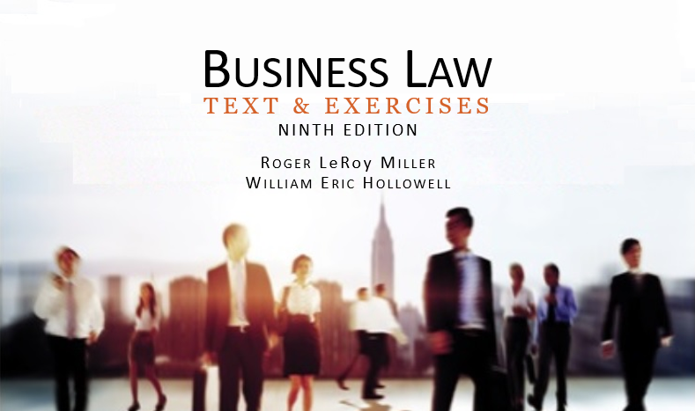
Business Law Text & Exercises Ninth Edition Roger LeRoy Miller William Eric Hollowell
Chapter 22 The Essentials of Negotiability

Slide 2
Learning Outcomes
LO1 Identify the basic types of negotiable instruments.
LO2 List the requirements of a negotiable instrument.
LO3 Distinguish between an order and a bearer instrument.
LO4 Describe a transfer of negotiation.

Slide 3
Introduction (1)
Negotiable Instrument.
A written and signed unconditional promise or order to pay a specified sum of money on demand or at a definite time to order (to a specific person or entity) or to bearer.

Slide 4
Introduction (2)
Negotiable Instruments and the Uniform Commercial Code.
UCC applies to transactions involving negotiable instruments, as well as to bank deposits and collections.

Slide 5
LO1 Types of Instruments (1)
LO1
Orders to Pay—Drafts and Checks.
Promises to Pay—Promissory Notes.
Promises to Pay—Certificates of Deposit.

Slide 6
LO1 Types of Instruments (2)
LO1
Orders to Pay—Drafts and Checks.
Draft is unconditional order to pay involving: Drawer (Customer), Drawee (Bank) and Payee.
Time Drafts and Sight Drafts.
Time: payable at a future time.
Sight: payable on sight.

Slide 7
LO1 Types of Instruments (3)
LO1
Orders to Pay—Drafts and Checks.
Trade Acceptance: seller is drawer and payee.
Checks (cashier’s, teller’s and traveler’s) are drafts on a bank.

Slide 8
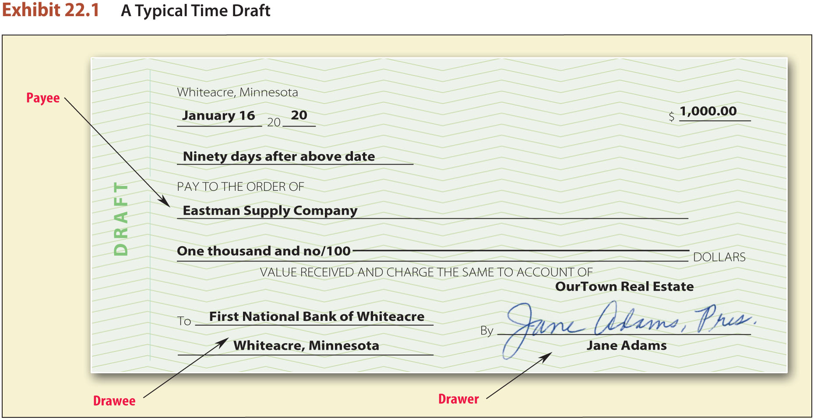
Time Draft

Slide 9
LO1 Types of Instruments (4)
LO1
Promises to Pay—Promissory Notes.
Promissory note: promise by the maker (promisor) to the payee or bearer.

Slide 10
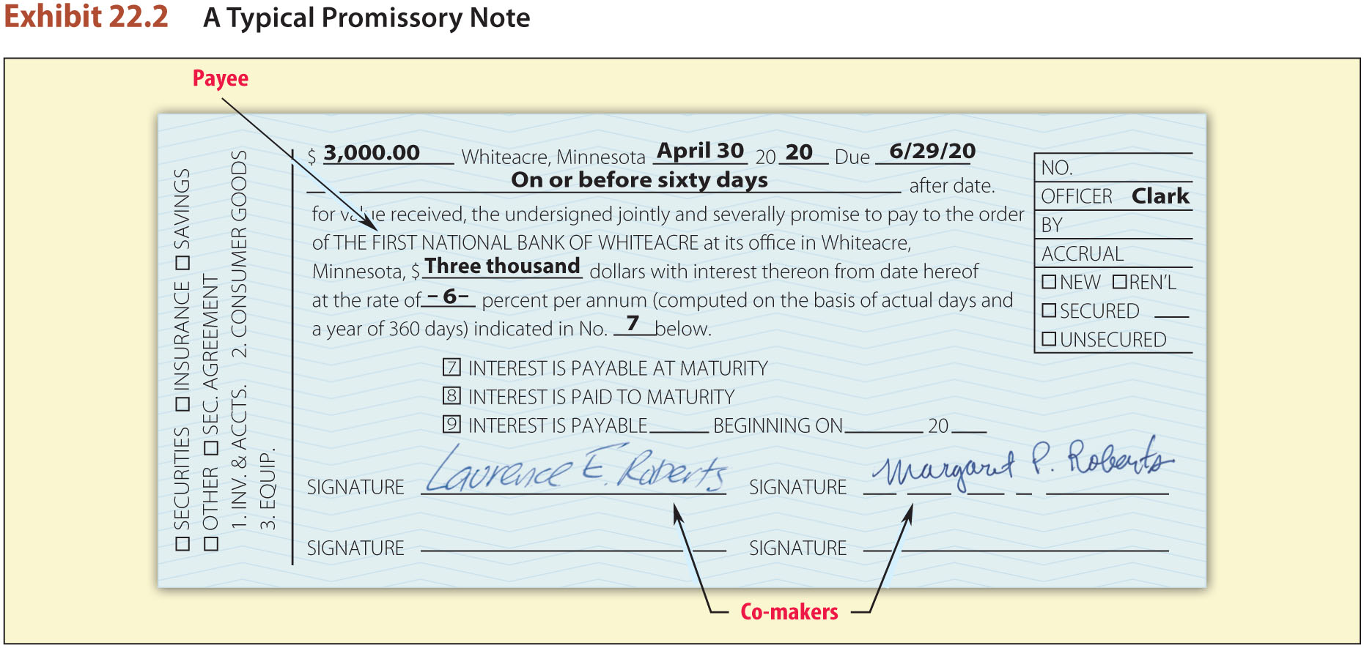
Promissory Note

Slide 11
LO1 Types of Instruments (5)
LO1
Promises to Pay—Certificates of Deposit.
Certificate of deposit (CD): bank note in which a bank acknowledges a receipt of money from a party and promises to repay it.

Slide 12
LO1 Types of Instruments (6)
LO1

Slide 13
LO2 What is a Negotiable Instrument? (1)
LO2
Writing signed by maker or drawer.
Unconditional promise or order to pay.
A fixed amount of money.

Slide 14
LO2 What is a Negotiable Instrument? (2)
LO2
Payable on demand or at a definite time.
Payable to order or bearer.

Slide 15
Negotiable Instrument: Written Form
Negotiable instruments must be in written form; with certain practical limitations.
Permanence.
Portability.

Slide 16
Negotiable Instrument: Signatures
The name or mark of a person, written by that person or at his or her direction. In commercial law, any name, word, or mark used with the intention to authenticate a writing constitutes a signature.

Slide 17
Negotiable Instrument: Unconditional Promise or Order to Pay (1)
For an instrument to be negotiable, it must contain an unconditional or promise to pay.
A mere acknowledgment of the debt is not sufficient, because the promise must be an affirmative, written undertaking.

Slide 18
Negotiable Instrument: Unconditional Promise or Order to Pay (2)
Promise or Order.
The traditional I.O.U. (“I.O.U. $10 [Signed] Bobby”) might logically imply a promise. It is not a negotiable instrument, however, because it does not contain an express promise to repay the debt.

Slide 19
Negotiable Instrument: Unconditional Promise or Order to Pay (3)
Unconditionality of a Promise or Order.
A negotiable instrument’s utility as a substitute for money or as a credit device would be dramatically reduced if it had conditional promises attached to it. →

Slide 20
Negotiable Instrument: Unconditional Promise or Order to Pay (4)
Unconditionality of a Promise or Order.
Expensive and time consuming to investigate conditional promises.
Matters of standard business practice do not affect unconditionality.

Slide 21
Negotiable Instrument: Fixed Amount of Money (1)
Instruments must state with a fixed amount of money to be paid at any time the instrument is payable.
To be negotiable, an instrument must be payable entirely in money.

Slide 22
Negotiable Instrument: Fixed Amount of Money (2)
Fixed Amount.
Means an amount that is ascertainable from the instrument.
Instruments with legal and judgment rates of interest, as well as those determined by state law, are negotiable.

Slide 23
Negotiable Instrument: Fixed Amount of Money (3)
Variable-Rate Notes.
Can be negotiable.
Only the principal is subject to the negotiability requirement.
The interest may be stated as a variable amount.

Slide 24
Negotiable Instrument: Fixed Amount of Money (4)
Payable in Money.
Money: medium of exchange authorized or adopted by a domestic or foreign government as a part of its currency.
Commodities or stock is not considered “money”.

Slide 25
Negotiable Instrument: Payable on Demand (1)
Payable on Demand or at a Definite Time.
Payable on Demand: Contain the words “payable at sight” or “payable on demand” and those that say nothing about when payment is due.

Slide 26
Negotiable Instrument: Payable on Demand (2)
Payable on Demand or at a Definite Time.
Payable at a Definite Time: to be negotiable an instrument must be payable at a definite time specified on the face (front) of the instrument.

Slide 27
LO3 Negotiable Instrument: Payable to Order or Bearer
LO3
Payable on Demand or at a Definite Time.
Order Instruments: payable “to the order of an identified person” or “to an identified person or order.”
Bearer Instruments: payable to bearer (possessor).

Slide 28
Transfer of Instruments (1)
By Assignment: transfer of rights under a contract.
When a transfer fails to qualify as a negotiation, it becomes an assignment. The transferee is then an assignee.

Slide 29
Transfer of Instruments (2)
By Negotiation.
Transfer of a negotiable instrument to another, in such form that the transferee becomes a holder.
Holder: person who, by the terms of a negotiable instrument, is legally entitled to payment on it.
L04

Slide 30
Transfer of Instruments (3)
By Negotiation.
Order Instruments: negotiated by delivery with any necessary indorsements.
Bearer Instruments: negotiated by delivery, i.e., transfer into another person’s possession. Indorsement is not necessary.
L04

Slide 31
Transfer of Instruments (4)
Types of Indorsements.
Indorsement is a signature, with or without words or statements.
Indorser: person who transfers instrument by signing it and delivering to another person.

Slide 32
Transfer of Instruments (5)
Types of Indorsements.
Blank Indorsements.
Special Indorsements.
Qualified Indorsements.
Restrictive Indorsements.

Slide 33
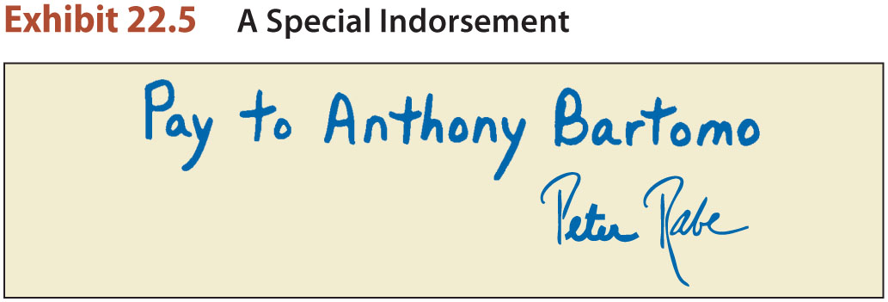
Indorsements (1)
Blank Indorsements.
Special Indorsements.
Qualified Indorsements.

Slide 34
Indorsements (2)
Qualified Indorsements.
Used by agents on behalf of a principal (example, insurance agents). The “without recourse” indorsement relieves the agent of liability on a check.

Slide 35
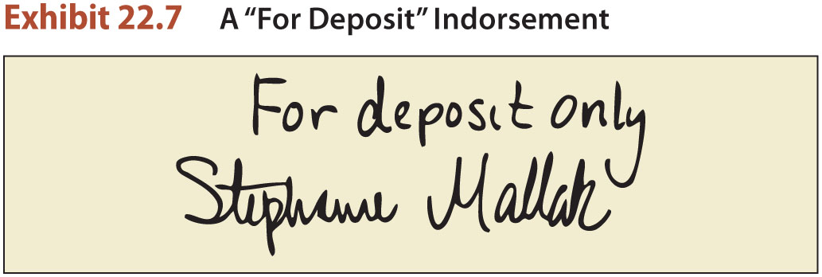
Indorsements (3)
Restrictive Indorsements.
Conditional Indorsements.
Indorsements for Deposit and Collection.

