Slide 1
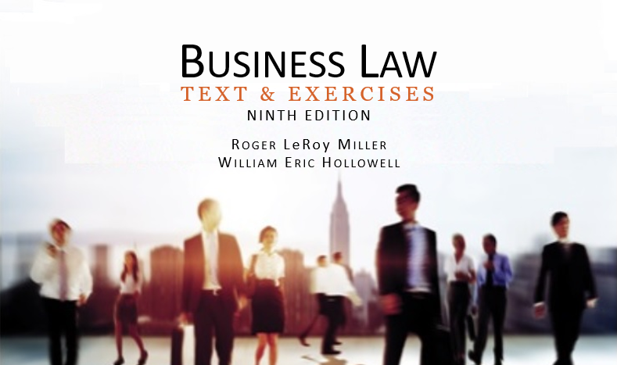
Business Law Text & Exercises Ninth Edition Roger LeRoy Miller William Eric Hollowell
Chapter 2 Ethics in Business

Slide 2
Learning Outcomes
LO1 Discuss how businesses can discourage unethical behavior.
LO2 Explain the relationship between law and ethics.
LO3 Compare duty-based ethics and utilitarian ethics.
LO4 Identify some ethical problems in the global context.

Slide 3
The Importance of Business Ethics (1)
What is Business Ethics?
Ethics is the study of right and wrong behavior; whether an action is fair, right or just.

Slide 4
The Importance of Business Ethics (2)
What is Business Ethics?
In business, ethical decisions are the application of moral and ethical principles to the marketplace and workplace.

Slide 5
The Importance of Business Ethics (3)
Why is Business Ethics Important?
Directors and officers owe a complex set of ethical duties to the company, shareholders, customers, community, employees, and suppliers.

Slide 6
The Importance of Business Ethics (4)
Why is Business Ethics Important?
When these duties conflict, ethical dilemmas are created.

Slide 7
LO1 Setting the Right Ethical Tone (1)
LO1
The Importance of Ethical Leadership.
Attitude of top management.
Management must be committed to creating an ethical company.
Management must deal with unethical issues quickly.

Slide 8
LO1 Setting the Right Ethical Tone (2)
LO1
Ethical Codes of Conduct.
Explicitly states a company’s ethical priorities.

Slide 9
LO1 Setting the Right Ethical Tone (3)
LO1
Corporate Compliance Programs.
Ethical codes of conduct just one part of a comprehensive program.
Other components include: ethics committee, ethical training programs, and internal audits.

Slide 10
LO1 Setting the Right Ethical Tone (4)
LO1
Corporate Compliance Programs.
Must be integrated throughout firm.
Coordinated and monitored by a committee separate from other corporate departments.

Slide 11
LO1 Setting the Right Ethical Tone (5)
LO1
Conflicts and Trade-Offs.
Firms have ethical obligations to both internal and external stakeholders.
Internal: staff and shareholders.
External: community.

Slide 12
The Sarbanes-Oxley Act (1)
Attempts to increase corporate responsibility by:
Stricter disclosure requirements.
Harsher penalties for legal violations.
Corporate officers take responsibility for financial statements and SEC reports.
CEOs and CFOs must personally certify reports.

Slide 13
The Sarbanes-Oxley Act (2)
The Public Company Accounting Oversight Board.
Oversee audits to protect investors and public.
Register public accounting firms; establishes standards relating to preparation of audit reports.

Slide 14
The Sarbanes-Oxley Act (3)
Enforcements and Penalties.
Enhanced penalties, as high as $15 million for intentional violations.
Prohibits destroying or falsifying records with the intent to obstruct or influence a federal investigation or in relation to bankruptcy proceedings.

Slide 15
Business Ethics and the Law (1)
Moral Minimum.
Minimum standard for ethical business behavior, really means bare compliance with the law.
Some actions may be legal, but not ethical.
LO2

Slide 16
Business Ethics and the Law (2)
Laws Regulating Business.
Extensive government regulations.
Ignorance does not dismiss liability.

Slide 17
Business Ethics and the Law (3)
“Gray Areas” in the Law.
When the law is “silent” on an action’s legality.
In addition, courts decide on a case by case basis, looking for “reasonable” acts or “foreseeable” results.

Slide 18
Approaches to Ethical Reasoning (1)
LO3
Duty-Based Ethics: derived from religious and philosophical principles.
Religion.
Philosophy.
Principle of Rights.

Slide 19
Approaches to Ethical Reasoning (2)
LO3
Duty-Based Ethics.
Religion.
The rightness or wrongness of an action is usually judged according to its conformity to an absolute rule that commands a particular form of behavior.

Slide 20
Approaches to Ethical Reasoning (3)
LO3
Duty-Based Ethics.
Philosophy: Kant.
Premised on the belief that general guiding principles for moral behavior can be derived from human nature.
The categorical imperative is a central postulate of Kantian ethics.

Slide 21
Approaches to Ethical Reasoning (4)
LO3
Duty-Based Ethics.
Philosophy: Kant.
The rightness or wrongness of an action is judged by estimating the consequences that would follow if everyone in a society performed the act under consideration.

Slide 22
Approaches to Ethical Reasoning (5)
LO3
Duty-Based Ethics.
The Principle of Rights.
This principle derives from the belief that every duty gives rise to a corresponding right.
The belief in fundamental rights is a deeply embedded feature of Western culture.

Slide 23
Approaches to Ethical Reasoning (6)
LO3
Duty-Based Ethics.
The Principle of Rights.
The ethicality of an action is judged by how the consequences of the action will affect the rights of others.

Slide 24
Approaches to Ethical Reasoning (7)
LO3
Outcome-Based Ethics: Utilitarianism.
Utilitarianism: action is ethical based on what produces the greatest good for the greatest number of people.

Slide 25
Approaches to Ethical Reasoning (8)
LO3
Outcome-Based Ethics: Utilitarianism.
Cost-benefit analysis is performed to determine the effects of competing alternatives on the persons affected.
The best alternative is the one that produces the greatest good for the greatest number.

Slide 26
Approaches to Ethical Reasoning (9)
LO3
Corporate Social Responsibility.
Corporations should be interested in impact on civil rights, environment, consumer protection, employee safety and welfare.

Slide 27
Approaches to Ethical Reasoning (10)
LO3
Corporate Social Responsibility.
Stakeholder Approach.
Corporate Citizenship.
A Way of Doing Business.

Slide 28
Business Ethics And Social Media
Businesses now face unique ethical issues with respect to all social media platforms.
Hiring decisions may be considered unethical when based on:
Online profiles.
Lack of online presence.

Slide 29
LO4 Business Ethics on A Global Level (1)
LO4
Frequent conflicts in ethics between foreign and U.S. businesspersons. In some countries:
Alcohol and certain foods are forbidden.
Little protection for discrimination against women.

Slide 30
LO4 Business Ethics on A Global Level (2)
LO4
Monitoring the Practices of Foreign Suppliers.
Corporate watch groups can disseminate information instantly around world.

Slide 31
LO4 Business Ethics on A Global Level (3)
LO4
Foreign Corrupt Practices Act.
Bribery of Foreign Officials.
Accounting Requirements.

