Slide 1
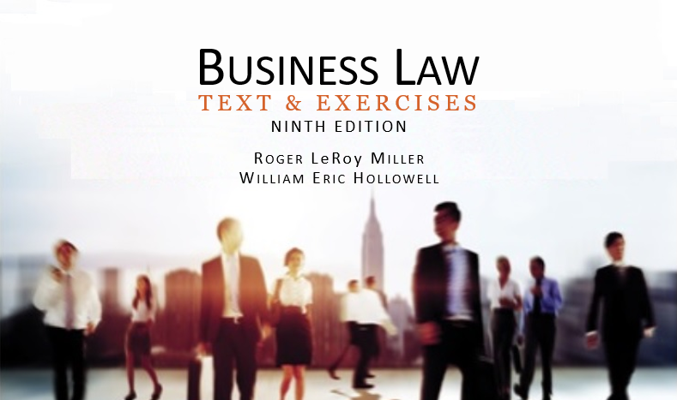
Business Law Text & Exercises Ninth Edition Roger LeRoy Miller William Eric Hollowell
Chapter 4 Constitutional Law

Slide 2
Learning Outcomes (1)
LO1 Explain Congress’s power to regulate commerce.
LO2 Discuss federal priority over state laws.
LO3 Describe the Bill of Rights.

Slide 3
Learning Outcomes (2)
LO4 Identify due process protections.
LO5 Outline privacy rights.

Slide 4
The Constitutional Powers of Government (1)
A Federal Form of Government: the federal constitution was a political compromise between advocates of state sovereignty and central government.

Slide 5
The Constitutional Powers of Government (2)
The Separation of Powers.
Provides checks and balances.
Legislative: makes laws
Executive: enforces laws
Judicial: interprets laws

Slide 6
LO1 The Commerce Clause (1)
LO1
U.S. Constitution gives Congress the power to “regulate Commerce with foreign Nations, and among the several States.” (Art. 1 § 8).

Slide 7
LO1 The Commerce Clause (2)
LO1
National Powers.
Under the commerce clause, the federal government has the power to regulate virtually all commercial enterprises in the United States.

Slide 8
LO1 The Commerce Clause (3)
LO1
The Regulatory Powers of the States.
Tenth Amendment reserves all powers to the states that have not been expressly delegated to the national government.

Slide 9
LO1 The Commerce Clause (4)
LO1
Regulatory Powers of the States.
State have inherent “police powers” to regulate health, safety, morals and general welfare.
Includes licensing, building codes, parking regulations and zoning restrictions.

Slide 10
LO1 The Commerce Clause (5)
LO1
The “Dormant” Commerce Clause.
U.S. Supreme Court has interpreted commerce clause to give national government exclusive power to regulate.
States only have a “dormant” (negative) power to regulate interstate commerce.

Slide 11
LO1 The Commerce Clause (6)
LO1
The “Dormant” Commerce Clause.
Dormant power comes into play when courts balance state’s interest vs. national interest, e.g., internet transactions.

Slide 12
LO2 The Supremacy Clause (7)
LO2
Supremacy Clause: Article VI of the Constitution provides that Constitution, laws and treaties of the United States are the “supreme law of the land.”

Slide 13
LO2 The Supremacy Clause (8)
LO2
Preemption: when Congress chooses to act in a concurrent area, federal law preempts state law.

Slide 14
The Taxing and Spending Powers (1)
The power of Congress to tax is found in Article 1, Section 8 “to lay and collect Taxes, Duties, Imposts, and Excises” which shall be “uniform” throughout the United States.

Slide 15
The Taxing and Spending Powers (2)
Revenues from taxes are spent by Congress “to pay the Debts and provide for the common Defence and general welfare of the United States.” (Art. 1 § 8).

Slide 16
LO3 Business and the Bill of Rights (1)
LO3
Constitution’s first ten amendments are referred to as the Bill of Rights.
Originally, the Bill of Rights were protection from interference by the federal government. Now they are “incorporated” and applied to the States as well.

Slide 17
LO3 Business and the Bill of Rights (2)
LO3
First Amendment: rights to religion, speech, the press, right to assemble peaceably and to petition the government.
Second Amendment: right to keep and bear arms.

Slide 18
LO3 Business and the Bill of Rights (3)
LO3
Third Amendment: prohibits lodging of soldiers in any house without the owner’s consent.
Fourth Amendment: prohibits unreasonable searches and seizures of persons or property.

Slide 19
LO3 Business and the Bill of Rights (4)
LO3
Fifth Amendment: guarantees right to indictment, due process of law, fair payment when private property is taken for public use, and prohibits compulsory self-incrimination and double jeopardy (trial for the same crime twice).

Slide 20
LO3 Business and the Bill of Rights (5)
LO3
Sixth Amendment: right to a speedy and public trial by an impartial jury and with counsel.
Seventh Amendment: right to a trial by jury in a civil case involving at least twenty dollars.

Slide 21
LO3 Business and the Bill of Rights (6)
LO3
Eighth Amendment: prohibits excessive bail and fines, as well as cruel and unusual punishment.
Ninth Amendment: establishes that the people have rights in addition to those specified in the Constitution.

Slide 22
LO3 Business and the Bill of Rights (7)
LO3
Tenth Amendment: those powers neither delegated to the federal government nor denied to the states are reserved to the states to the people.

Slide 23
LO3 The First Amendment— Freedom of Speech (1)
LO3
Right to free speech is the basis for our democratic government.
Also protected is symbolic speech, including gestures, movements, articles of clothing.

Slide 24
LO3 The First Amendment— Freedom of Speech (2)
LO3
Reasonable Restrictions.
Analyzed on a case-by-case basis.
Restriction must be “content neutral,” aimed at combating social problems, not conduct of the speech.

Slide 25
LO3 The First Amendment— Freedom of Speech (3)
LO3
Corporate Political Speech.
Businesses also have protected political speech (although not to the degree of a natural person).
See Citizens United v. Federal Election Commission, 558 U.S. 50 (2010).

Slide 26
LO3 The First Amendment— Freedom of Speech (4)
LO3
Unprotected Speech:
Defamatory speech.
Threatening speech that violates criminal laws.
Patently offensive sexual contact.
Fighting words.

Slide 27
LO3 The First Amendment— Freedom of Religion (1)
LO3
First Amendment guarantees that “Congress shall make no law respecting an establishment of religion, or prohibiting the free exercise thereof…”

Slide 28
LO3 The First Amendment— Freedom of Religion (2)
LO3
The Establishment Clause.
No state-sponsored religion or preference for one religion over another.

Slide 29
LO3 The First Amendment— Freedom of Religion (3)
LO3
The Free Exercise Clause.
Person can believe what he/she wants, but actions may be unconstitutional.
Businesses have to make a reasonable attempt to accommodate the sincerely held religious beliefs of its employees.

Slide 30
LO4 Due Process (1)
LO4
Due process clauses of the Fifth and Fourteenth Amendment have two aspects: procedural and substantive.

Slide 31
LO4 Due Process (2)
LO4
Procedural Due Process.
Requires that any government decision to take life, liberty or property must be fair.
Requires notice and fair hearing.

Slide 32
LO4 Due Process (3)
LO4
Substantive Due Process.
Focuses on the content or the legislation (the right itself).
A law limiting a fundamental right (e.g., travel, speech, privacy) will violate due process, unless it promotes a compelling state interest.
A law limiting a non-fundamental right (e.g., insurance, finance, trade) need only show a rational relationship to state interest.

Slide 33
Equal Protection (1)
Fourteenth Amendment: A state may not “deny to any person within its jurisdiction the equal protection of the laws.”

Slide 34
Equal Protection (2)
Equal protection means the government must treat similarly situated individuals (or businesses) in the same manner.

Slide 35
Equal Protection (3)
When a law distinguishes between or among individuals, the basis for the distinction—the “suspect classification”—is examined using different tests.

Slide 36
Equal Protection (4)
Rational Basis: Economic rights (legitimate government interest).
Intermediate Scrutiny: Gender or legitimacy.
Strict Scrutiny: Fundamental rights (compelling government interest).

Slide 37
LO5 Privacy Rights (1)
LO5
Implied by Third, Fourth, Fifth, and Ninth Amendments.
Receive protection under various state and federal statutes.

Slide 38
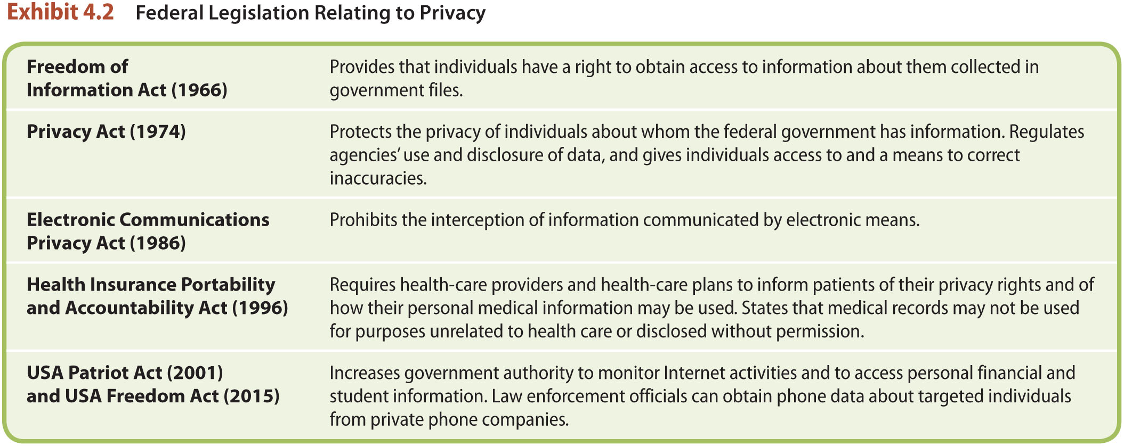
LO5 Privacy Rights (2)
LO5

