Slide 1
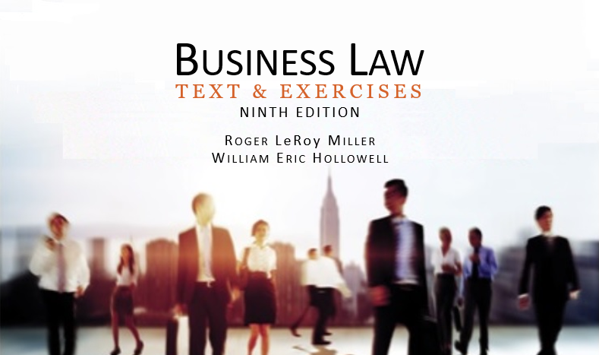
Business Law Text & Exercises Ninth Edition Roger LeRoy Miller William Eric Hollowell
Chapter 3 The Courts and Our Legal System

Slide 2
Learning Outcomes (1)
LO1 Outline a state court system.
LO2 Define federal court jurisdiction.
LO3 Discuss trial procedure.

Slide 3
Learning Outcomes (2)
LO4 Summarize the steps in a lawsuit.
LO5 Identify alternative methods for resolving disputes.

Slide 4
Jurisdiction (1)
Geographical area within which a court has the right and power to decide cases, or matters concerning people, property, or subject matter.

Slide 5
Jurisdiction (2)
Power of a court to hear a dispute and to “speak the law” into a controversy and render a verdict that is legally binding on the parties to the dispute.

Slide 6
Jurisdiction (3)
Jurisdiction Over Persons or Property.
In Personam: power of a court over persons within its territorial boundaries.

Slide 7
Jurisdiction (4)
Jurisdiction Over Persons or Property.
Long Arm Statute: out-of-state defendants based on defendant’s activities within the state. TEST: usually whether advertising or sales of products within the state.

Slide 8
Jurisdiction (5)
Jurisdiction in Cyberspace.
Usually based on a “sliding scale” standard.

Slide 9
LO1 The State Court System (1)
LO1

Slide 10
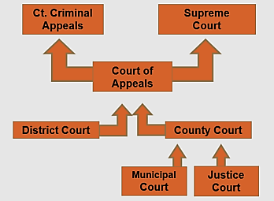
LO1 The State Court System (2)
LO1

Slide 11
LO1 The State Court System (3)
LO1
Trial Courts: general or limited jurisdiction.
General: gives broad authority over different types of cases.
Limited (special): deal with cases restricted to certain subject matter.

Slide 12
LO1 The State Court System (4)
LO1
Trial Courts: general or limited jurisdiction.
Small Claims Court: informal, involving claims of less than a certain amount, e.g., $2,500 or $5,000, depending on state statute.

Slide 13
LO1 The State Court System (5)
LO1
Appellate, or Reviewing, Courts.
Every state has at least one appellate court.
Courts of Appeals, up to Supreme Court, affirm lower court decisions or reverse.

Slide 14
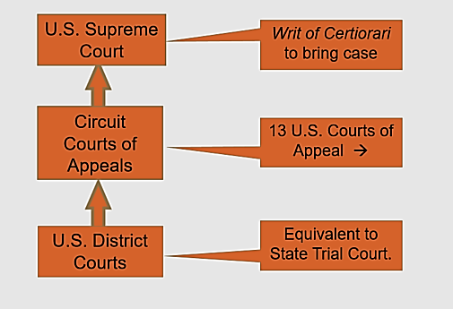
The Federal Court System

Slide 15
U.S. Courts of Appeal

Slide 16
LO2 Federal Court Jurisdiction (1)
LO2
Federal Questions.
Cases in which the rights or obligations of a party are created or defined by some federal law.

Slide 17
LO2 Federal Court Jurisdiction (2)
LO2
Diversity-of-Citizenship.
The parties are not from the same state, and
The amount in controversy is greater than $75,000.

Slide 18
LO2 Federal Court Jurisdiction (3)
LO2

Slide 19
The State Court Case Process (1)
Standing to Sue.
Individual must have a sufficient stake in a controversy before she can bring a law suit.

Slide 20
The State Court Case Process (2)
The Pleadings.
Complaint.
Summons.
Motion to Dismiss.
Answer.

Slide 21
The State Court Case Process (3)
Pretrial Motions.
Motion for judgment on the pleadings.
Motion for summary judgment.

Slide 22
The State Court Case Process (4)
Discovery.
Depositions and Interrogatories.
Other information.
E-Evidence for Discovery.

Slide 23
The State Court Case Process (5)
LO3
The Trial—Procedures.
Opening Arguments.
Plaintiff’s Case in Chief.
Direct Examination.
Cross Examination (by defense).
Rebuttal (by plaintiff).
Rejoinder (by defense).
Closing Arguments.

Slide 24
The State Court Case Process (6)
Motions at the Trial.
Motion to Dismiss the Case.
Motion for Summary Judgment.
Motion for a Directed Verdict.
Motion for Judgment as a Matter of Law.

Slide 25
The State Court Case Process (7)
Posttrial Motions.
Motion for a New Trial.

Slide 26
The State Court Case Process (8)
The Appeal
Appellant: the party who takes an appeal from one court to another.
Appellee: the party against whom an appeal is taken.
Attorneys for both sides file briefs: facts summary, law summary, and argument.

Slide 27
The State Court Case Process (9)
The Appeal
Types of Rulings.
Reversed.
Remanded.
Affirmed.
Final Review.

Slide 28
LO4 Stages in a Lawsuit
LO4

Slide 29
LO5 Alternative Dispute Resolution (1)
LO5
Methods range from individual parties sitting down together, to multinational companies agreeing to binding arbitration.

Slide 30
LO5 Alternative Dispute Resolution (2)
LO5
Negotiation.
Simplest form of ADR.
Voluntary, and usually attempted before trial.

Slide 31
LO5 Alternative Dispute Resolution (3)
LO5
Mediation.
Neutral third party works with both sides to facilitate a resolution.
Main advantage, it is not adversarial as litigation.

Slide 32
LO5 Alternative Dispute Resolution (4)
LO5
Arbitration.
Neutral third party (or panel) hears a dispute and issues a decision which is usually not binding on the parties.
Parties can go forward with lawsuit if they wish.

Slide 33
LO5 Alternative Dispute Resolution (5)
LO5
Arbitration.
Arbitrator’s decision is an award.
An award can be set aside by a court if:
Bad Faith.
Violates public policy.
Arbitrator exceeded her powers.

Slide 34
LO5 Alternative Dispute Resolution (6)
LO5

Slide 35
LO5 Alternative Dispute Resolution (7)
LO5
Online Dispute Resolution (ODR).
Negotiation.
Mediation.
Arbitration (employment contracts).

