Slide 1
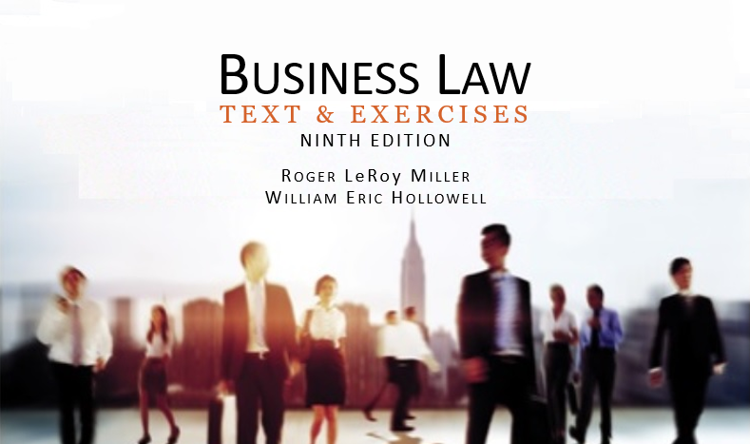
Business Law Text & Exercises Ninth Edition Roger LeRoy Miller William Eric Hollowell
Chapter 6 Intellectual Property

Slide 2
Learning Outcomes
LO1 Identify intellectual property.
LO2 Discuss legal protection for trademarks.
LO3 Describe legal protection for patents.
LO4 Summarize legal protection for copyrights.
LO4 Define trade secret.

Slide 3
LO1 Intellectual Property
LO1
Intellectual property: Property resulting from intellectual, creative processes.

Slide 4
Trademarks and Related Property (1)
A trademark is a distinctive identity that a manufacturer attaches to its product.
Consumers can be misled when a trademark appears on other products.

Slide 5
Trademarks and Related Property (2)
The tort of trademark infringement occurs when one who does not own a trademark copies it to a substantial degree or uses it in its entirety.

Slide 6
Trademarks and Related Property (3)
Trademark Protection.
Lanham Act (1946) protects businesses from competitors that use confusingly similar trademarks.

Slide 7
Trademarks and Related Property (4)
Trademark Dilution.
Occurs when a trademark is used in a way that diminishes its distinctiveness.
Requires a mark be famous when the dilution occurs.

Slide 8
Trademarks and Related Property (5)
Distinctive Marks.
Only trademarks that are deemed sufficiently distinctive from all competing trademarks are protected.
LO2

Slide 9
Trademarks and Related Property (6)
Distinctive Marks.
Distinctive (strong) trademarks are less likely to be infringed.
Fanciful: Xerox, Google.
Arbitrary: Dutch Boy.
Suggestive: Dairy Queen.
LO2

Slide 10
Trademarks and Related Property (7)
Distinctive Marks.
Secondary Meaning.
Descriptive terms are not inherently distinctive and do not receive protection under the law.
LO2

Slide 11
Trademarks and Related Property (8)
Distinctive Marks.
Secondary Meaning.
Geographical terms, personal names: Calvin Klein.
Secondary meaning may arise once customers associate the product with the name.
LO2

Slide 12
Trademarks and Related Property (9)
Trademark Registration.
State and federal governments provide for the registration of trademarks.
Registration is not required for protection, but the mark must be distinctive and in use.

Slide 13
Trademarks and Related Property (10)
Trademark Registration.
Trademark registration provides for proof of the date of inception.
Infringement.
A trademark has been infringed when it is used without authorization.

Slide 14
Trademarks and Related Property (11)
Counterfeit Goods.
Crime to intentionally (or attempt to) traffic goods or trademarks.
Criminal penalties.

Slide 15
Trademarks and Related Property (12)
Service Marks and Trade Names.
Service marks distinguish services rather than goods.
Protected in the same way as trademarks.

Slide 16
Trademarks and Related Property (13)
Service Marks and Trade Names.
Trade names are not the same as trademarks.
Trade names indicate part or all of a business name that is directly related to it and its goodwill. Example: Safeway.
.

Slide 17
Trademarks and Related Property (14)
Domain Names.
Internet address, such as www.amazon.com.
No two businesses can have the same domain name on the internet.

Slide 18
Trademarks and Related Property (15)
Domain Names.
Unauthorized use of domain name constitutes trademark infringement.
Internet Corporation for Assigned Names and Numbers (ICANN) oversees distribution, complaints, and disputes.

Slide 19
Trademarks and Related Property (16)
Cybersquatting.
Occurs when a person registers a domain name that is the same as, or similar to, the trademark of another and then offers to sell the domain name back to the trademark owner.

Slide 20
Trademarks and Related Property (17)
ACPA (1999): Anticybersquatting Consumer Protection Act.
A mark’s owner can file a suit under ACPA against an alleged cybersquatter.
Meta Tags: unauthorized use of constitutes infringement.

Slide 21
Patents (1)
A patent is a grant from the government that conveys to, and secures for, an inventor the exclusive right to make, use, and sell an invention for a period of twenty years.

Slide 22
Patents (2)
Patent Infringement.
If a firm makes, uses, or sells another’s patented design, product, or process without the patent owner’s permission, the tort of patent infringement exists.
LO3

Slide 23
Patent Infringement
Licensing.
An agreement permitting the use of intellectual property.
Allows the use of the patented design, product, or process for certain specified purposes.
LO3

Slide 24
Copyrights (1)
Intangible right granted by statute to the author or originator of certain literary or artistic productions by federal law (U.S. Copyright Act).

Slide 25
Copyrights (2)
Copyright Protection.
Copyrights can be registered with the U.S. Copyright Office, not required.
Automatic protection.
© not necessary to protect against infringement.

Slide 26
Copyrights (3)
What is Protected Expression?
A work must be original, fixed in a durable medium, and fit into one of these categories:
Literary ● Musical
Dramatic ● Pantomimes and Choreographic
Pictorial, graphic, and sculptural
Motion pictures and other audiovisual
Sound recordings
Computer software

Slide 27
Copyrights (4)
Copyright Exclusions.
Any “idea, procedure, process,
system, method of operation, concept, principle or discovery, regardless of the form in which it is described, explained, illustrated, or embodied.”
Only expressions of ideas can be copyrighted, not ideas.

Slide 28
LO4 Copyright Infringement (1)
LO4
Whenever the form or expression of an idea is copied, an infringement of copyright occurs.

Slide 29
LO4 Copyright Infringement (2)
LO4
“Fair use”— exception to infringement. Courts consider:
Purpose of the use.
Nature of the copyrighted work.
How much of the original is copied.
Effect of the use on the market for the original.

Slide 30
LO4 Copyright Infringement (3)
LO4
The First Sale Doctrine.
Once a copyright owner sells or gives away a copy of a work, the copyright owner no longer has the right to control the distribution of that copy.

Slide 31
Copyright Protection for Software
Computer Software Copyright Act, 1980.
Covers software coding and binary-language object code of the program.
Elements of overall structure, sequence, and organization of a program may also be copyrightable.
Does not cover general appearance. (This may fall under trademark laws.)

Slide 32
Copyrights in Digital Information (1)
Copyright law is probably the most important form of intellectual property protection on the Internet.

Slide 33
Copyrights in Digital Information (2)
Courts have held that loading a file or program into a computer’s RAM constitutes a copy for purposes of copyright law.

Slide 34
Copyrights in Digital Information (3)
The Digital Millenium Copyright Act (DMCA).
Established civil and criminal penalties for anyone who circumvents (bypasses) encryption software or other technological antipiracy protection.

Slide 35
Copyrights in Digital Information (4)
The Digital Millenium Copyright Act (DMCA).
Exception to DMCA Liability: under “Fair Use” doctrine.

Slide 36
Copyrights in Digital Information (5)
ISP Limited Liability.
Internet service providers are not liable for infringements by subscribers if unaware of the violation.
ISP may be liable if it has knowledge and fails to take action. Copyright holders must act promptly to file suit.

Slide 37
Copyrights in Digital Information (6)
File Sharing.
People make files on their own PCs directly accessible to others via network.
On the Internet, usually a web server.
P2P networking, generally via software.

Slide 38
Trade Secrets
LO5
Information or a process that gives a business an advantage over competitors who do not know the information or process.
The Economic Espionage Act of 1996 made the theft of trade secrets a federal crime.

Slide 39
International Protection for Intellectual Property (1)
The Paris Convention of 1883.
Allows parties in one country to file for patent and trademark protection in any of the other member countries.

Slide 40
International Protection for Intellectual Property (2)
The Berne Convention of 1888.
Every member country must recognize the copyrights of authors who are citizens of other member countries.

Slide 41
International Protection for Intellectual Property (3)
The TRIPS Agreement of 1994.
Trade-Related Aspects of Intellectual Property Rights.
Specifically provides protection for computer programs.

Slide 42
International Protection for Intellectual Property (4)
The Anti-Counterfeiting Trade Agreement of 2011 (ACTA).
International treaty to combat counterfeiting.
Applies to physical goods as well as works being distributed online.

