Slide 1
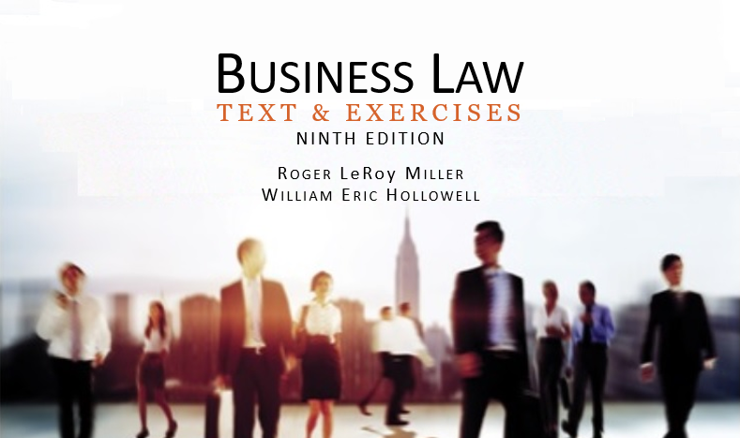
Business Law Text & Exercises Ninth Edition Roger LeRoy Miller William Eric Hollowell
Chapter 17 Introduction to Sales and Lease Contracts

Slide 2
Learning Outcomes
LO1 State the scope of Article 2 of the UCC.
LO2 Identify how the UCC deals with open contract terms.
LO3 Explain the UCC’s treatment of additional terms.
LO4 Discuss the UCC’s Statute of Frauds.

Slide 3
Sales and Leases of Goods
A contract for the sale of goods over $500 is governed by UCC Article 2.
Sales contracts can also be governed by general contract law whenever it is relevant and has not been modified by the UCC.
Article 2A, essentially a repetition of Article 2, covers leases with variations to reflect the differences.

Slide 4
LO2 What is a Sale? (1)
LO1
Article 2 of the UCC states that it “applies to transactions in goods.”
Most courts treat Article 2 as being only applicable to a sale.

Slide 5
LO2 What is a Sale? (2)
LO1
Sale: the passing of title to property from the seller to the buyer for a price.

Slide 6
What Are Goods? (1)
Tangible property: property that has physical existence (such as a car).
Intangible property is not a good and therefore not covered by UCC Article 2.

Slide 7
What Are Goods? (2)
Goods Associated with Real Estate
Must be legally severable, such as mineral deposits or crops.
Goods and Services Combined.
Most courts treat services as being excluded from the UCC.

Slide 8
Who is a Merchant?
Under the UCC, a person who deals in goods of the kind involved in the sales contract
Someone who holds himself or herself out as having knowledge and skill unique to the practices or goods involved in the transaction.

Slide 9
What Is a Lease? (1)
Lease: an agreement to transfer the right to possess and use goods for a period of time in exchange for payment.

Slide 10
What Is a Lease? (2)
Lessor is a person who sells the right to the possession or use of goods to the Lessee in exchange for rental payments.

Slide 11
Sales and Lease Contracts (1)
Parties to sales and lease contracts are free to establish whatever terms they wish.
The UCC comes into play when the parties have left a term out of their contract and that omission later gives rise to a dispute.

Slide 12
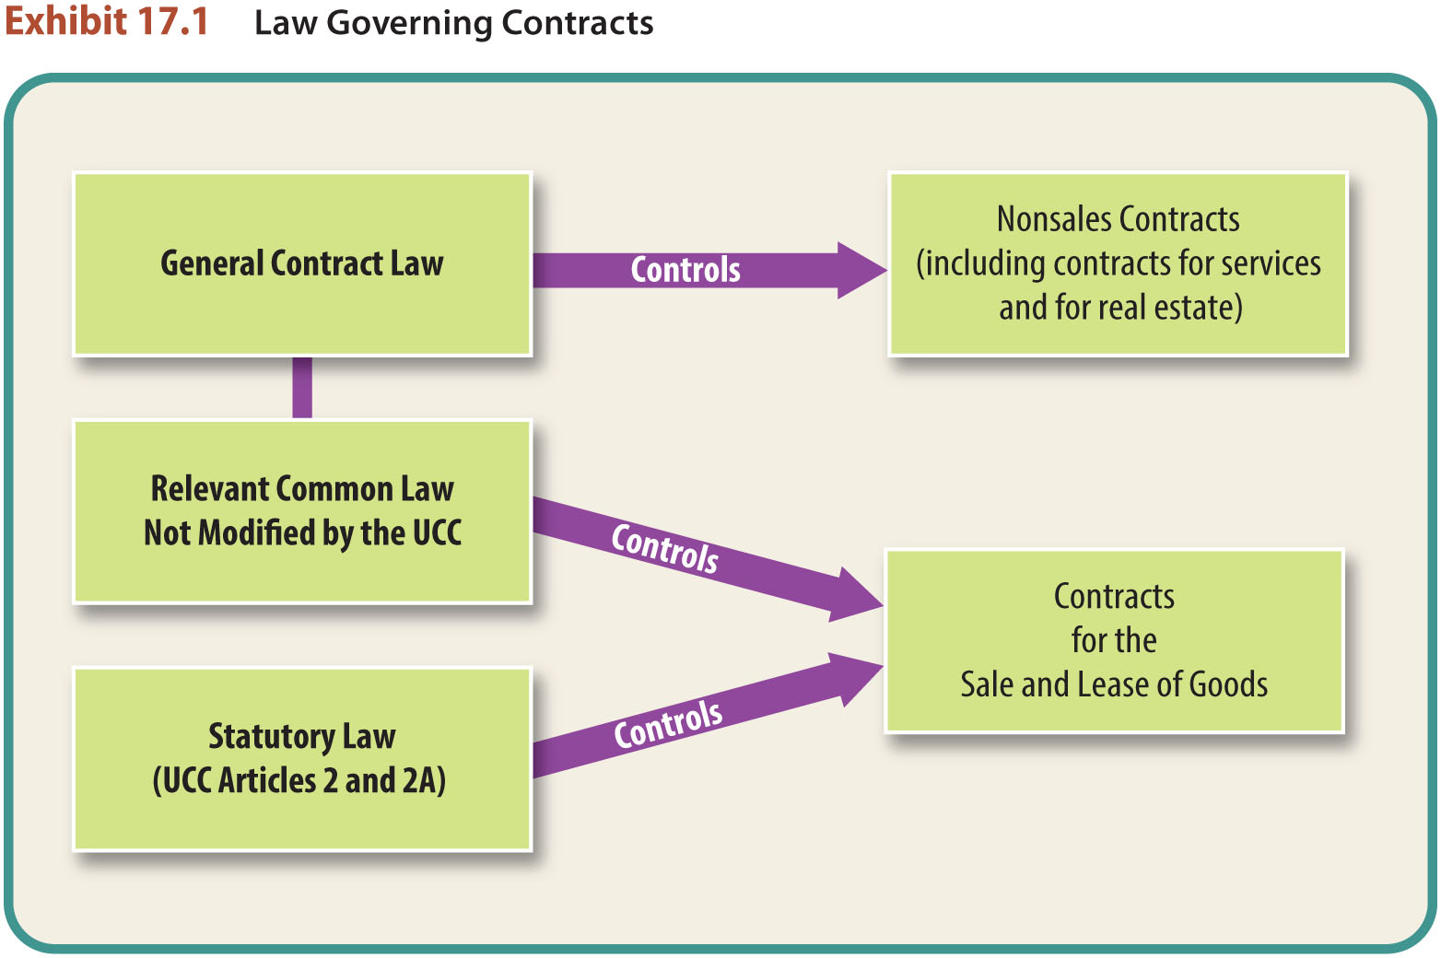
Sales and Lease Contracts (2)

Slide 13
Sales and Lease Contracts (3)
The Offer.
In general contract law, the moment a definite offer is met by an unqualified acceptance, a binding contract is formed.

Slide 14
Sales and Lease Contracts (4)
The Offer.
In commercial sales transactions, the verbal exchanges, the correspondence, and the actions of the parties may not reveal exactly when a binding contract arises.

Slide 15
LO2 Offer: Open Terms (1)
LO2
The UCC states that a sales or lease contract will not fail for indefiniteness even if one or more terms are left open as long as:
Parties intended to make a contract and
There is a reasonably certain basis for the court to grant an appropriate remedy.

Slide 16
LO2 Offer: Open Terms (2)
LO2
In case of a dispute, all that is necessary to prove the existence of a contract is some indication there is a contract.
Missing terms can be proved by evidence, or it will be presumed that the parties intended reasonable terms.

Slide 17
Offer: Merchant’s Firm Offer (1)
Under regular contract principles, an offer can be revoked at any time before acceptance.
UCC has an exception that applies only to firm offers for the sale or lease of goods made by a merchant.

Slide 18
Offer: Merchant’s Firm Offer (2)
An offer (by a merchant) that is irrevocable without consideration for a period of time (not longer than three months).
A firm offer by a merchant must be in writing and must be signed by the offeror.

Slide 19
Acceptance (1)
Acceptance of an offer to buy, sell, or lease goods generally may be made in any reasonable manner and by any reasonable means.

Slide 20
Acceptance (2)
The UCC permits acceptance of an offer to buy goods by either a promise to ship or the prompt shipment of conforming or nonconforming goods to the buyer.

Slide 21
Acceptance (3)
Notice of Acceptance.
Under the common law, because a unilateral offer invites acceptance by performance, the offeree need not notify the offeror of the performance unless the offeror would not otherwise know about it.

Slide 22
Acceptance (4)
Shipment of Nonconforming Goods.
If the seller promptly ships nonconforming goods, this shipment constitutes both an acceptance of an offer (contract) and a breach.

Slide 23
Acceptance (5)
Notice of Acceptance.
Under the UCC, if a sales contract is unilateral, the offeror must be notified of the offeree’s performance (acceptance) within a reasonable time, or the offeror can treat the offer as having lapsed.

Slide 24
Acceptance (6)
Additional Terms.
UCC dispenses with the common law “mirror image” rule.
Under the UCC, a contract is formed if the offeree makes a definite expression of acceptance.
LO3

Slide 25
Acceptance (7)
Additional Terms.
When at least one of the parties is a nonmerchant—a contract is formed according to the terms of the original offer only.
LO3

Slide 26
Acceptance (8)
Additional Terms.
When both parties are merchants—the additional terms automatically become part of the contract unless:
The original offer expressly required acceptance of its terms
LO3

Slide 27
Acceptance (9)
Additional Terms.
When both parties are merchants—the additional terms automatically become part of the contract unless:
The new or changed terms materially alter the contract
LO3

Slide 28
Acceptance (10)
Additional Terms.
When both parties are merchants—the additional terms automatically become part of the contract unless:
The offeror rejects the new or changed terms within a reasonable time.
LO3

Slide 29
Acceptance (11)
Additional Terms.
Terms subject to the offeror’s consent—regardless of merchant status, the offeree’s expression is not an acceptance if the new terms are expressly conditioned on the offeror’s consent.
LO3

Slide 30
Consideration
Modifications must be made in good faith.
In some situations, modification without consideration must be written to be enforceable.

Slide 31
The UCC’s Statute of Frauds
The UCC contains a Statute of Frauds provision that applies to contracts for the sale or lease of goods.
If the price is $500 or more, there must be a writing for the contract to be enforceable.

Slide 32
LO4 Statute of Frauds (1)
LO4
Sufficiency of the Writing.
Indicates parties intended to form a contract, AND signed by party against whom enforcement is sought.

Slide 33
LO4 Statute of Frauds (2)
Written Confirmation between Merchants.
After oral agreement, one party sends signed written confirmation to the other merchant.

Slide 34
LO4 Statute of Frauds (3)
Exceptions.
Specially manufactured goods—
for a particular buyer, goods cannot be easily resold, and seller has substantially started the manufacturing process.

Slide 35
LO4 Statute of Frauds (4)
Exceptions.
Admissions—oral contact enforceable if the party against whom enforcement is sought admits under oath that a contract was made.

Slide 36
LO4 Statute of Frauds (5)
Exceptions.
Partial performance—oral contact enforceable to the extent performance actually took place.

Slide 37
Parol Evidence Rule (1)
Consistent Additional Terms.
Course of Dealing.
Usage of Trade.
Course of Performance.

Slide 38
Parol Evidence Rule (2)
Course of Dealing.
A sequence of previous conduct between the parties to a particular transaction that establishes a common basis for their understanding.

Slide 39
Parol Evidence Rule (3)
Usage of Trade.
Any practice or method of dealing having such regularity of observance in a place, vocation, or trade as to justify an expectation that it will be observed with respect to the transaction in question.

Slide 40
Parol Evidence Rule (4)
Course of Performance.
The conduct that occurs under the terms of a particular agreement; such conduct indicates what the parties to an agreement intended it to mean.

