Slide 1
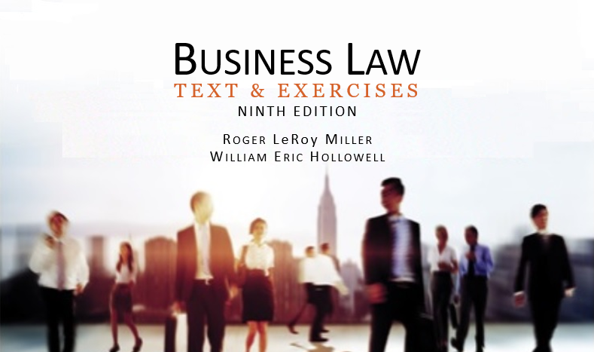
Business Law Text & Exercises Ninth Edition Roger LeRoy Miller William Eric Hollowell
Chapter 18 Title and Risk of Loss

Slide 2
Learning Outcomes
LO1 Explain the concept of identification.
LO2 Describe the effects of imperfect title on sales of goods.
LO3 Discuss the concept of risk loss.
LO4 Identify insurable interest in goods.

Slide 3
LO1 Identification (1)
LO1
Before any interest in goods can pass from seller to buyer the goods:
1. Must be in existence, and
2. Must be identified.

Slide 4
LO1 Identification (2)
LO1
Identification.
Takes place when specific goods are designated as the subject matter of the contract.
Gives buyer insurable interest and rights against third parties.

Slide 5
LO1 Identification (3)
LO1
Existing Goods.
If goods exist at the time of contracting, identification takes place at that time.

Slide 6
LO1 Identification (4)
LO1
Future Goods.
That do not exist and cannot be identified.
Identification of unborn animals within 12 months takes place on conception.

Slide 7
LO1 Identification (5)
LO1
Future Goods.
That do not exist and cannot be identified.
Identification of crops harvested within 12 months of contracting takes place at planting.
Other: identification takes place on shipment, mark, or other designation.

Slide 8
LO1 Identification (6)
LO1
Goods from a Larger Mass.
Goods identified when marked, shipped, or specially designated by seller.
Exceptions: Fungible goods that are alike by physical nature, by agreement, or by trade usage.

Slide 9
Passage of Title (1)
Once goods exist and are identified, title can be determined.
Unless agreed otherwise, usually title passes upon physical delivery.
UCC provisions do not apply to leases.

Slide 10
Passage of Title (2)
Shipment Contracts.
A contract requiring the seller to deliver the goods to a carrier, at which time title passes to the buyer.

Slide 11
Passage of Title (3)
Shipment Contracts.
Generally all contracts are assumed to be shipment contracts, unless designated otherwise.

Slide 12
Passage of Title (4)
Destination Contracts.
A contract for the sale of goods in which the seller assumes liability for any losses or damage to the goods until they are tendered at the destination specified in the contract.

Slide 13
Passage of Title (5)
Delivery Without Movement of Goods.
Document of Title: paper exchanged in the regular course of business that evidences the right to possession of goods (e.g., a bill of lading or warehouse receipt).

Slide 14
Passage of Title (6)
Sales or Leases by Nonowners.
Void Title.
A buyer acquires at least whatever title the seller has to the goods sold.
If the seller is a thief, the seller’s title is void.
The same result would occur if the goods were leased.
LO2

Slide 15
Passage of Title (7)
Sales or Leases by Nonowners.
Voidable Title.
Seller has voidable title if the goods he is selling were obtained by fraud; paid for with a dishonored check; purchased from a minor, or purchased on credit, when the seller was insolvent.
LO2

Slide 16
Passage of Title (8)
Sales or Leases by Nonowners.
Voidable Title.
Seller with voidable title has the power to transfer good title to a good faith purchaser.
LO2

Slide 17
Passage of Title (9)
Sales or Leases by Nonowners.
Entrustment Rule.
Entrusting goods to a merchant who deals in goods of that kind gives the merchant the power to transfer all rights to a buyer in the ordinary course of business.

Slide 18
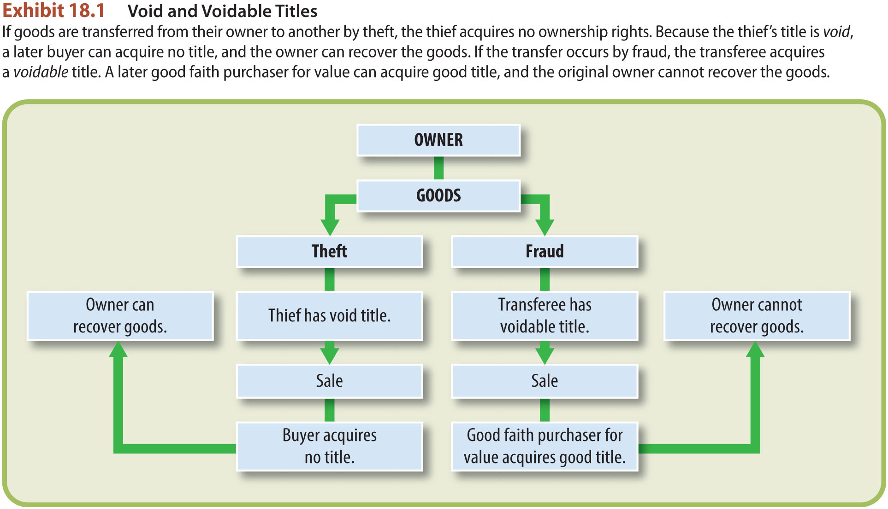
Void and Voidable Title
LO2

Slide 19
LO3 Risk of Loss (1)
LO3
Not necessarily determined by title.
Can be determined by the parties in the contract.
May also depend on whether the sales or lease contract has been breached at the time of loss.

Slide 20
LO3 Risk of Loss (2)
LO3

Slide 21
LO3 Risk of Loss (3)
LO3
Delivery with Movement of Goods.
Shipment contracts: risk of loss passes to buyer when the goods are delivered to the carrier.

Slide 22
LO3 Risk of Loss (4)
LO3
Delivery with Movement of Goods.
Destination Contracts: risk of loss passes from the seller to the buyer when the goods are tendered to the buyer at the destination.

Slide 23
LO3 Risk of Loss (5)
LO3
Delivery without Movement of Goods.
Goods held by Seller or Lessor: if a merchant, risk of loss passes to buyer when buyer takes physical possession of the goods.

Slide 24
LO3 Risk of Loss (6)
LO3
Delivery without Movement of Goods.
Goods Held by Bailee. Goods usually represented by a document of title (bill or lading or warehouse receipt).

Slide 25
LO3 Risk of Loss (7)
LO3
Delivery Without Movement of Goods.
Goods Held by Bailee. ROL passes to Buyer when: (1) buyer receives negotiable document of title for goods, (2) bailee acknowledges buyer’s right to possess the goods,

Slide 26
LO3 Risk of Loss (9)
LO3
Delivery Without Movement of Goods.
Goods Held by Bailee. ROL to Buyer when: (3) buyer receives a nonnegotiable document of title and presents it to bailee, to demand the goods.

Slide 27
LO3 Risk of Loss (10)
LO3
Conditional Sales.
Sale on Approval.
Sale is final when buyer approves of the good(s) sold. Approval may be inferred if buyer keeps the goods beyond a reasonable time or uses the goods in any way that is inconsistent with the seller’s ownership.

Slide 28
LO3 Risk of Loss (11)
LO3
Conditional Sales.
Sale or Return.
A type of conditional sale wherein title and possession pass from the seller to the buyer.
However, buyer retains the option to rescind or return the goods during a specified period even though the goods conform to the contract.

Slide 29
Risk of Loss in Breach (1)
Seller or Lessor Breach: if the goods are so nonconforming that the buyer has the right to reject them, the risk of loss does not pass to the buyer until the defects are cured.
Cure: right of seller to correct his contractual performance within the contract period.

Slide 30
Risk of Loss in Breach (2)
Buyer or Lessee Breach:
The seller or lessor must have already identified the goods under the contract.
The buyer or lessee bears the risk for only a commercially reasonable time after the seller or lessor learns of the breach.
The buyer or lessee is liable only to the extent of any deficiency in the seller’s insurance coverage.

Slide 31
LO4 Insurable Interest (1)
LO4
Any party purchasing insurance must have “sufficient interest.”
Insurance law determines “sufficiency”; not the UCC.
The UCC does have certain rules regarding insurable interest.

Slide 32
LO4 Insurable Interest (2)
LO4
An interest either in a person’s life or well-being or in property that is sufficiently substantial that insuring against injury to the person or damage to the property does not amount to a mere wagering (betting) contract.

Slide 33
LO4 Insurable Interest (3)
LO4
Buyer or Lessee: have insurable interest in identified goods.
Seller or Lessor: have insurable interest as long as they retain title to the goods.

