Slide 1
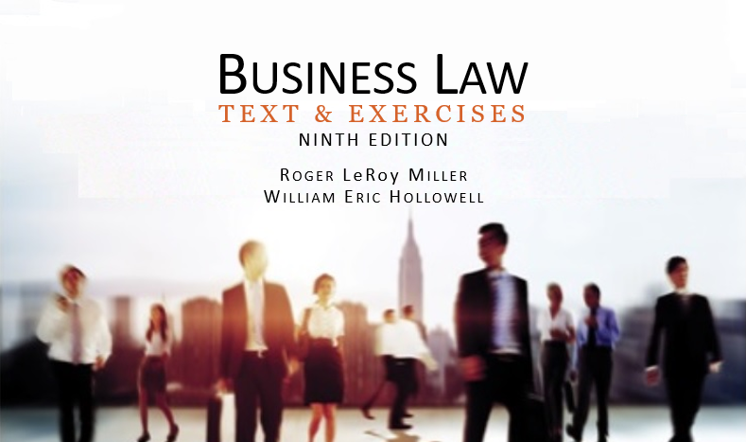
Business Law Text & Exercises Ninth Edition Roger LeRoy Miller William Eric Hollowell
Chapter 25 Agency Relationships

Slide 2
Learning Outcomes (1)
LO1 Describe how an agency relationship is created.
LO2 List the duties of agents and principals.
LO3 Define the scope of an agent’s authority.

Slide 3
Learning Outcomes (2)
LO4 Identify the parties’ liability in agency relationships.
LO5 Explain how an agency relationship is terminated.

Slide 4
Introduction
Agency relationship: relationship in which one party (the agent) acts for another (the principal).
Agent: person authorized to act for another.
Principal: person who authorizes an agent to act on his or her behalf.

Slide 5
Principal-Agent Relationships (1)
Employer-Employee.
An employee is one whose physical conduct is controlled, or subject to control, by the employer.
Normally, all employees who deal with third parties are deemed to be agents.

Slide 6
Principal-Agent Relationships (2)
Employer-Independent Contractor.
Contractor: a person whose working conditions are not controlled by an employer.

Slide 7
Principal-Agent Relationships (3)
Employer-Independent Contractor.
An independent contractor is not an employee but may be an agent.
The greater control an employer has, the more likely the worker is an employee.

Slide 8
LO1 Agency Formation (1)
LO1
Agency agreement need not be in writing, with two exceptions:
If the Statute of Frauds requires it.
Powers of attorney.
A principal must have the contractual capacity to enter into an agency agreement.

Slide 9
LO1 Agency Formation (2)
LO1
Agency can be created four ways:
Agency by Agreement of the Parties.
Agency by Ratification.
Agency by Estoppel.
Agency by Operation of Law.

Slide 10
LO1 Agency Formation (3)
LO1
Agency by Agreement of the Parties.
Must be an affirmative indication.
Can be written, or oral.
Can also be implied from conduct.

Slide 11
LO1 Agency Formation (4)
LO1
Agency by Ratification.
Confirmation by one person of an act or contract performed or entered into on his or her behalf by another, who did so without express authority.

Slide 12
LO1 Agency Formation (5)
LO1
Agency by Estoppel.
Principal causes a third party to reasonably believe the person is her agent.
If the third party deals with the agent, the principal is estopped (barred) from denying the agency.

Slide 13
LO1 Agency Formation (6)
LO1
Agency by Operation of Law.
Courts may enforce this in family relationships.
Also in emergency situations, when principal is unavailable and agent’s failure to act would cause principal substantial losses.

Slide 14
LO2 Duties of Agents and Principals (1)
LO2
In general, for every duty of the principal, the agent has a corresponding right, and vice versa.

Slide 15
LO2 Duties of Agents and Principals (2)
LO2
Agent’s Duties to the Principal.
Performance.
Notification.
Loyalty.
Obedience.
Accounting.

Slide 16
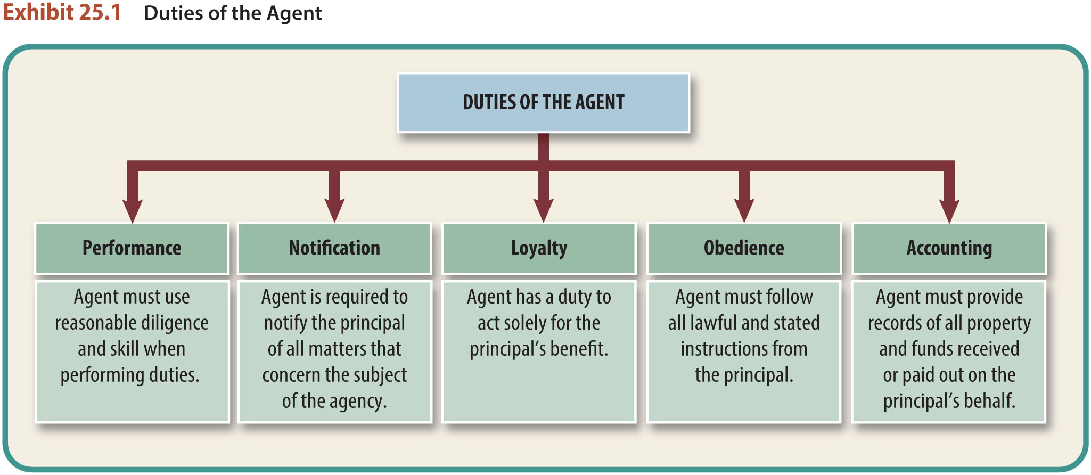
LO2 Duties of Agents and Principals (3)
LO2

Slide 17
LO2 Duties of Agents and Principals (4)
LO2
Principal’s Duties to the Agent.
Compensation.
Reimbursement and indemnification.
Cooperation.

Slide 18
LO3 Agent’s Authority (1)
LO3
An agent’s authority to act can be either actual (express or implied) or apparent.
If an agent contracts outside the scope of his or her authority, the principal may still become liable by ratifying the contract.

Slide 19
LO3 Agent’s Authority (2)
LO3
Express Authority.
Equal Dignity Rule: In most states, a rule stating that express authority given to an agent must be in writing if the contract to be made on behalf of the principal is required to be in writing.

Slide 20
LO3 Agent’s Authority (3)
LO3
Express Authority.
Power of Attorney: document or instrument authorizing another to act as one’s agent or attorney.

Slide 21
LO3 Agent’s Authority (4)
LO3
Implied Authority of agent can be:
Implied by custom.
Inferred from the position the agent occupies.

Slide 22
LO3 Agent’s Authority (5)
LO3
Apparent Authority.
Apparent authority exists when principal, by either word or action, causes a third party reasonably to believe that an agent has authority to act, even though the agent has no express or implied authority.

Slide 23
LO3 Agent’s Authority (6)
LO3
Apparent Authority.
If the third party changes his or her position in reliance on the principal’s representations, the principal may be estopped (barred) from denying that the agent had authority.

Slide 24
LO3 Agent’s Authority (7)
LO3
Ratification.
Affirmation of a previously unauthorized contract or act involving an agent and third party.
Requirements:
The one who acted as an agent must have acted on behalf of a principal who subsequently ratifies.

Slide 25
LO3 Agent’s Authority (8)
LO3
Ratification.
Requirements:
The principal must know of all material facts involved in the transaction.
The agent’s act must be affirmed in its entirety by the principal.

Slide 26
LO3 Agent’s Authority (9)
LO3
Ratification.
Requirements:
The principal must have the legal authority to authorize the transaction.
The principal’s affirmance must occur prior to the withdrawal or change in position of reliance of the third party upon the contract.

Slide 27
LO3 Agent’s Authority (10)
LO3
Ratification.
Requirements:
The principal must observe the same formalities as the agent used in the initial authorization.

Slide 28
Liability in Agency Relationships
Liability for Agent’s Contracts.
Disclosed principal.
Partially disclosed principal.
Undisclosed principal.
Liability for Agent’s Torts.

Slide 29
LO4 Liability for Agent’s Contracts (1)
LO4
Disclosed Principal.
Principal’s identity and existence is known by a third person at the time a transaction is conducted by an agent.
Principal is liable if agent acted within her scope of authority.

Slide 30
LO4 Liability for Agent’s Contracts (2)
LO4
Partially Disclosed Principal.
Principal’s identity is unknown, but third person knows the agent is (or may be) acting for a principal at the time the contract is made.
Both principal and agent are liable to third party.

Slide 31
LO4 Liability for Agent’s Contracts (3)
LO4
Undisclosed Principal.
Totally unknown, and third party believes agent is actually a principal.
Principal is liable, unless:
Expressly excluded from the contract.
Contract is a negotiable instrument.
Performance of the agent is personal to the contract.

Slide 32
Liability for Agent’s Torts
Principle is liable under respondeat superior.
Employer is vicariously liable for the wrongful acts committed by an agent or employee while acting within the scope of his agency or employment.

Slide 33
LO5 Termination of Agency Relationships
LO5
An agency can terminate by an act of the parties or by operation of law.
Once the relationship between the principal and agent has ended, the agent no longer has the right to bind the principal.

Slide 34
LO5 Termination by Act of the Parties
LO5
Lapse of time.
Purpose achieved.
Occurrence of a specific event.
Mutual agreement.
Termination by one party.
Agency coupled with an interest.

Slide 35
LO5 Termination by Operation of Law (1)
LO5
Death or insanity.
Impossibility.
Changed circumstances.
Bankruptcy.
War.

Slide 36
LO5 Termination by Operation of Law (2)
LO5
When an agency terminates by operation of law, there is no duty to notify third parties, unless the agent’s authority is coupled with an interest.

Slide 37
LO5 Termination by Operation of Law (3)
LO5
If the parties themselves have terminated the agency, however, it is the principal’s duty to inform any third parties who know of the existence of the agency that it has been terminated.
No particular form is required.

