Slide 1
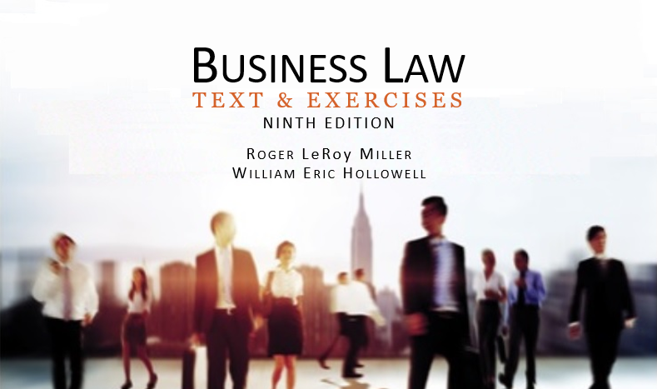
Business Law Text & Exercises Ninth Edition Roger LeRoy Miller William Eric Hollowell
Chapter 28 Types of Business Organizations

Slide 2
Learning Outcomes
LO1 Describe a sole proprietorship.
LO2 Identify the feature of a general partnership.
LO3 Outline the elements of a limited partnership.
LO4 List the advantages of a limited liability company.

Slide 3
LO1 Sole Proprietorships (1)
LO1
The simplest form of business in which the owner is the business.
A sole proprietor reports business income on his or her personal income tax return and is legally responsible for all debts of the business.

Slide 4
LO1 Sole Proprietorships (2)
LO1
Advantages.
Proprietor receives all profits.
Less costly to startup.
Taxed once.

Slide 5
LO1 Sole Proprietorships (3)
LO1
Disadvantages.
Proprietor bears all liability.
Limited opportunity for raising capital.
Business is dissolved upon death.

Slide 6
LO2 Partnerships (1)
LO2
An association of two or more persons to carry on, as co-owners, a business for profit.
Uniform Partnership Act (UPA) governs in the absence of a different agreement among partners.

Slide 7
LO2 Partnerships (2)
LO2
Elements.
Sharing of profits and losses.
Joint ownership of the business.
Equal rights in the management of the business.

Slide 8
LO2 Partnerships (3)
LO2
Characteristics.
Independent entity.
Can sue or be sued, collect judgments, and have all accounting procedures performed in the name of the partnership entity.

Slide 9
LO2 Partnerships (4)
LO2
Tax Treatment.
Aggregate of the individual partners.
Pass-through entity.

Slide 10
LO2 Partnerships (5)
LO2
Formation.
Partnership By Agreement.
Can be oral, but some agreements must be written under Statute of Frauds.
Partnership agreement is called articles of partnership.

Slide 11
LO2 Partnerships (6)
LO2
Formation.
Partnership by Estoppel.
Occurs when a party who is not a partner represents himself as such to third persons, who rely on the representations.

Slide 12
LO2 Partnerships (7)
LO2
Formation.
Partnership by Estoppel.
Or, when a partner represents that a nonpartner is a member of the firm. The nonpartner is regarded as an agent whose acts are binding on the partnership.

Slide 13
LO2 Partnerships (8)
LO2
Formation.
Partnership by Estoppel.
Third person relies on representation that the nonpartner was part of the partnership.

Slide 14
LO2 Partnerships (9)
LO2
Formation.
Partnership by Estoppel.
Partners (and the nonpartner) are liable to third party and estopped (prevented or barred) from denying that the nonpartner is a partner.

Slide 15
LO2 Partnerships (10)
LO2
Rights of Partners.
Management Rights.
Sharing Partnership Profits and Losses.
Compensation.
Inspection of Partnership Books.

Slide 16
LO2 Partnerships (11)
LO2
Rights of Partners.
Partner’s Interest in the Firm.
personal asset consisting of proportional share of profits and return of capital. Partner’s personal creditors can sue for that interest.

Slide 17
LO2 Partnerships (12)
LO2
Rights of Partners.
Partnership Property.
A partner may use or possess partnership property only on behalf of the partnership.

Slide 18
LO2 Partnerships (13)
LO2
Rights of Partners.
Partnership Property.
A partner is not a co-owner of partnership property and has no interest in the property that can be transferred. Partnership property is owned by the partnership as an entity and not by the individual partners.

Slide 19
LO2 Partnerships (14)
LO2
Duties, Powers, and Liabilities of Partners.
Fiduciary Duties: partners are fiduciaries of each other, based on extraordinary trust and loyalty.
Good faith, duty of care, duty of loyalty.
May pursue personal rights as long as fiduciary duties are not violated.

Slide 20
LO2 Partnerships (15)
LO2
Duties, Powers, and Liabilities of Partners.
Agency Powers: partners are general agents of the partnership.
Joint and Several Liability: third party may sue one or more of the partners separately or all of them together, at his option.

Slide 21
LO2 Partnerships (16)
LO2
Duties, Powers, and Liabilities of Partners.
Joint and Several Liability.
If third party is successful, he may collect judgment only against assets of those partners sued.
Partner who commits tort resulting in judgment against partnership is required to repay damages to the firm.

Slide 22
LO2 Partnerships (17)
LO2
Partner’s Dissociation.
Severance of the relationship between a partner and a partnership when the partner ceases to be associated with the carrying on of the partnership business.

Slide 23
LO2 Partnerships (18)
LO2
Partner’s Dissociation.
Events that Cause Dissociation.
Notice.
Bankruptcy.
Assignment of partnership interest.
Incapacity.
Death.

Slide 24
LO2 Partnerships (19)
LO2
Partner’s Dissociation.
Effects of Dissociation.
Right to have interest purchased by the partnership.
Right to participate in the management and conduct of the partnership business ends, along with the duty of loyalty.

Slide 25
LO2 Partnerships (20)
LO2
Partnership Termination.
Acts of Partners.
Operation of Law.
Judicial Decree.

Slide 26
LO2 Partnerships (21)
LO2
Winding Up.
Once a partnership is dissolved (terminated), it continues to exist legally until the process of winding up all business affairs (collecting and distributing the firm’s assets) is complete.

Slide 27
LO3 Limited Partnerships (1)
Elements.
Consists of one or more general partners and one or more limited partners.

Slide 28
LO3 Limited Partnerships (2)
General partner: manages the LP and is fully personally liable for debts and obligations of the LP.
Limited partner: does not engage in management and is only liable up to the amount contributed.

Slide 29
Limited Liability Partnership
A form of partnership that allows professionals to enjoy the tax benefits of a partnership while limiting their personal liability for the malpractice of other partners.

Slide 30
Limited Liability Companies (1)
An LLC is a hybrid form of business enterprise that offers the limited liability of the corporation but the tax advantages of a partnership.

Slide 31
Limited Liability Companies (2)
Advantages.
Profits pass through and taxes are paid individually.
Liability is limited to a member’s investment.
Managers need not be members.
LO4

Slide 32
Limited Liability Companies (3)
Advantages.
Corporations, partnerships, and foreign investors can be members.
No limit on members.
Flexibility of a simple operating agreement.
LO4

