Slide 1
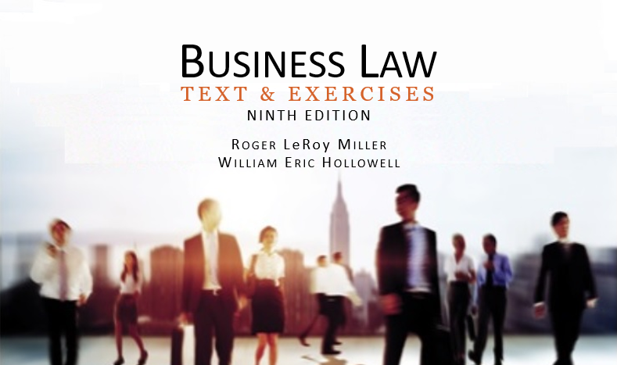
Business Law Text & Exercises Ninth Edition Roger LeRoy Miller William Eric Hollowell
Chapter 39 Landlord and Tenant Law

Slide 2
Learning Outcomes (1)
LO1 Identify the different types of tenancies.
LO2 Describe a lease agreement.
LO3 Outline the rights and duties under a lease agreement.
LO4 Discuss the transfer of rights to leased property.

Slide 3
Learning Outcomes (2)
LO5 Explain how a lease usually terminates.

Slide 4
LO1 Types of Tenancies (1)
LO1
Tenancy for Years.
Created by an express contract.
Property is leased for a specified period of time.

Slide 5
LO1 Types of Tenancies (2)
LO1
Periodic Tenancy.
Does not specify how long lease lasts.
But rent paid at certain intervals.

Slide 6
LO1 Types of Tenancies (3)
LO1
Tenancy at Will.
For as long as both agree.
Tenancy at Sufferance.
Wrongful possession without the right to possess.

Slide 7
LO2 The Lease Agreement (1)
LO2
Lease Agreement.
Can be oral or written (oral may not be enforceable).
Gives tenant the temporary right to exclusively possess the property, and:

Slide 8
LO2 The Lease Agreement (2)
LO2
Lease Agreement.
1. Express an intent to establish the relationship.
2. Transfer the property’s possession to the tenant at the beginning of the term.

Slide 9
LO2 The Lease Agreement (3)
LO2
Lease Agreement.
3. Provide for landlord’s reversionary (future) interest, allowing her to retake possession of the property.
4. Describe the property (give its street address).

Slide 10
LO2 The Lease Agreement (4)
LO2
Lease Agreement.
5. Indicate the length of the term, the amount of the rent, and how and when the rent is to be paid.

Slide 11
LO3 Rights and Duties of Landlords and Tenants (1)
LO3
Possession.
Tenant’s right to exclusive possession is only subject to landlord’s limited right to come unto the property.

Slide 12
LO3 Rights and Duties of Landlords and Tenants (2)
LO3
Possession.
Covenant of Quiet Enjoyment: Landlord promises Tenant’s peace and enjoyment of the property.

Slide 13
LO3 Rights and Duties of Landlords and Tenants (3)
LO3
Possession.
Eviction: occurs when Landlord deprives tenant of possession of the leased property; or interferes with use or enjoyment of the property to the extent that Tenant cannot use or enjoy.

Slide 14
LO3 Rights and Duties of Landlords and Tenants (4)
LO3
Rights and Duties: Possession.
Constructive Eviction: occurs when landlord breaches lease or covenant or quiet enjoyment; and landlord makes it impossible for the tenant to use and enjoy the property.

Slide 15
LO3 Rights and Duties of Landlords and Tenants (5)
LO3
Use and Maintenance.
Implied Warranty of Habitability: Landlord must furnish premises in habitable condition.

Slide 16
LO3 Rights and Duties of Landlords and Tenants (6)
LO3
Use and Maintenance.
Implied Warranty of Habitability: landlord responsible for maintaining common areas (e.g., stairs, parking lots, elevators), and repairing major or substantial defects.

Slide 17
LO3 Rights and Duties of Landlords and Tenants (7)
LO3
Rent for Leased Property.
Payment based on agreement, custom, state statute, waiver.

Slide 18
LO3 Rights and Duties of Landlords and Tenants (8)
LO3
Rent for Leased Property.
Tenant can deposit rent into an ‘escrow’ account if landlord breaches the implied warranty of habitability.

Slide 19
LO4 Transferring Rights to Leased Property (1)
LO4
Landlord may sell any and all of his rights in the real property.
New owner buys “subject to the lease,” if lease is recorded.

Slide 20
LO4 Transferring Rights to Leased Property (2)
LO4
Assignment.
Tenant transfers his or her entire interest in the lease to a third person, but original Tenant is not released from liability under the lease.

Slide 21
LO4 Transferring Rights to Leased Property (3)
LO4
Sublease
Tenant transfers all or part of his interest in the lease for a shorter period of time than the lease. The original tenant is not relieved of liability under the lease.

Slide 22
LO5 Terminating the Lease (1)
LO5
Usually terminates when it ends; tenant surrenders property and landlord retakes possession.
Once lease terminates, tenant has no legal right to remain.

Slide 23
LO5 Terminating the Lease (2)
LO5
Terminating The Lease.
What happens when a tenant abandons the premises?
Tenant is responsible to pay the rent, but landlord is responsible to mitigate his damages by making reasonable attempts to lease the property.

