Slide 1
Business Law Text & Exercises Ninth Edition Roger LeRoy Miller William Eric Hollowell
Chapter 7 Business Crimes

Slide 2
Learning Outcomes (1)
LO1 Indicate elements of criminal liability.
LO2 Outline the rights of criminal suspects.
LO3 List the crimes that affect business.

Slide 3
Learning Outcomes (2)
LO4 Summarize the defenses to criminal liability.
LO5 Know the legal protection for online victims.

Slide 4
Civil Law and Criminal Law (1)
Civil Law: duties that exist between persons and their governments.
Contract law is part of civil law.
Tort law is also part of civil law.

Slide 5
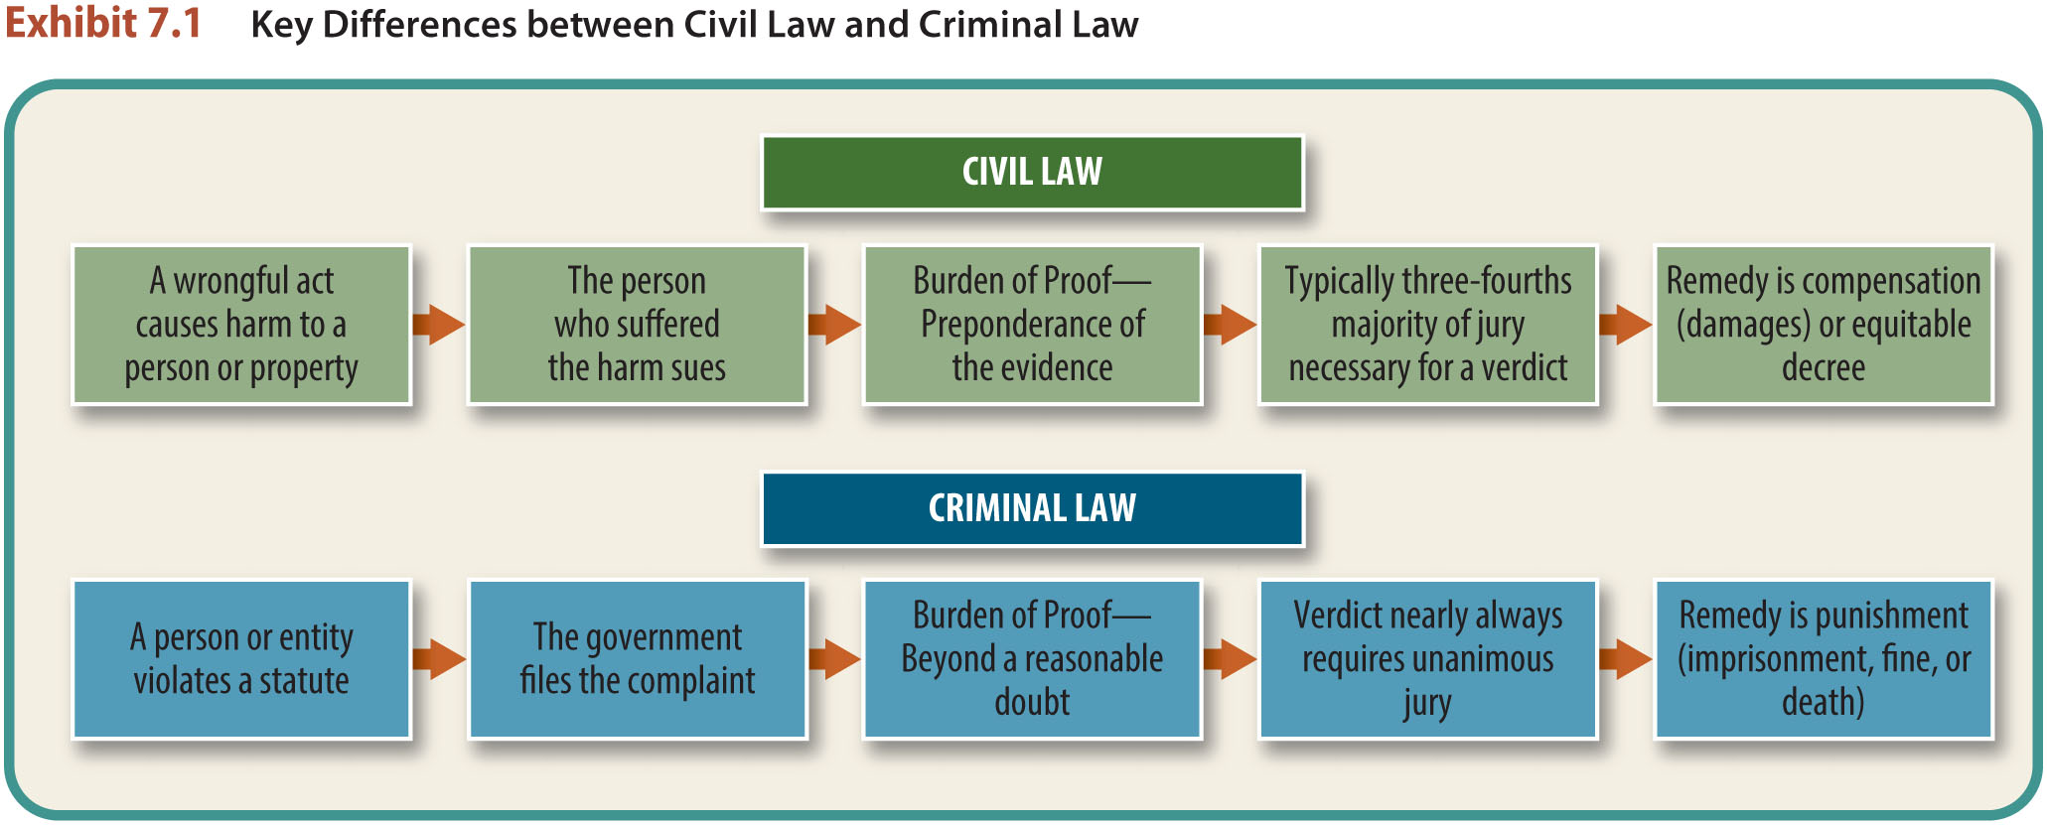
Civil Law and Criminal Law (2)
Key Differences.

Slide 6
Classification of Crimesv (1)
Felony: serious crime punishable by death or imprisonment in a federal penitentiary for more than one year.

Slide 7
Classification of Crimes (1)
Misdemeanor: Under federal law and in most states, any crime that is not a felony, punishable by fine or confinement for up to one year in a local prison.

Slide 8
LO1 What Constitutes Criminal Liability? (1)
LO1
Two elements must exist for a person to be convicted of a crime:
Criminal Act.
Intent to Commit a Crime.

Slide 9
LO1 What Constitutes Criminal Liability? (2)
LO1
The Criminal Act.
Most crimes require an act of commission (a person must do something).
Omission can be a crime, but only when a person has a legal duty to perform the omitted act.

Slide 10
LO1 What Constitutes Criminal Liability? (3)
LO1
Intent to Commit a Crime.
A wrongful mental state is as necessary as a wrongful act in establishing criminal liability.

Slide 11
LO2 Constitutional Safeguards (1)
LO2
Fourth amendment protects against unreasonable searches and seizures.
Fourth Amendment requires that no warrants for a search or an arrest can be issued without probable cause.

Slide 12
LO2 Constitutional Safeguards (2)
LO2
Fifth amendment requirement for due process.
Fifth amendment prohibition against double jeopardy.
Fifth amendment requirement that no person can be forced to incriminate himself.

Slide 13
LO2 Constitutional Safeguards (3)
LO2
Sixth amendment guarantees a speedy, public trial, by jury, the right to confront witnesses, and the right to a lawyer.
Eighth amendment prohibits excessive bail and fines, and cruel and unusual punishment.

Slide 14
LO2 Constitutional Safeguards (4)
LO2
Searches and Seizures.
Search warrant: an order from a judge or public official giving authorization.

Slide 15
LO2 Constitutional Safeguards (5)
LO2
Searches and Seizures.
Probable cause requires evidence that would convince a reasonable person that the proposed search or seizure is justified.

Slide 16
LO2 Constitutional Safeguards (6)
LO2
The Exclusionary Rule.
Evidence obtained in violation of the Fourth, Fifth, and Sixth amendments usually must be excluded (suppressed), as well as all evidence derived from the illegally obtained evidence.

Slide 17
LO2 Constitutional Safeguards (7)
LO2
Informing Suspects of Their Rights.
Individuals who are arrested must be informed of their Constitutional rights, otherwise their statements are usually not admissible in court.
Voluntary confessions can be used as evidence in federal cases.

Slide 18
LO3 Crimes Affecting Business (1)
LO3
White Collar Crimes: nonviolent crimes by an individual or business.
Forgery.
Robbery.
Larceny.
Embezzlement.

Slide 19
LO3 Crimes Affecting Business (2)
LO3
White Collar Crimes: nonviolent crimes by an individual or business.
Mail and Wire Fraud.
Cyber Crime.
Bribery.

Slide 20
LO3 Crimes Affecting Business (3)
LO3
Forgery: The fraudulent making or altering of any writing in a way that changes the legal rights and liabilities of another.
Includes changing trademarks, counterfeits.

Slide 21
LO3 Crimes Affecting Business (4)
LO3
Robbery is forcefully and unlawfully taking personal property of any value from another.
Force or intimidation is usually necessary.

Slide 22
LO3 Crimes Affecting Business (5)
LO3
Larceny: any person who wrongfully or fraudulently takes and carries away another person’s personal property is guilty of larceny.
Whereas robbery involves force or fear, larceny does not.

Slide 23
LO3 Crimes Affecting Business (6)
LO3
Embezzlement.
When a person entrusted with another person’s property or money fraudulently appropriates it, embezzlement occurs.

Slide 24
LO3 Crimes Affecting Business (7)
LO3
Embezzlement.
Embezzlement is not larceny, because the wrongdoer does not physically take the property from the possession of another, and it is not robbery, because force or fear is not used.

Slide 25
LO3 Crimes Affecting Business (8)
LO3
Mail and Wire Fraud.
Federal laws state it is a federal crime to devise a scheme that uses the U.S. mail, commercial carriers, or wire with the intent to defraud the public.

Slide 26
LO3 Crimes Affecting Business (9)
LO3
Bribery.
Bribery of Public Officials: it is a crime to attempt a public official to act in a way serving private interest.
Commercial Bribery: i.e. industrial espionage.

Slide 27
LO3 Crimes Affecting Business (10)
LO3
Bribery.
Bribery of Foreign Officials.
The Foreign Corrupt Practices Act of 1977 prohibits American businessmen from bribing foreign officials for foreign contracts.

Slide 28
LO3 Crimes Affecting Business (11)
LO3
Racketeer Influenced and Corrupt Organizations Act (RICO):
It is a federal crime to use income from racketeering activity to purchase an enterprise,
Acquire an enterprise through racketeering activity,

Slide 29
LO3 Crimes Affecting Business (12)
LO3
Racketeer Influenced and Corrupt Organizations Act (RICO):
Participate in an enterprise through racketeering activity,
Or to conspire to do any of the above.

Slide 30
LO4 Defenses to Criminal Liability
LO4
Mistakes: mistake of fact.
Insanity.
Entrapment: defendant claims to have been induced to commit a crime he/she would not normally have committed.
Immunity: used in plea bargaining.

Slide 31
Cyber Crime (1)
Computer crime: any violation of criminal law that involves knowledge of computer technology for its perpetration, investigation, or prosecution.
Cyber crime: criminal activity occurring online.

Slide 32
Cyber Crime (2)
Cyber Crime.
Cyber Fraud.
Identity Theft.
Hacking.
Cyberterrorism.

Slide 33
Cyber Crime (3)
Prosecuting Cyber Crime.
Jurisdiction and Identification Challenges.

Slide 34
Cyber Crime (4)
Prosecuting Cyber Crime.
The Computer Fraud and Abuse Act. (CFAA)
A person who accesses a computer online without authority to obtain classified, restricted, or protected data, or attempts to do so, is subject to criminal prosecution.
LO5

