Slide 1
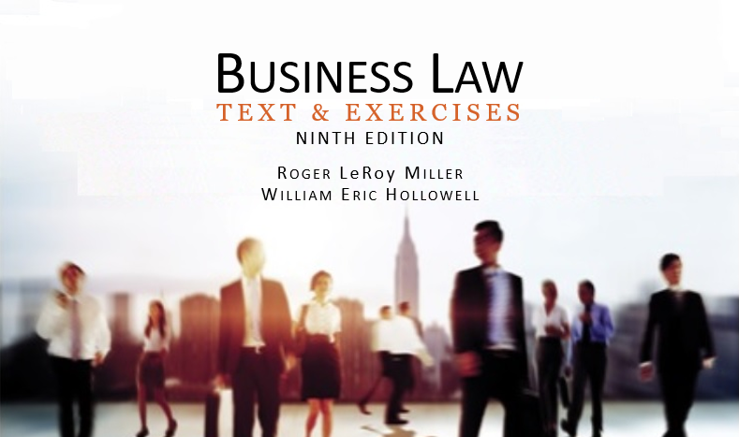
Business Law Text & Exercises Ninth Edition Roger LeRoy Miller William Eric Hollowell
Chapter 10 Consideration

Slide 2
Learning Outcomes
LO1 List the elements of consideration.
LO2 State the preexisting duty rule.
LO3 Name two ways to settle a legal claim.
LO4 Understand the concept of promissory estoppel.

Slide 3
LO1 Elements of Consideration (1)
LO1
Something of legally sufficient value must be given in exchange for promise.
There must be a bargained-for exchange.

Slide 4
LO1 Elements of Consideration (2)
LO1
Legally Sufficient Value.
Legal sufficiency:
Consideration must be something of value in the eyes of the law.

Slide 5
LO1 Elements of Consideration (3)
LO1
Legally Sufficient Value.
May consist of any of the following:
A promise to do something, no legal duty.
The performance of an action, no obligation.
The refraining from an action, legal right to undertake–forebearance.

Slide 6
LO1 Elements of Consideration (4)
LO1
Legally Sufficient Value.
Adequacy of consideration:
The fairness of the bargain.

Slide 7
LO1 Elements of Consideration (5)
LO1
Bargained-for Exchange.
Item of value must be given or promised by the promisor (offeror).
The promisee must make a promise or perform.

Slide 8
The Lack of Consideration (1)
One of the parties (or both parties) think consideration has been given when it has not.
Preexisting duty.
Past consideration.
Illusory promises.

Slide 9
The Lack of Consideration (2)
Preexisting Duty.
Preexisting duty rule: a promise made after what one already has a legal duty to do is not legally sufficient consideration, because no legal detriment or benefit has been incurred.
LO2

Slide 10
The Lack of Consideration (3)
Preexisting Duty.
Exceptions:
Unforeseen Difficulties.
Rescission and New Contract:
The unmaking of an executory contract so as to return the parties to the positions they occupied before the contract was made.

Slide 11
The Lack of Consideration (4)
Past Consideration.
Promises made in return for actions or events that have already taken place are unenforceable.
One cannot bargain for something that has already taken place.

Slide 12
The Lack of Consideration (5)
Illusory Promises.
Terms of the contract express such uncertainty of performance that the promisor has not definitely promised to do anything.

Slide 13
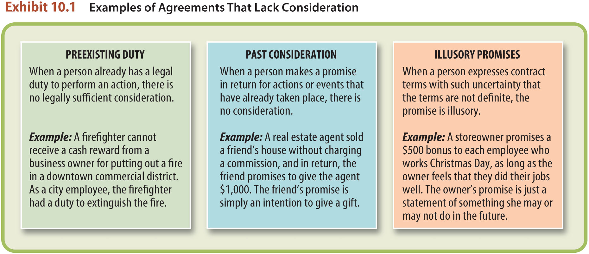
The Lack of Consideration (6)

Slide 14
Settlement of Claims (1)
Contracts to settle legal claims.
Accord and satisfaction.
Release.
LO3

Slide 15
Settlement of Claims (2)
Accord and Satisfaction.
Settling a claim by the debtor offering to pay less than the creditor claims to be owed.

Slide 16
Settlement of Claims (3)
Release.
An agreement in which one party gives up the right to pursue a legal claim against another party.

Slide 17
LO4 Promissory Estoppel (1)
LO4
Certain promises are enforceable without consideration (detrimental reliance).
When this doctrine is applied, the promisor is estopped from revoking the promise.

Slide 18
LO4 Promissory Estoppel (2)
LO4
Requirements:
There must be a clear and definite promise.
The promisee must justifiably rely on the promise.
The reliance normally must be of a substantial and definite character.
Justice will be better served by the enforcement of the promise.

