Slide 1
Business Law Text & Exercises Ninth Edition Roger LeRoy Miller William Eric Hollowell
Chapter 16 Contract Discharge
and Remedies

Slide 2
Learning Outcomes
LO1 Explain the difference between complete and substantial performance.
LO2 Describe discharge by agreement.
LO3 Identify different types of damages.
LO4 Define the remedy of rescission and restitution.

Slide 3
Introduction
Breach of Contract.
Failure, without legal excuse, of a promisor to perform the obligations of a contract.
Once this occurs, the nonbreaching party can choose one or more remedies.

Slide 4
Contract Termination (1)
Most common way to discharge a contract is to fully perform.
Other ways to discharge:
Failure of a Condition.
By Performance.
By Agreement.
By Operation of Law.

Slide 5
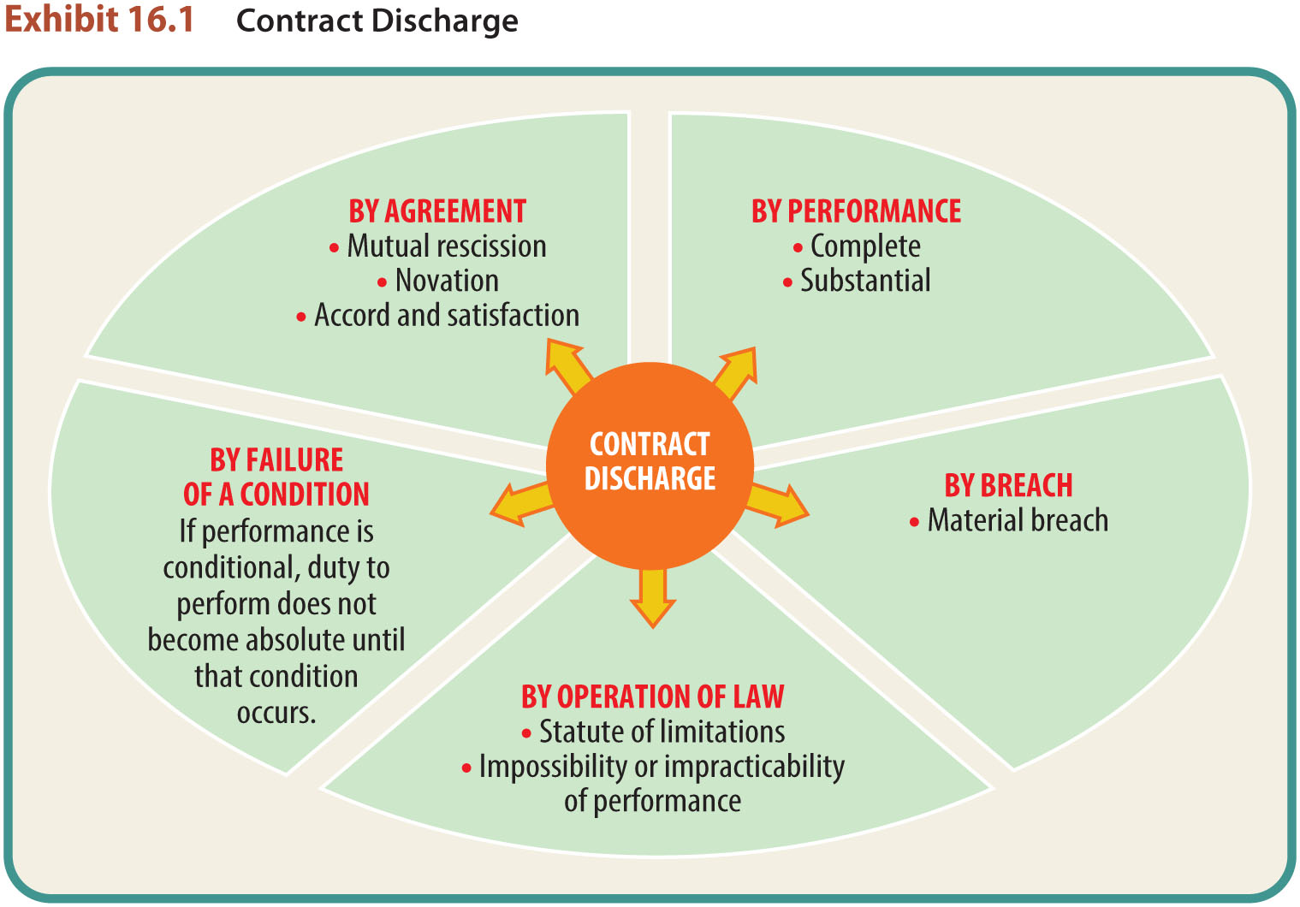
Contract Termination (2)

Slide 6
Contract Termination (3)
Discharge by Failure of a Condition.
In some contracts, performance can be conditioned on the occurrence (or non occurrence) of a certain event.

Slide 7
Contract Termination (4)
Discharge by Performance.
In contract law, the fulfillment of one’s duties arising under a contract with another; the normal way of discharging one’s contractual obligations.

Slide 8
Contract Termination (5)
Discharge by Performance.
Tender: an unconditional offer to perform by a person who is ready, willing, and able to do so.

Slide 9
Contract Termination (6)
Complete vs. Substantial Performance.
Normally, conditions expressly stated in the contract must fully occur in all aspects for complete (or strict) performance to take place.
LO1

Slide 10
Contract Termination (7)
Complete vs. Substantial Performance.
To qualify as substantial, the performance must not vary greatly from the performance promised in the contract.
LO1

Slide 11
Contract Termination (8)
Material Breach of a Contract.
If performance is not substantial, there is a material breach.
The nonbreaching party is excused from performance and can sue.

Slide 12
Contract Termination (9)
Performance to the Satisfaction of Another.
When the subject matter of the contract is personal, performance must actually satisfy the party whose satisfaction is required.

Slide 13
Contract Termination (10)
Performance to Satisfaction of Another.
Personal contracts (art, medical) must be personally satisfied.
Contracts involving mechanical fitness, utility, or marketability, satisfied by reasonable person.

Slide 14
LO2 Discharge by Agreement (1)
LO2
Mutual Rescission.
Process in which the parties cancel the contract and are returned to the positions they occupied prior to its formation.

Slide 15
LO2 Discharge by Agreement (2)
LO2
Novation.
Substitution of a third party for one of the original parties. Requires:
Existence of a previous valid obligation.
Agreement by all parties to a new contract.
The extinguishing of the old obligation.
A new valid contract.

Slide 16
LO2 Discharge by Agreement (3)
LO2
Accord and Satisfaction.
Agreement and payment (or other performance) between two parties, one of whom has a right of action against the other.

Slide 17
Discharge by Operation of Law (1)
Statute of Limitations.
Impossibility of Performance.
Commercial Impracticability.

Slide 18
Discharge by Operation of Law (2)
Statute of Limitations.
A statute setting the maximum time period during which a certain action can be brought.

Slide 19
Discharge by Operation of Law (3)
Impossibility of Performance.
A doctrine under which a party to a contract is relieved of his or her duty to perform when performance becomes impossible or totally impracticable (through no fault of either party).

Slide 20
Discharge by Operation of Law (4)
Impossibility of Performance.
Qualifying situations:
One party dies or becomes incapacitated prior to performance.
Subject matter of the contract is destroyed.
Change in law renders performance illegal.

Slide 21
Discharge by Operation of Law (5)
Commercial Impracticability.
A situation in which the duty to perform becomes too difficult or costly due to unforeseen factors.

Slide 22
Discharge by Operation of Law (6)
Temporary Impossibility.
An occurrence or event (such as war) that makes it temporarily impossible to perform the act for which a party has contracted operates to suspend performance until the impossibility ceases.

Slide 23
Contract Remedies
Relief given to innocent parties, by law or by contract, to enforce a right or to prevent or compensate for the violation of a right.

Slide 24
LO3 Remedies: Damages (1)
LO3
Money sought as a remedy for a breach of contract or a wrongful act.

Slide 25
LO3 Remedies: Damages (2)
LO3
Types of Damages:
Compensatory damages.
Consequential damages.
Punitive damages.
Liquidated damages.
Penalties.

Slide 26
Compensatory Damages
A money award equivalent to the actual value of injuries or damages sustained by the aggrieved party.
Amount = difference between the value of the promised performance and the actual performance.

Slide 27
Consequential Damages
Special damages to compensate for a loss that goes beyond the contract itself (for example, lost profits).
The special damages must have been reasonably foreseeable at the time the breach or injury occurred.

Slide 28
Punitive Damages
Compensation in excess of actual or consequential damages.
Awarded in order to punish the wrongdoer and usually will be awarded only in cases involving willful or malicious misconduct.

Slide 29
Liquidated Damages
Fixed amount stipulated by the parties as a reasonable estimation of damages.
Penalty.
Fixed amount, not as a measure of compensation, but rather as punishment for breach.

Slide 30
LO4 Rescission and Restitution (1)
LO4
Rescission.
An equitable action by a court to undo, or cancel, a contract—to return nonbreaching parties to the positions that they occupied prior to the transaction.

Slide 31
LO4 Rescission and Restitution (2)
LO4
Restitution.
The restoration of goods, property, or funds previously conveyed.
A remedy under which a person is restored to his or her original position prior to formation of a contract.

Slide 32
Specific Performance
Equitable remedy requiring exactly the performance that was specified in a contract.
Used when money damages would be an inadequate remedy and the subject matter of the contract is unique.

Slide 33
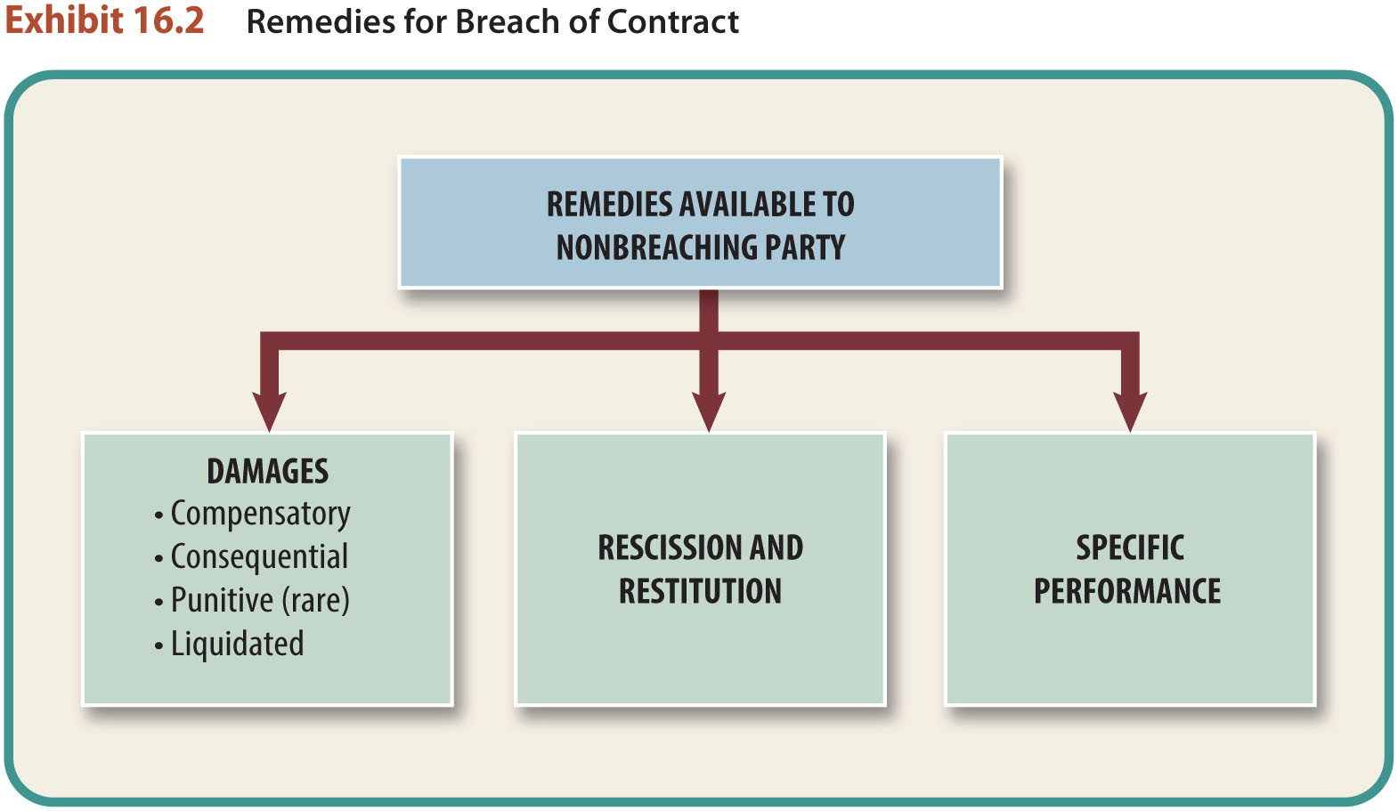
Remedies for Breach of Contract

Slide 34
Mitigation of Damages
A rule requiring a plaintiff to reasonably minimize the damages caused by the defendant.

