Slide 1
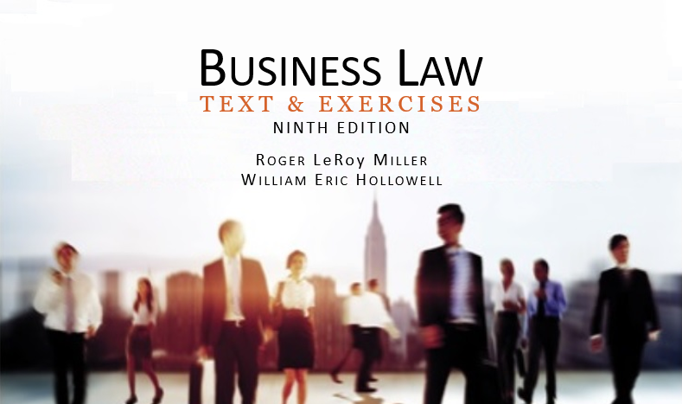
Business Law Text & Exercises Ninth Edition Roger LeRoy Miller William Eric Hollowell
Chapter 24 Banking in the Digital Age

Slide 2
Learning Outcomes (1)
LO1 List the types of relationships between banks and customers.
LO2 Discuss the liability for forged drawers’ signatures.
LO3 Outline a bank’s duty to accept deposits.

Slide 3
Learning Outcomes (2)
LO4 Define an electronic fund transfer.
LO5 Define e-money.

Slide 4
Checks and the Bank-Customer Relationship (1)
A check does not operate as an immediate legal assignment of funds between the drawer and the payee.
The funds in the bank represented by that check do not immediately move from the drawer’s account to the payee’s account.

Slide 5
Checks and the Bank-Customer Relationship (2)
No underlying debt is discharged until the drawee-bank honors the check and makes final payment.
To transfer checkbook dollars among different banks, each bank acts as the agent of collection for its customer.

Slide 6
Checks and the Bank-Customer Relationship (3)
Cashier’s check: when a bank draws a check on itself.
Certified check: a check that has been accepted in writing by the bank on which it is drawn.

Slide 7
Checks and the Bank-Customer Relationship (4)
The Bank-Customer Relationship.
There are three types of relationships established.
Creditor-debtor relationship.
Agency relationship.
Contractual rights and duties.
LO1

Slide 8
Honoring Checks (1)
Check Dishonor.
A drawee-bank that wrongfully fails to honor a check, is liable to its customer for damages resulting from its refusal to pay.
When the bank properly dishonors a check for insufficient funds, it has no liability to the customer.

Slide 9
Honoring Checks (2)
Overdrafts.
Check written on an account in which there are insufficient funds to cover the check.

Slide 10
Honoring Checks (3)
Stale Checks.
A check, other than a certified check, that is presented for payment more than six months after its date.

Slide 11
Honoring Checks (4)
Death or Incompetence of a Customer.
Neither death nor incapacity revokes the bank’s authority to pay an item, until the bank knows of the situation and has reasonable time to act.

Slide 12
Honoring Checks (5)
Stop-Payment Orders.
An order by the drawer of a draft or check directing the drawer’s bank not to pay the check.

Slide 13
Honoring Checks (6)
Checks with Forged Drawers’ Signatures.
General rule: bank must recredit the customer’s account.
Bank may recover some loss from:
Negligent customer.
Check’s forger.
Holder who cashes the check.
LO2

Slide 14
Honoring Checks (7)
Checks Bearing Forged Indorsements.
Bank that pays a customer’s check bearing a forged indorsement must recredit the customer’s account or be liable for breach of contract.

Slide 15
LO3 Accepting Deposits
LO3
Traditional Collection Process.
Depositary Bank.
Payor Bank.
Collecting Bank.
Intermediary Bank.

Slide 16
Traditional Collection Process (1)
Depositary Bank.
First bank to which an item is transferred for collection, even though it may also be the payor bank.

Slide 17
Traditional Collection Process (2)
Payor Bank.
Bank on which an item is payable as drawn (or is payable as accepted).
Collecting Bank.
Bank handling an item for collection, except the payor bank.

Slide 18
Traditional Collection Process (3)
Intermediary bank.
Bank to which an item is transferred in the course of collection, except the depositary or payor bank.

Slide 19
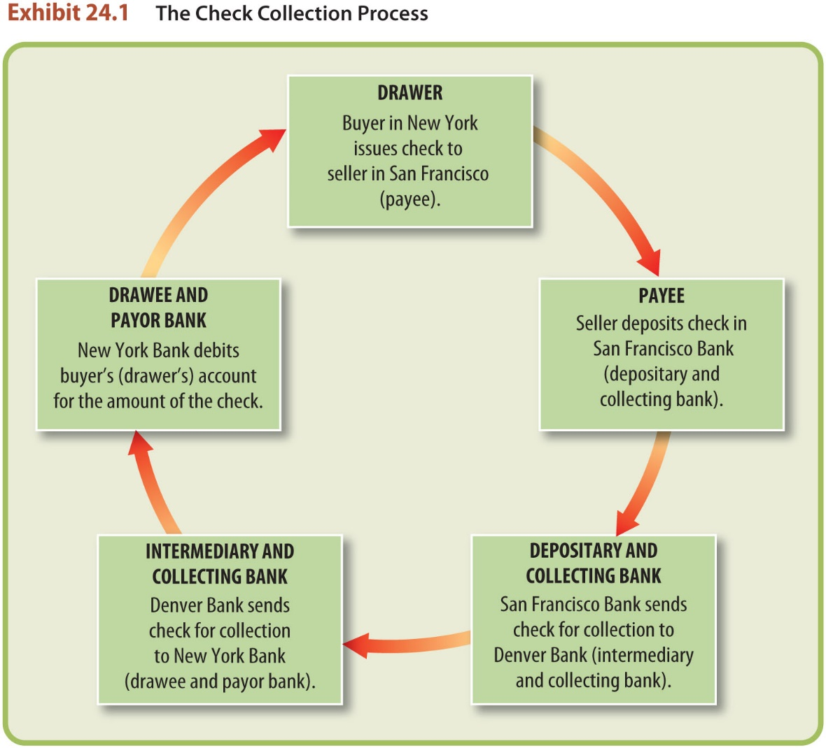
Check Collection Process

Slide 20
Traditional Collection Process (4)
Check Collection Between Customers of the Same Bank.
An item that is payable by the depositary bank that receives it.
An “on-us” item.

Slide 21
Traditional Collection Process (5)
Check Collection Between Customers of Different Banks.
Once a depositary bank receives a check, it must arrange to present it, either directly or through intermediary banks, to the appropriate payor bank.

Slide 22
Traditional Collection Process (6)
Check Collection Between Customers of Different Banks.
Unless payor bank dishonors the check or returns it by midnight on the next banking day following receipt, payor bank is accountable for the face amount of the check.

Slide 23
Traditional Collection Process (7)
The Role of the Federal Reserve System.
Network of twelve government banks in which private banks have accounts called reserve accounts.

Slide 24
Traditional Collection Process (8)
The Role of the Federal Reserve System.
Gives United States an elastic currency, supervise and regulate banking activities, and facilitate the flow and discounting of commercial paper.

Slide 25
Traditional Collection Process (9)

Slide 26
Traditional Collection Process (10)
Electronic Presentment.
Today, most checks are processed electronically.
Encoded electronic information is exchanged between banks.
Often, the original check is discarded and only an image is kept (see Check 21 Act ).

Slide 27
Traditional Collection Process (11)
The Check 21 Act.
Substitute check: paper reproduction of the front and back of a check.
Takes place of original, which is discarded.

Slide 28
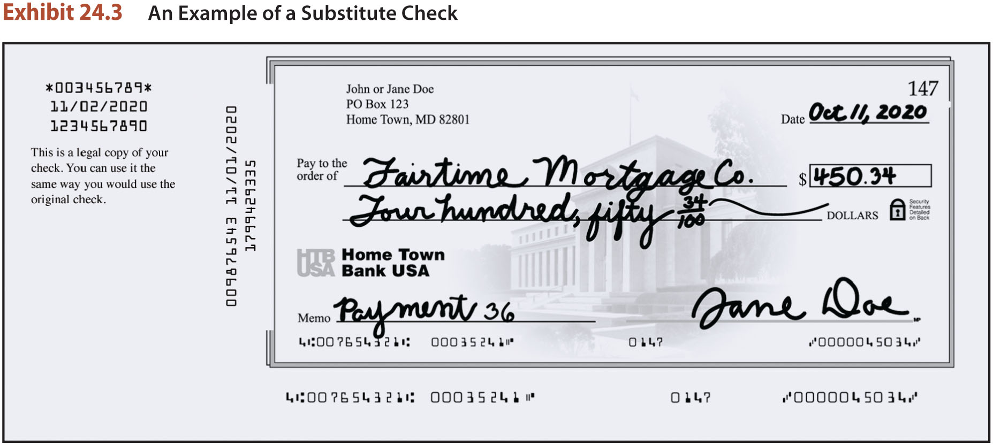
Substitute Check

Slide 29
Electronic Funds Transfers (1)
LO4
EFT: transfer of funds though use of electronic terminal, a phone, a computer, or magnetic tape.
Types of EFT Systems.
Automated teller machines (ATM).
Point-of-sale systems. (POS).
Direct deposits and withdrawals.
Online payment systems.

Slide 30
Electronic Funds Transfers (2)
Consumer Fund Transfers.
Electronic Fund Transfer Act (EFTA) provides framework for rights, liabilities, and responsibilities of users of EFT systems.

Slide 31
Electronic Funds Transfers (3)
A transfer is unauthorized if the following conditions are met:
Initiated by a person (other than the customer) with no authority.
Consumer receives no benefit.
Consumer did not furnish access to his or her account.

Slide 32
E-Money and Online Banking (1)
E-money: funds stored on microchips in laptops, smartphones, and other devices.
LO5

Slide 33
E-Money and Online Banking (2)
Stored-Value Cards and Smart Cards.
Stored-value cards: bear a magnetic stripe that hold magnetically encoded data, providing access to stored funds (ATM card).

Slide 34
E-Money and Online Banking (3)
Stored-Value Cards and Smart Cards.
Smart cards: contain a microprocessor which carries and processes security programming for financial transactions. The microprocessor can authenticate validity of transaction.

Slide 35
E-Money and Online Banking (4)
Online Banking.
Used for paying bills, transfer of funds, loan applications.
Limited availability to deposit and withdraw funds (unless using smart cards).
Apps to make check deposits via smartphones.

