Slide 1
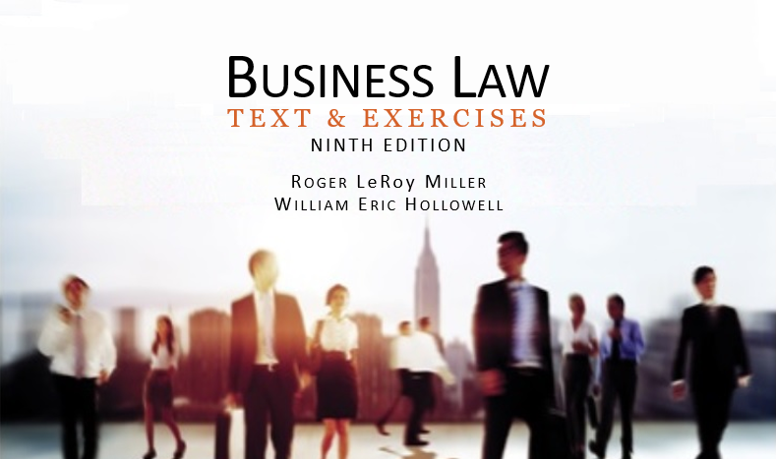
Business Law Text & Exercises Ninth Edition Roger LeRoy Miller William Eric Hollowell
Chapter 26 Employment, Immigration, and Labor Law

Slide 2
Learning Outcomes (1)
LO1 State exceptions to the employment-at-will doctrine.
LO2 Describe the major provisions of the Fair Labor Standards Act.
LO3 Identify the benefits of the Social Security Act.

Slide 3
Learning Outcomes (2)
LO4 Name the two most important federal statutes governing immigration.
LO5 Identify the federal law allowing workers to organize unions and to engage in collective bargaining.

Slide 4
Employment At-Will
A doctrine under which an employment contract may be terminated at any time and for any reason.

Slide 5
LO1 Exceptions To At-Will Doctrine
LO1
Statutory: Whistleblower.
Employee who tells the government or the press that his or her employer is engaged in some unsafe or illegal activity.
Contract-Based.
Public-Policy Exceptions.

Slide 6
Worker Protections (1)
State Workers’ Compensation Laws.
Occupational Safety and Health Act.
OSHA: employers with eleven or more employees required to keep occupational injury or illness records.

Slide 7
Worker Protections (2)
Family and Medical Leave Act (FMLA).
Employers with fifty or more employees must provide up to twelve weeks unpaid leave for any twelve-month period.

Slide 8
Worker Protections (3)
Family and Medical Leave Act (FMLA).
Employer must continue health care coverage and guarantee employment.

Slide 9
Worker Protections (4)
Family and Medical Leave Act (FMLA).
To care for newborn or baby within one year of birth.
To care for an adopted or foster child within one year of placement.

Slide 10
Worker Protections (5)
Family and Medical Leave Act (FMLA).
To care for the employee’s spouse, child or parent.
If the employee suffers from a serious health condition and is unable to perform essential job duties.

Slide 11
Worker Protections (6)
LO2
Fair Labor Standards Act (FLSA).
Child Labor Restrictions.
Minimum Wage Requirement.
Overtime Provisions and Requirements.

Slide 12
Worker Protections (7)
LO2
Fair Labor Standards Act (FLSA).
Child Labor Restrictions.
Protects all children under eighteen from working in hazardous jobs.
Children under fourteen are limited to certain jobs.
Limited weekly hours.

Slide 13
Worker Protections (8)
LO2
Fair Labor Standards Act (FLSA).
Minimum Wage Requirement.
Federal minimum wage.
State minimum usually higher.

Slide 14
Worker Protections (9)
LO2
Fair Labor Standards Act (FLSA).
Overtime Provisions and Requirements.
Employees are entitled to 1.5 times regular pay for any hours in excess of forty hour per workweek.

Slide 15
Worker Protections (10)
LO2
Fair Labor Standards Act (FLSA).
Child Labor Restrictions.
Minimum Wage Requirement.
Overtime Provisions and Requirements.

Slide 16
Worker Protections (11)
Employee Privacy.
Lie-Detector Tests.
ECPA prohibits employers from requiring employees or applicants to take a lie-detector test.
Restricts employers’ ability to use or ask about results of any lie-detector test.

Slide 17
Worker Protections (12)
Employee Privacy.
Drug Testing.
State statutes may restrict drug testing.
Collective bargaining agreement may provide protection.

Slide 18
Worker Protections (13)
Employee Privacy.
Drug Testing.
Held constitutional for government employees only when:
Reasonable basis for suspecting drug use.
Drug use in particular job would threaten public safety.

Slide 19
Worker Protections (14)
Employee Privacy.
Electronic Monitoring.
More than half of employers engage in some form.
Electronic Communication Privacy Act prohibits intentional interception of communications.
If the device is provided by the company for business use, the employer is allowed to monitor business communications.

Slide 20
Retirement Income and Security (1)
LO3
Social Security.
The Social Security Act of 1935 provides for:
Old-age (retirement).
Survivors.
Disability insurance.

Slide 21
Retirement Income and Security (2)
LO3
Social Security.
Federal Insurance Contributions Act (FICA): employers and employees contribute.

Slide 22
Retirement Income and Security (3)
Medicare.
Private Retirement Plans.
Unemployment Compensation.
The Federal Unemployment Tax Act.

Slide 23
Retirement Income and Security (4)
Group Health Plans.
The Health Insurance Portability and Accountability Act (HIPAA).
COBRA.
The Consolidated Omnibus Budget Reconciliation Act.

Slide 24
LO4 Immigration Law (1)
LO4
The Immigration Reform and Control Act.
Illegal to hire, recruit, or refer for a fee someone not authorized to work in the U.S.
Form I-9, Employment Eligibility Verification.

Slide 25
Immigration Law (2)
The Immigration Act.
Caps on the number of visas issued to immigrants every year.

Slide 26
Labor Law (1)
The Norris-LaGuardia Act.
Restricts the power of federal courts to issue injunctions against unions engaged in peaceful strikes.
The National Labor Relations Act (NRLA).
Establishes the rights of private-sector employees to form unions.
LO5

Slide 27
Labor Law (2)
The Labor-Management Relations Act (LMRA).
Prohibits unfair union practices.
The Labor-Management Reporting and Disclosure Act.
Regulates internal union business procedures.

Slide 28
Labor Law (3)
Union Organization.
Authorization card: states that a worker desires to have a certain union represent the workforce.
At least 30 percent of the workers must show support in order for an election to be held.

Slide 29
Labor Law (4)
Collective Bargaining.
The process by which labor and management negotiate the terms and conditions of employment.

Slide 30
Labor Law (5)
Collective Bargaining.
Negotiating terms and conditions.
Good faith.
Employer unfair labor practices.
Strikes.

