Slide 1
Business Law Text & Exercises Ninth Edition Roger LeRoy Miller William Eric Hollowell
Chapter 32 Security Interests and Creditors’ Remedies

Slide 2
Learning Outcomes (1)
LO1 Explain how an enforceable security interest can be created and perfected.
LO2 Identify general priority rules governing security interests.
LO3 State a secured party’s options on a debtor’s default.

Slide 3
Learning Outcomes (2)
LO4 Distinguish different types of liens.
LO5 Define suretyship and guaranty contracts.

Slide 4
Secured Transactions (1)
Security interest: interest in the collateral that secures the performance.
Secured party: creditor who has a security interest in debtor’s collateral.

Slide 5
Secured Transactions (2)
Debtor: person who owes payment of a secured obligation.
Security agreement: agreement that creates or provides for a security interest.
Collateral: subject of the security interest.

Slide 6
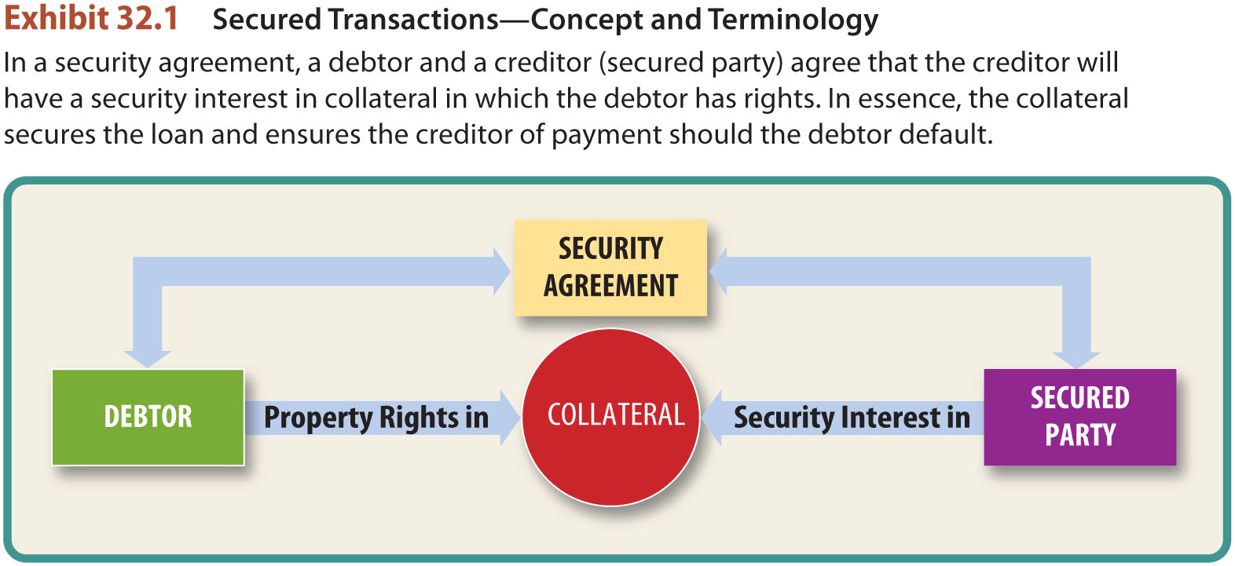
Concept and Terminology

Slide 7
LO1 Creating a Security Interest (1)
LO1
Three requirements:
Collateral in possession of creditor, or a written agreement describing the collateral, signed by debtor.
Creditor must give something of value to debtor.
Debtor must have “rights” in collateral.

Slide 8
LO1 Creating a Security Interest (2)
LO1
Attachment:
Once requirements are met, creditor’s rights ATTACH to the collateral.
Creditor has an enforceable security interest against the debtor.

Slide 9
LO1 Creating a Security Interest (3)
LO1
Attachment:
Attachment ensures that the security interest between the debtor and the secured party is effective.

Slide 10
Perfecting a Security Interest (1)
Perfection is the legal process by which the secured party protects herself from third party claims against the same collateral.

Slide 11
Perfecting a Security Interest (2)
In most situations, perfection is accomplished by filing the financing statement with the appropriate government agency.

Slide 12
Perfecting a Security Interest (3)
Financing statement must contain:
legal name and signature of debtor,
addresses of debtor and creditor, and
description of collateral by type or item.

Slide 13
Perfecting a Security Interest (4)
Financing statement:
Improper filing reduces secured party’s claim in bankruptcy to an unsecured creditor.

Slide 14
The Scope of a Security Interest (1)
Security agreement covers:
Proceeds of sale of collateral: whatever received when collateral sold or disposed.
After-acquired property: provide for a security interest in property acquired after execution of security agreement.

Slide 15
The Scope of a Security Interest (2)
Security agreement covers:
Future advances: continuing line of credit; subject to security interest.
Floating liens: security interest in proceeds in after-acquired property, or collateral subject to future advances.

Slide 16
Priorities Among Security Interests (1)
General Priority Rules.
Conflicting unperfected security interests: first to attach has priority.
Perfected security interests versus unperfected interests: a perfected security interest has priority over any unperfected interests.

Slide 17
Priorities Among Security Interests (2)
General Priority Rules.
Conflicting perfected security interests: first to perfect generally has priority.

Slide 18
Priorities Among Security Interests (3)
An Exception to the General Priority Rules.
Buyer in ordinary course of business: good faith, without knowledge, buys goods from seller in the business of selling those goods.

Slide 19
Default (1)
Not expressly defined by Article 9 but rather in the security agreement. Any breach can constitute default.

Slide 20
Default (2)
Basic Remedies.
Judicial remedies.
Obtaining a judgment .
Repossession of the collateral (peaceful possession).
Cannot commit a crime when repossessing.

Slide 21
Default (3)
Retention of Collateral by the Secured Party.
Notice required. If objection, then secured party must sell property.
Disposition of the Collateral by Secured Party: must dispose in a commercially reasonable manner.

Slide 22
Default (4)
Disposition of the Collateral by Secured Party.
Must dispose in a commercially reasonable manner.

Slide 23
Default (5)
Deficiency Judgment.
Judgment against debtor for the amount of debt remaining unpaid after collateral has been repossessed and sold.

Slide 24
Default (6)
Redemption Rights of the Debtor.
Debtor (or any other secured party) has the right of redemption before the collateral is disposed or sold.

Slide 25
Default (7)
Redemption Rights of the Debtor.
Debtor must tender performance of all obligations secured by the collateral, pay all reasonable expenses by secured party, and by retaking the collateral, and maintaining its care and custody.

Slide 26
Laws Assisting Creditors (1)
Liens.
Mechanic’s Lien (real property).
Artisan’ Lien (personal property).
Innkeeper’s Lien (baggage of guests).
LO4

Slide 27
Laws Assisting Creditors (2)
Liens.
Judicial Lien:
Attachment: court-ordered seizure of property.
Writ of Execution: court-ordered sale.
LO4

Slide 28
Laws Assisting Creditors (3)
Garnishment.
Creditor permitted to collect a debt by seizing property held by third party (usually wages held by debtor’s employer).

Slide 29
Laws Assisting Creditors (4)
Suretyship and Guaranty.
Third person promises to pay debt owed by another.
Surety. Third person is primarily liable.
Guaranty. Third person is secondarily liable.
LO5

Slide 30
Laws Assisting Creditors (5)
Suretyship and Guaranty.
Must be in writing unless the “main purpose” of the guaranty is to personally benefit the guarantor.
LO5

Slide 31
Laws Assisting Creditors (6)
Suretyship and Guaranty.
Defenses of the Surety and the Guarantor.
Material modification of the contract.
Surrender or impairment of the collateral.
Payment of the obligation.
LO5

Slide 32
Laws Assisting Creditors (7)
Suretyship and Guaranty.
Defenses of the Principal Debtor.
Can assert any defense except debtor’s incapacity or bankruptcy (which are personal to debtor).
LO5

Slide 33
Laws Assisting Creditors (8)
Suretyship and Guaranty.
Rights of Surety and Guarantor.
Subrogation.
Reimbursement (from debtor).
Contribution.
LO5

Slide 34
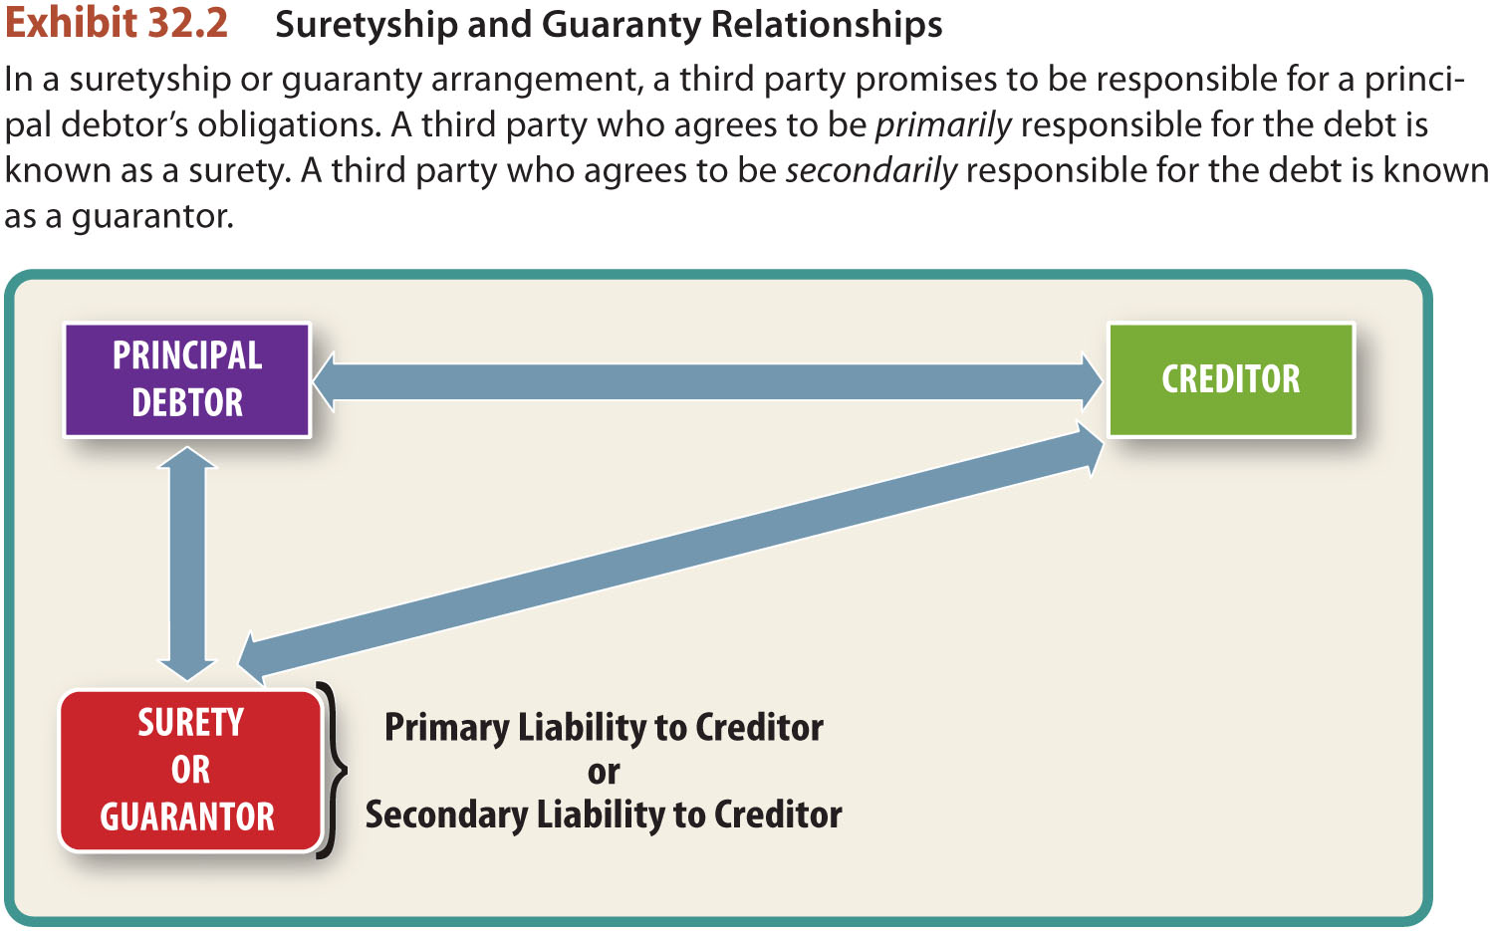
Laws Assisting Creditors (9)

