Slide 1
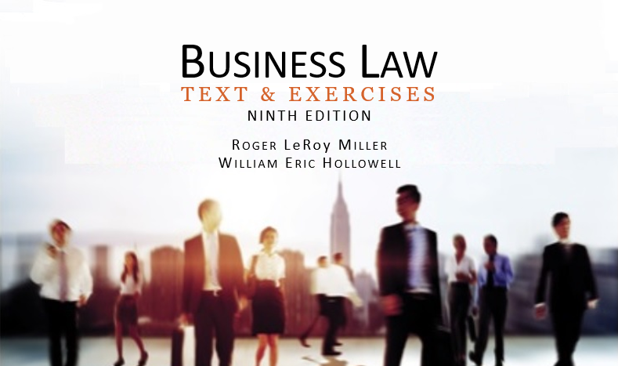
Business Law Text & Exercises Ninth Edition Roger LeRoy Miller William Eric Hollowell
Chapter 40 Wills and Trusts

Slide 2
Learning Outcomes
LO1 Outline the requirements of a will.
LO2 Discuss how to revoke or modify a will.
LO3 Describe intestate distribution of property.
LO4 List the elements of a trust.

Slide 3
Wills (1)
A will is the final declaration of how a person wants to have his property disposed of after death.

Slide 4
Wills (2)
Terminology.
Testator (Testatrix): person who makes a will.
Probate a will: establish its validity.
Probate Court: oversees administration of estate.

Slide 5
Wills (3)
Terminology.
Executor is a personal representative named in a will.
Administrator is a personal representative appointed by a court for a person without a will.

Slide 6
Wills (4)
Terminology.
Devise: gift of real estate.
Bequest (Legacy): gift of personal property.

Slide 7
Wills (5)
Types of Gifts.
Specific: describes particular property.
General: specifies value of property.
Residuary: pays for debts after gifts are made.

Slide 8
LO1 Requirements of a Valid Will (1)
LO1
Testamentary Capacity: Testator must have legal capacity at the time the will is made (the “sound mind” requirement).
Testamentary Intent: Testator must have the intent to transfer and distribute his or her property.

Slide 9
LO1 Requirements of a Valid Will (2)
LO1
Written: Will must be in writing. (Holographic will in Testator’s handwriting.)
Signed: Will must be signed by Testator.
Witnessed: A written will must be witnessed (attested to be genuine) by at least two competent witnesses.

Slide 10
LO1 Requirements of a Valid Will (3)
LO1
Publication: will is published by Testator by an oral declaration to the witnesses that the document they are signing is in fact his last will and testament.

Slide 11
LO2 Revocation of a Will
LO2
Revocation by Act of Testator.
Physical Acts.
Subsequent Writings.
Marriage.
Divorce.
Children.

Slide 12
LO3 Intestacy Laws (1)
LO3
State laws that regulate how a decedent’s property is distributed when he or she dies without a will.

Slide 13
LO3 Intestacy Laws (2)
LO3
Order of Distribution.
First decedent’s debts.
Then to surviving spouse and children. If no surviving spouse or child, then to grandchildren, then brothers and sisters, and then parents.

Slide 14
LO3 Intestacy Laws (3)
LO3
Surviving Spouse and Children.
Surviving spouse usually receives the homestead and a share of the estate, as follows:
1/3 of estate if two or more children.

Slide 15
LO3 Intestacy Laws (4)
LO3
Surviving Spouse and Children.
1/2 of estate if one surviving child.
Entire estate, if no children or grandchildren.

Slide 16
LO3 Intestacy Laws (5)
LO3
Grandchildren.
Per Stirpes Distribution: method of dividing an intestate share by which a class or group of distributees take the share that their deceased parent would have been entitled to inherit had that parent lived.

Slide 17
LO3 Intestacy Laws (6)
LO3
Grandchildren.
Per Capita Distribution: each person takes an equal share of the estate.

Slide 18
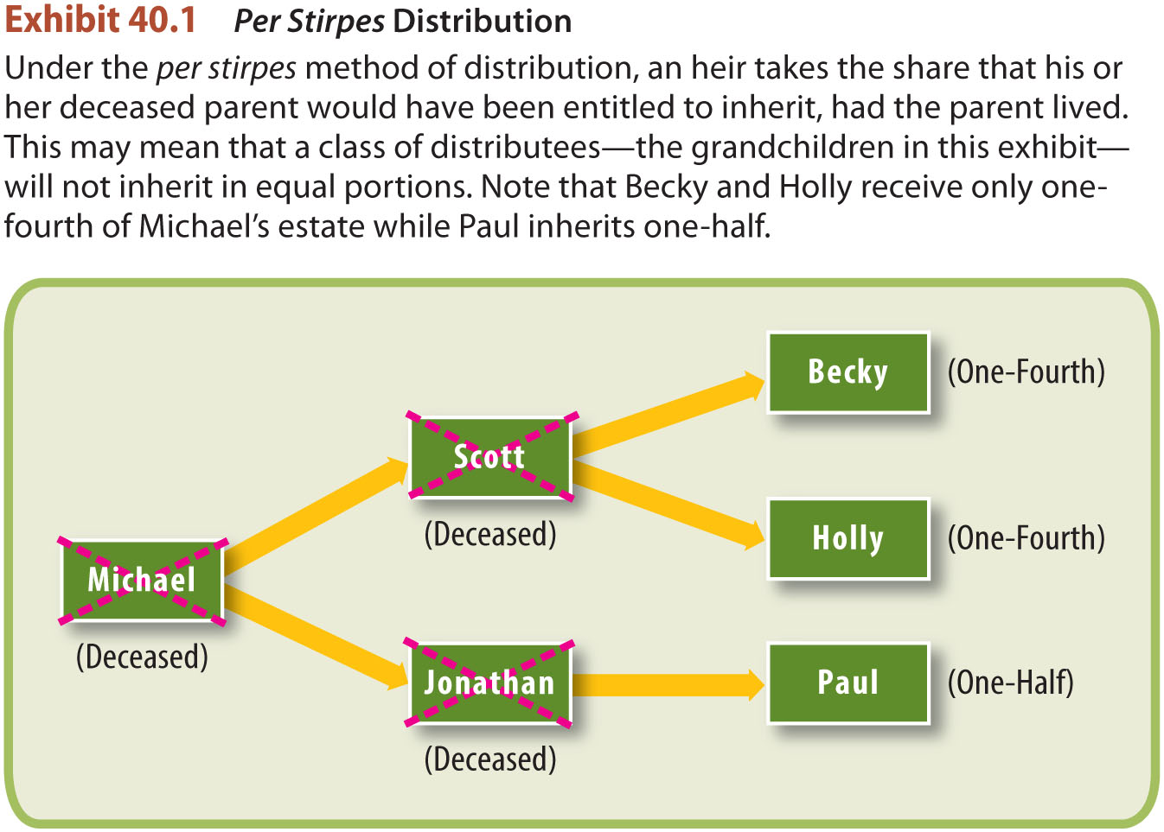
Per Stirpes Distribution

Slide 19
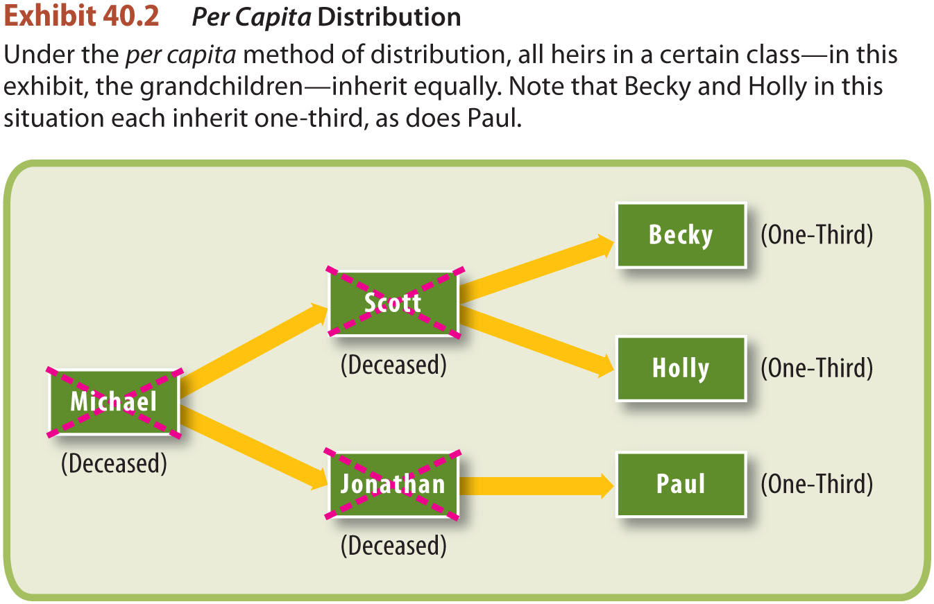
Per Capita Distribution

Slide 20
Trusts (1)
Trust.
An arrangement to administer property for the benefit of another.

Slide 21
Trusts (2)
Trustee.
Holds property on behalf of the beneficiary.
Acts with honesty, good faith, and prudence in administering the trust and must exercise a high degree of loyalty toward the trust beneficiaries.

Slide 22
LO4 Elements of a Trust
LO4
Designated beneficiary.
Designated trustee.
Fund sufficiently identified to enable title to pass to the trustee.
Actual delivery to the trustee with the intention of passing title.

Slide 23
Express Trusts
Living Trusts: created by and effective during grantor’s lifetime (revocable vs. irrevocable).
Testamentary Trusts: created as part of a will, comes into existence at testator’s death.

Slide 24
Revocable Living Trust

Slide 25
Implied Trusts
Constructive Trusts.
Arises by operation of the law in the interest of equity and fairness.
Resulting Trusts.
Arises from the conduct of the parties.

