Slide 1
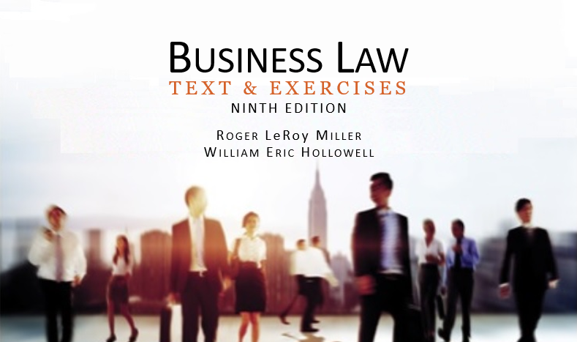
Business Law Text & Exercises Ninth Edition Roger LeRoy Miller William Eric Hollowell
Chapter 12 The Legality of Agreements

Slide 2
Learning Outcomes
LO1 Identify contracts contrary to statute.
LO2 Describe an enforceable covenant to not compete.
LO3 Identify contracts contrary to public policy.
LO4 Explain the consequences of an illegal agreement.

Slide 3
LO1 Contracts Contrary to Statute (1)
LO1
Contracts to Commit a Crime.
Usury.
Charging an illegal rate of interest.
Gambling.
Even in states that allow certain types of gambling, courts often find gambling contracts illegal.

Slide 4
LO1 Contracts Contrary to Statute (2)
LO1
Licensing Statutes.
If a person enters into a contract with an unlicensed professional, the contract may still be enforceable.
However, if purpose of statute is to protect the public, contract is illegal and unenforceable.

Slide 5
LO1 Contracts Contrary to Statute (3)
LO1
Contracts in Restraint of Trade.
Exception is recognized when restraint is reasonable and integral to contract.
Covenant not to compete.
A promise to refrain from competing in business with another.

Slide 6
LO1 Contracts Contrary to Statute (4)
LO1
Contracts in Restraint of Trade.
Covenants Not to Compete and the Sale of an Ongoing Business.
Reasonable and integral part of contract.
Enable sale and purchase of the reputation of an ongoing business.

Slide 7
LO1 Contracts Contrary to Statute (5)
LO1
Contracts in Restraint of Trade.
Covenants Not to Compete in Employment Contracts.
Specified period of time and geographical restraint must be reasonable.
LO2

Slide 8
LO1 Contracts Contrary to Statute (6)
LO1
Contracts in Restraint of Trade.
Covenants Not to Compete and Reformation.
Reformation: a court-ordered correction of a written contract to reflect the parties’ true intentions.

Slide 9
LO3 Contracts Contrary to Public Policy (1)
LO3
Even though contracts involve private parties, they may have a negative effect on society.
Unconscionable Contracts or Clauses.
Exculpatory Clauses.

Slide 10
LO3 Contracts Contrary to Public Policy (2)
LO3
Unconscionable Contracts or Clauses.
Void on the basis of public policy because one party, as a result of his or her inferior bargaining power, is forced to accept terms that are unfairly burdensome and that unfairly benefit the dominating party.

Slide 11
LO3 Contracts Contrary to Public Policy (3)
LO3
Unconscionable Contracts or Clauses.
Procedural Unconscionability.
Substantive Unconscionability: adhesion contracts.

Slide 12
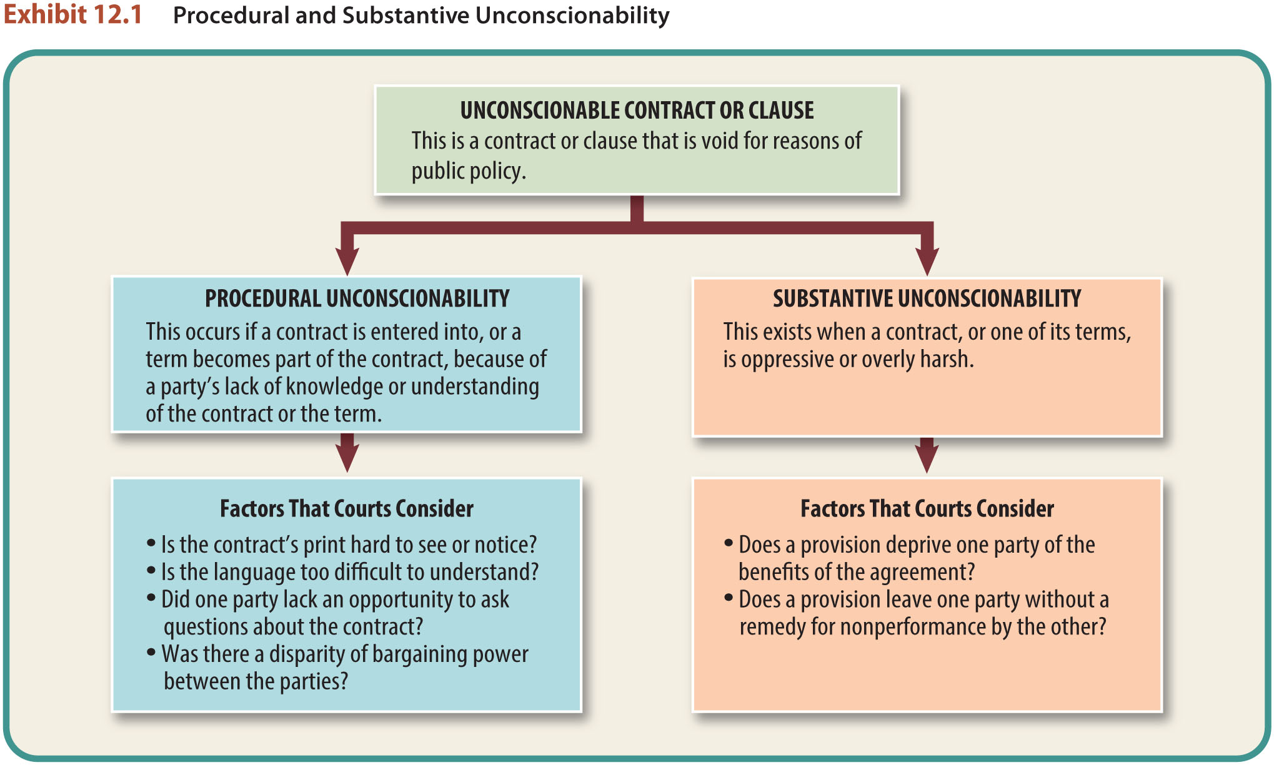
LO3 Contracts Contrary to Public Policy (4)
LO3

Slide 13
LO3 Contracts Contrary to Public Policy (5)
LO3
Exculpatory Clauses.
Clauses that releases a party to a contract from liability for his or her wrongful acts.
Often held to be enforceable.

Slide 14
LO4 The Effect of Illegality (1)
LO4
In general, an illegal contract is void.
If a contract is executory (not yet fulfilled), neither party can enforce it.
In most illegal contracts, both parties are considered to be equally at fault.

Slide 15
LO4 The Effect of Illegality (2)
LO4
Some persons are excluded from the general rule that neither party to an illegal bargain can sue for breach or recover for performance rendured.
Justifiable Ignorance of the Facts.
Members of Protected Classes.
Withdrawal From an Illegal Agreement.

Slide 16
LO4 The Effect of Illegality (3)
LO4
Justifiable Ignorance of the Facts.
When one of the parties is relatively innocent, that party can often obtain restitution in a partially executed contract.

Slide 17
LO4 The Effect of Illegality (4)
LO4
Members of Protected Classes.
When a statute protects a certain class of people, a member of that class can enforce an illegal contract even though the other party cannot.

Slide 18
LO4 The Effect of Illegality (5)
LO4
Withdrawal from an Illegal Agreement.
Party tendering performance can withdraw from the bargain and recover the performance or its value.

