Slide 1
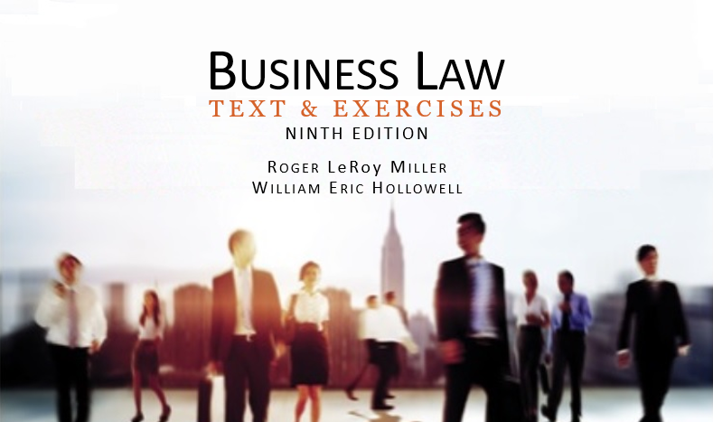
Business Law Text & Exercises Ninth Edition Roger LeRoy Miller William Eric Hollowell
Chapter 36 Personal Property

Slide 2
Learning Outcomes
LO1 Explain the nature of personal property.
LO2 Identify different types of property ownership.
LO3 State how ownership of personal property is acquired.
LO4 Define mislaid, lost, and abandoned property.

Slide 3
LO1 The Nature of Personal Property
LO1
Property is divided into two categories:
Real property: land everything permanently attached to it.
Personal property. All other property, both tangible and intangible.

Slide 4
LO2 Property Ownership: Fee Simple
LO2
Owner owns the entire “bundle of rights”.
Gives the owner the maximum possible estate or right of ownership of real property, continuing forever.

Slide 5
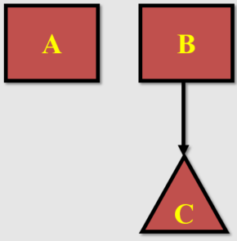
LO2 Property Ownership: Concurrent Ownership (1)
LO2
Tenancy in Common.
A and B own an undivided interest in the property.
Upon B’s death interest passes to B’s heir, “C”.
The new owners of the property are A and C.

Slide 6
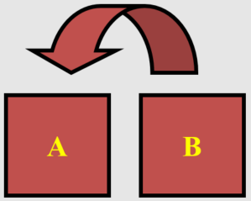
Property Ownership: Concurrent Ownership (2)
LO2
Joint Tenancy.
A and B own a joint tenant interest in property.
Upon B’s death, B’s interest automatically passes to A, the surviving joint tenant.

Slide 7
Property Ownership: Concurrent Ownership (3)
LO2
Community Property (limited number of states).
Property acquired by couple during their marriage is owned as an undivided ½ interest in property (real and personal).

Slide 8
LO3 Acquiring Ownership of Personal Property
LO3
Possession.
Capture of wild animals (wild animals belong to no one).
Finding of abandoned property.
Production: fruits of one’s labor.

Slide 9
LO3 Acquiring Ownership: Gifts (1)
LO3
Voluntary transfer of property ownership from donor (owner) to donee (recipient) for no consideration.

Slide 10
LO3 Acquiring Ownership: Gifts (2)
LO3
Elements:
Donative Intent.
Delivery—actual or “constructive” (symbolic). Donor must give up complete control or dominion.
Acceptance by donee. →

Slide 11
LO3 Acquiring Ownership: Gifts (3)
LO3
Three Types:
Intervivos—while donor is living.
Causa Mortis: -- made by donor in contemplation of imminent death.
Testamentary – after death, by will/inheritance.

Slide 12
Acquiring Ownership of Personal Property (1)
Accession.
Adds value to a piece of personal property by use of either labor or materials.

Slide 13
Acquiring Ownership of Personal Property (2)
Confusion.
Commingling so that a person’s personal property cannot be distinguished from another’s. Fungible goods consists of identical particles such as oil or grain.

Slide 14
LO4 Mislaid, Lost, and Abandoned Property (1)
LO4
Mislaid Property.
Voluntarily placed somewhere, then inadvertently forgotten.
Finder is steward for true owner.→

Slide 15
LO4 Mislaid, Lost, and Abandoned Property (2)
LO4
Lost Property.
Involuntarily left somewhere.
Property owner acquires title against whole world, except for true owner.

Slide 16
LO4 Mislaid, Lost, and Abandoned Property (3)
LO4
Lost Property.
Conversion of Lost Property.
Finder must return to true owner or be liable for conversion.
Estray Statutes.
Encourage and facilitate the return of property to its true owner.

Slide 17
LO4 Mislaid, Lost, and Abandoned Property (4)
LO4
Abandoned Property:
Discarded by true owner with no intention of recovering.
Finder acquires title against all the world, including the original owner.

