Slide 1
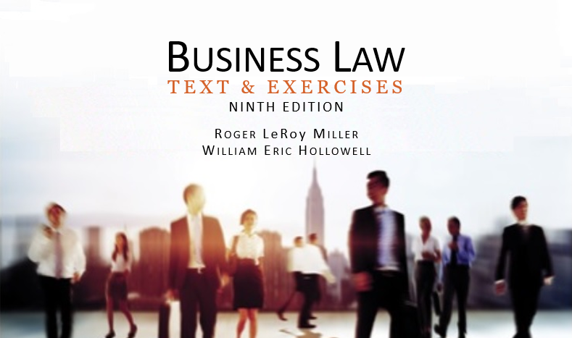
Business Law Text & Exercises Ninth Edition Roger LeRoy Miller William Eric Hollowell
Chapter 20 Warranties and Product Liability

Slide 2
Learning Outcomes (1)
LO1 Name the three types of warranties of title.
LO2 State when express warranties arise in a sales or lease contract.
LO3 Identify the implied warranties that arise in a sales or lease contract.
LO4 Define a warranty disclaimer.

Slide 3
Learning Outcomes (2)
LO5 List the requirements of strict product liability.

Slide 4
LO1 Warranties of Title (1)
LO1
Good Title.
Valid and rightful.
No Liens.
Encumbrance on a property to satisfy or protect a claim for payment of a debt.→

Slide 5
LO1 Warranties of Title (2)
LO1
No Infringements.
Patents, trademarks, copyright.

Slide 6
Express Warranties (1)
Seller (or lessor) makes a written or oral promise in which the seller assures the quality, description, or performance potential of the goods.

Slide 7
Express Warranties (2)
Express warranties arise when:
Goods conform to any affirmation or fact that the seller makes to the buyer about the goods.
Goods conform to any description.
Goods conform to any sample or model.
LO2

Slide 8
Express Warranties (3)
Basis of the Bargain.
Seller does not need to use words such as “warrant” or “guarantee.”
The UCC only requires that the affirmation, promise, description, or sample must become part of the “basis of the bargain.”

Slide 9
Express Warranties (4)
Statements of Opinion.
Value or worth of good, or “puffery” do not constitute warranties (unless EXPERT opinion).

Slide 10
LO3 Implied Warranties (1)
LO3
The law implies a warranty based on either the nature of the transaction or the situation or circumstances of the parties.

Slide 11
LO3 Implied Warranties (2)
LO3
Merchantability.
Implied promise by a merchant- seller of goods that the goods are “reasonably fit for the general purpose for which they are sold” or leased, are properly packaged and labeled, and are of proper quality.

Slide 12
LO3 Implied Warranties (3)
LO3
Fitness for a Particular Purpose.
Arises when any seller or lessor (merchant or nonmerchant):
Knows the particular purpose for which a buyer or lessee will use the goods, and
Knows that the buyer or lessee is relying on the seller’s skill and judgment to select suitable goods.

Slide 13
LO3 Implied Warranties (4)
LO3
Other Implied Warranties.
UCC recognizes implied warranties can arise from course of dealing, performance, or usage of trade.
In the absence of specific language to the contrary, courts will infer an “industry wide” implied warranties in a contract.

Slide 14
Warranty Disclaimers and Limitations on Liability (1)
Warranty disclaimer: an oral or written statement indicating that the seller is not bound by any warranty guarantees regarding the product sold.
LO4

Slide 15
Warranty Disclaimers and Limitations on Liability (2)
Disclaimer of Title Warranty.
Disclaimer of Express Warranties.
Disclaimer of Implied Warranties.
Buyer’s or Lessee’s Examination or Refusal to Inspect.

Slide 16
Warranty Disclaimers and Limitations on Liability (3)
Magnuson-Moss Warranty Act.
The MMWA (1975) was designed to prevent deception in warranties by making them easier to understand.
Under the act, no seller or lessor is required to give an express written warranty for consumer goods.

Slide 17
Warranty Disclaimers and Limitations on Liability (4)
Magnuson-Moss Warranty Act.
The warrantor must use “readily understood language.”
Full vs. limited: full warranty requires free repair or replacement of any defective part, typically has no time limit.

Slide 18
Product Liability
The legal liability of manufacturers and sellers to buyers, users, and sometimes bystanders for injuries or damages suffered because of defects in goods purchased.

Slide 19
Product Liability: Negligence (1)
Failure to exercise the standard of care that a reasonable person would have exercised under similar circumstances.
A manufacturer must exercise “due care” to make a product safe.

Slide 20
Product Liability: Negligence (2)
Manufacturer must exercise “due care” in:
Design, selection of materials, production, assembly, testing, and placing adequate warnings on the label informing users of dangers.

Slide 21
Product Liability: Misrepresentation
Fraud can be basis of product liability when intentional misrepresentation is made to a user or consumer, and injury results from that misrepresentation.

Slide 22
Product Liability: Strict Liability (1)
Liability without fault, regardless of intentions or exercise of reasonable care.
To hold a manufacturer or seller strictly liable, the following requirements must be met:

Slide 23
Product Liability: Strict Liability (2)
Requirements:
Product must be in a defective condition when the defendant sells it.
Defendant normally must be engaged in the business of selling that product.
LO5

Slide 24
Product Liability: Strict Liability (3)
Requirements:
Product must be unreasonably dangerous to user because of its defective condition.
The plaintiff must incur physical harm to self or property by use or consumption of the product.
LO5

Slide 25
Product Liability: Strict Liability (4)
Requirements:
The defective condition must be the proximate cause of the harm.
The goods must not have been substantially changed from the time the product was sold to the time the injury was sustained.
LO5

Slide 26
Product Liability: Strict Liability (5)
Unreasonably dangerous: defective to the point of threatening a consumer’s health or safety.

Slide 27
Product Liability: Defects (1)
Manufacturing defects: product departs from its intended design even though all possible care was exercised in the preparation and marketing of the product.

Slide 28
Product Liability: Defects (2)
Design defects: foreseeable risks of harm posed by the product could have been reduced or avoided by the adoption of a reasonable alternative design, and the omission of that design renders the product unsafe.

Slide 29
Product Liability: Defects (3)
Warning defects: foreseeable risk of harm could have been reduced or avoided by the provision reasonable instructions or warnings, and their omission renders the product unsafe.

Slide 30
Product Liability: Suppliers of Component Parts
Under the rule of strict liability in tort, the basis of liability includes suppliers of component parts.

Slide 31
Product Liability: Defenses (1)
Assumption of Risk.
Plaintiff voluntarily engaged in the risk while realizing the danger, appreciated the risk created by defect in the product, and undertaking the risk was unreasonable.

Slide 32
Product Liability: Defenses (2)
Product Misuse.
Product used for unintended purpose.
Comparative Negligence.
Liability for plaintiff’s injuries is shared by all persons who were negligent (including plaintiff) on a pro-rata basis depending on each person’s carelessness.

Slide 33
Product Liability: Defenses (3)
Commonly Known Dangers.
Dangers associated with certain products (such as sharp knives and guns) are so commonly known that manufacturers need not warn users.

