Slide 1
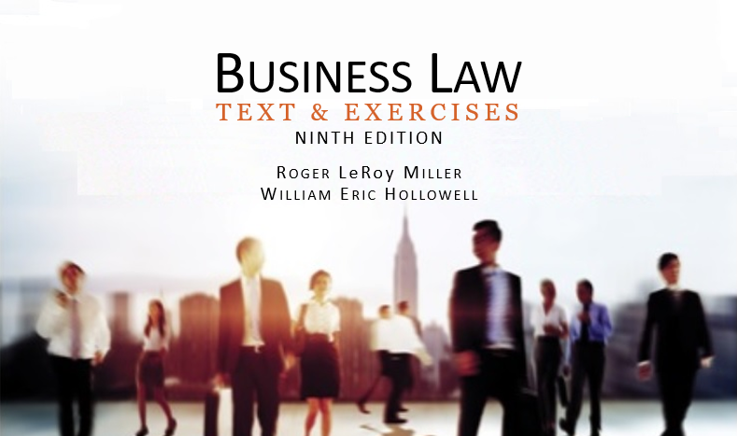
Business Law Text & Exercises Ninth Edition Roger LeRoy Miller William Eric Hollowell
Chapter 38 Real Property

Slide 2
Learning Outcomes
LO1 Define real property.
LO2 Identify common types of real property ownership.
LO3 Explain how real property ownership is transferred.
LO4 Describe eminent domain.

Slide 3
LO1 The Nature of Real Property (1)
LO1
Real property is immovable and includes:
Land & Permanent Buildings.
Airspace & Subsurface Rights.
Plant Life and Vegetation.
Subsurface (mineral) rights.
Fixtures.

Slide 4
LO1 The Nature of Real Property (2)
LO1
Real property includes:
Fixtures.
Personal property that is “intentionally” and permanently affixed to real property.

Slide 5
LO1 The Nature of Real Property (3)
LO1
Real property includes:
Fixtures.
Intent is determined by showing:
Property cannot be removed without causing damage to the realty, or
Property is so adapted to the realty that it has become part of the realty.

Slide 6
LO2 Ownership Interests (1)
LO2
Fee Simple Absolute.
Gives owner the greatest aggregation of rights, powers and privileges possible under American law.
Potentially infinite in duration.

Slide 7
LO2 Ownership Interests (2)
LO2
Fee Simple Absolute.
Owner has exclusive possession and use of property and can assign to heirs.

Slide 8
LO2 Ownership Interests (3)
LO2
Life Estates.
Estate that lasts for the life of some specified individual.
“A grants property to B for B’s life” grants B a life estate. When B dies, the property returns to A.

Slide 9
LO2 Ownership Interests (4)
LO2
Nonpossessory Interests.
Easement: right to make limited use of another person's real property without taking anything from the property.

Slide 10
LO2 Ownership Interests (5)
LO2
Nonpossessory Interests.
Profit: right to go onto another’s land and remove some part of the land itself (or some product of the land).

Slide 11
LO2 Ownership Interests (6)
LO2
Nonpossessory Interests.
License: revocable right to come unto another’s land without removing anything from the land.

Slide 12
LO3 Transfer of Ownership (1)
LO3
Ownership in real property can be transferred by:
Written Deed.
Gift.
Sale.
Inheritance.
Adverse Possession.
Eminent Domain.

Slide 13
LO3 Transfer of Ownership (2)
LO3
Deeds.
Legal, written document setting forth the interests in real property being transferred.
Necessary components: names of grantor and grantee, words evidencing intent to convey, legal description, grantor’s signature, and delivery of the deed.

Slide 14
LO3 Transfer of Ownership (3)
LO3
Will or Inheritance.
Owner of real property dies, his property is transferred by will (testate).
Without Will (intestate).
Title is transferred at the time state law provides.

Slide 15
LO3 Transfer of Ownership (4)
LO3
Adverse Possession.
One person possesses the property of another for a statutory period of time. Possession must be:
Actual and exclusive.
Open, visible and notorious.
Continuous and peaceable.
Hostile and adverse.

Slide 16
Transfer of Ownership (5)
Eminent Domain.
Government can only “take” private land for public use with just compensation.
Generally invoked during condemnation proceedings.
LO4

