Slide 1
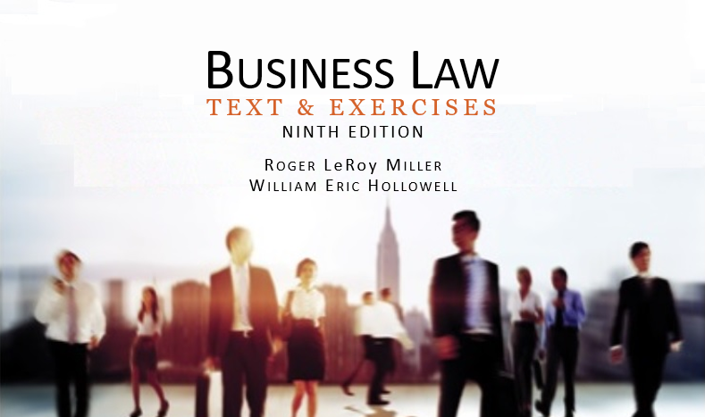
Business Law Text & Exercises Ninth Edition Roger LeRoy Miller William Eric Hollowell
Chapter 14 Contracts That Must
Be in Writing

Slide 2
Learning Outcomes
LO1 Identify contracts that must be in writing.
LO2 Describe what satisfies the writing requirement.
LO3 State the parole evidence rule.
LO4 Differentiate between an integrated and a partially integrated contract.

Slide 3
Introduction
A contract may be unenforceable if it is not in the proper form.
Certain types of contracts must have a writing to be enforceable under the Statute of Frauds.

Slide 4
Statute of Frauds—Writing Requirement (1)
A state statute under which certain types of contracts must be in writing to be enforceable.

Slide 5
Statute of Frauds—Writing Requirement (2)
LO1
Contracts that must be in writing to be enforceable:
Contracts involving interest in land.
Contracts that cannot, by their own terms, be performed within one year.

Slide 6
Statute of Frauds—Writing Requirement (3)
LO1
Contracts that must be in writing to be enforceable:
Collateral contracts.
Promises made in consideration of marriage.
Contracts for the sale of goods priced at $500 or more.

Slide 7
Contracts Involving Interests in Land
Must be in writing.
Fixture: A thing that was once personal property but that has become attached to real property in such a way that it takes on the characteristics of real property and becomes part of that real property.

Slide 8
The One-Year Rule (1)
Contracts that, by their own terms, cannot be performed within one year from the day after the contract is formed must be in writing.
Contract performance must be objectively impossible.

Slide 9
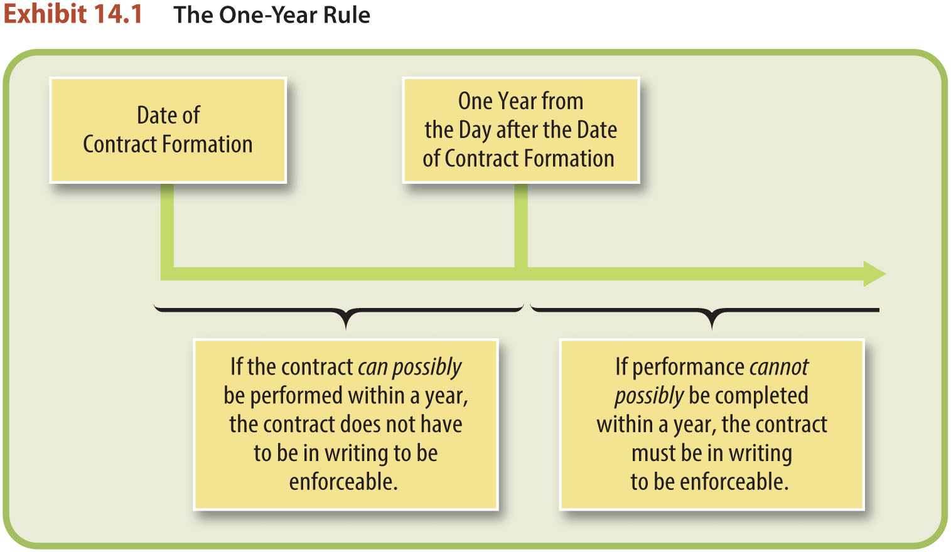
The One-Year Rule (2)

Slide 10
Collateral Promises (1)
A secondary promise ancillary to a principal transaction or primary contractual relationship.
Normally must be in writing to be enforceable.

Slide 11
Collateral Promises (2)
Primary vs. Secondary Obligations.
Primary: you agree to pay for something.
Secondary: you agree to pay for something on the condition that the primary party fails to make the payment.

Slide 12
Collateral Promises (3)
An Exception—The “Main Purpose” Rule.
Oral promise is generally not enforceable unless the main purpose is a personal benefit for the guarantor.

Slide 13
Promises Made in Consideration of Marriage
Prenuptial Agreement.
An agreement entered into in contemplation of marriage, specifying the rights and ownership of the parties’ property.

Slide 14
Contracts for the Sale of Goods
The Uniform Commercial Code (UCC) includes Statute of Frauds provisions that require written evidence or an electronic record of a contract over $500.
Only quantity of goods needs to be stated accurately.

Slide 15
Exceptions to the Writing Requirement (1)
Partial Performance.
Court may grant specific performance if land.
Under UCC, oral contract is enforceable if seller accepts payment or buyer accepts goods.

Slide 16
Exceptions to the Writing Requirement (2)
Admissions.
Promissory Estoppel.
Person making the promise must foresee that the promise will rely on it.
No way to avoid injustice except to enforce the promise.

Slide 17
LO2 The Sufficiency of Writing (1)
LO2
A written contract or a written memorandum signed by the party against whom enforcement is sought will satisfy the Statute of Frauds.

Slide 18
LO2 The Sufficiency of Writing (2)
LO2
Memorandums.
A written memorandum signed by the party against whom enforcement is sought.
Any confirmation, invoice, sales slip, check, fax, e-mail, or combination.

Slide 19
LO2 The Sufficiency of Writing (3)
LO2
Essential Terms.
Sale of goods.
Under UCC–quantity term and signature.
Under most provisions of Statute of Frauds–parties, subject matter, consideration and quantity.
Sale of land.
State essential terms.
Describe the property with sufficient clarity.

Slide 20
LO2 The Sufficiency of Writing (4)
LO2
Signatures.
Full name or initials placed anywhere.
E-Signature. An electronic sound, symbol or process used as a signature.
Enforcement. Only the party against whom the enforcement is sought must have signed the writing.

Slide 21
LO3 The Parol Evidence Rule
LO3
Prohibits the introduction at trial of evidence of the parties’ prior negotiations or agreements or contemporaneous oral agreements if that evidence contradicts or alters the terms of a written contract.

Slide 22
Exceptions to the Parol Evidence Rule (1)
Contracts Subsequently Modified.
Voidable or Void Contracts.
Amiguous Terms.
Incomplete Contracts.

Slide 23
Exceptions to the Parol Evidence Rule (2)
Customary Practices.
An Orally Agreed-on Condition.
Obvious Errors.

Slide 24
Integrated Contracts (1)
Written contract that constitutes the final expression of the parties’ agreement.
If a contract is integrated, evidence extraneous to the contract that contradicts or alters the meaning of the contract in any way is inadmissible.

Slide 25
Integrated Contracts (2)
LO4
An integrated contract is a writing that is intended to be a complete and final embodiment of the terms of an agreement between contracting parties.
A partially integrated contract omits an agreed-on term that is consistent with the parties’ agreement.

Slide 26
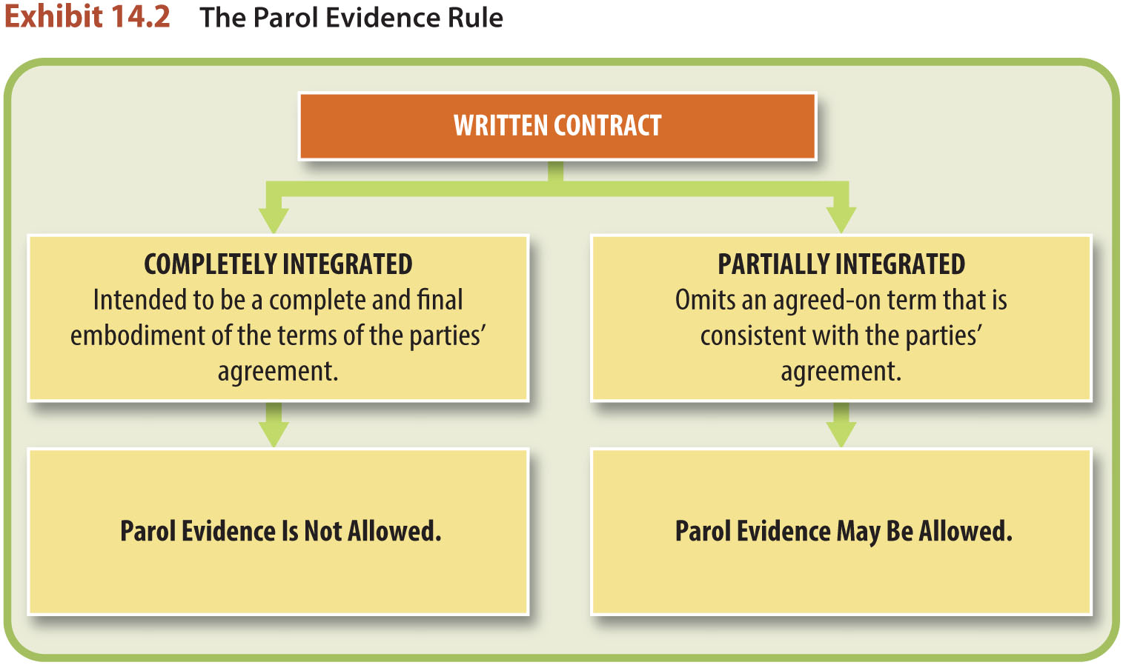
LO4 Integrated Contracts (3)
LO4

