Slide 1
Business Law Text & Exercises Ninth Edition Roger LeRoy Miller William Eric Hollowell
Chapter 15 Third Party Rights

Slide 2
Learning Outcomes
LO1 Describe a contract assignment.
LO2 Define a contract delegation.
LO3 Identify noncontracting parties with contract rights.
LO4 Explain when a third party beneficiary’s rights in a contract vest.

Slide 3
Introduction
Privity of Contract.
The relationship that exists between the promisor and the promisee of a contract.

Slide 4
LO1 Assignments (1)
LO1
Assignments.
The transfer of rights under a contract to a third party.

Slide 5
LO1 Assignments (2)
LO1
Parties to an Assignment.
Assignor: the person assigning the rights.
Assignee: the person to whom the rights are assigned.
Obligee: the person to who a duty, or obligation, is owed.
Obligor: the person who is obligated to perform duty.

Slide 6
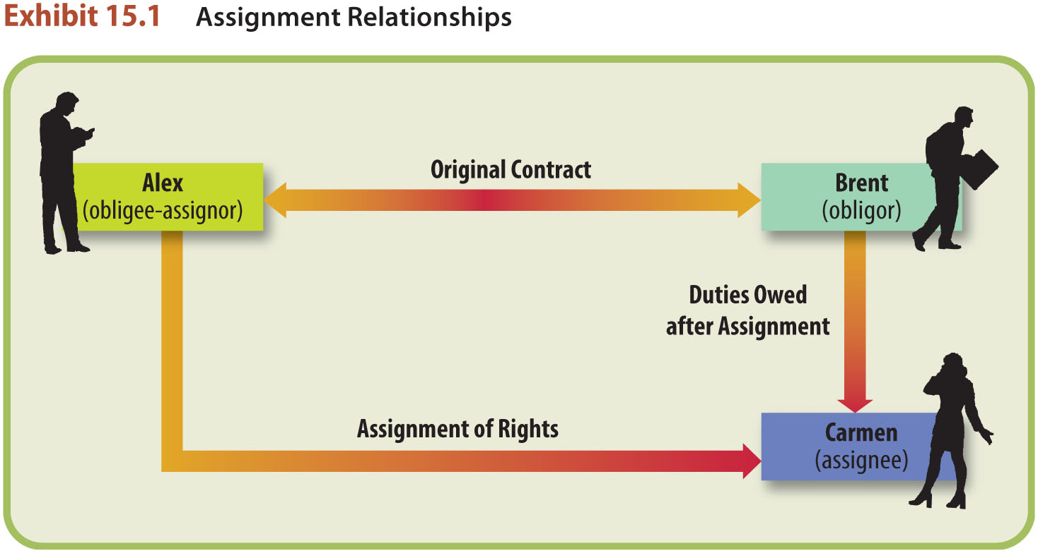
LO1 Assignments (3)
LO1

Slide 7
LO1 Assignments (4)
LO1
Extinguished Rights.
If unconditional, assignor’s rights are extinguished. Assignee can demand performance.

Slide 8
LO1 Assignments (5)
LO1
Rights that Cannot be Assigned.
Assignment is prohibited by statute.
Contract is personal in nature.
Assignment will significantly increase or alter the risks to, or the duties of, the obligor.

Slide 9
LO1 Assignments (6)
LO1
Rights that Cannot be Assigned.
Contract prohibits assignment.
A contract stating that any assignment is void effectively prohibits assignment of rights.

Slide 10
LO1 Assignments (7)
LO1
Notice of Assignment.
Once a valid assignment of rights has been made to a third party, the third party should notify the obligor—the original party to the contract—of the assignment.

Slide 11
LO1 Assignments (8)
LO1
Notice of Assignment (issues).
If the assignor assigns the same right to two different persons, the question arises as to which one has priority—that is, the right to performance by the obligor.

Slide 12
LO1 Assignments (9)
LO1
Notice of Assignment (issues).
Until the obligor has notice of assignment, obligor can discharge her performance to the assignor, and performance by obligor to assignor constitutes a discharge to the assignee.

Slide 13
LO2 Delegations (1)
LO2
Transfer of a contractual duty to a third party.
The party delegating the duty (delegator) to the third party (delegatee) is still obliged to perform on the contract if the delegatee fails to perform.

Slide 14
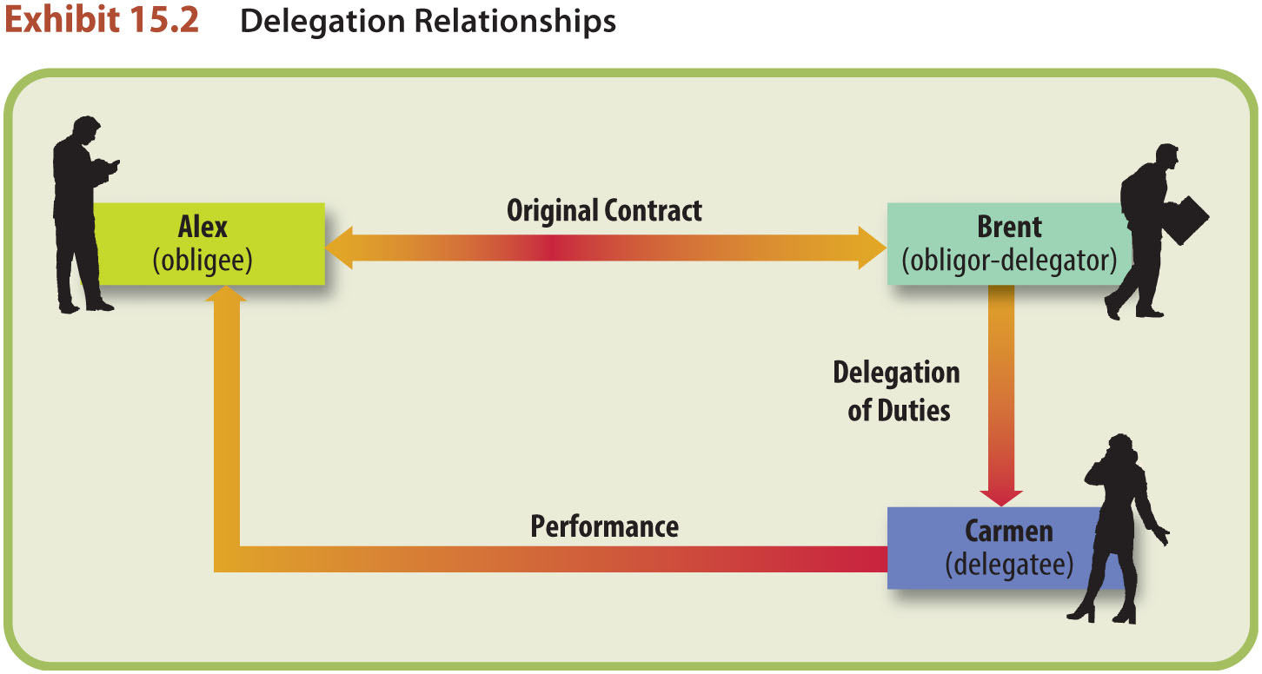
LO2 Delegations (2)
LO2

Slide 15
LO2 Delegations (3)
LO2
Duties That Cannot Be Delegated.
Generally, any duty can be delegated, except:
When the duties are personal in nature.
When performance by a third party will vary materially from that expected by the obligee under the contract.

Slide 16
LO2 Delegations (4)
LO2
Duties That Cannot Be Assigned.
Generally, any duty can be delegated, except:
When the contract prohibits delegation.

Slide 17
LO2 Delegations (5)
LO2
Effect: if a delegation of duties is enforceable, the obligee must accept performance from the delegatee.
Liability: breach of duty makes the delegatee liable to the obligee (assumption of duty).

Slide 18
LO2 Delegations (6)
LO2
Assignment of “All Rights.”
A contract with assumption of all rights may also be treated as assumption of duties on the part of the assignee.

Slide 19
Third Party Beneficiaries (1)
LO3
TPB: One who is not a party to a contract but who benefits from the contract.
Intended beneficiaries.
Incidental beneficiaries.

Slide 20
Third Party Beneficiaries (2)
Intended Beneficiaries.
A third party for whose benefit a contract is formed; intended beneficiaries can sue the promisor if such a contract is breached.
LO3

Slide 21
Third Party Beneficiaries (3)
Intended Beneficiaries.
Creditor: promise to pay a debt, can sue the promisor directly to enforce the contract.
Donee: promise for a gift, can sue the promisor directly to enforce the contract.
LO3

Slide 22
Third Party Beneficiaries (4)
Vested Intended Beneficiary Rights.
Intended TPB cannot enforce a contract against the original party until the TPB’s rights have vested, which means the rights have taken effect and cannot be taken away.

Slide 23
Third Party Beneficiaries (5)
Vested Intended Beneficiary Rights. When rights vest:
When TPB demonstrates manifest assent to the contract, such as by sending a letter or note consenting to a contract formed for his or her benefit.
LO4

Slide 24
Third Party Beneficiaries (6)
Vested Intended Beneficiary Rights. When rights vest:
When the third party materially alters his or her position in detrimental reliance on the contract.
LO4

Slide 25
Third Party Beneficiaries (7)
Vested Intended Beneficiary Rights. When rights vest:
When the conditions for vesting are satisfied.
LO4

Slide 26
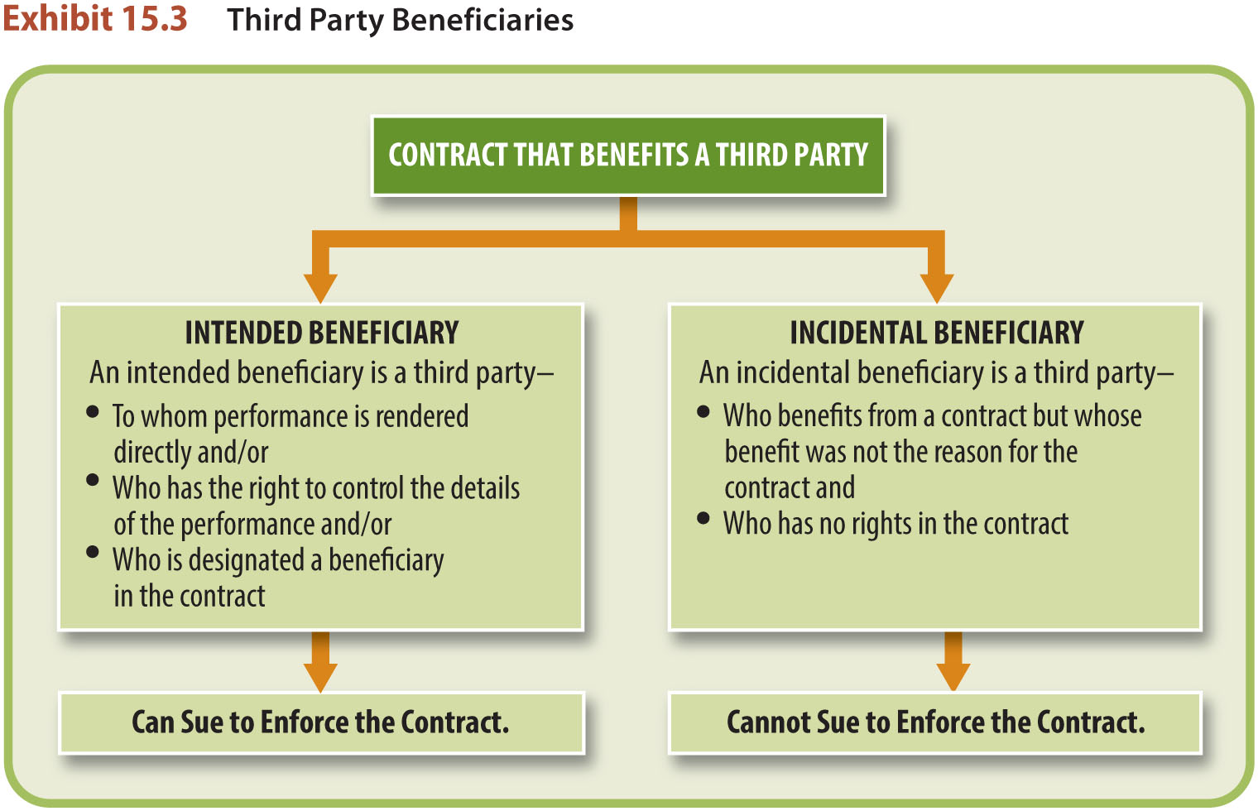
Third Party Beneficiaries (8)

Slide 27
Incidental Beneficiaries (1)
Incidental beneficiary: a third party who incidentally benefits from a contract but whose benefit was not the reason the contract was formed.

Slide 28
Incidental Beneficiaries (2)
An incidental beneficiary has no rights in a contract and cannot sue the promisor if the contract is breached.

Slide 29
Intended or Incidental Beneficiary?
Three factors to indicate an intended benefit:
Performance rendered directly to the third party.
The right of the third party to control the details of the performance.
Express designation in the contract.

