Slide 1
Business Law Text & Exercises Ninth Edition Roger LeRoy Miller William Eric Hollowell
Chapter 21 Consumer Protection

Slide 2
Learning Outcomes
LO1 Define deceptive advertising.
LO2 Recognize what information must be included on labels.
LO3 State the Truth-in-Lending Act requirements.
LO4 Describe health and safety protection.

Slide 3
LO1 Deceptive Advertising (1)
LO1
Deceptive advertising: advertising that misleads consumers.
Federal Trade Commission investigates deceptive ads, and determines what constitutes a deceptive practice.

Slide 4
LO1 Deceptive Advertising (2)
LO1
Deceptive advertising:
As defined by FTC, generally means the advertisement may be interpreted in more than one way and that one of those interpretations is false or misleading.

Slide 5
LO1 Deceptive Advertising (3)
LO1
False statements or claims.
Statements about a product’s quality, effects, price, origin, or availability.
Omission of important information.
Half-truths.

Slide 6
Deceptive Advertising (1)
Bait and Switch Advertising.
Advertising a product at a very attractive price (bait) and informing the consumer the product is not available or is poor quality. The customer is then urged to purchase (switch) a more expensive item.

Slide 7
Deceptive Advertising (2)
Online Deceptive Advertising.
Claims made must be substantiated.
FTC guidelines on Internet marketing also call for “clear and conspicuous” disclosure of any qualifying information.

Slide 8
Deceptive Advertising (3)
FTC Actions against Deceptive Advertising.
If complaints are widespread, the FTC will investigate and perhaps take action.
If, after its investigations, the FTC believes a given advertisement is unfair or deceptive, it drafts a formal complaint, which is sent to the offender.

Slide 9
Deceptive Advertising (4)
FTC Actions against Deceptive Advertising.
Cease and desist order: administrative or judicial order prohibiting a person or business firm from conducting activities that an agency or court has deemed illegal.

Slide 10
Deceptive Advertising (5)
False Advertising Claims under the Lanham Act.
A successful claim must establish:
Company suffered injury in reputation or sales.
Injury was directly caused by false or deceptive advertising.
Company lost business from consumers who were deceived.

Slide 11
LO2 Labeling Laws (1)
LO2
Labeling and Packaging Laws.
Labels must be accurate and use words that are understood by ordinary consumers.
In some instances:
Specify raw materials.
Carry a health warning.

Slide 12
LO2 Labeling Laws (2)
LO2
The Fair Packaging and Labeling Act.
Food product labels must identify:
The product.
The net quantity of the contents, size of a serving.
The manufacturer.
The packager or distributor.

Slide 13
LO2 Labeling Laws (3)
LO2
The Energy Policy and Conservation Act.
Information label on new cars must include EPA’s fuel economy estimate.
The Nutrition Labeling and Education Act.
Food labels must include standard nutrition facts.

Slide 14
Consumer Sales (1)
Statutes for disclosures, the regulation of door-to-door sales, mail order.

Slide 15
Consumer Sales (2)
Telephone and Mail-Order Sales.
FTC provides specific protections for consumers.
Merchants required to ship within time promised.
Merchants must issue a refund within a specified period of time for cancelled orders.

Slide 16
Consumer Sales (3)
Online Sales.
FTC protects consumers from fraudulent and deceptive sales practices conducted online.
FTC has brought a number of enforcement actions against those who perpetrate online fraud.

Slide 17
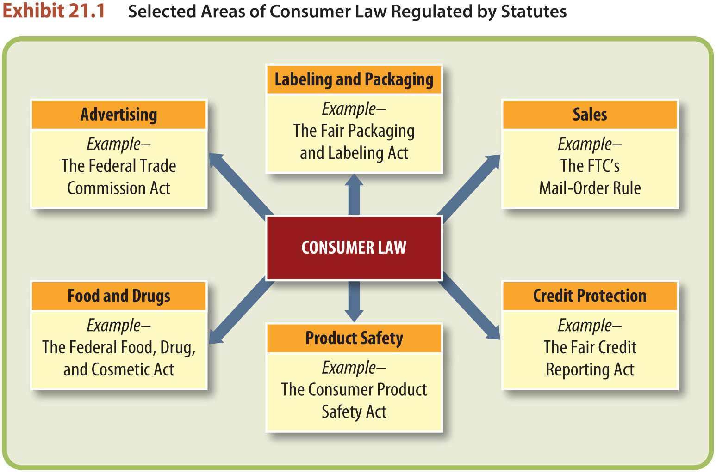
Consumer Sales (4)

Slide 18
Credit Protection (1)
Truth-in-Lending Act.
Title 1 of the Consumer Credit Protection Act (CCPA), 1974.
TILA: essentially a full disclosure law, found under Regulation Z.
LO3

Slide 19
Credit Protection (2)
Truth in Lending Act.
Application.
TILA requirements apply only to those who, in the ordinary course of their business, lend money, sell on credit, or arrange for the extension of credit.
LO3

Slide 20
Credit Protection (3)
Truth in Lending Act.
Disclosure Requirements.
Regulation Z: a set of rules that implements the Truth-in-Lending Act.
LO3

Slide 21
Credit Protection (4)
Equal Credit Opportunity Act.
Prohibits the denial of credit solely on the basis of race, religion, national origin, color, gender, marital status, or age.

Slide 22
Credit Protection (5)
Credit Cardholder Protection.
Liability of card holder who solicited the card is $50 for unauthorized charges made before the bank is notified.
If unsolicited, card holder is not liable for unauthorized charges.

Slide 23
Credit Protection (6)
TILA Amendments (2010).
Cardholders protected from retroactive interest rate increases on existing card balances, unless the account is sixty days delinquent.
Cardholders must be notified at least forty-five days before changes are made to their credit-card terms.

Slide 24
Credit Protection (7)
TILA Amendments (2010).
A monthly bill must be sent to a cardholder at least twenty-one days before the due date.
The interest rate charged on a cardholder’s balance can be increased only in specific situations, such as when a promotional rate ends.

Slide 25
Credit Protection (8)
TILA Amendments (2010).
Over-limit fees can be charged only in specific situations.
Cardholders’ payments in excess of the minimum amount due must be applied to the higher-interest balances first.

Slide 26
Credit Protection (9)
TILA Amendments (2010).
Finance charges cannot be based on a previous billing cycle (known as double-cycle billing, under which a cardholder is charged interest on the balance from a previous cycle even when it has been paid in full).

Slide 27
Credit Protection (10)
The Fair Credit Reporting Act.
The FCRA covers all credit bureaus, investigative reporting companies, detective and collection agencies, and computerized information reporting companies.

Slide 28
Credit Protection (11)
Fair and Accurate Credit Transactions Act (FACT).
Established a national fraud alert system for identity theft.
Requires credit reporting agencies to provide consumers with free copies of credit reports every twelve months.

Slide 29
Credit Protection (12)
Fair and Accurate Credit Transactions Act (FACT).
Requires account numbers on credit-card receipts to be truncated.

Slide 30
Credit Protection (13)
Fair Debt Collection Practices Act.
In 1977, Congress passed the Fair Debt Collection Practices Act (FDCPA) in an attempt to curb what were perceived to be abuses by collection agencies.

Slide 31
Credit Protection (14)
Fair Debt Collection Practices Act, prohibits:
Contacting the consumer at his place of employment.
Contacting third parties.
Using harassment and intimidation.

Slide 32
Credit Protection (15)
Fair Debt Collection Practices Act, prohibits:
Further communication with a consumer after receipt of a notice of refusal to pay the debt.

Slide 33
LO4 Protection of Health and Safety (1)
LO4
The Federal Food, Drug, and Cosmetic Act.
Establishes food standards, specifies safe levels of potentially hazardous food activities, and provides classifications of food and food advertising.

Slide 34
LO4 Protection of Health and Safety (2)
LO4
Health-Care Reforms.
Patient Protection and Affordable Care Act of 2010.
After 2014, PPACA prohibits certain insurance company practices, helps more children get health coverage.

Slide 35
LO4 Protection of Health and Safety (3)
LO4
The Consumer Product Safety Act.
Protects consumers from unreasonable risk of injury from hazardous products.
Consumer Product Safety Commission: sets standards for consumer products and can ban the manufacture and sale of products that pose unreasonable risk.

