Slide 1
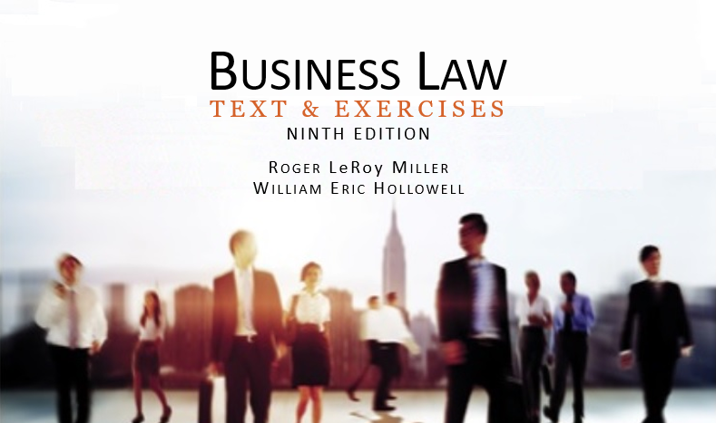
Business Law Text & Exercises Ninth Edition Roger LeRoy Miller William Eric Hollowell
Chapter 31 Combining and Dissolving Corporations

Slide 2
Learning Outcomes
LO1 Identify the basic steps in a merger and consolidation.
LO2 Explain successor liability following a purchase of assets.
LO3 Identify actions to resist takeovers.
LO4 Discuss the phases for corporate termination.

Slide 3
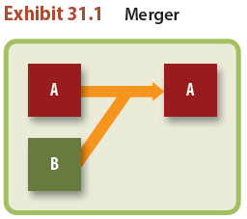
Mergers, Consolidations, and Share Exchanges (1)
A merger involves the legal combination of two or more corporations, so that only one survives.

Slide 4
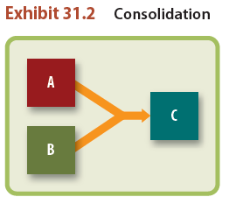
Mergers, Consolidations, and Share Exchanges (2)
In a consolidation, two or more corporations combine so that each corporation ceases to exist, and a new one emerges.

Slide 5
Mergers, Consolidations, and Share Exchanges (3)
In a share exchange, some or all of the shares of one corporation are exchanged for some or all of the shares of another corporation.

Slide 6
LO1 Procedures for a Corporate Combination
LO1
Board of directors and all shareholders must approve the plan.
The plan is filed with the secretary of state.
State issues a certificate of merger, consolidation or share exchange.

Slide 7
Short-Form Mergers (1)
A merger between a subsidiary corporation and a parent corporation that owns at least 90 percent of the outstanding shares of each class of stock issued by the subsidiary corporation.

Slide 8
Short-Form Mergers (2)
Short-form mergers can be accomplished without the approval of the shareholders of either corporation.

Slide 9
Appraisal Rights
A dissenting shareholder’s right, if he objects to an extraordinary transaction of the corporation, to have his shares appraised and to be paid the fair market value of his shares by the corporation.

Slide 10
Purchase of Assets (1)
Purchasing corporation extends its ownership and control over more assets.
Since there is no change in the legal entity, shareholder approval is not required.

Slide 11
Purchase of Assets (2)
Sales of Corporate Assets.
A corporation whose assets are being acquired must obtain approval of both the board of directors and the shareholders.

Slide 12
Purchase of Assets (3)
Successor Liability.
Generally, a corporation that purchases the assets of another corporation is not responsible for the liabilities of the selling corporation.
Exceptions occur when:
LO2

Slide 13
Purchase of Assets (4)
Successor Liability.
Exceptions occur when:
The purchasing corporation assumes the seller’s liabilities or a court imposes the liabilities on the purchasing corporation.
The sale is in fact a merger or consolidation.
LO2

Slide 14
Purchase of Assets (5)
Successor Liability.
Exceptions occur when:
The purchaser continues the seller’s business with the same personnel.
The sale is fraudulently executed to escape liability.
LO2

Slide 15
Purchase of Stock (1)
Target corporation: the acquired corporation in a corporate takeover; a corporation to whose shareholders a tender offer is submitted.

Slide 16
Purchase of Stock (2)
Tender Offer.
An offer made by one company directly to the shareholders of another company to buy the shareholders’ shares in that company.

Slide 17
Purchase of Stock (3)
Responses to Takeover Attempts.
Takeover Defenses.
Self-Tender.
Crown Jewel.
Pac-Man.
Poison Pill.
White Knight.
LO3

Slide 18
Purchase of Stock (4)
Responses to Takeover Attempts.
Directors’ Fiduciary Duties.
Judgment rule: directors must show that they had reasonable grounds to believe the tender offer posed a danger to the corporation’s effectiveness.
LO3

Slide 19
Termination of a Corporation (1)
Dissolution of a Corporation:
An act of the state.
An agreement of the shareholders and the board of directors.
The expiration of a time period stated in the certificate of incorporation.
A court order.

Slide 20
Termination of a Corporation (2)
Dissolution of a Corporation:
Voluntary Dissolution.
By the shareholders’ unanimous vote.
By a proposal of the board of directors.

Slide 21
Termination of a Corporation (3)
Dissolution of a Corporation:
Involuntary Dissolution. State can dissolve a corporation in certain circumstances.
Failure to comply with administrative requirements.
Procurement of a corporate charter through fraud.
LO4

Slide 22
Termination of a Corporation (4)
Dissolution of a Corporation:
Involuntary Dissolution. State can dissolve a corporation in certain circumstances.
Abuse of corporate powers.
Violation of state criminal code after a demand to discontinue.
Failure to commence business operations.
Abandonment of operations before startup.
LO4

Slide 23
Termination of a Corporation (5)
Liquidation.
The sale of the assets of a business or an individual for cash and the distribution of the cash received to creditors, with the balance going to the owner(s).

Slide 24
Termination of a Corporation (6)
Liquidation or Winding Up.
Receiver is appointed when creditors force a liquidation of the corporate assets.

